Slide 1

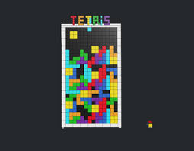


H
TO GAMES

