Slide 1
The Fighting Meerkats
Present the Gameboy

Slide 2
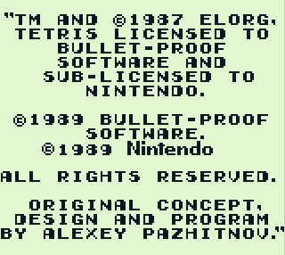
The Game
Supposed to be Tetris
It’s not (but it’s still fun)!
Nintendo logo scrolls
Ping noise plays
Tetris starting credits appear
Grinding noises happen
Right now, the game is: debug the design using ChipScope
You can play if you want, just ask

Slide 3
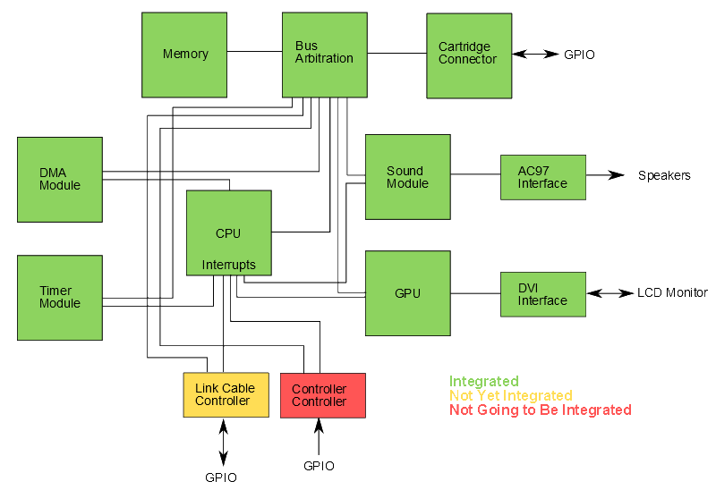
The Design

Slide 4
The CPU
Implementation:
Multi-cycle microcoded design, Z80/8080 custom hybrid
Interrupt module with 5 maskable interrupts
On-board SRAM for high memory accesses separate from other modules (addresses above 0xFF80)
Single-cycle asynchronous read memory interface

Slide 5
The CPU
Testing:
Testbench that runs GB80 assembly files through the CPU and an external emulator and compares the register outputs
57 instruction-level test programs
7 interrupt and functional test programs
Bootstrap ROM
Tetris
Blargg test ROMs
Xilinx sucks

Slide 6
The Video Interface
Promised:
A working GPU and framebuffer
Delivered:
A broken framebuffer
No GPU functionality
No working DVI output to monitor

Slide 7
The Video Interface
Plans for the future:
Very quickly get DVI properly set up and displaying something
Will probably use code from team Dragonforce
Get a working framebuffer
Understand how the GPU works
Revised schedule:
By Wednesday get test image on monitor
In two weeks have framebuffer fully functional
About one month behind schedule

Slide 8
The Audio Interface
Copied code from team Dragonforce
Added full square wave functionality
Accurate frequency control
Amplitude control using rotary controller
“Coded” memory-mapped registers

Slide 9
The Audio Interface
Promised:
A working audio interface
Delivered:
Proper configuration of the AC’97
The ability to play square waves and sound files from flash
Pseudo-code memory-mapped registers
No frequency sweep, volume envelope, or white noise

Slide 10
The Audio Interface
Plans for the future:
Actually make memory-mapped registers
Probably just “reg” variables
Add functions for frequency sweep and volume envelope
Revised schedule:
By the end of October:
Have frequency sweep and volume envelope functions
Have CPU interface with memory-mapped registers
About two weeks behind schedule

Slide 11
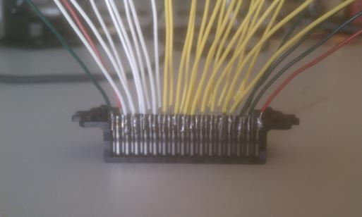
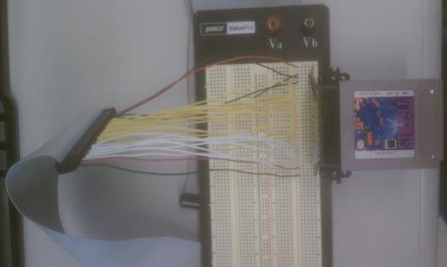
The Cartridge Connector

Slide 12
The Cartridge Connector
Promised:
A working cartridge interface with ability to read ROM
Delivered:
Exactly that
Full ROM access
No bank switching
Only conceptual access to SRAM

Slide 13
The Cartridge Connector
Plans for the future:
SRAM and bank switching are lower priority
Revised schedule:
ROM is fully accessible
Get Tetris working
Test capability to access SRAM
Then work on bank switching
Ahead of schedule!

Slide 14
Timers/DMA
Timer generates an interrupt on overflow
Selectable frequencies
Enable/Disable
Adjustable overflow reset value
DMA module that copies sections of memory
Roughly 8 times faster than CPU copying

Slide 15
Memory
(Mostly) Generated with CoreGen
Block RAM
8kB of work RAM
8kB and then some of video RAM
1 MB of framebuffer (not a block RAM)
Synthesizes in a finite amount of time
Verdict: block RAM is probably not necessary in our system

Slide 16
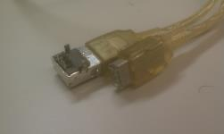
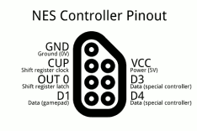
User Input and Link Cable
This doesn’t exist!
We never mentioned it!
Forget about it!

Slide 17
Problems
We only get to the Tetris starting credits
ChipScope is a pain in the ass
The RHEL machines we’re using are completely unstable

Slide 18
Goals
Wednesday: Start screen?
Thursday: Start screen
Next Monday: Possibly buggy gameplay

Slide 19
Conclusions
If your project involves implementing a CPU/using a buggy one…
Find a new project
Testing a buggy CPU requires understanding of it’s implementation (i.e. you’ve already implemented it)
Implementing a CPU means it will be buggy and you will have to test it
Takes a long, long time either way
If your project involves Xilinx…
Install Windows on the lab machines
Seriously, what the fuck is going on

Slide 20
Conclusions
ChipScope, you are our only hope
Don’t take 18-349
Ever
For any reason
The Virtex-7-based VC707 is not a good board for this class
Until someone writes a SystemVerilog HDMI driver
Or buys an expansion board with GPIO, VGA, and an AC97 chip

Slide 21
Negative Feedback
Too many lab handouts/presentations
Sound lab is ridiculously difficult unless you find Team Dragonforce’s code
Virtex-7 is useless for video/sound

Slide 22
Positive Feedback
Self-driven course
Learn about interfacing with other people’s designs
AC97, Chrontel DVI, Flash, Xilinx ChipScope/BlockRAM
Cartridge, controller
Testing, testing, testing

Slide 23
Comments/Questions?

