Slide 1
The Fighting Meerkats
Present the Gameboy!

Slide 2
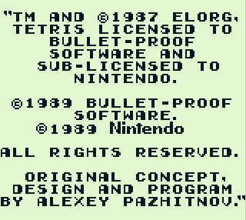
The Game
Gameboy running Tetris (almost)
It’s not finished (but it’s still fun)!
Nintendo logo scrolls
Ping noise plays
Tetris starting credits appear
Start screen shows up!
Demo plays in fast motion!
Just a little further to go!

Slide 3
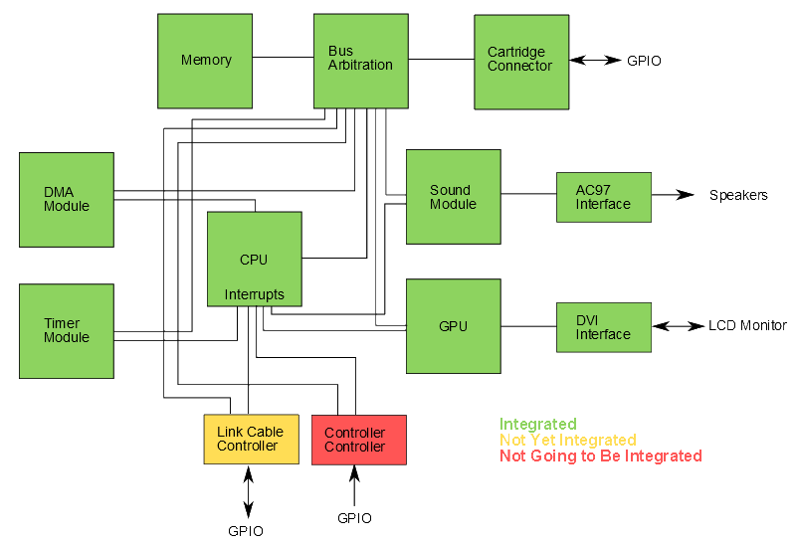
The Design

Slide 4
The CPU
Implementation:
Multi-cycle microcoded design, Z80/8080 custom hybrid
Interrupt module with 5 maskable interrupts
On-board SRAM for high memory accesses separate from other modules (addresses above 0xFF80)
Single-cycle asynchronous read memory interface

Slide 5
The CPU
Testing:
Testbench that runs GB80 assembly files through the CPU and an external emulator and compares the register outputs
57 instruction-level test programs
7 interrupt and functional test programs
Bootstrap ROM
Tetris
Blargg test ROMs
Xilinx sucks

Slide 6
The Video Interface
Implementation:
Took code from TeamDragonForce and FpgaBoy
If you want access to memory-mapped registers, VRAM and OAM, gotta go through the GPU
2 scanline buffers (one for upper pixel bits, one for lower pixel bits)
Double frame buffering
Conversion to fit monitor
Communicates via DVI with monitor

Slide 7
The Video Interface
Testing:
Simulating the DVI module
Loading it on the FPGA and making it produce colors on the monitor
Simulating the GPU, comparing register simulation values with those in a great emulator Joseph found called bgb.
Loading it on the FPGA and seeing what happens.

Slide 8
The Audio Interface
Copied code from team Dragonforce
Added
Full square wave functionality
Length, volume, frequency control full supported and accurate
Volume envelope, frequency sweep supported
Amplitude control using rotary controller
18 memory-mapped registers for CPU communication

Slide 9
The Audio Interface
Fully functional though perhaps buggy
Unit tested each function
Can’t test more until Tetris works
Did not implement white noise or sound enabled flags
Deemed relatively low importance

Slide 10
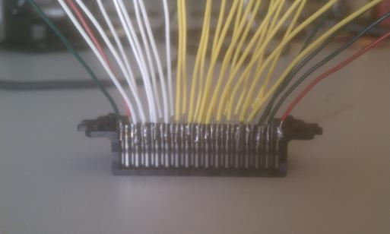
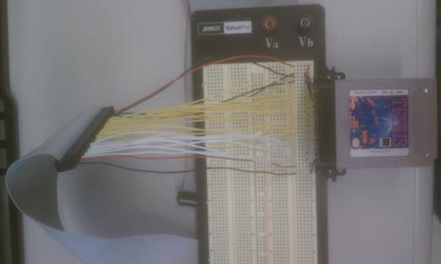
The Cartridge Connector

Slide 11
The Cartridge Connector
Fully functional ability to read game ROM
Enough to play Tetris
SRAM accessible in theory
Tetris does not have SRAM
Did not implement bank switching
Only necessary for larger games

Slide 12
Timers/DMA
Timer generates an interrupt on overflow
Selectable frequencies
Enable/Disable
Adjustable overflow reset value
DMA module that copies sections of memory
Roughly 8 times faster than CPU copying

Slide 13
Memory
(Mostly) Generated with CoreGen
Block RAM
8kB of work RAM
8kB and then some of video RAM
1 MB of framebuffer (not a block RAM)
Synthesizes in a finite amount of time
Verdict: block RAM is probably not necessary in our system

Slide 14
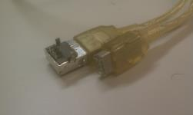
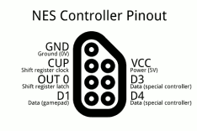
User Input and Link Cable
NES interface still buggy
Working to debug
Link cable not attempted
Time crunch and all that… You know.
There’s still time!

Slide 15
Problems
We can’t really play Tetris quite yet
ChipScope is a pain in the ass
The RHEL machines we’re using are completely unstable

Slide 16
Goals
Wednesday: Gameplay!
Thursday: Link cable?
Friday: Other games??

Slide 17
Conclusions
If your project involves implementing a CPU/using a buggy one…
Find a new project
Testing a buggy CPU requires understanding of it’s implementation (i.e. you’ve already implemented it)
Implementing a CPU means it will be buggy and you will have to test it
Takes a long, long time either way
If your project involves Xilinx…
Install Windows on the lab machines
Seriously, what the fuck is going on

Slide 18
Conclusions
ChipScope, you are our only hope
Don’t take 18-349
Ever
For any reason
The Virtex-7-based VC707 is not a good board for this class
Until someone writes a SystemVerilog HDMI driver
Or buys an expansion board with GPIO, VGA, and an AC97 chip
You will never have enough time. Don’t even pretend.

Slide 19
Negative Feedback
Too many lab handouts/presentations
Sound lab is ridiculously difficult unless you find Team Dragonforce’s code
Virtex-7 is useless for video/sound

Slide 20
Positive Feedback
Self-driven course
Learn about interfacing with other people’s designs
AC97, Chrontel DVI, Flash, Xilinx ChipScope/BlockRAM
Cartridge, controller
It was a lot of fun
Exciting to come into lab and work on something you love
Testing, testing, testing

Slide 21
Comments/Questions?

