Slide 1
Bluestock Mutual Fund Analytics
Customer Behavior Analytics & Performance Dashboard
Analyst: MERLIN J | Teyzix Core Internship 2026
Python | SQLite | Plotly | Streamlit | Pandas
40 Schemes | 32,778 Transactions | 5,000+ Investors

Slide 2
Project Overview
40
32,778
5,000+
8,050
Fund Schemes
Transactions
Investors
Benchmark Rows
Built complete ETL pipeline loading 10 CSV datasets into SQLite star schema
Computed CAGR, Sharpe, Sortino, Alpha, Beta and Max Drawdown for all 40 funds
Investor cohort analysis, SIP continuity and sector HHI concentration analysis
Built 4-page Streamlit dashboard with real-time AI-powered fund recommendations
Generated automated 7-page PDF report with embedded charts and business insights

Slide 3
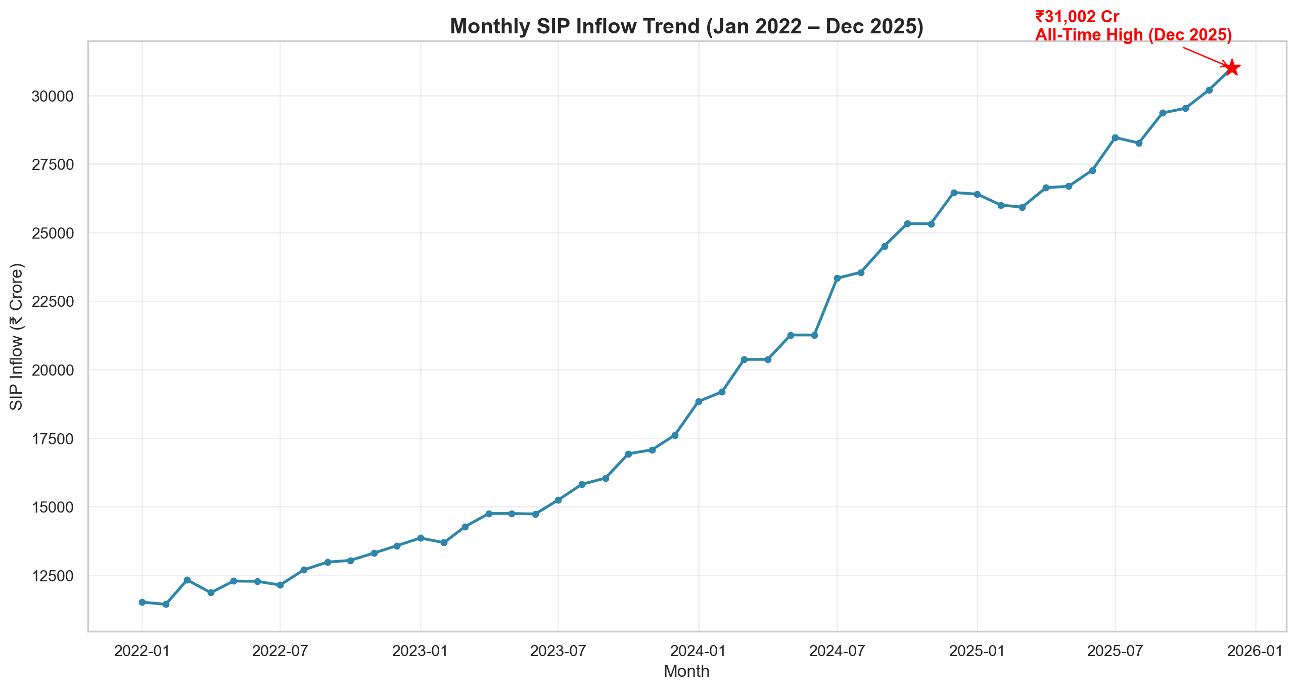
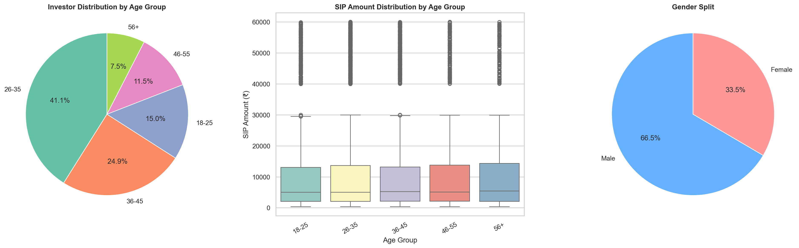
EDA Highlights
SIP inflows hit all-time high Dec 2025
Age 26-35 = largest investor segment (35%+)
T30 cities contribute 65%+ of SIP volume
UPI dominates payment mode (40%+)
Folio count doubled from 2022 to 2025

Slide 4
Performance Metrics
CAGR
Sharpe Ratio
Sortino Ratio
1yr / 3yr / 5yr computed for all 40 funds
Risk-adjusted returns using Rf = 6.5%
Downside risk adjusted measure
Alpha / Beta
Max Drawdown
Fund Scorecard
OLS regression vs Nifty 100 benchmark
Worst peak-to-trough decline per fund
Composite 0-100 ranking system

Slide 5
Top 10 Fund Scorecard
Rank
Fund Name
Score
3yr CAGR%
Sharpe
1
Mirae Asset Large Cap Fund - Regula
85.9
33.99
1.068
2
ICICI Pru Midcap Fund - Regular - G
82.4
31.77
0.883
3
Kotak Flexicap Fund - Regular - Gro
81.5
29.58
0.966
4
HDFC Mid-Cap Opportunities Fund - R
80.6
32.43
0.808
5
ICICI Pru Bluechip Fund - Direct -
78.8
32.48
0.715
6
Axis Midcap Fund - Regular - Growth
78.1
35.1
0.731
7
SBI Bluechip Fund - Regular Plan -
73.7
30.45
0.861
8
Mirae Asset Tax Saver Fund - Regula
73.2
29.17
0.919
9
SBI Small Cap Fund - Regular Plan -
67.2
26.66
0.712
10
ABSL Frontline Equity Fund - Regula
66.9
28.96
0.717

Slide 6
Interactive Streamlit Dashboard
Page 1
Page 2
Overview
NAV & Performance
KPI cards, AUM by fund house, transaction trends
Multi-fund NAV charts, risk distribution, fund table
Page 3
Page 4
Investor Analytics
Fund Recommender
Demographics, geography, SIP patterns, city tier
AI-powered recommendations by risk appetite
Run: streamlit run dashboard/app.py

Slide 7
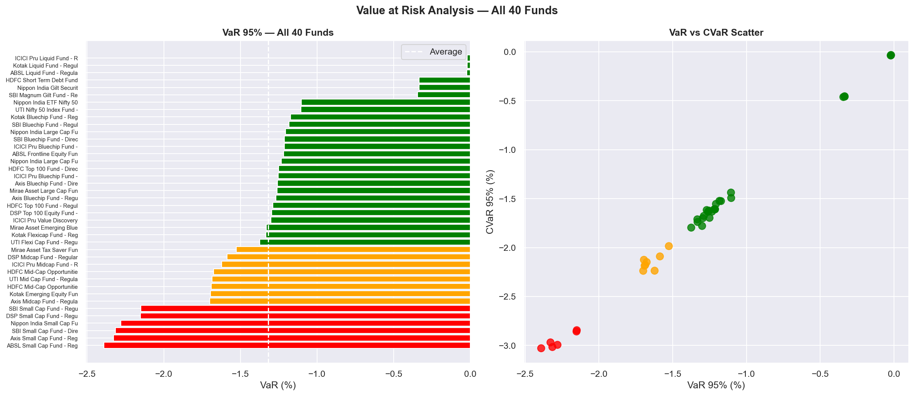
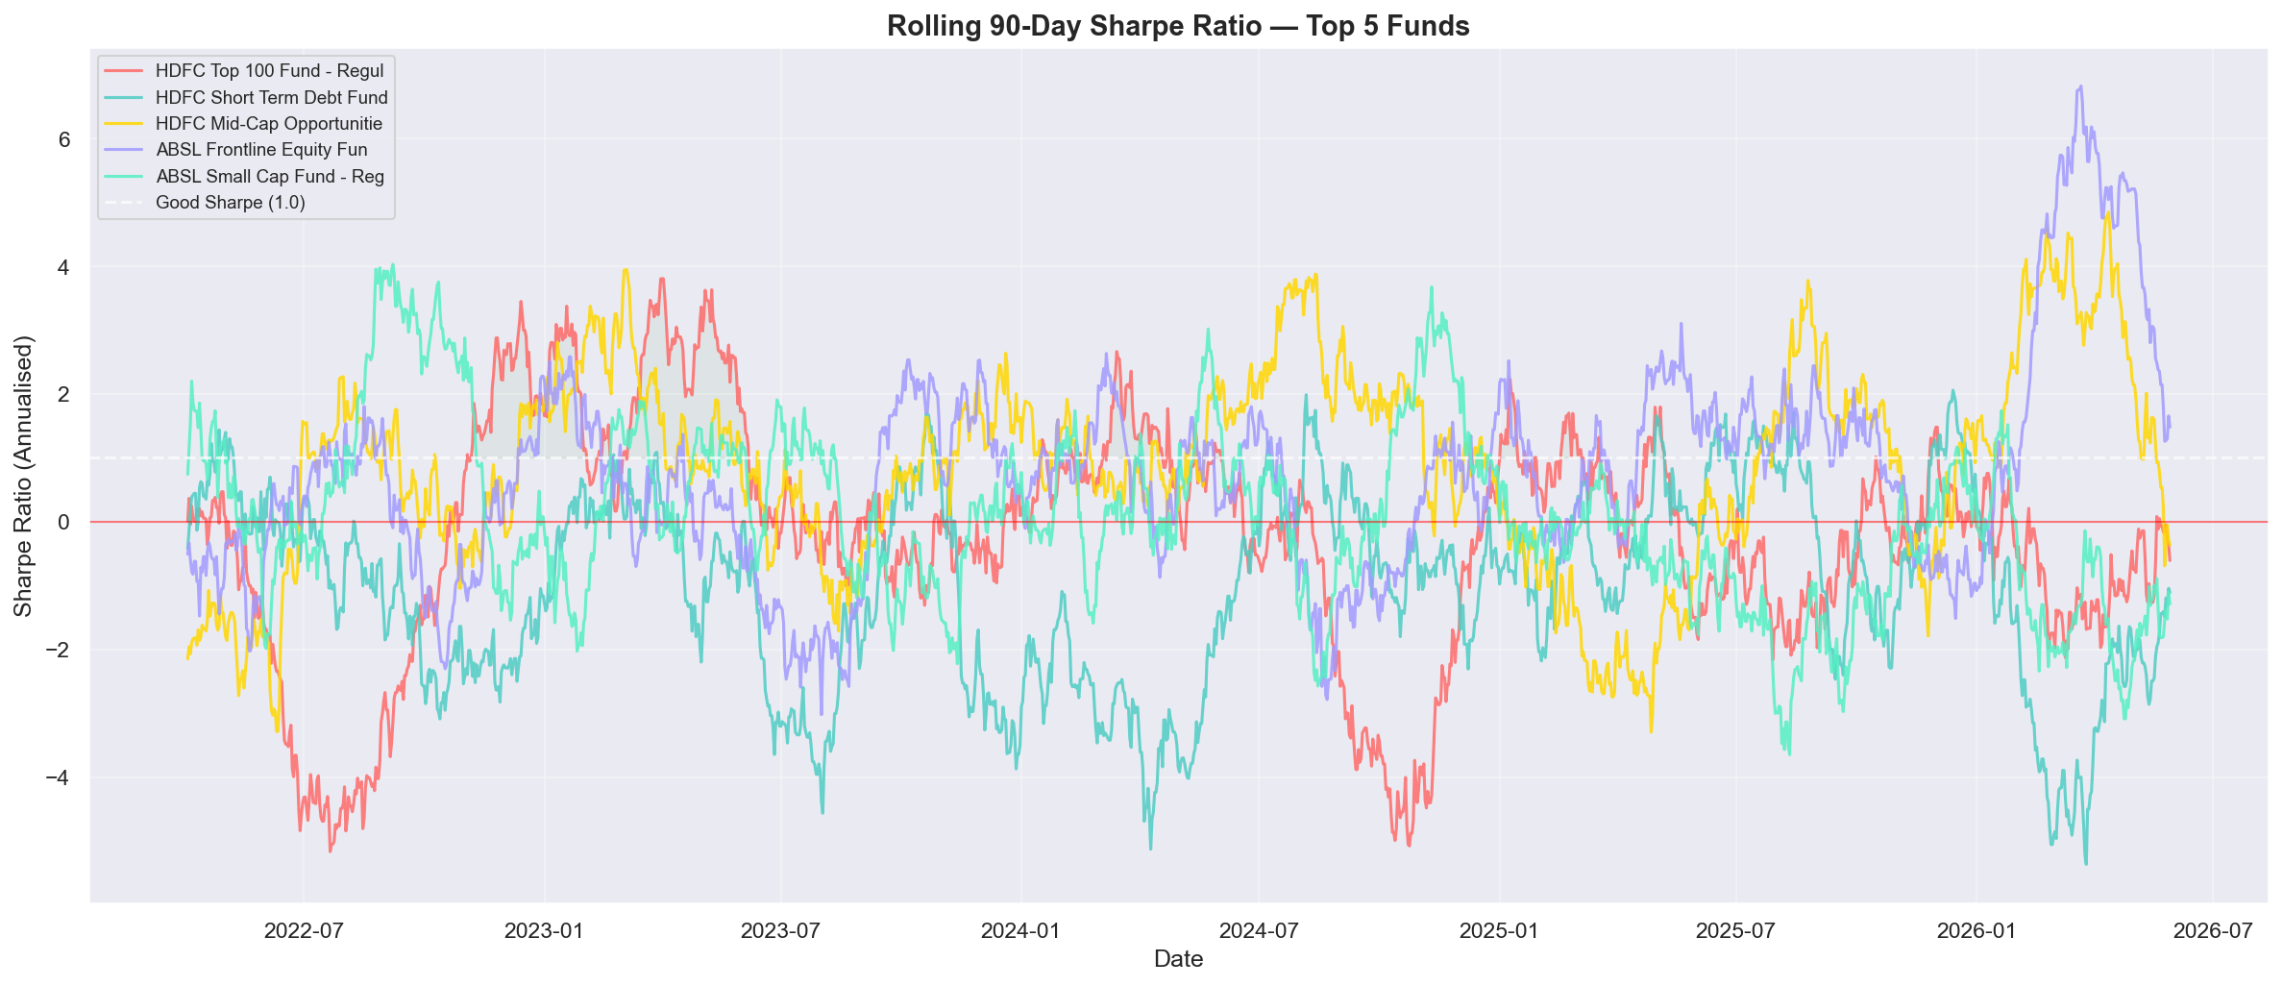
Advanced Analytics
VaR 95%: Small cap worst at -2.5% | Large cap at -1.5%
Rolling Sharpe > 1 during 2023 bull run, dropped in 2024
SIP Continuity: 70%+ investors regular (gap < 35 days)
HHI: Most funds concentrated in Financial Services sector
Fund Recommender built for Low/Moderate/High risk profiles

Slide 8
Key Insights & Recommendations
Key Insights
Recommendations
SBI Mutual Fund dominates AUM with Rs.12.5L Crore market leadership
Prioritise direct plan funds for cost-conscious long-term investors
2023 bull run delivered exceptional NAV growth across all 40 schemes
Launch B30 city SIP campaigns to capture untapped retail market
SIP inflows reached all-time high Dec 2025 showing investor confidence
Flag at-risk SIP investors for proactive retention outreach
Direct plan funds consistently outperform regular plans on Sharpe ratio
70%+ investors maintain regular SIP discipline — gap under 35 days
Diversify beyond Financial Services to reduce concentration risk

Slide 9
Thank You!
Bluestock Mutual Fund Analytics Capstone
MERLIN J | Teyzix Core Internship 2026
Python | SQLite | Plotly | Streamlit | ReportLab | Pandas
GitHub: github.com/EVANGELINAMERLIN/Mutual-Fund-Analytics

