Slide 1
A Synopses Data Engine for Interactive Extreme-Scale Analytics

Slide 2
Motivation – using synopses for analytics at scale
Big Streaming Data processing pipelines
At scale (e.g. TB/min or higher)
Synopses (sketches, samples, histograms) provide a perfect fit to speed up the processing boosting interactivity in analytics
Enhanced Horizontal Scalability
Parallel processing with reduced load due to data summarization
Vertical Scalability
Scaling to very high number of processed streams
Federated Scalability
Reduce bandwidth consumption in multi-cluster settings

Slide 3
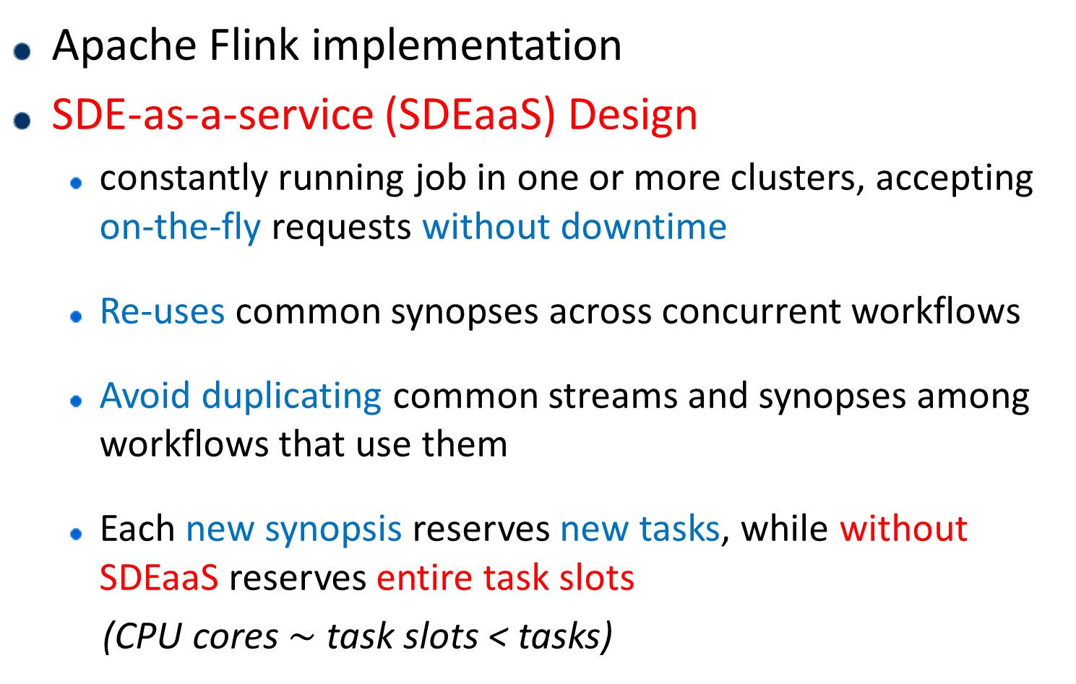
A Synopses Data Engine (SDE)-as-a-Service
Apache Flink implementation
SDE-as-a-service (SDEaaS) Design
constantly running job in one or more clusters, accepting on-the-fly requests without downtime
Re-uses common synopses across concurrent workflows
Avoid duplicating common streams and synopses among workflows that use them
Each new synopsis reserves new tasks, while without SDEaaS reserves entire task slots
(CPU cores $\sim$ task slots < tasks)

Slide 4
SDEaaS API & Remarks
SDEaaS API
Build/Stop synopsis at runtime, with zero downtime
Dynamically plug-in of code of new synopsis on the fly
Continuous & Ad-hoc queries
Remarks
Support for cross Big Data platform execution scenarios
… via Input/output in JSON format
… and Kafka Input/output topics

Slide 5
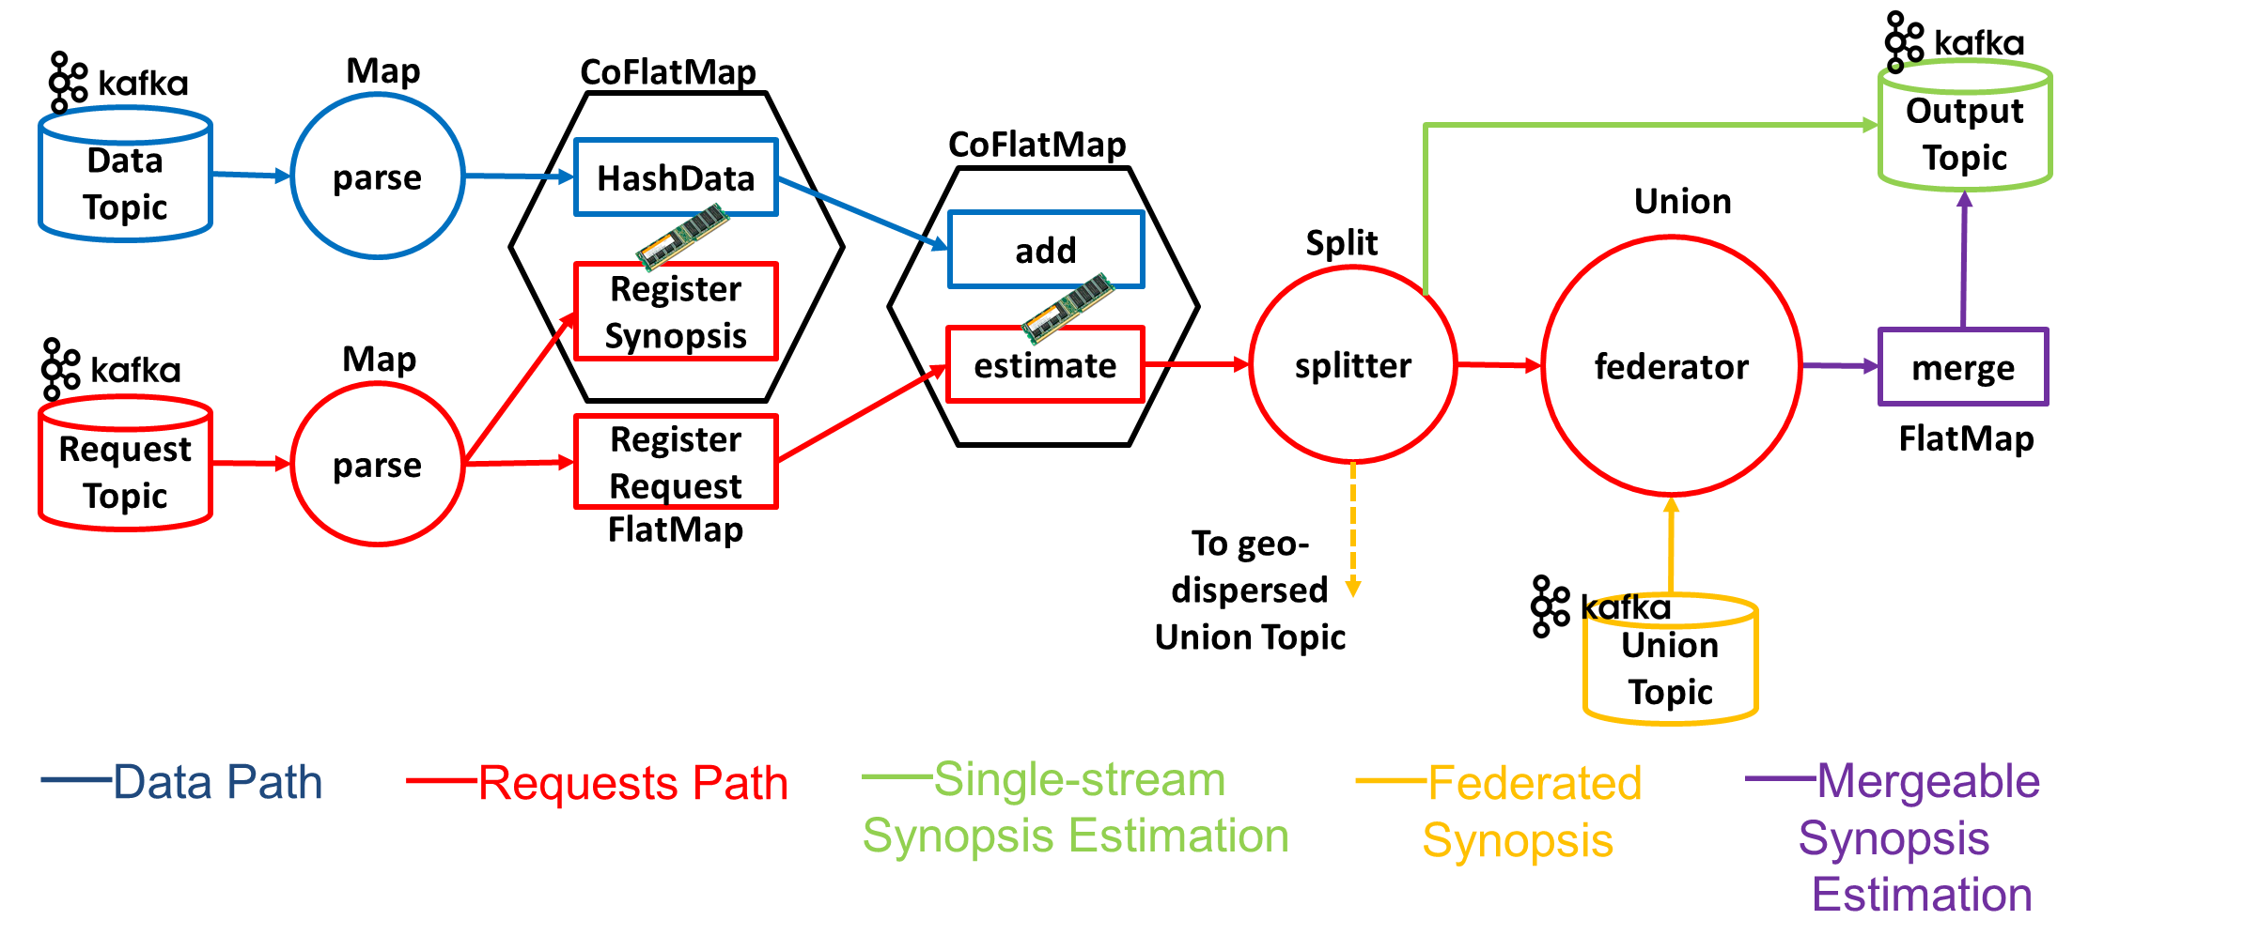
SDE Architecture – Condensed View
New Synopsis maintenance request
**each CoFlatMap hosts 2 FlatMap operators
Produce keys pointing to workers

Slide 6
SDE Architecture – Condensed View
Updating a synopsis upon new data tuple arrival
Lookup keys of workers handling that synopsis

Slide 7
SDE Architecture – Condensed View
Querying a synopsis
Look up keys to workers

Slide 8
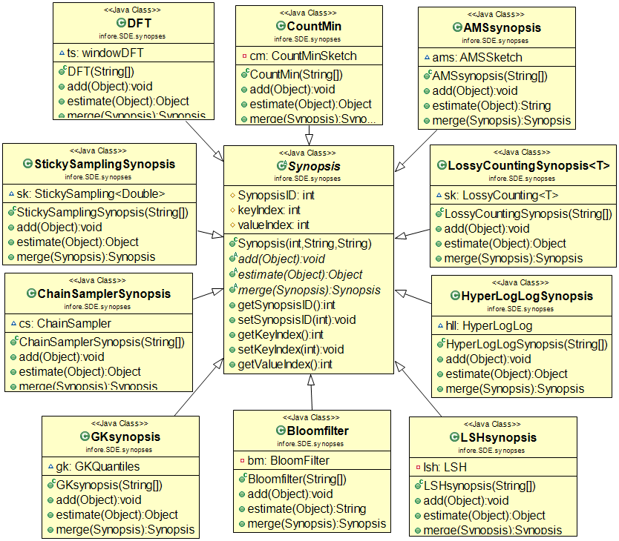
SDE Library
The structure of the SDE Library, utilizing
inheritance & polymorphism, is key for plugging in new synopses classes at runtime.

Slide 9
Experimental Setup
Datasets
10 TB of stock data, ~5000 stocks
Date, Time, Price, Volume for each data tick of a stock
Portion of the data available @ http://doi.org/10.5281/zenodo.3886895
Clusters
Kafka cluster with 4 Dell PowerEdge R320 Intel Xeon E5-2430 v2 2.50GHz machines with 32GB RAM each
Flink cluster has 10 Dell PowerEdge R300 Quad Core Xeon X3323 2.5GHz machines with 8GB RAM each

Slide 10
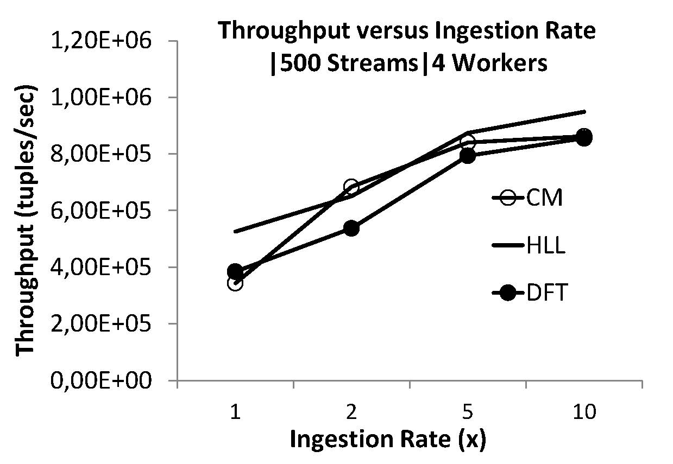
Experimental Results
Nearly Linear Trends
Horizontal Scalability
(volume, velocity)

Slide 11
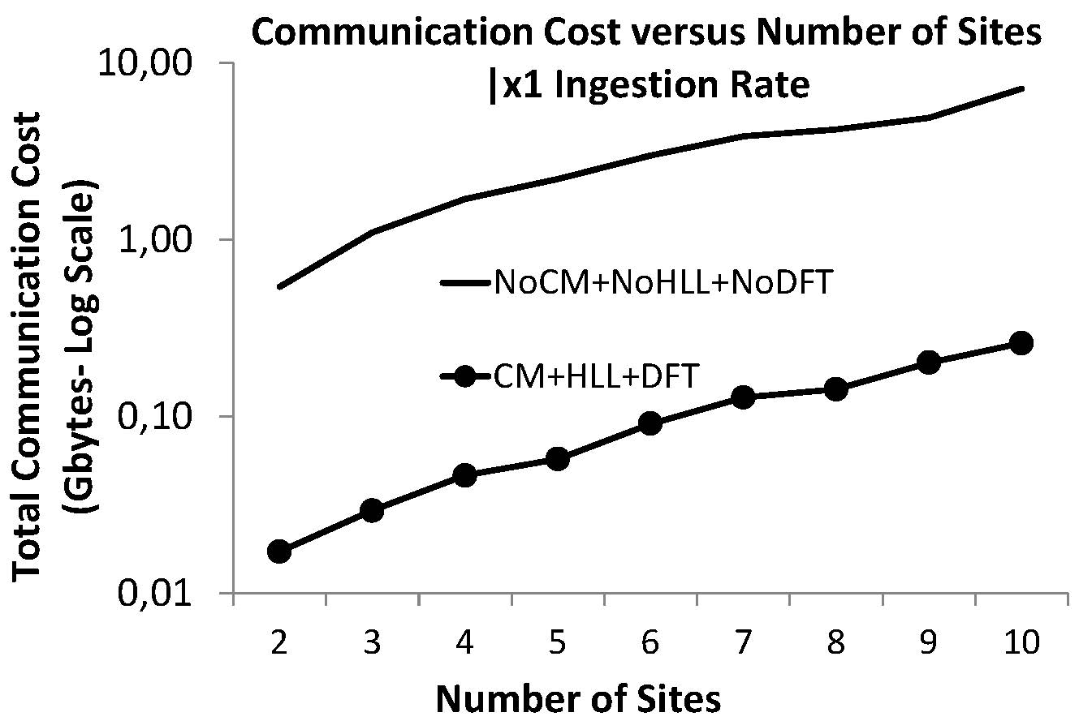
Experimental Results
Federated Scalability

Slide 12
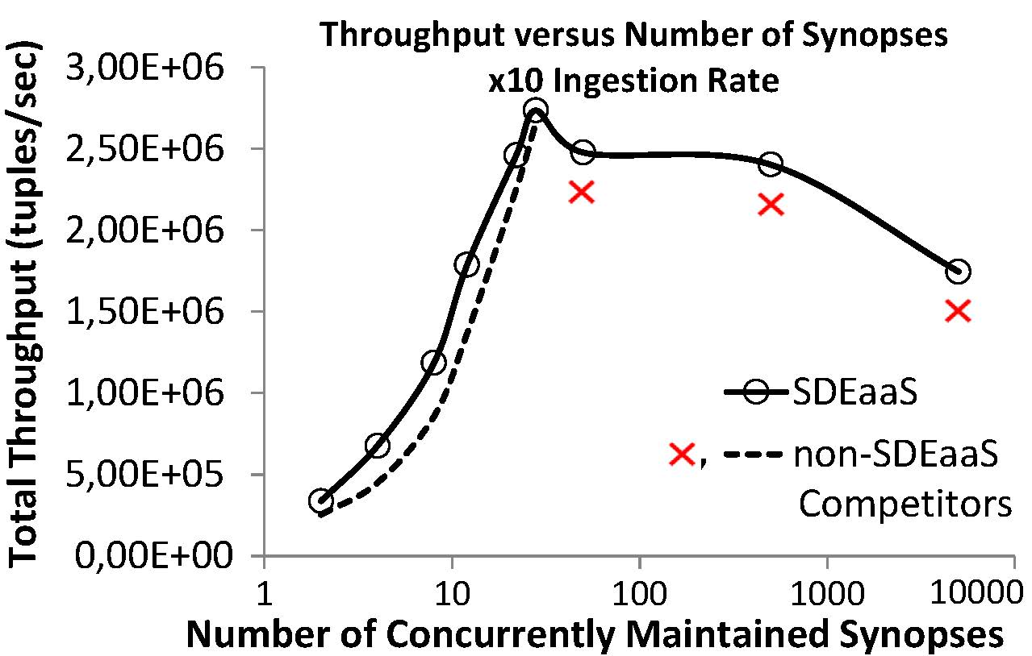
Experimental Results
Vertical Scalability

Slide 13
29th International Conference on Information and Knowledge Management (CIKM 2020)
Virtual Event, Ireland
Oct 19 – Oct 23 2020
http://infore-project.eu/
A Synopses Data Engine for Interactive Extreme-Scale Analytics
Thank you!
Antonis Kontaxakis, Nikos Giatrakos,
Antonios Deligiannakis

