Slide 1
A Synopses Data Engine for Interactive Extreme-Scale Analytics
Notes:
Hello everyone, my name is Nikos Giatrakos and I am going to present our paper entitled “A Synopses Data Engine for Interactive Extreme-Scale Analytics “

Slide 2
Motivation – using synopses for analytics at scale
Big Streaming Data processing pipelines
At scale (e.g. TB/min or higher)
Synopses (sketches, samples, histograms) provide a perfect fit to speed up the processing boosting interactivity in analytics
Enhanced Horizontal Scalability
Parallel processing with reduced load due to data summarization
Vertical Scalability
Scaling to very high number of processed streams
Federated Scalability
Reduce bandwidth consumption in multi-cluster settings
Notes:
Many diverse applications require the online analysis on Big streaming data of extreme scale to support decision making procedures.
Streaming Big Data platforms such as Flink or Spark handle the stream processing load by distributing, parallelizing it to a number of machines.
On the other hand, It is common in stream processing to use approximations of quantities such as counts, frequency moments, quantiles derived via sampling, sketching or histogram techniques, to speed up the processing while controllably tuning the analytics accuracy.
the use of synopses aids towards interactivity at scale by providing 3 types of scalability.
Enhanced horizontal scalability, i.e., not only we distribute the processing load to a number of machines but we also use parallel implementations of synopses operators, to shed the load that is assigned to each machine
Vertical scalability, i.e. the ability to scale the computation with the number of processed streams.
Federated scalability, i.e., scaling the computation in networked settings composed of many clusters reducing bandwidth consumption by communicating data summaries instead of the original streams.

Slide 3
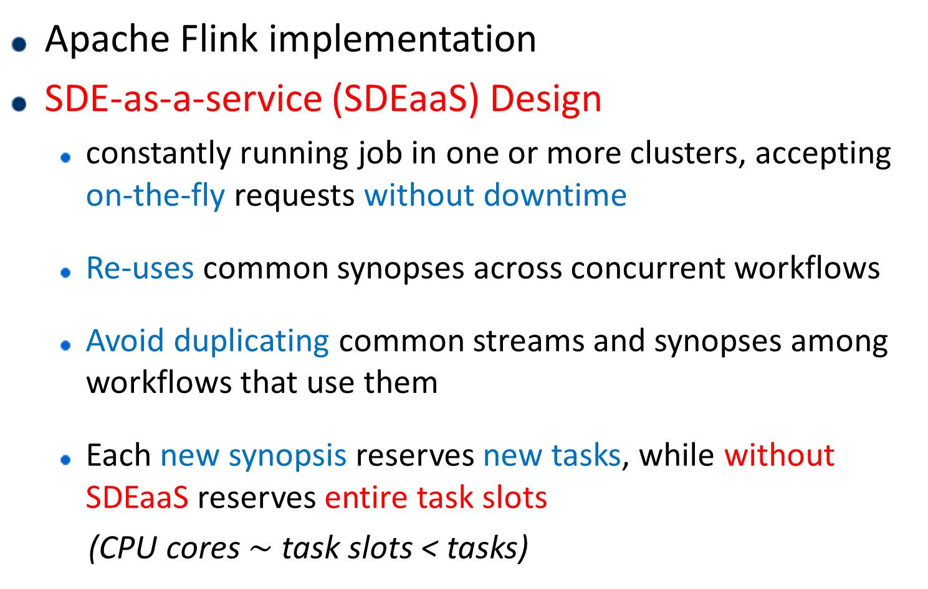
A Synopses Data Engine (SDE)-as-a-Service
Apache Flink implementation
SDE-as-a-service (SDEaaS) Design
constantly running job in one or more clusters, accepting on-the-fly requests without downtime
Re-uses common synopses across concurrent workflows
Avoid duplicating common streams and synopses among workflows that use them
Each new synopsis reserves new tasks, while without SDEaaS reserves entire task slots
(CPU cores $\sim$ task slots < tasks)
Notes:
To realize these benefits of synopses in interactive analytics at scale, we design a Synopses Data Engine, or SDE for short, which is built on Apache Flink using a Synopses as a service paradigm. That is our SDE is a constantly running job in one or more clusters accepting on the fly requests without downtime for the SDE and the workflows it serves
The additional benefits of the SDEaaS design is that it can serve multiple concurrently running workflows, reusing synopses which are common to them, instead of duplicating streams and synopses
And every time we request a new synopses to be maintained the running SDE reserves new tasks while lacking the SDEaaS design would reserve entire threads or task slots in terms of Flink.

Slide 4
SDEaaS API & Remarks
SDEaaS API
Build/Stop synopsis at runtime, with zero downtime
Dynamically plug-in of code of new synopsis on the fly
Continuous & Ad-hoc queries
Remarks
Support for cross Big Data platform execution scenarios
… via Input/output in JSON format
… and Kafka Input/output topics
Notes:
Our SDE can accept on the fly requests for maintaing new synopses
We can dynamically plug in the code of new synopses techniques, thus customizing it to new application needs at runtime without downtime
Requests for continuous queries and ad-hoc queries.
We support execution scenarios across platforms and clusters because we ingest data and requests via kafka topics and we use json format both in the input and the output of the SDE

Slide 5
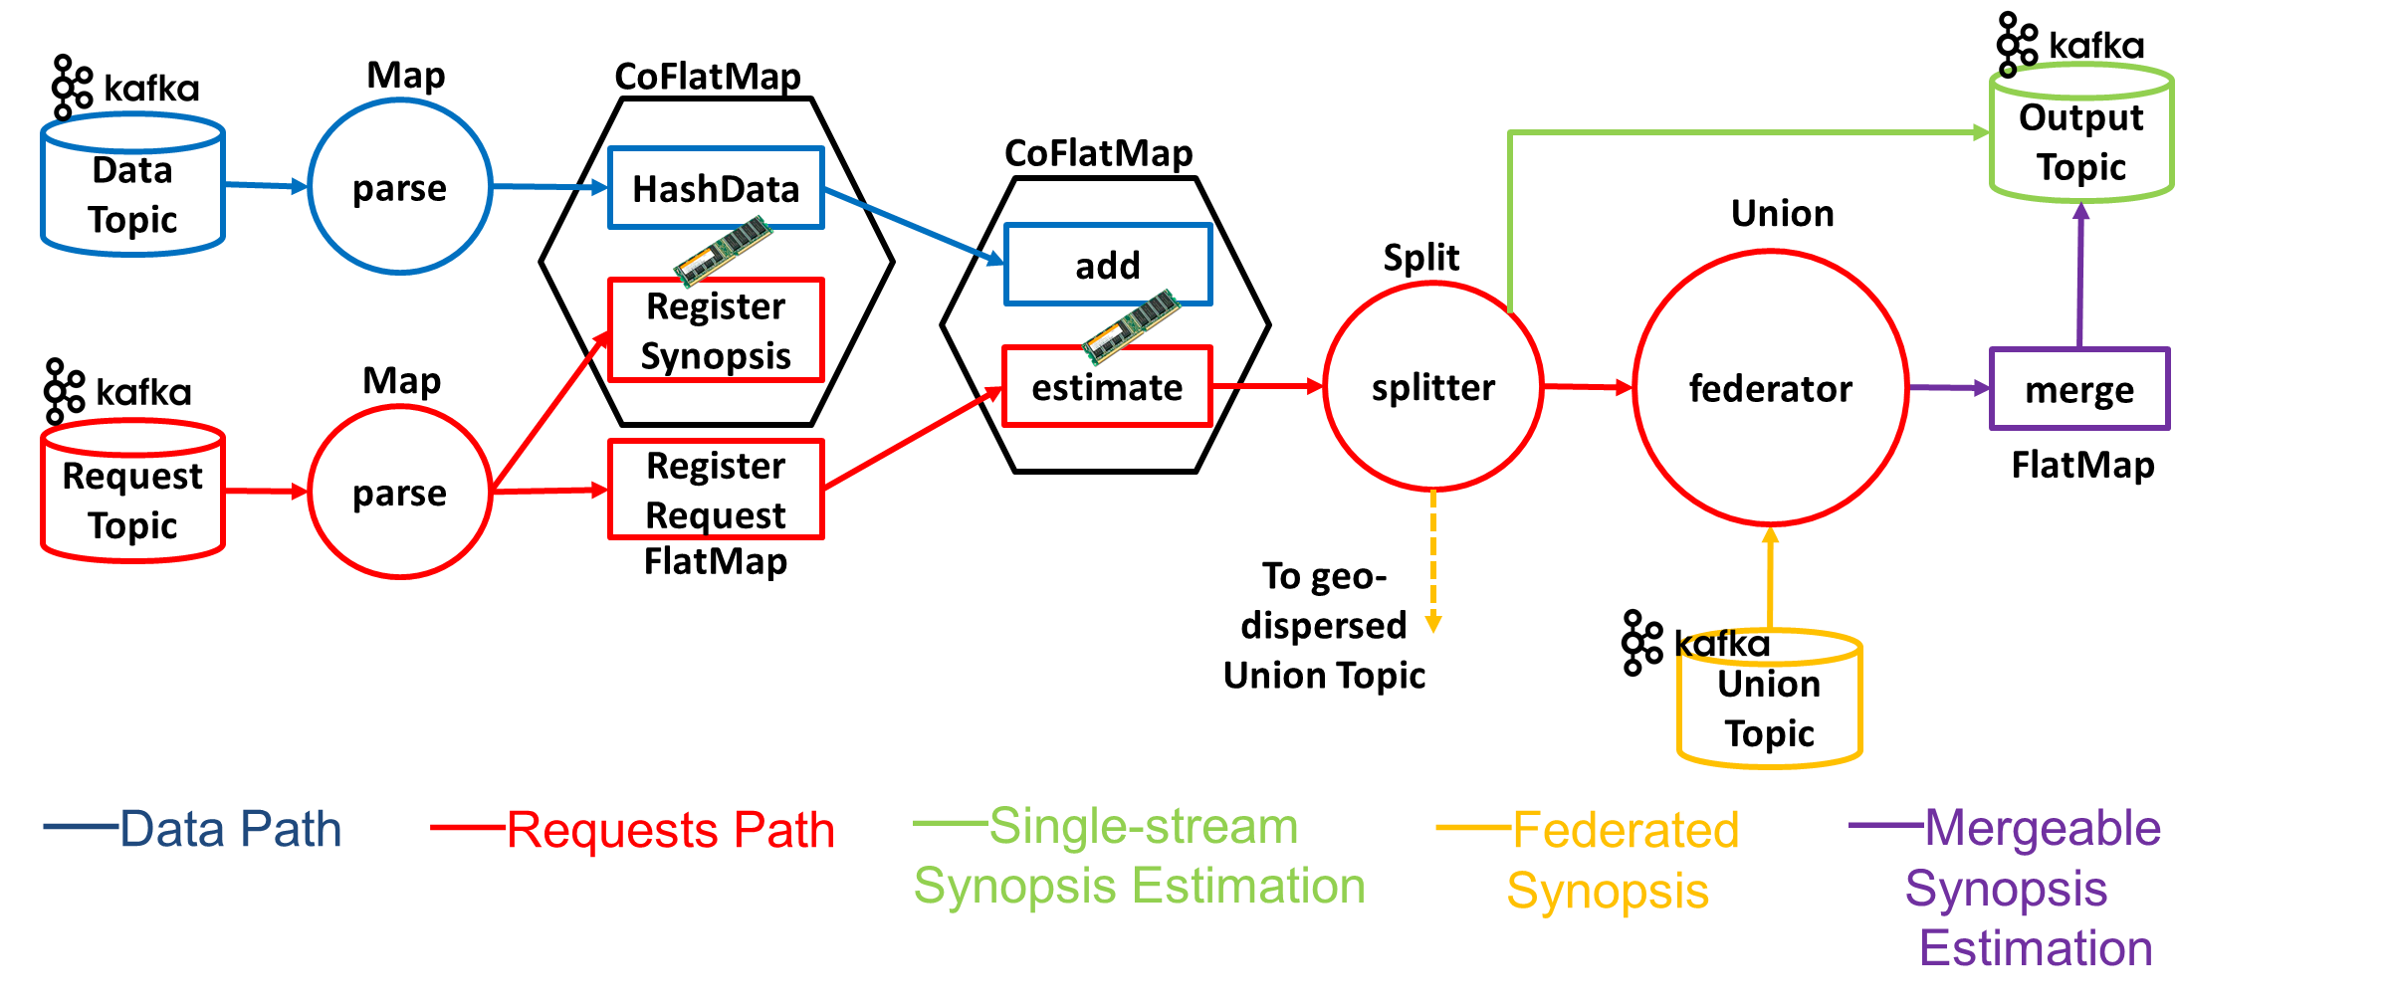
SDE Architecture – Condensed View
New Synopsis maintenance request
**each CoFlatMap hosts 2 FlatMap operators
Produce keys pointing to workers
Notes:
This is the SDE architecture. We are going to describe it along with how it is used in practice. This a condensed view. Each of the operators in the slide is executed in multiple parallel instances.
When a synopsis operator of the SDE is included in a workflow,
every request arrives via the RequestTopic. For building
A synopsis the request follows part of the red-colored path.
In case we have a new synopses maintenance request,
The RegisterSynopsis and RegisterRequest FlatMaps initially produce
the same keys pointing to workers that
should start maintaining the synopsis, but the two flatmaps do that for a different purpose each. As explained shortly.
RegisterSynopsis uses these keys to direct streaming tuples, which
follow the blue-colored path, to assigned workers to update the
synopsis. Registe Request uses the same keys to direct queries to
those workers and derive estimations at the estimation FlatMap.

Slide 6
SDE Architecture – Condensed View
Updating a synopsis upon new data tuple arrival
Lookup keys of workers handling that synopsis
Notes:
When a streaming update arrives at the DataTopic, the HashData
FlatMap looks up the keys of workers produced by RegisterSynopsis
and directs the update to the proper workers. There, the add FlatMap
includes the update in the maintained synopsis. For instance, in case a FM sketch is maintained, the add operation hashes the incoming
tuple to a position of the maintained bitmap and turns the
corresponding bit to 1 if it is not already set

Slide 7
SDE Architecture – Condensed View
Querying a synopsis
Look up keys to workers
Notes:
Upon a query, The RegisterRequest flatmap looks up the keys of workers for the queried synopsis and direct the query there, where the estimate platmap is executed, reading the status of the synopses from the add flatmap and deriving the estimation.
The rest of the operators on the right-hand side of the architecture are
used for appropriately controlling the output topics. The splitter
(split operator in Flink) directs the estimation to the OutputTopic
if a synopsis is defined on a single stream handled by one worker
(green path). If a synopses is maintained at multiple workers the results are partial synopses of each worker are first merged and then we output an estimation.
When a synopsis is maintained in multiple clusters we first union the partial synopses, then merge them and finally output the overall estimation.
(for instance, in case of FM sketches, merge perfroms a logical disjunction operation on various
FM sketches.

Slide 8
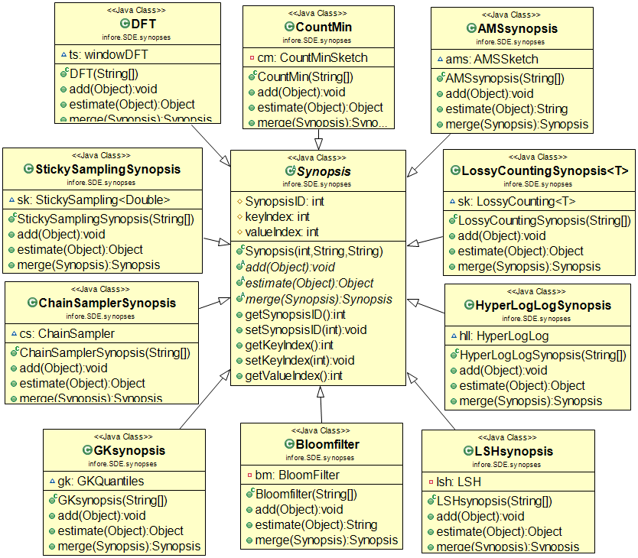
SDE Library
The structure of the SDE Library, utilizing
inheritance & polymorphism, is key for plugging in new synopses classes at runtime.
Notes:
The SDE library has a parent class named “synopsis” and every new synopsis extends this parent class overriding the add, estimate and merge methods. Inheritance and polymorphism are the keys here to allow pluggability of new code on the fly.

Slide 9
Experimental Setup
Datasets
10 TB of stock data, ~5000 stocks
Date, Time, Price, Volume for each data tick of a stock
Portion of the data available @ http://doi.org/10.5281/zenodo.3886895
Clusters
Kafka cluster with 4 Dell PowerEdge R320 Intel Xeon E5-2430 v2 2.50GHz machines with 32GB RAM each
Flink cluster has 10 Dell PowerEdge R300 Quad Core Xeon X3323 2.5GHz machines with 8GB RAM each
Notes:
We use a real financial dataset composing trades for approximately 5000 stocks of total size of 10TB, we have made portion of this data available online
We use a setup of a Kafka cluster with these characteristics and a Flink cluster with these ones

Slide 10
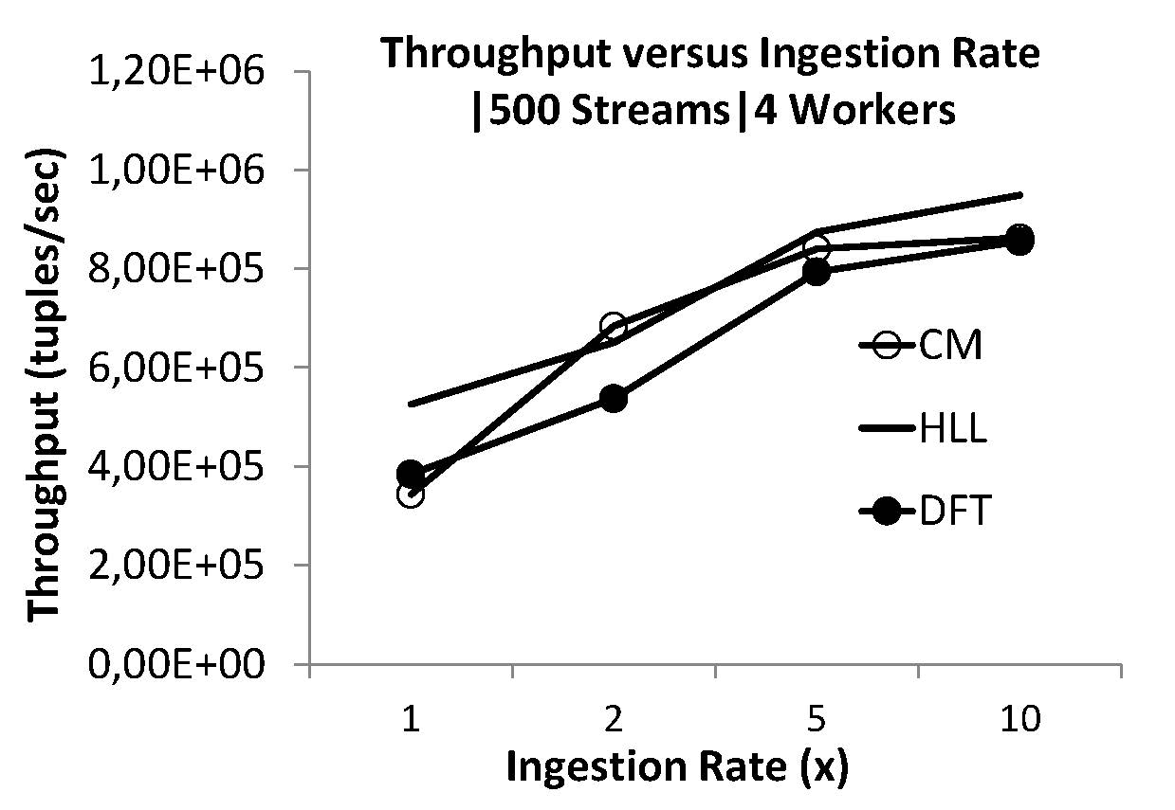
Experimental Results
Nearly Linear Trends
Horizontal Scalability
(volume, velocity)
Notes:
We build and maintain Discrete Fourier Transform, HyperLogLog, CountMin synopses which are destined to support analytics related to correlation, distinct count and frequency estimation, respectively
The vertical axis plots the achieved throughput, for a setup of 500 streams and a parallelization degree of 4.
In the horizontal axis of the plot, we vary the velocity of the incoming streams, as a factor of the maximum ingestion rate allowed by Kafka. So we clone each tuple the number of times indicated in the horizontal plot axis
the trend is almost linear which is a key sign of horizontal scalability, the SDE can handle the volume and speed of data that are fed and the more we increase the ingestion rate, throughput is proportionally increased.

Slide 11
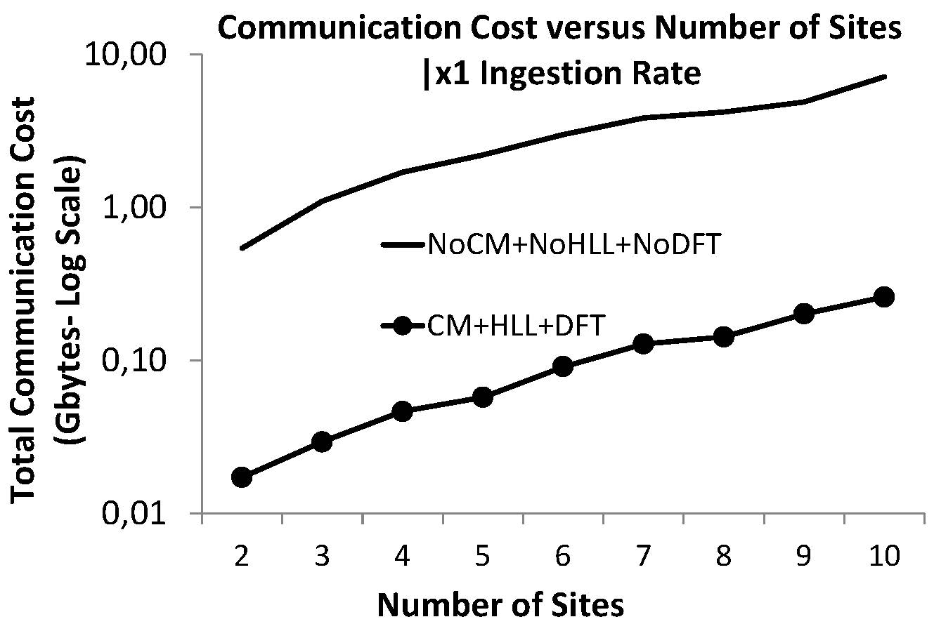
Experimental Results
Federated Scalability
Notes:
Here we simulate a geo-distributed cluster setting composed of the number of nodes noted in the horizontal axis and in the vertical axis we measure the communication cost required to transmit the maintained summaries to a single site and compute the global estimation there. We can observe that the SDEaaS can provide more than an order of magnitude reduction in communicated gigabytes compared to transmitting the original data streams.

Slide 12
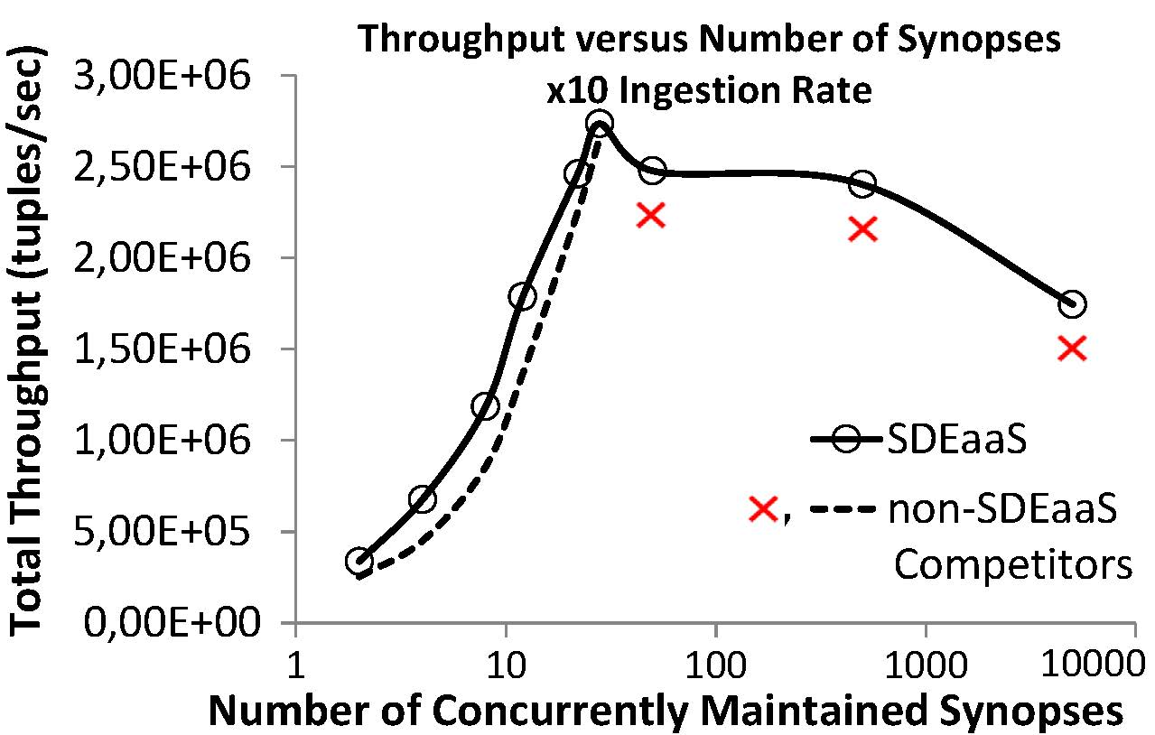
Experimental Results
Vertical Scalability
Notes:
In these plot we judge the vertical scalability of the SDE
We start by maintaining few count min sketches and then we express requests for mainting new synopses without stopping the running ones and thus we would not stop the workflows they serve. We compare our approach with a non SDEaaS approach that is simplt an SDE library
the nonSDEaaS approach cannot maintain more than 40 synopses because every demand for new synopsis reserves entire task slots in Flink and the taskslots of our clusters are depleted after a while.
Son the contrary, SDEaaS reserves new tasks when we express demands for new synopses, we can maintain thousands of synopses for thousands of streams, also exhibiting higher throughput because of fine grained resource management at the task, instead of task slot, level.

Slide 13
29th International Conference on Information and Knowledge Management (CIKM 2020)
Virtual Event, Ireland
Oct 19 – Oct 23 2020
http://infore-project.eu/
A Synopses Data Engine for Interactive Extreme-Scale Analytics
Thank you!
Antonis Kontaxakis, Nikos Giatrakos,
Antonios Deligiannakis

