Slide 1
Cats Lots Of Cats
Cute. Fluffy. Soft. Perfect.

Slide 3
There are many types of cats
Fluffy Cats | Scrawny Cats | Fierce Cats | Playful Cats | Chubby Cats
Meow | Murp | Rawr | Mew | Chomp

Slide 4
What is your favorite cat?
All of them
The orange ones
Lions
Tuxedos

Slide 5
Here kitty kitty kitty
Everybody knows that cats are the best.
Lets talk about cats.
I want more cats in my life

Slide 6
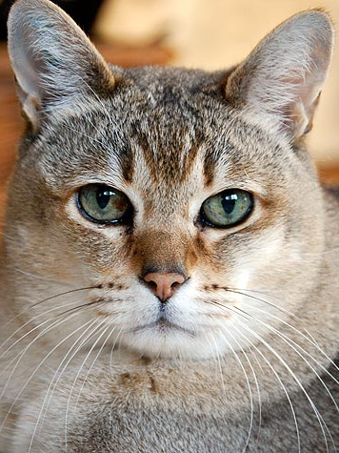
Look at this picture of a cat
This cat is hungry. Please feed it.

Slide 7
Tuna
Marshmallows
This is an appropriate food for cats
This is not an appropriate food for cats

Slide 11
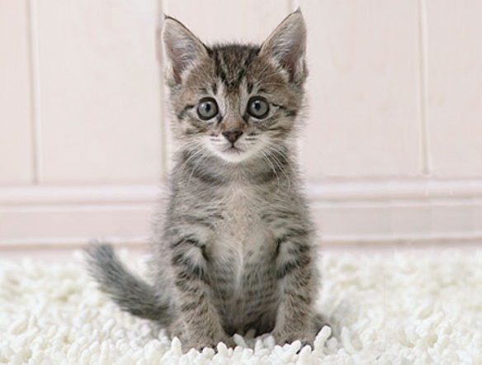
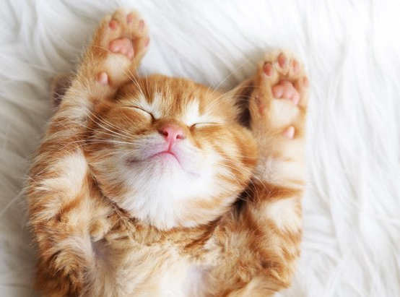
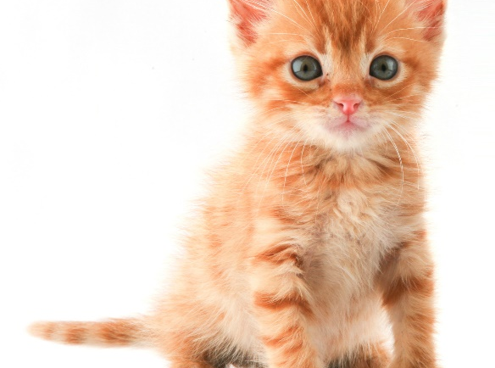
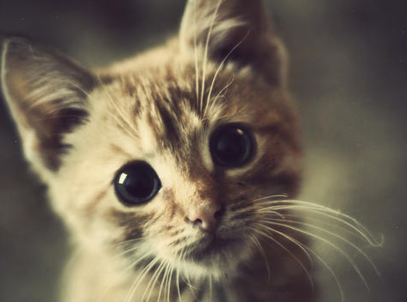
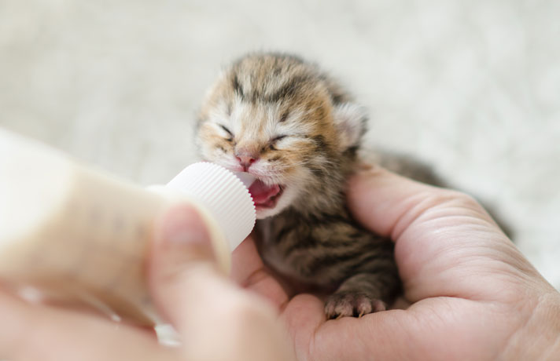
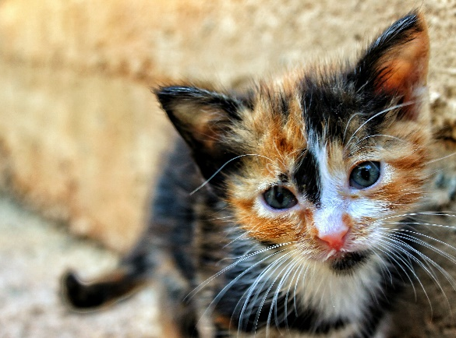
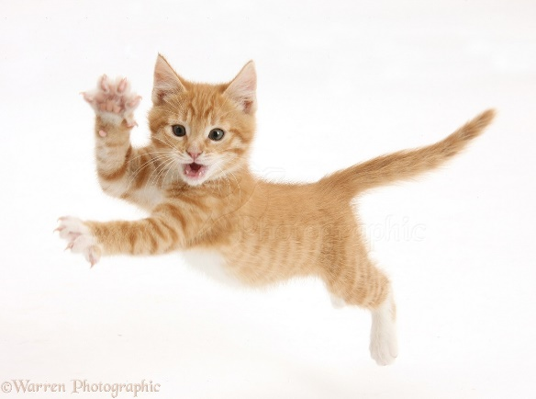
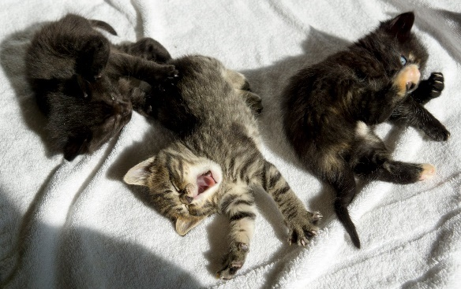
Kittens Being Cute

Slide 13
Kittens playing in the snow

Slide 14
Kitten scared of bigger kitten
Notice how as the orange kitten sneaks up behind the grey kitten his ears perk up right before he pounces!

Slide 15
Dancing Kittens!

Slide 16
Kittens chasing yarn
Kittens often prefer to chase yarn of a color similar to their fur

Slide 17
Did you know that cats have tails?

Slide 18
Cats also have paws.

Slide 19
Make sure your kittens are safe

