Slide 1
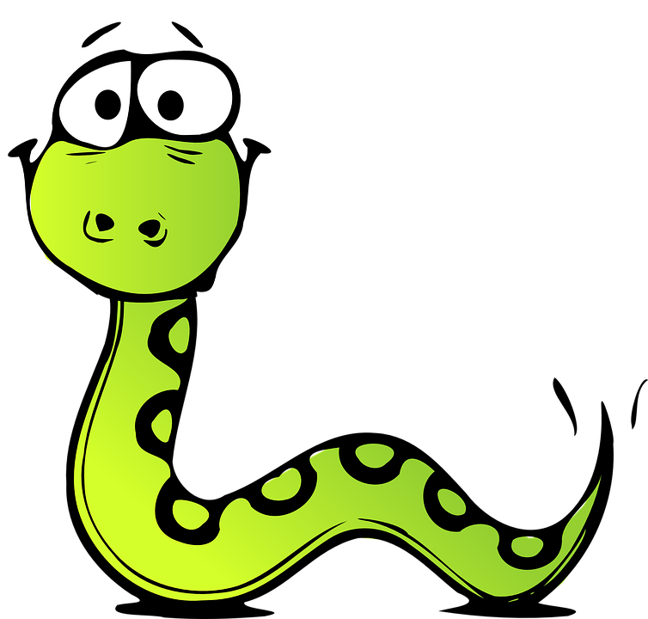
Course Structure

Slide 2
Syllabus
Introduction and Setup
Control Structures
Functions
Sequential Data
Dictionary and Sets
Classes
File Handling
Exception Control
Advanced concepts and libraries

Slide 3
Objective
The objective of this course is to introduce learners to Python programming. At the end of the course learners will be able to:
Learn how to write programs using Python.
Identify the appropriate modules for the application at hand.
Understand the documentation and therefore be able to use functions in several modules with higher confidence.
Understand advanced concepts like decorators and generators and how to use them along with classes and functions, thereby be able to develop programs that are complex in nature.

Slide 4
Introduction and Setup, Control Structures, Functions
Advanced concepts and libraries
Classes
Part 1
Part 2
Part 3
Part 4
Part 5
Sequential Data, Dictionary and Sets
File Handling, Exception Control

Slide 5
Thank You
Happy Learning :)

