Slide 1
Coral Cloud-Based File System
Presented by
Sai Leela Venkata Sukhesh Gopaluni
SCUBE

Slide 2
Modules
Basic idea
Introduction
Motivation
Contributions
Architecture
Operations
Algorithms
Evaluation
References
conclusion

Slide 3
Basic Idea
To create a new cloud based file system called coral based on PaaS.
Using efficient data structures and algorithmic designs.
Provides high performance and reduces cost.

Slide 4
Motivation
Traditional filesystems cannot totally utilize main features of cloud.
Poor cache hit rate.
Limited performance and high cost.
Goal
Improve resource utilization.
Cost reduction.

Slide 5
Introduction
Currently cloud services are viewed as a backend for network file system. So, they tend to adopt classical caching strategies and data block management mechanisms.
In contrast to that we use inherent characteristics of cloud storage like the billing model that improves resource utilization and minimize cost.

Slide 6
Contributions
Building kd-tree to improve cache performance.
Analyzed operations on billing models to reduce cost.
Storing user defined file systems in a cloud using Wampserver.
Security is provided using ECDSA algorithm.

Slide 7
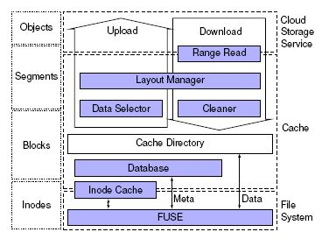
Coral Architecture
This figure shows the main components of the proposed file system. Coral manages metadata by using
relational dataThere are mainly four components in it they are Inodes, Blocks, Segments, and
Objects. There are connected to database tables directly, for example inode is stored with schema that
consists of id, uid, gid etc).

Slide 8
INODES
In the bottom FUSE layer acts as a restriction for the Read and Write operations, it also monitors the accessibility to the applications.
The most frequently used data block’s inode is stored in inode cache.
BLOCKS
The data is stored in several blocks and initially they are stored in cache directory.
The metadata exchanges between FUSE and the database and being synchronized with the cloud periodically.

Slide 9
SEGMENTS
The role of the data selector is to figure out the unwanted data with inherent correlation and later this data is segmented in to several parts and compressed.
This compressed data is then stored in the cloud cache.
OBJECTS
If the user sends a GET request, the data sitting on the disk is assembled in to several objects. This
Assembling process is done by the Layout Manger.
When the data is obtained, it gives the access to the user and allows to download it

Slide 10
Metadata database
Coral manages metadata in the form of relational database
It contains all the information about the file structure and directory such as size inode numbers etc..
It helps to save the state of the file system at anytime with less storage space.
To avoid cost, in coral metadata is stored in disk itself.

Slide 11
Cloud Operations
Put
Delete
Get is done by the user
Update operations is not allowed
Again the new file should be uploaded in order to update the file in the cloud.

Slide 12
Effects of operations on monetary cost
Caching and pre-fetching
Most frequent instructions can be cached and pre-fetched.
Split
This is done by K D tree basis and decreases no of hits.
Merge
Data is assembled and displayed for the user.

Slide 13
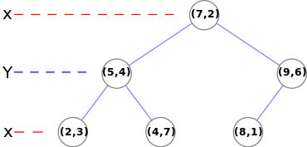
Kd-Tree
A kd-tree is a space partitioning data structure for organizing points in k-dimensional space.
Among a set of elemens, median is calculated and partitioned at the resultant element.
This process is done among all the directions i.e., k-directions.
Nearest neighbours are identified for storing in cache to make better prediction.

Slide 14
Algorithms
1.Kd-tree is constructed based on this time interval that is retrieved from database.
2.
Store the user defined file into the cloud and split the file to store in metadatabase.
Encryption algorithms are used to provide security.
3. Files are stored into the cloud based upon different access modes .

Slide 15
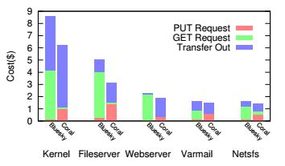
Evaluations
We are trying to find no.of requests for coral and bluesky a cloud based file system and compare the cost for different operations.

Slide 16
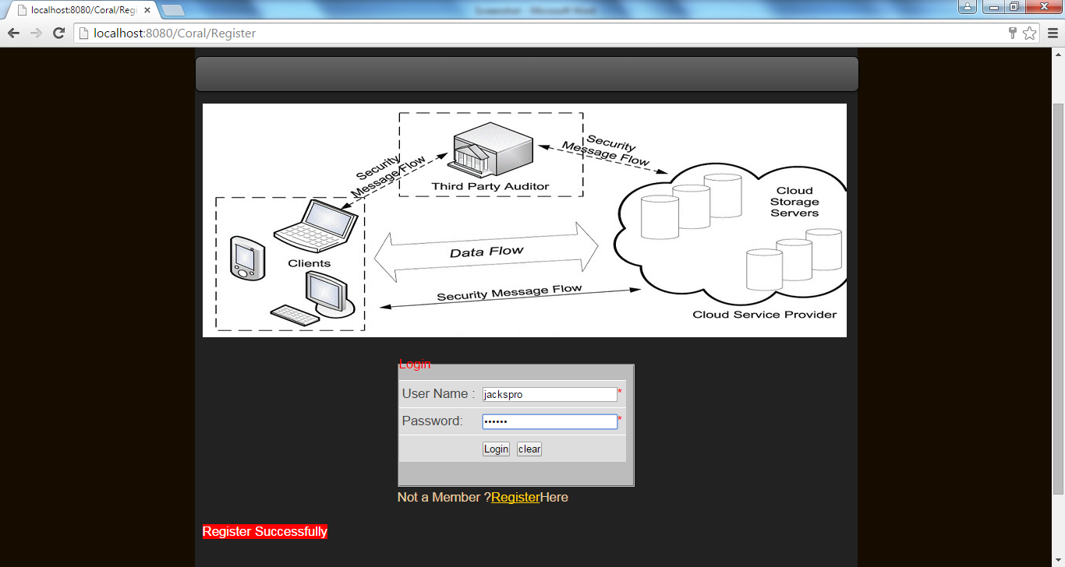
Testing

Slide 17
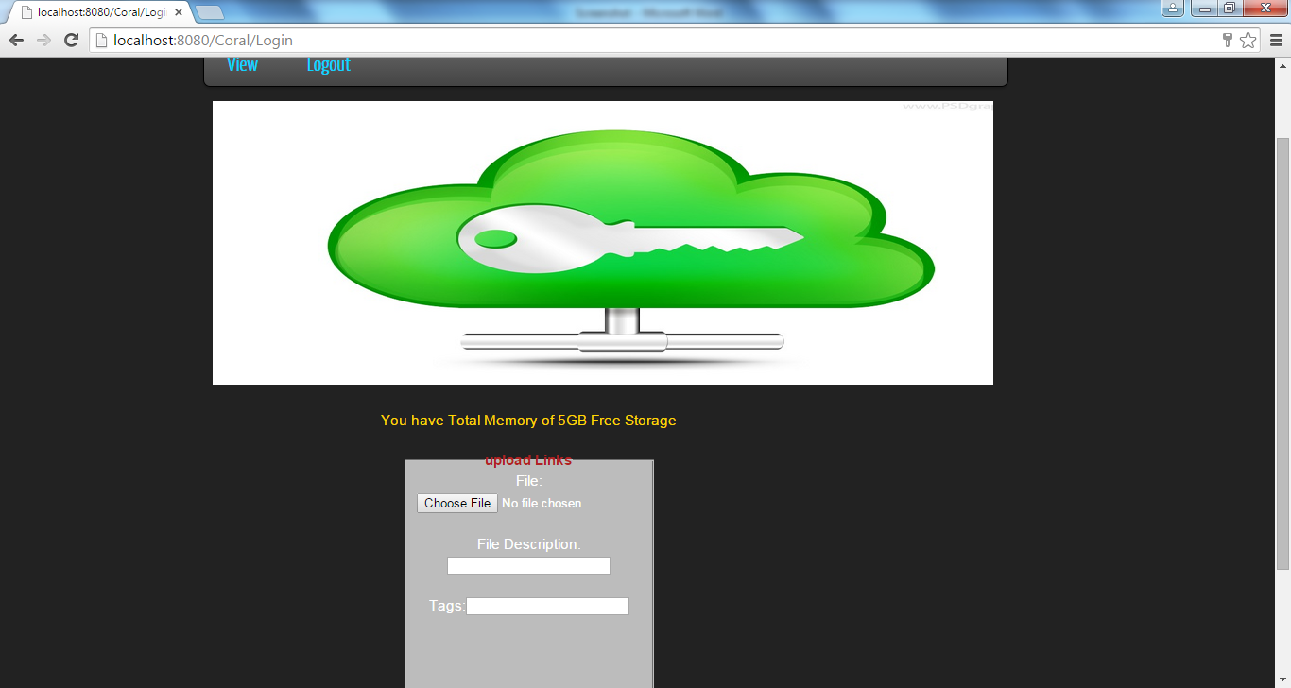
Testing

Slide 18
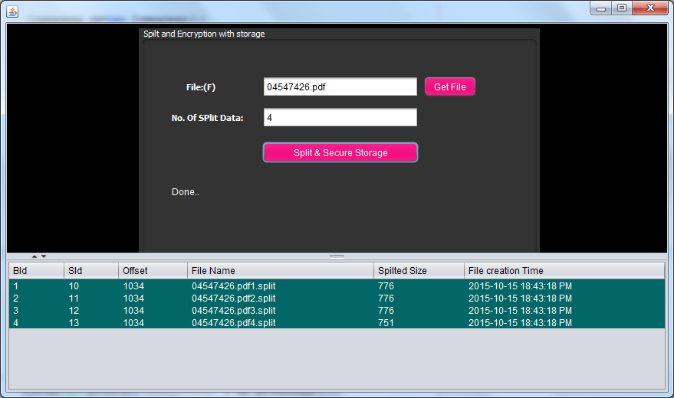
Testing

Slide 19
Advantages
Improves performance.
Reduce the cost
Metadata is used to find information about files and directory structure at anytime.
Disadvantages
Read after file may fail sometime.
Crashing is possible at client side.

Slide 20
Conclusion
Implementing cloud based file system.
User can store files in cloud with specified size as free storage using algorithmic designs.
By evaluating few operations on filesystem we reduce the cost and improve the performance.

Slide 21


