Slide 1
Collaborative Machine Learning Project
The use of machine learning techniques to predict students’ performance on exams based on external factors
Tanguy Stekke & EMMANUEL ATWAM

Slide 2
01.
Introduction
Data Cleaning
02.
Model training
04.
EDA
03.
Correlations among explanatory variables
Handling missing values, data encoding.
Supervised learning, regression and classification
05.
Conclusion

Slide 3
1.
Introduction
Our Machine Learning Project utilized a dataset from the education domain. We built a model using a dataset of students with variables such as hours_studied, attendance, parent_involvement, access to resources, and extracurricular activities, among others, to predict students' scores and to determine relevant factors influencing the exam_score of students, which is the target.
Our presentation is divided into the Data Cleaning phase, Exploratory Data Analysis phase, model selection with its rationale, and a conclusion.

Slide 4
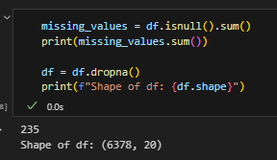
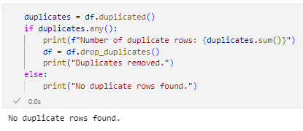
2.
Data cleaning
To handle the missing values that total for 3% of our dataset we tried to replace them using the mean of the columns. Because the missing values are ordinal, the mean is less valuable and introduce a bias which reduce the accuracy of our model. We decided to just remove the rows that have missing values.
Notes:
Because even breads company needs their cybersecurity checked.

Slide 5
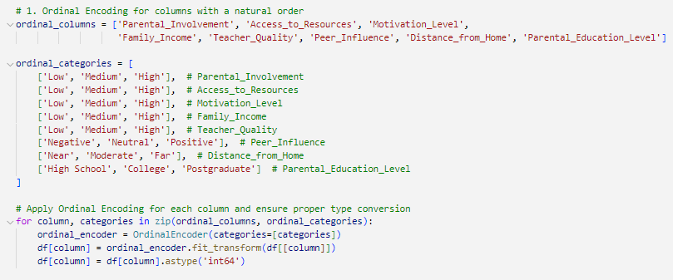
2.
Data cleaning
To handle ordinal values like Motivation level: low, medium, high we use the “OriginalEncoder”. Categories are then ordered in a way that it allows to keep the comparison between categories.
Notes:
Because even breads company needs their cybersecurity checked.

Slide 6
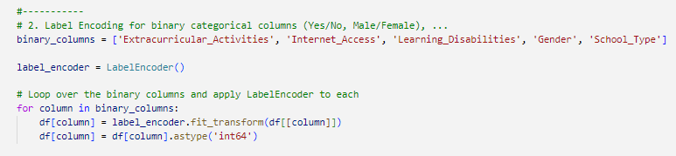
2.
Data cleaning
To handle binary values like gender: Yes or No we use the “LabelEncoder”. This method encodes each unique category with a numerical value.
Notes:
Because even breads company needs their cybersecurity checked.

Slide 7
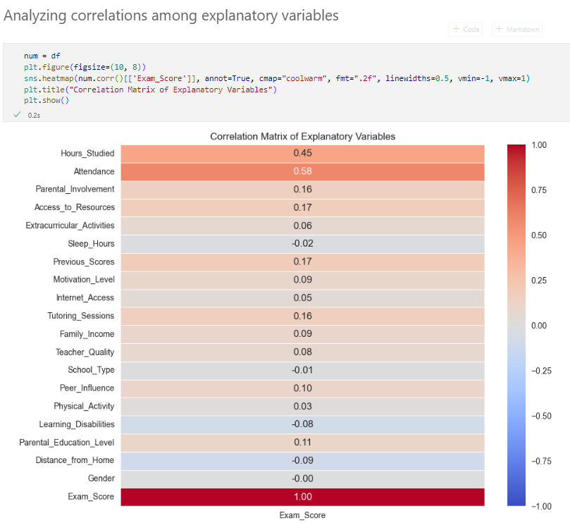
3.
Exploratory Data Analysis
The correlation between Hours Studied and Exam Score is 0.45 and this indicates a moderate positive correlation. Hours studied appear to be a significant factor in determining performance.
There is a stronger positive correlation of 0.58 between Attendance and Exam score and no correlation with gender as gender has no significant impact on performance.

Slide 8
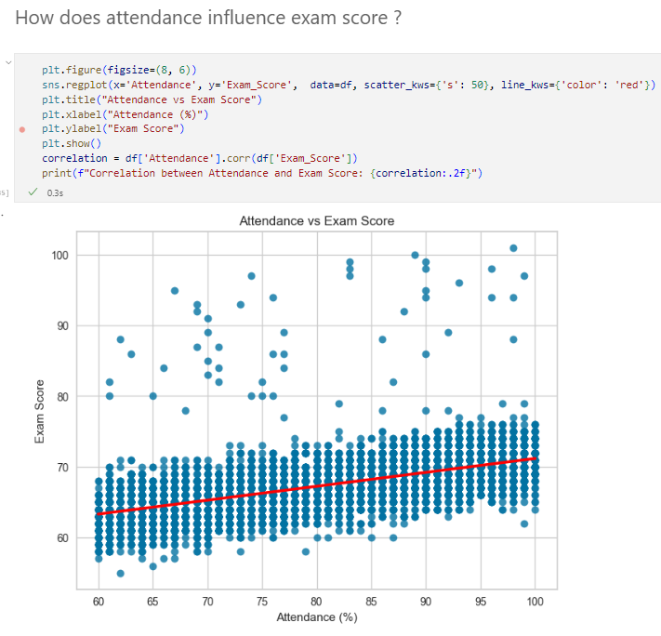
3.
Exploratory Data Analysis
The high correlation between Attendance and Exams Score is great for our model as it indicate that attendance is a strong predictor of exams performance.
The high correlation will make it easier to explain our model’s result.
This also suggest that Attendance is an important feature of our model.

Slide 9
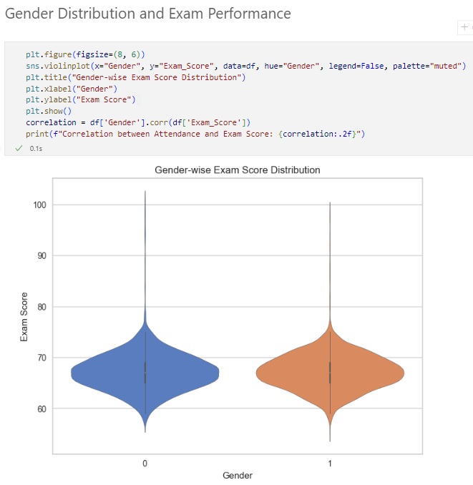
3.
Exploratory Data Analysis
There is No correlation so the data on gender will be removed to enhance our prediction.

Slide 10
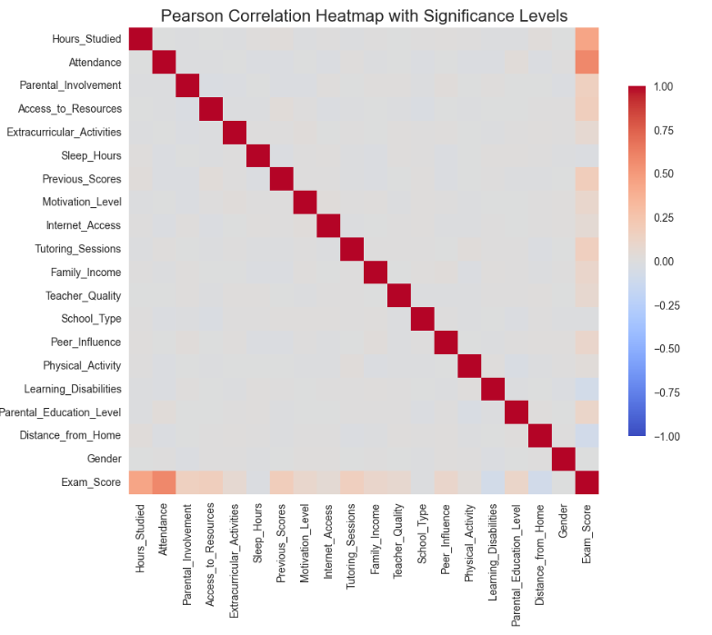
3.
Exploratory Data Analysis
No PCA because no correlation between each features.

Slide 11
4.
Model selection
Based on PCA, EDA, and the characteristics of the continuous target variable Exam Score, we identified two primary tasks:
- Regression: Suitable for predicting the exact score, as many numerical features show correlations with the target (e.g., Hours Studied, Attendance, Previous Scores).
- Classification: Can categorize students into performance groups.
We will use Linear Regression and Random Forest Regression and Random Forest Classifier on the other hand.

Slide 12
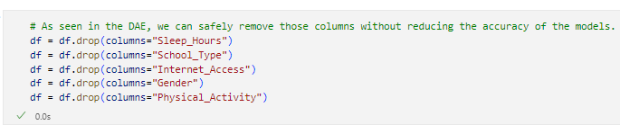
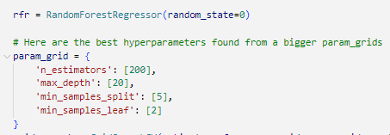
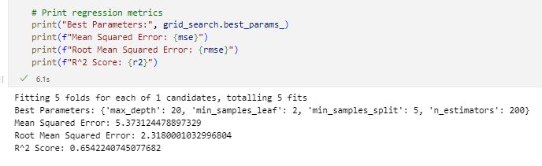
4.
Model selection

Slide 13
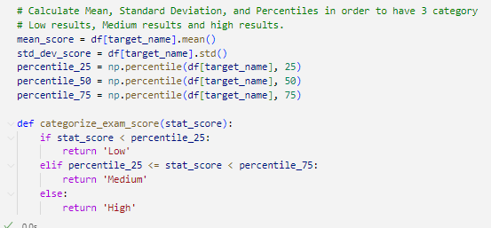
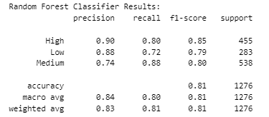
4.
Model selection
The results show that the Random Forest Classifier has very high precision (0.90) and recall (0.80) for the "High" class, indicating that it is able to accurately identify the "High" class with a high degree of confidence and sensitivity.

Slide 14
5.
Conclusion
Classification and regression works well on our models. We were able to remove data points that had no meaningful representation in our model's target population.

