Slide 1
Greenhouse Gasses, Climate Change and Mitigation
Prof McCoy
Physics

Slide 2
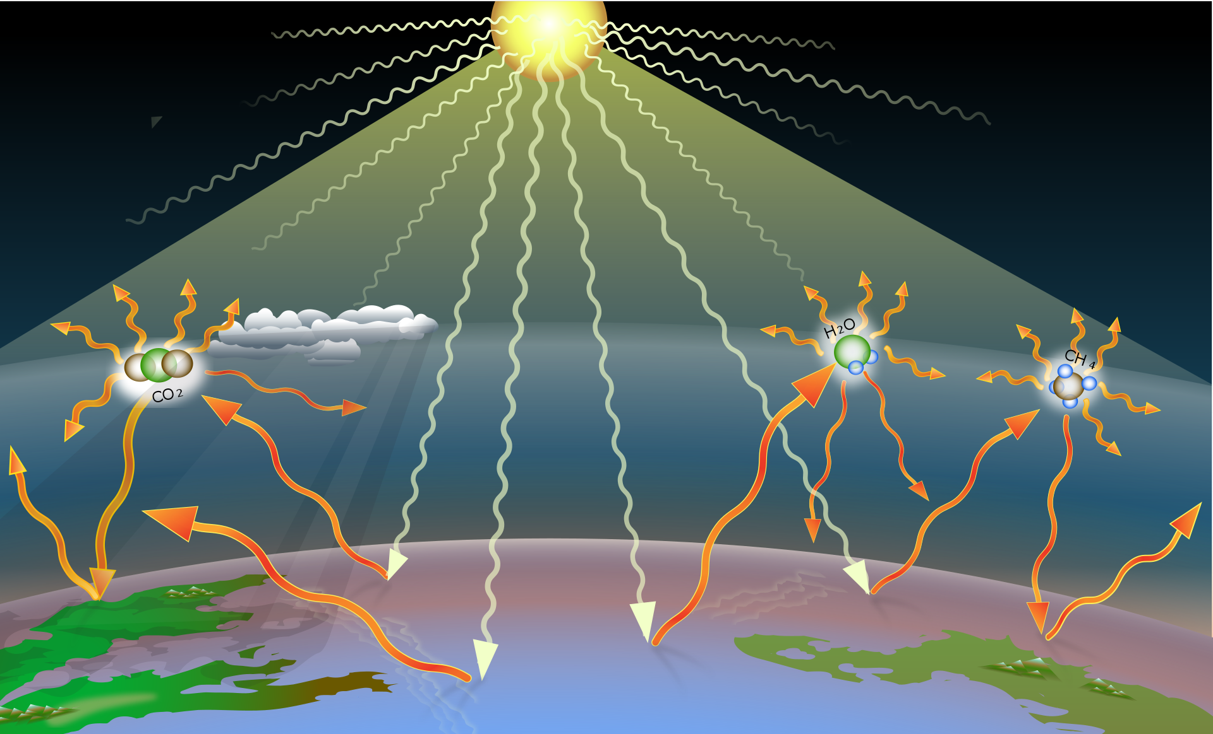
Greenhouse Effect
Earth’s atmosphere is transparent to the wavelengths of solar radiation which passes through, is partially absorbed at Earth’s surface, the partially reflected back into space.
Absorbed radiation warms Earth’s surface which then re-radiates the excess energy at longer wavelengths in order to achieve thermal equilibrium.
A small amount of greenhouse gasses makes our atmosphere nearly opaque to the longer-wavelength, re-radiated energy. This energy is absorbed and re-radiated by greenhouse gasses preventing that energy from escaping to space, resulting in a warming of the planet.
The naturally occurring greenhouse effect, keeps Earth’s average temp at ~60º instead of ~ 5^{o.}
Increases in human-caused greenhouse gasses trap more energy causing Earth’s surface to grow warmer (“global warming”). This additional energy is responsible for climate change.

Slide 3
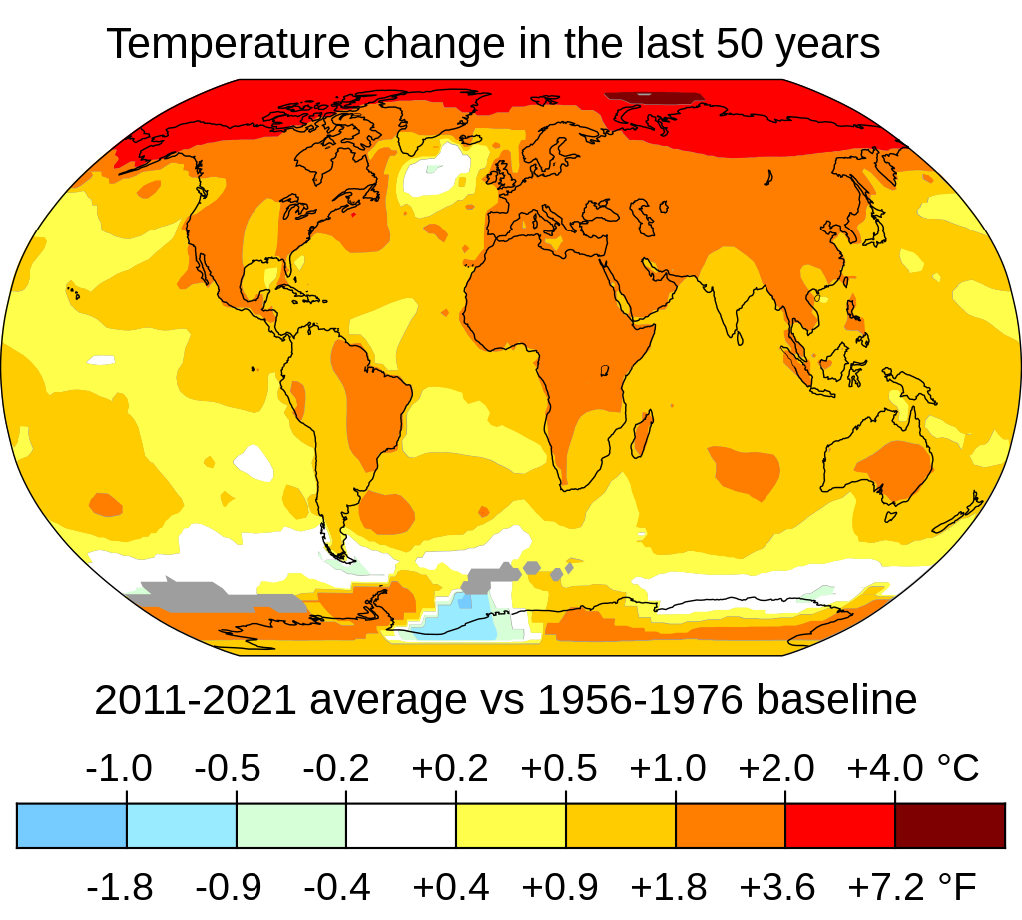
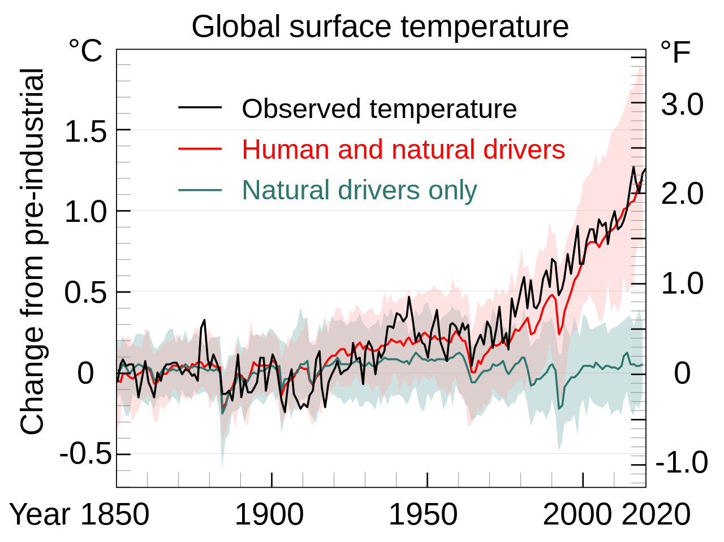
Climate Change
There have been previous periods of climate change, but current changes are significantly more rapid and not due to natural causes. Instead, they are due to greenhouse-gas emissions.
Current climate change is due to greenhouse-gas emission resulting from burning fossil fuels for energy.
Temperatures on land have risen about twice as fast as the global average.

Slide 4

Impacts of Climate Change
Expansion of deserts
Increased frequency of heat waves and wild fires
Melting permafrost, glacial retreat, sea-ice loss
Increased storm intensity and weather extremes
Species relocation to avoid extinction
Humans:
Food and water scarcity
Increased flooding, extreme heat
Increased disease
Economic loss
Human migration
"Climate change is the greatest threat to global health in the 21st century.”

Slide 5
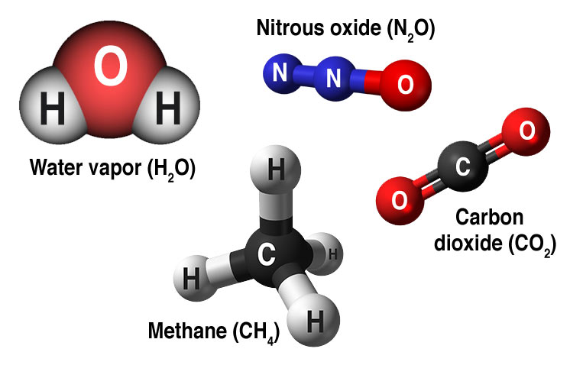
Greenhouse Gasses
A greenhouse gas is any gas that absorbs and re-radiates energy within the infrared (thermal) range of wavelengths.
Greenhouse gasses include (ranked by direct contribution to the greenhouse effect):
Water vapor and clouds (H₂O): 36 – 72%
Carbon dioxide (CO₂): 9 – 26%
Methane (CH₄): 4 – 9%
Ozone O₃: 3 – 7%
The direct radiative effect of a mass of methane is about 84 times stronger than the same mass of CO₂ over a 20-year interval.

Slide 6
Sources of Methane
Over the last two centuries, methane concentrations in the atmosphere have more than doubled, largely due to human-related activities.
Because methane is both a powerful greenhouse gas and short-lived compared to carbon dioxide, achieving significant reductions would have a rapid and significant effect on atmospheric warming potential.
There are 3.2 million abandoned oil and gas wells in the US. Over 18K of these are in OK.

