Slide 1
Study & Play Trivia Maze
Team java.lang.NullPointerException
Stefan Bostain, Stacy Carlson, and Dan Watt

Slide 2
Basics of the Game
Java Application
SWT (Standard Widget Toolkit)
JDBC Driver for SQLite
Multiple Modes
Notes:
Multi Modes – Standard mode – choice of cat – how to play
endless mode – asked question until wrong or exhaust all questions

Slide 3
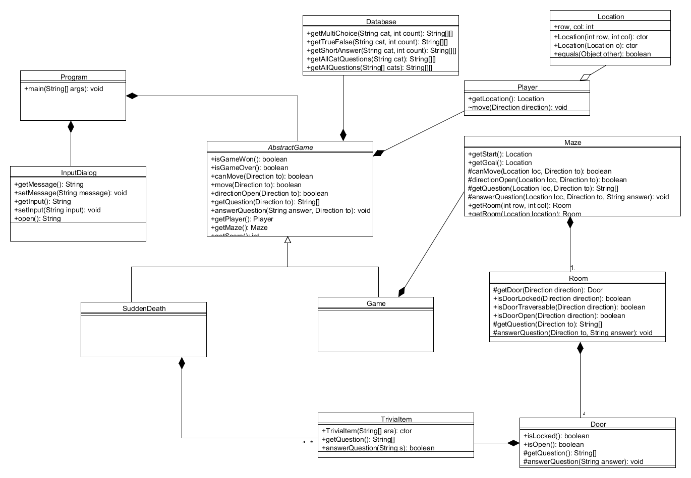
Class Diagram

Slide 4
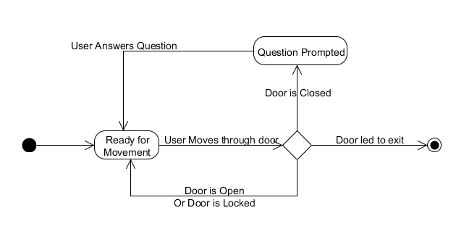
State Diagram

Slide 5
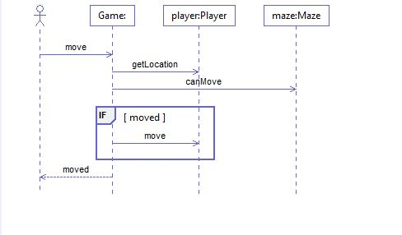
Sequence Diagram

