Slide 2
DEV
UAT
PROD
Continuous integration

Slide 3



Github
Back end code (C#, REST)
Front end code (HTML, JS)
Continuous integration (build, unit tests)
Continuous deployment (DEV)
Azure Devops
Azure cloud
Continuous deployment (UAT)
Continuous deployment (PROD)

Slide 4


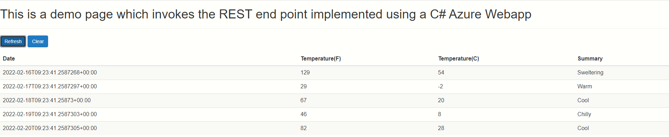
Azure Web App(C#, REST)
Azure App Service Plan
Web browser
Azure storage account (HTML, JS)

Slide 5
New feature branch in Github
Make regular commits to feature branch
Raise Pull Request
Start
Run other code quality tests
Run unit tests
Build the code
CI kicks in on feature branch
CD kicks in
Deploy feature to DEV
Is PR complete?
Merge into master branch
Is PROD approved?
Deploy master to UAT
Deploy master to DEV
CI kicks in on master branch
Deploy master to PROD
End

Slide 6
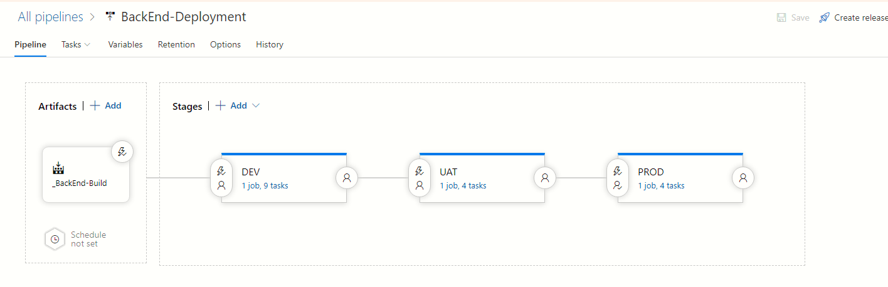
The PROD stage should run only when approved
This is where you tell CD which CI artifact to pull in
This is where you configure CD to kick off each time a CI build is available
We need to let DEV stage run on PR build

Slide 7
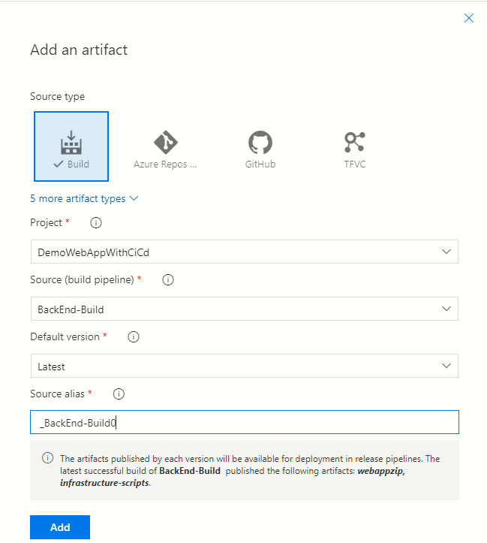
This is where you specify that the CD will expect a CI pipeline as the source
This is an alias which will be used for referencing the files under this artifact. E.g. Deploy.ps1
This is where you select which CI pipeline to use

Slide 8
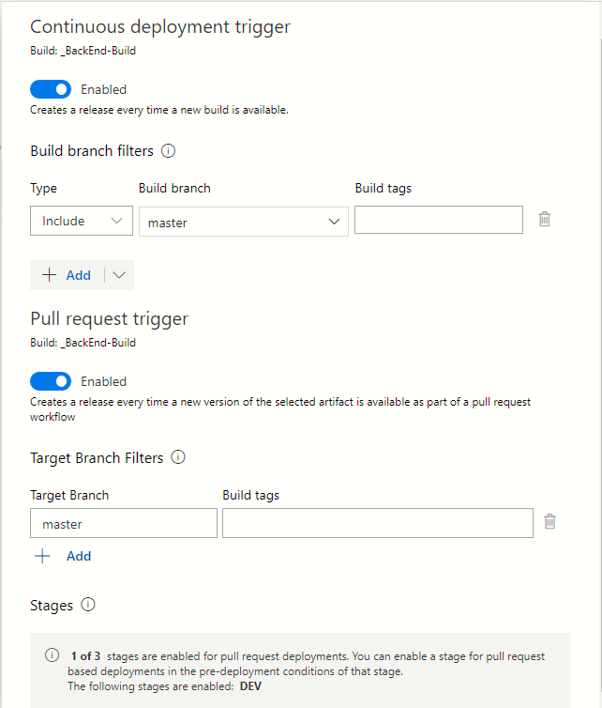
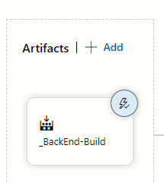
We want this to be enabled so that any CI build produced from the master branch triggers the CD
Click here to define what triggers this CD pipeline
We want this to be enabled so that any CI build produced by a PR branch triggers the CD

Slide 9
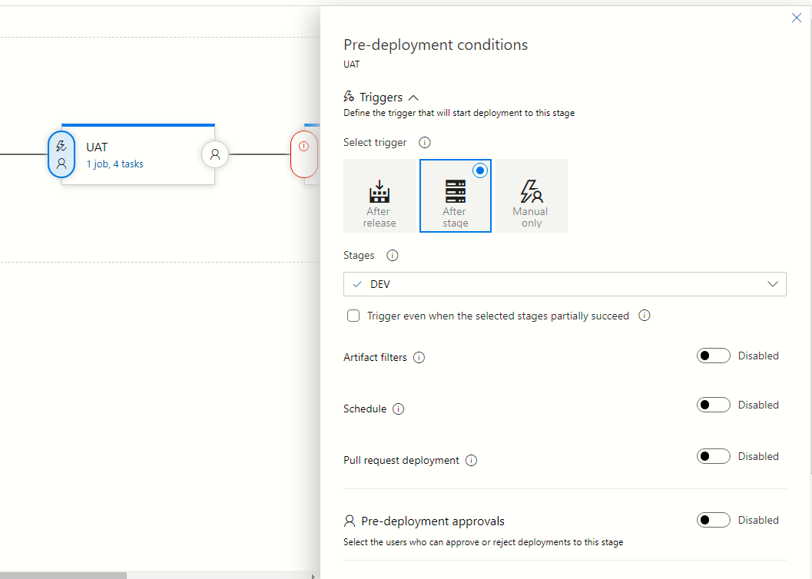
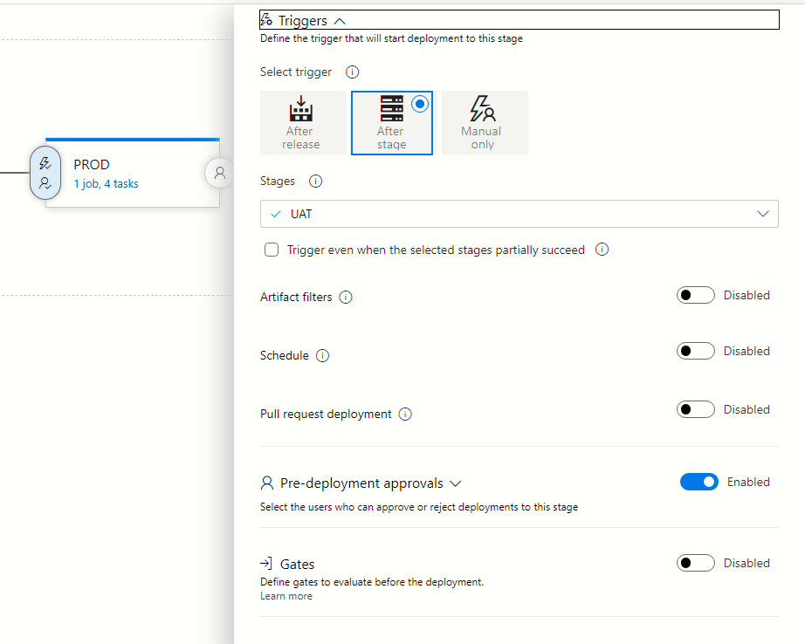
We specify here that UAT stage runs only after DEV stage
We specify here that PROD stage runs only after UAT stage

Slide 10
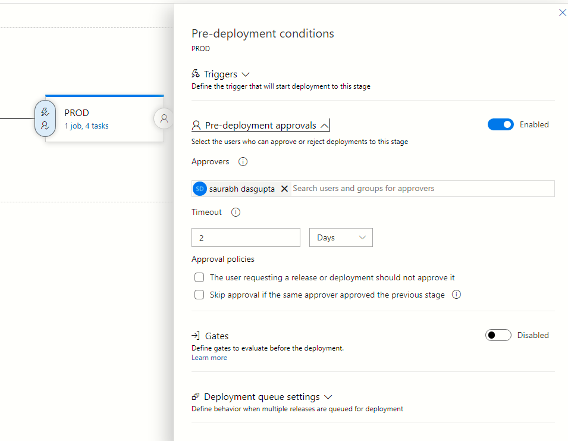
We specify the user or group of users who are authorized to run the PROD stage
We specify here that PROD stage requires a human operator to approve

Slide 11
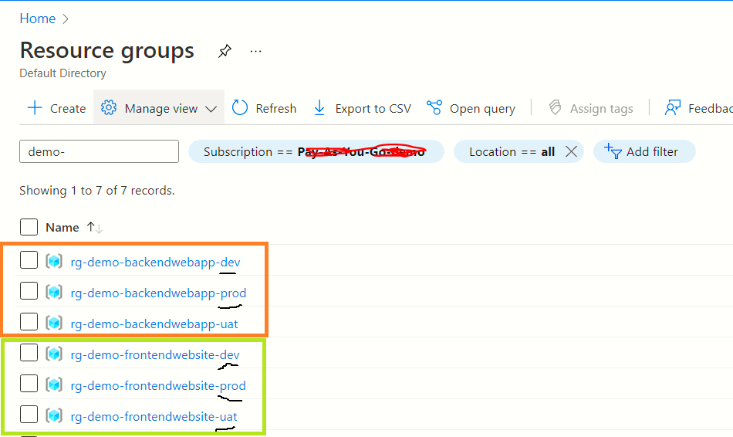
3 resource groups for FrontEnd deployments
3 resource groups for BackEnd deployments

Slide 12
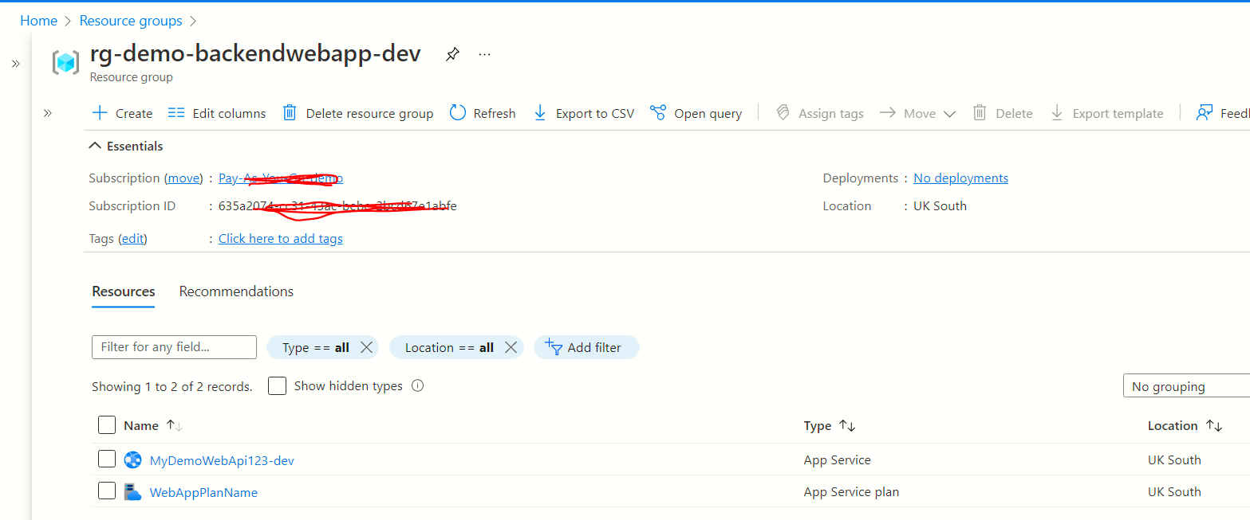
App service plan and the an App service which uses the plan

Slide 13
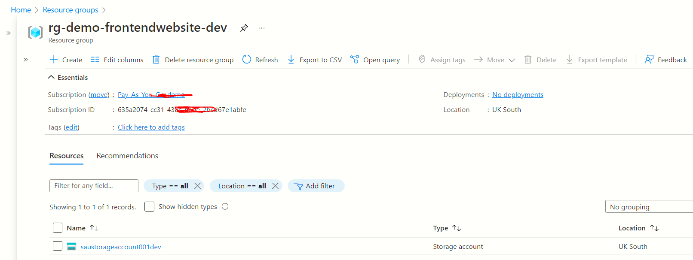
Storage account with Static site hosting enabled

Slide 14
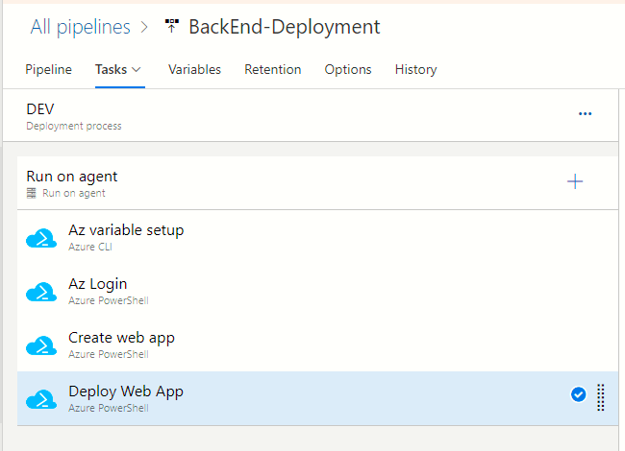
We are exporting the service principal id, principal key and tenant id as environment variables
We are doing an AZ LOGIN with the environment variables from the previous step. This allows using CLI and PowerShell from the same script in subsequent Azure PowerShell tasks
We are executing the PowerShell script BackEnd/infrastructure/createwebapp.ps1
We are executing the PowerShell script BackEnd/infrastructure/deploy.ps1

