Slide 1
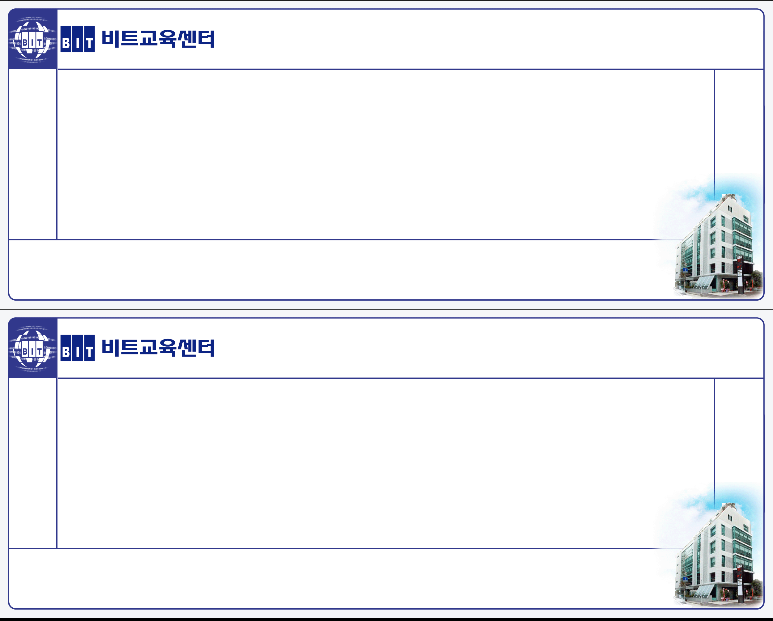
Client/Server 293기 – 1조
Routing
주제: Cross Layer-MAC based on IEEE 802.15.4
Client/Server 293기 – 1조
Routing
주제: Cross Layer-MAC based on IEEE 802.15.4

