Slide 1
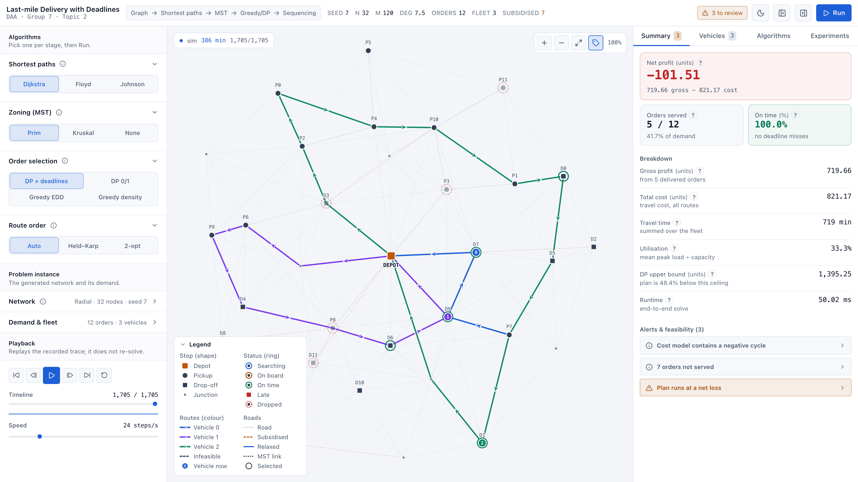
DAA · PROJECT-BASED LEARNING · CSE RHINOS · GROUP 7
Last-mile Delivery with Deadlines
Choosing the right algorithm at every stage of a delivery plan
Lakshay Sethia · 25WU0101167
Sidharth Sood · 25WU0101132
Ananey Sharma · 25WU0102017
The interactive dashboard: routes, algorithm choices and live results

Slide 2
The problem and our approach
Maximise profit while every order meets its deadline
Given
Decide
Hard because
A road network, a depot, a fleet with capacity, and orders with pickup, drop-off, profit and deadline.
Which orders to take, which vehicle carries each, and the stop order on every route.
Selection is knapsack-like and sequencing is a pickup-and-delivery TSP: both NP-hard.
Our answer: split it into stages and use the right algorithm for each
1
2
3
4
5
Shortest paths
›
MST zoning
›
Order selection
›
Route order
›
Simulate & repair
Dijkstra · Floyd · Johnson
Prim · Kruskal
DP · greedy
Held-Karp · 2-opt
drop until feasible
CSE Rhinos · Group 7 · Last-mile Delivery with Deadlines · DAA PBL
2

Slide 3
Algorithms we used
One table, every stage; the dashboard lets you swap them live
Stage | Algorithms | Complexity | Why this one
Shortest paths | Dijkstra · Floyd–Warshall · Johnson | O((V+E)log V) · O(V³) · O(VE+V²log V) | Best choice depends on graph density
Cost screen | Bellman-Ford | O(VE) | Detects negative cycles from subsidised roads
Zoning | Prim · Kruskal (MST, cut k−1 edges) | O(E log V) | One compact zone per vehicle
Selection | DP with deadlines · DP 0/1 · Greedy EDD · Greedy density · LP bound | knapsack DP over capacity × time | Deadline-aware DP respects deadlines up front
Sequencing | Held–Karp (≤12 stops) · insertion + 2-opt | O(2ⁿ·n²) · O(n²) per pass | Exact when small, fast heuristic when large
Repair | Drop worst order and re-solve | bounded loop | Guarantees a feasible final plan
CSE Rhinos · Group 7 · Last-mile Delivery with Deadlines · DAA PBL
3

Slide 4
Comparison: shortest paths and zoning
Measured on our benchmark runs (lower is better)
Dijkstra from stops is fastest. Johnson beats Floyd on sparse graphs and loses on dense ones, crossing near density 0.3.
MST zoning cuts fleet travel time by 16%. Prim and Kruskal give the same tree weight.
CSE Rhinos · Group 7 · Last-mile Delivery with Deadlines · DAA PBL
4

Slide 5
Comparison: order selection and scaling
Measured on our benchmark runs
Ignoring deadlines (DP 0/1) needs 4.2 repair drops on average against 2.3 for deadline-aware DP.
Solve time grows from 5 ms (20 nodes) to 191 ms (130 nodes), dominated by the metric closure.
CSE Rhinos · Group 7 · Last-mile Delivery with Deadlines · DAA PBL
5

Slide 6
What we built
A runnable solver and an interactive dashboard
Solver
Dashboard
Quality
Python + FastAPI. Pure-Python algorithms return the plan, metrics and a typed trace of every step.
React + Vite + Tailwind. Replays the trace so you can watch each algorithm work, in dark or light theme.
388 backend tests, 39 frontend tests, strict TypeScript build. Deployed on Vercel.
• Choose one algorithm per stage, set the instance, press Run: compare strategies side by side.
• Play, pause and scrub the trace: see the search frontier, MST links and routes appear in turn.
• Read the result: net profit, orders served, on-time %, per-vehicle routes, five live benchmark charts.
Live demo: frontend-rust-phi-66.vercel.app · Code: github.com/EXCALIBUR303/lastmile-daa
CSE Rhinos · Group 7 · Last-mile Delivery with Deadlines · DAA PBL
6

Slide 7
Conclusions
What we found
Limits
Next
No single algorithm wins everywhere. Density picks the shortest-path method, and deadline-aware selection beats deadline-blind selection.
A heuristic pipeline, not a proven optimum. The LP bound is loose (mean gap about 43–53%) and benchmarks use synthetic graphs with a few seeds.
Tighter bounds, real road data with time-dependent travel, and metaheuristics for larger zones.
Thank you. Questions?
Lakshay Sethia · Sidharth Sood · Ananey Sharma · CSE Rhinos, Group 7
CSE Rhinos · Group 7 · Last-mile Delivery with Deadlines · DAA PBL
7

