Slide 1
Last-mile Delivery with Deadlines
A two-layer heuristic pipeline: shortest paths, MST zoning, knapsack selection and exact route sequencing
Design and Analysis of Algorithms · Project-Based Learning
CSE Rhinos · Group 7 · Problem 2
Lakshay Sethia (25WU0101167) · Sidharth Sood (25WU0101132) · Ananey Sharma (25WU0102017)
Woxsen University

Slide 2
The problem
Plan vehicle routes that earn the most profit while every delivery meets its deadline
• Input: a road network, a depot, a fleet of vehicles and a list of orders (pickup, drop-off, profit, quantity, deadline).
• Decide: which orders to accept, which vehicle carries each, and the order of stops on every route.
• Objective: maximise profit gained minus travel cost.
• Constraints: vehicle capacity, delivery deadlines, a shift horizon, pickup before drop-off.
• Twist: some roads carry a negative cost in one direction (subsidies), so plain Dijkstra is not enough for cost.
Why it is hard
Selecting orders under capacity and deadlines is a knapsack-style problem; sequencing stops is a pickup-and-delivery TSP. Both are NP-hard, so one exact solve is out of reach.
Our answer
Break it into stages. Use exact algorithms where the sub-problem is small, heuristics where it is not, and a repair loop to guarantee a valid final plan.
What you can run
A FastAPI solver plus an interactive dashboard that replays every algorithm step by step and lets you compare strategies.
CSE Rhinos · Group 7 · Last-mile Delivery with Deadlines · DAA PBL
2

Slide 3
Solution overview: an 8-stage pipeline
Every stage is a swappable algorithm; the dashboard lets you pick one per stage
S1
Build & validate
S2
Metric closure
S3
Negative-cycle screen
S4
MST zoning
road graph, dual metric
Dijkstra / Floyd / Johnson
Bellman-Ford
Prim / Kruskal, cut k−1 edges
S5
Order selection
S6
Route sequencing
S7
Simulation & repair
S8
Benchmarks
DP / greedy / LP bound
Held-Karp / insertion + 2-opt
drop orders until feasible
5 experiments, CSV + charts
Layer 1 (S1–S4) prepares the geometry. Layer 2 (S5–S7) makes the decisions. S8 measures all of it.
CSE Rhinos · Group 7 · Last-mile Delivery with Deadlines · DAA PBL
3

Slide 4
Graph model and the dual metric
Time and cost are different weights on the same road
τ travel time (always ≥ 0)
• Three generators: radial rings, grid lattice, scale-free (preferential attachment).
• Seeded: the same seed and parameters always reproduce the same instance.
• Negative edges are deliberate: they make Bellman-Ford load-bearing rather than decorative.
• Validation: S1 rejects instances that cannot place every order on distinct nodes.
• Why two metrics: minimising time keeps routes fast; minimising cost alone could send vehicles on long detours.
Used for routing, deadlines and the simulation clock. Because it is never negative, Dijkstra is always valid for it.
cost (directional, may be < 0)
A subsidised road can pay the driver in one direction. Total cost and profit use it, so cost shortest paths may not exist if a negative cycle appears.
CSE Rhinos · Group 7 · Last-mile Delivery with Deadlines · DAA PBL
4

Slide 5
Shortest paths: four algorithms, each used where it wins
Algorithm | Complexity | Role in the pipeline
Dijkstra | O((V+E) log V) per source | Default. Runs only from stop nodes, so it is cheapest when stops ≪ nodes.
Floyd–Warshall | O(V³) | Full all-pairs matrix. Independent of edge count, so it wins on dense graphs.
Johnson | O(VE + V² log V) | Reweights with Bellman-Ford potentials, then Dijkstra from every node. Best on sparse graphs.
Bellman-Ford | O(VE) | Always runs once to screen the cost model for negative cycles.
Why not just one?
The right choice depends on graph density: the next slide shows the measured crossover. The dashboard lets you switch algorithms and watch the search frontier, relaxed edges and (for Floyd) the matrix fill in.
CSE Rhinos · Group 7 · Last-mile Delivery with Deadlines · DAA PBL
5

Slide 6
Measured: all-pairs runtime vs graph density
100-node graphs · mean runtime over seeds · lower is better
Dijkstra is fastest
Running only from stop nodes: 7.5–36 ms across all densities.
Crossover at ≈ 0.3
Johnson beats Floyd–Warshall on sparse graphs (20.7 vs 38.0 ms at 0.05) and loses on dense ones (74.7 vs 52.8 ms at 0.7).
Floyd stays flat
Its cost depends on V³, not on the number of edges.
CSE Rhinos · Group 7 · Last-mile Delivery with Deadlines · DAA PBL
6

Slide 7
MST zoning: one contiguous zone per vehicle
1
2
3
Build the MST
Cut k−1 edges
Assign & bound
Over the pickup stops, on the shortest-path metric. Prim grows from a node; Kruskal sorts edges and uses union-find.
Removing the k−1 heaviest tree edges splits the stops into k clusters (single-linkage clustering), one per vehicle.
Each vehicle serves its own zone. The tree weight also gives a lower bound on that zone’s route length.
• Prim and Kruskal produce the same tree weight: they differ only in build order, which the dashboard shows side by side in the trace.
• Baseline: “none” assigns orders round-robin and ignores geography, to show what zoning actually buys.
CSE Rhinos · Group 7 · Last-mile Delivery with Deadlines · DAA PBL
7

Slide 8
Measured: does MST zoning help?
Mean fleet travel time over 20 instances · lower is better
16% less driving
MST zoning cuts mean fleet travel time from 1041 to 873 minutes against round-robin.
Prim = Kruskal
Identical tree weight, as theory predicts. Pick either.
Honest limit
20 seeds; the gain varies per instance.
CSE Rhinos · Group 7 · Last-mile Delivery with Deadlines · DAA PBL
8

Slide 9
Order selection: knapsack with deadlines
Which orders does each vehicle commit to?
DP with deadlines (the main method)
Greedy EDD
Knapsack over capacity and a discretised time axis, so deadlines are respected during selection, not after. Exact on the discretised problem.
Earliest deadline first, checking capacity and deadline as the route is built.
Greedy density
Highest profit-per-minute first, each candidate checked for feasibility before it is accepted.
DP 0/1 (deliberate baseline)
Classic 0/1 knapsack on capacity only. It ignores deadlines on purpose, so the repair loop has to clean up after it.
LP upper bound
Fractional relaxation: no feasible plan can beat it. The gap shows how much of that ceiling a plan captures.
CSE Rhinos · Group 7 · Last-mile Delivery with Deadlines · DAA PBL
9

Slide 10
Measured: which selector needs the least repair?
Orders dropped by the repair loop, mean over seeds · lower is better
DP 0/1 needs most repair
4.2 drops on average vs 2.3 for DP with deadlines: ignoring deadlines costs real orders.
Why not on-time %?
Repair removes every miss, so on-time saturates at 100% for all.
Fastest: greedy
About 15–17 ms vs 23–25 ms for DP.
CSE Rhinos · Group 7 · Last-mile Delivery with Deadlines · DAA PBL
10

Slide 11
Route sequencing, simulation and repair
Held–Karp (exact)
Insertion + 2-opt
Simulation
Bitmask DP for pickup-and-delivery order, O(2ⁿ·n²). Used up to 12 stops; beyond that it falls back automatically.
Cheapest-insertion builds a route; precedence-preserving 2-opt swaps improve it. Scales to larger zones.
Replays each route with release times, service times and deadlines to find real arrival times and misses.
Bounded repair loop
• If the simulation finds a deadline miss, drop the worst offending order and re-solve that zone.
• Repeat until no deadline is missed or no orders remain, so the returned plan is always feasible.
• The dashboard marks dropped orders with a dashed red ring so you can see exactly what the repair removed.
CSE Rhinos · Group 7 · Last-mile Delivery with Deadlines · DAA PBL
11

Slide 12
Measured: scaling and capacity sensitivity
Solve time grows from 5 ms at 20 nodes to 191 ms at 130 nodes: roughly cubic, dominated by the metric closure.
More capacity buys more profit (524 → 962) with diminishing, noisy returns once capacity stops binding.
CSE Rhinos · Group 7 · Last-mile Delivery with Deadlines · DAA PBL
12

Slide 13
How the software is built
Backend: Python + FastAPI
Frontend: React + Vite
All algorithms live in a pure-Python core package. One /api/solve call returns the plan, metrics and a typed trace of every algorithm step; /api/bench runs the experiments.
TypeScript, Tailwind, Motion for animation, Zustand for state, Recharts for charts. Dark and light themes, keyboard accessible, responsive.
Trace-driven UI
Quality
The UI never re-runs algorithms. It folds the recorded trace up to a cursor, so play, pause, step and scrub are exact and cheap.
388 automated backend tests, 39 frontend tests, strict TypeScript build, accessibility and contrast checks; deployed on Vercel.
CSE Rhinos · Group 7 · Last-mile Delivery with Deadlines · DAA PBL
13

Slide 14
The dashboard: what you can do with it
• Choose algorithms: one per stage (shortest paths, zoning, selection, sequencing), then Run.
• Shape the instance: topology, nodes, density, subsidised edges, orders, vehicles, capacity, horizon.
• Watch it think: play the trace and see the search frontier, MST links and routes appear in turn.
• Read the answer: net profit, orders served, on-time %, utilisation, bound gap, alerts.
• Inspect: click any stop or road; step through them with the keyboard.
Result tabs
• Summary: headline numbers and alerts
• Vehicles: per-vehicle route, load and isolate-on-map
• Algorithms: trace log, Floyd matrix heat-map, DP table
• Experiments: five live benchmark charts with data tables
Live: frontend-rust-phi-66.vercel.app
Code: github.com/EXCALIBUR303/lastmile-daa
CSE Rhinos · Group 7 · Last-mile Delivery with Deadlines · DAA PBL
14

Slide 15
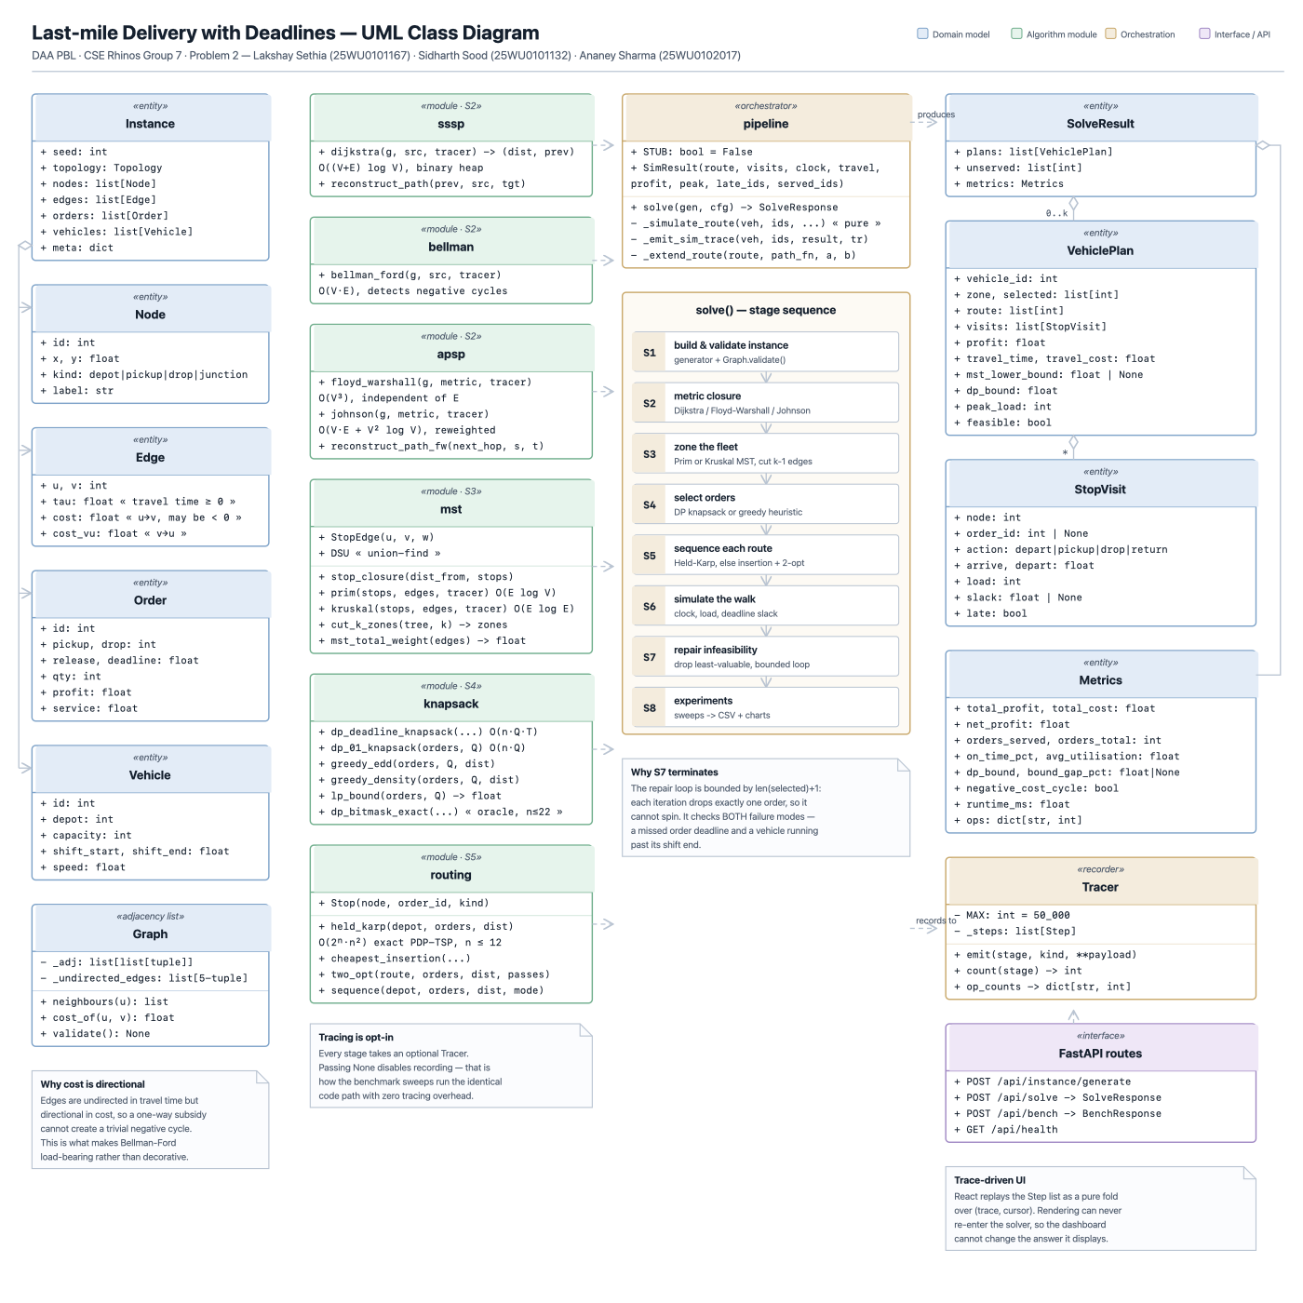
Class diagram
How to read it
Boxes are the backend classes grouped by pipeline stage; arrows show which stage feeds which. The full-size vector file is docs/uml-class-diagram.svg.
Design idea
Pure algorithm classes in the core package, a thin API layer on top, and a typed Step trace that the UI replays.
CSE Rhinos · Group 7 · Last-mile Delivery with Deadlines · DAA PBL
15

Slide 16
Results and conclusions
What we found
What it shows
Limits we state openly
Dijkstra from stops is fastest overall; Johnson wins sparse, Floyd dense. MST zoning cuts travel by 16%. Deadline-aware DP needs ~46% fewer repairs than deadline-blind DP.
No single algorithm wins everywhere. Matching the algorithm to the graph and constraint structure is the real lesson of the course.
Heuristic pipeline, not a proven optimum. The LP bound is loose (mean gap ≈ 43–53%). Benchmarks use synthetic graphs and a few seeds.
Future work
• Tighter upper bounds (column generation) to measure true optimality gaps.
• Real road data and time-dependent travel times.
• Larger zones with metaheuristics (LNS, genetic) on top of 2-opt.
CSE Rhinos · Group 7 · Last-mile Delivery with Deadlines · DAA PBL
16

Slide 17
Thank you
Questions?
Lakshay Sethia · Sidharth Sood · Ananey Sharma
CSE Rhinos · Group 7 · Woxsen University
Live demo: frontend-rust-phi-66.vercel.app

