Slide 1
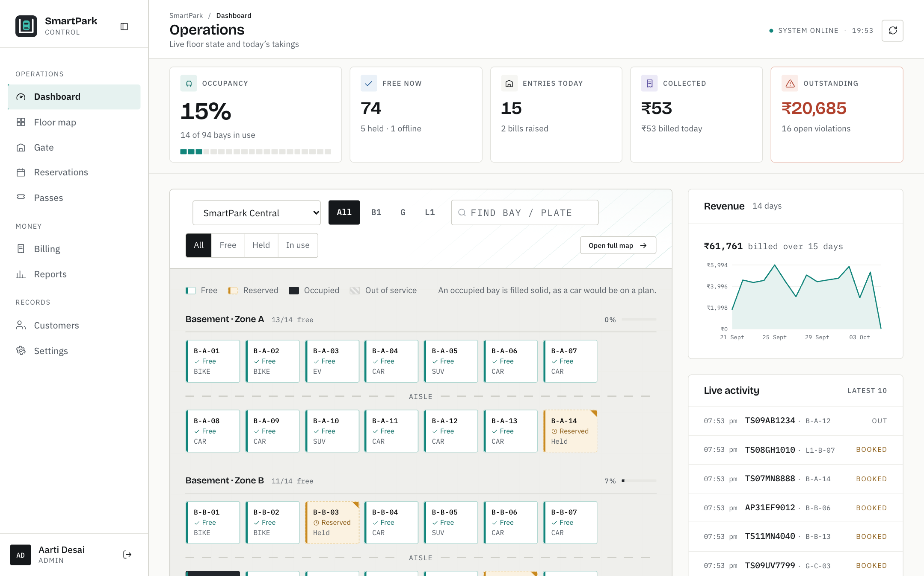
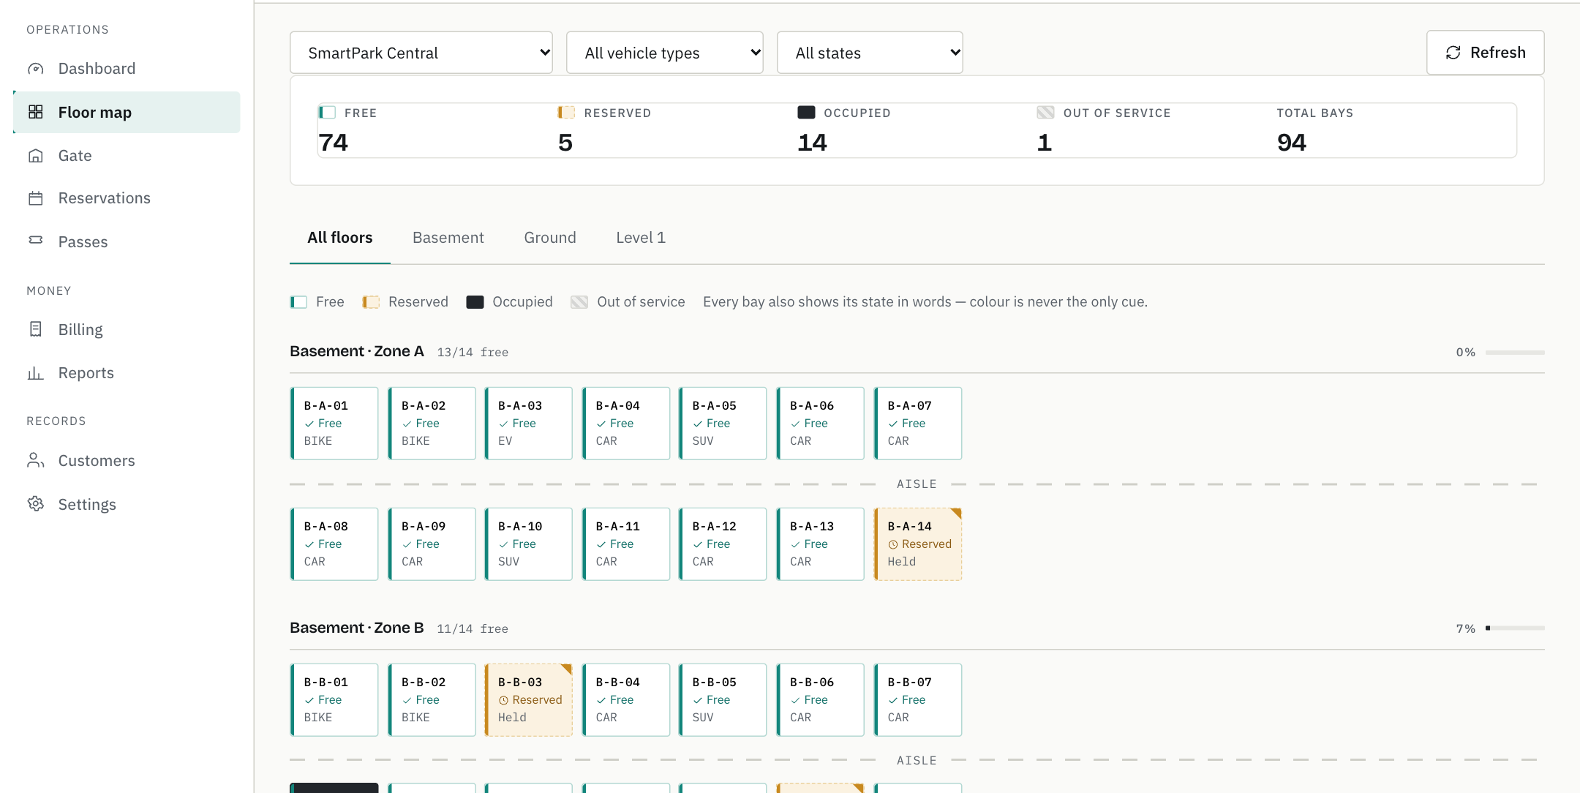
DBMS Final Presentation
Design and Implementation of a Database Management System for Smart Parking Lot Allocation and Billing System
Project 20, Group 12
Lakshay Sethia, Sidharth Sood, Shardul Yadav, Naman Singla
Repository commit: 16c5f23
DBMS final presentation, verified against the current GitHub repository
Notes:
Sources: faculty PDF requires the order and 10-minute timing. Project report cover gives Project 20, Group 12 and member names. Current GitHub checkout at commit 16c5f23 is the implementation source.

Slide 2
Problem Description
Multi-level parking needs one trusted record of bays, vehicles, reservations, entries, exits and payments. Manual ticketing fails when slot availability changes faster than staff can coordinate.
Failures to remove
Core objective
Users and scope
Slot conflicts
Two attendants can assign the same bay
Revenue leakage
Charges can vary by person and unpaid exits may be missed
Make invalid parking states hard to store by using keys, constraints, triggers, transactions and role-based access in the database.
Administrators
Gate operators
Customers
No mobile app, no hardware sensor integration, no payment gateway build-out
Notes:
Sources: SmartPark report sections 1 and 2, README problem section. Scope excludes mobile applications and hardware integration per report scope table.

Slide 3
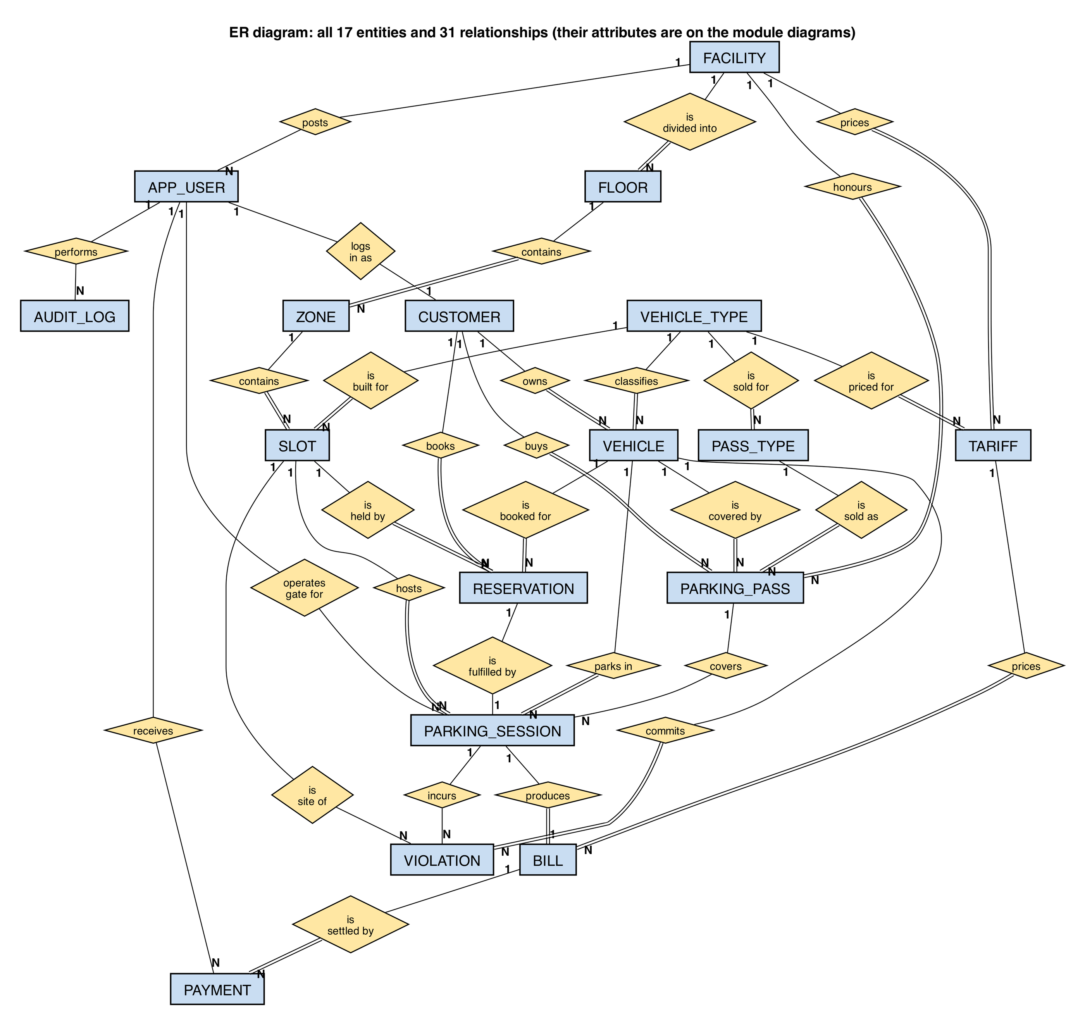
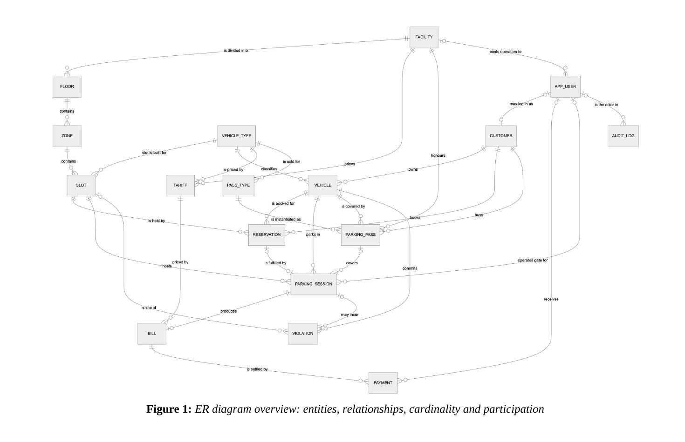
ER Diagram and Relationships
Entities
17 tables model the domain:
facility, floor, zone, slot, vehicle type, customer, vehicle, reservation, parking session, pass, tariff, bill, payment, violation, app user, pass type, audit log.
Cardinality to defend
Facility to floor: 1 to many
Vehicle to session: 1 to many over time, 1 active at a time
Slot to reservation: 1 to many, non-overlapping while live
Session to bill: 1 to 0 or 1
Notes:
Sources: report pages 8 to 12 and repository docs/database/ER_DIAGRAM.md. Use this slide to explain entities, cardinality and participation, not every attribute.

Slide 4
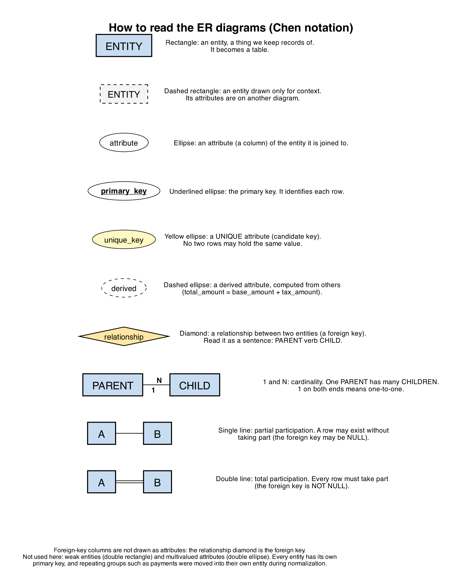
ER Notation Key (Chen)
How to read every ER diagram
Rectangle: an entity (a table). Dashed rectangle: context entity shown for reference.
Diamond: a relationship, labelled with a verb; 1 / N on each line is the cardinality.
Single line: partial participation (nullable foreign key). Double line: total participation (NOT NULL foreign key).
Underlined ellipse: primary key. Yellow ellipse: UNIQUE. Dashed ellipse: derived attribute.
Foreign-key columns are not drawn as attributes; they are the relationship lines.
All cardinalities and participation are read from the live database constraints, so the diagram cannot drift from the schema.

Slide 5
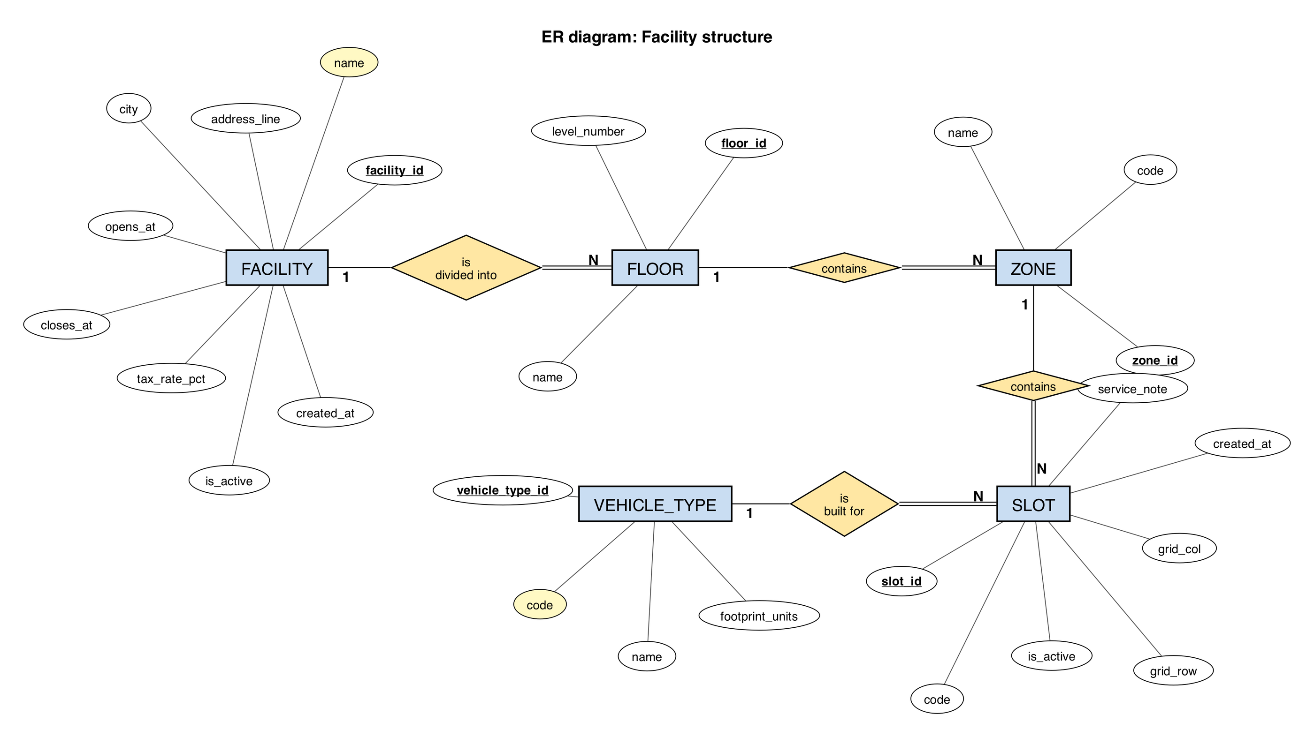
ER Detail: Facility structure
Facility to floor to zone to slot; slot is built for one vehicle type.

Slide 6
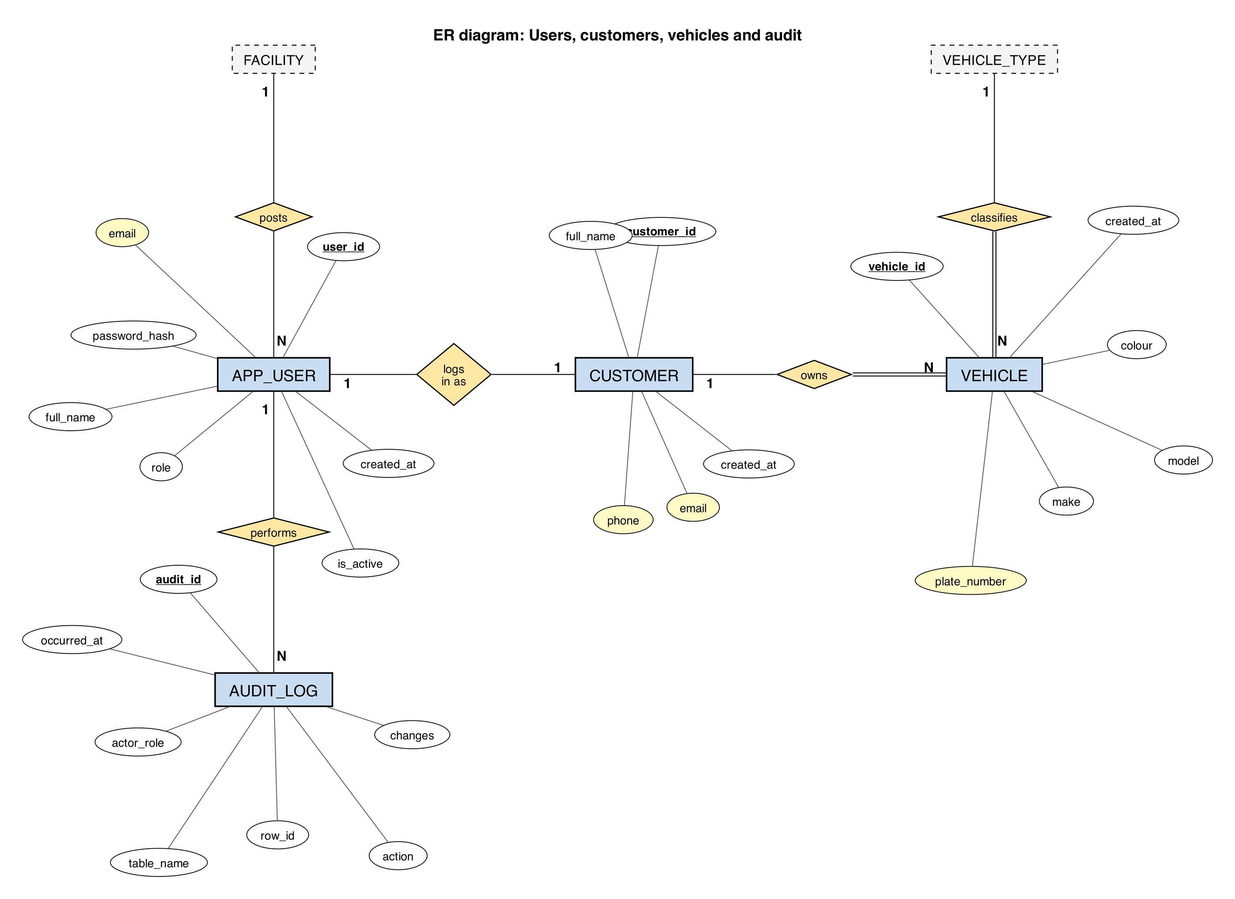
ER Detail: Users, customers, vehicles and audit
Login identity is separate from the customer record; audit log records changes.

Slide 7
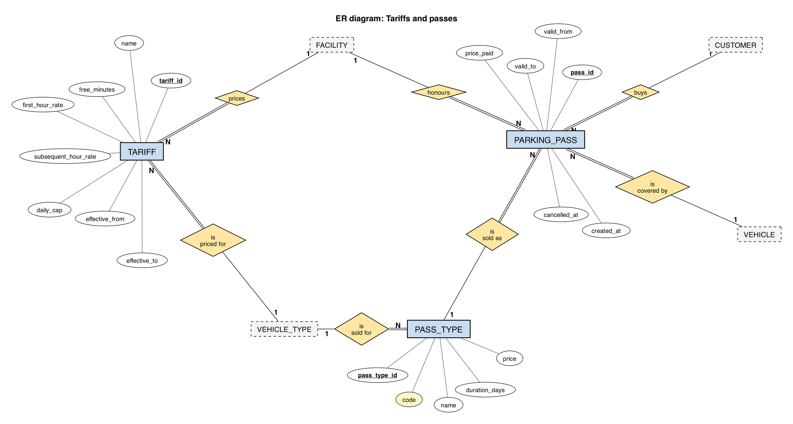
ER Detail: Tariffs and passes
Tariffs are priced per vehicle type; passes bind a customer, vehicle and pass type.

Slide 8
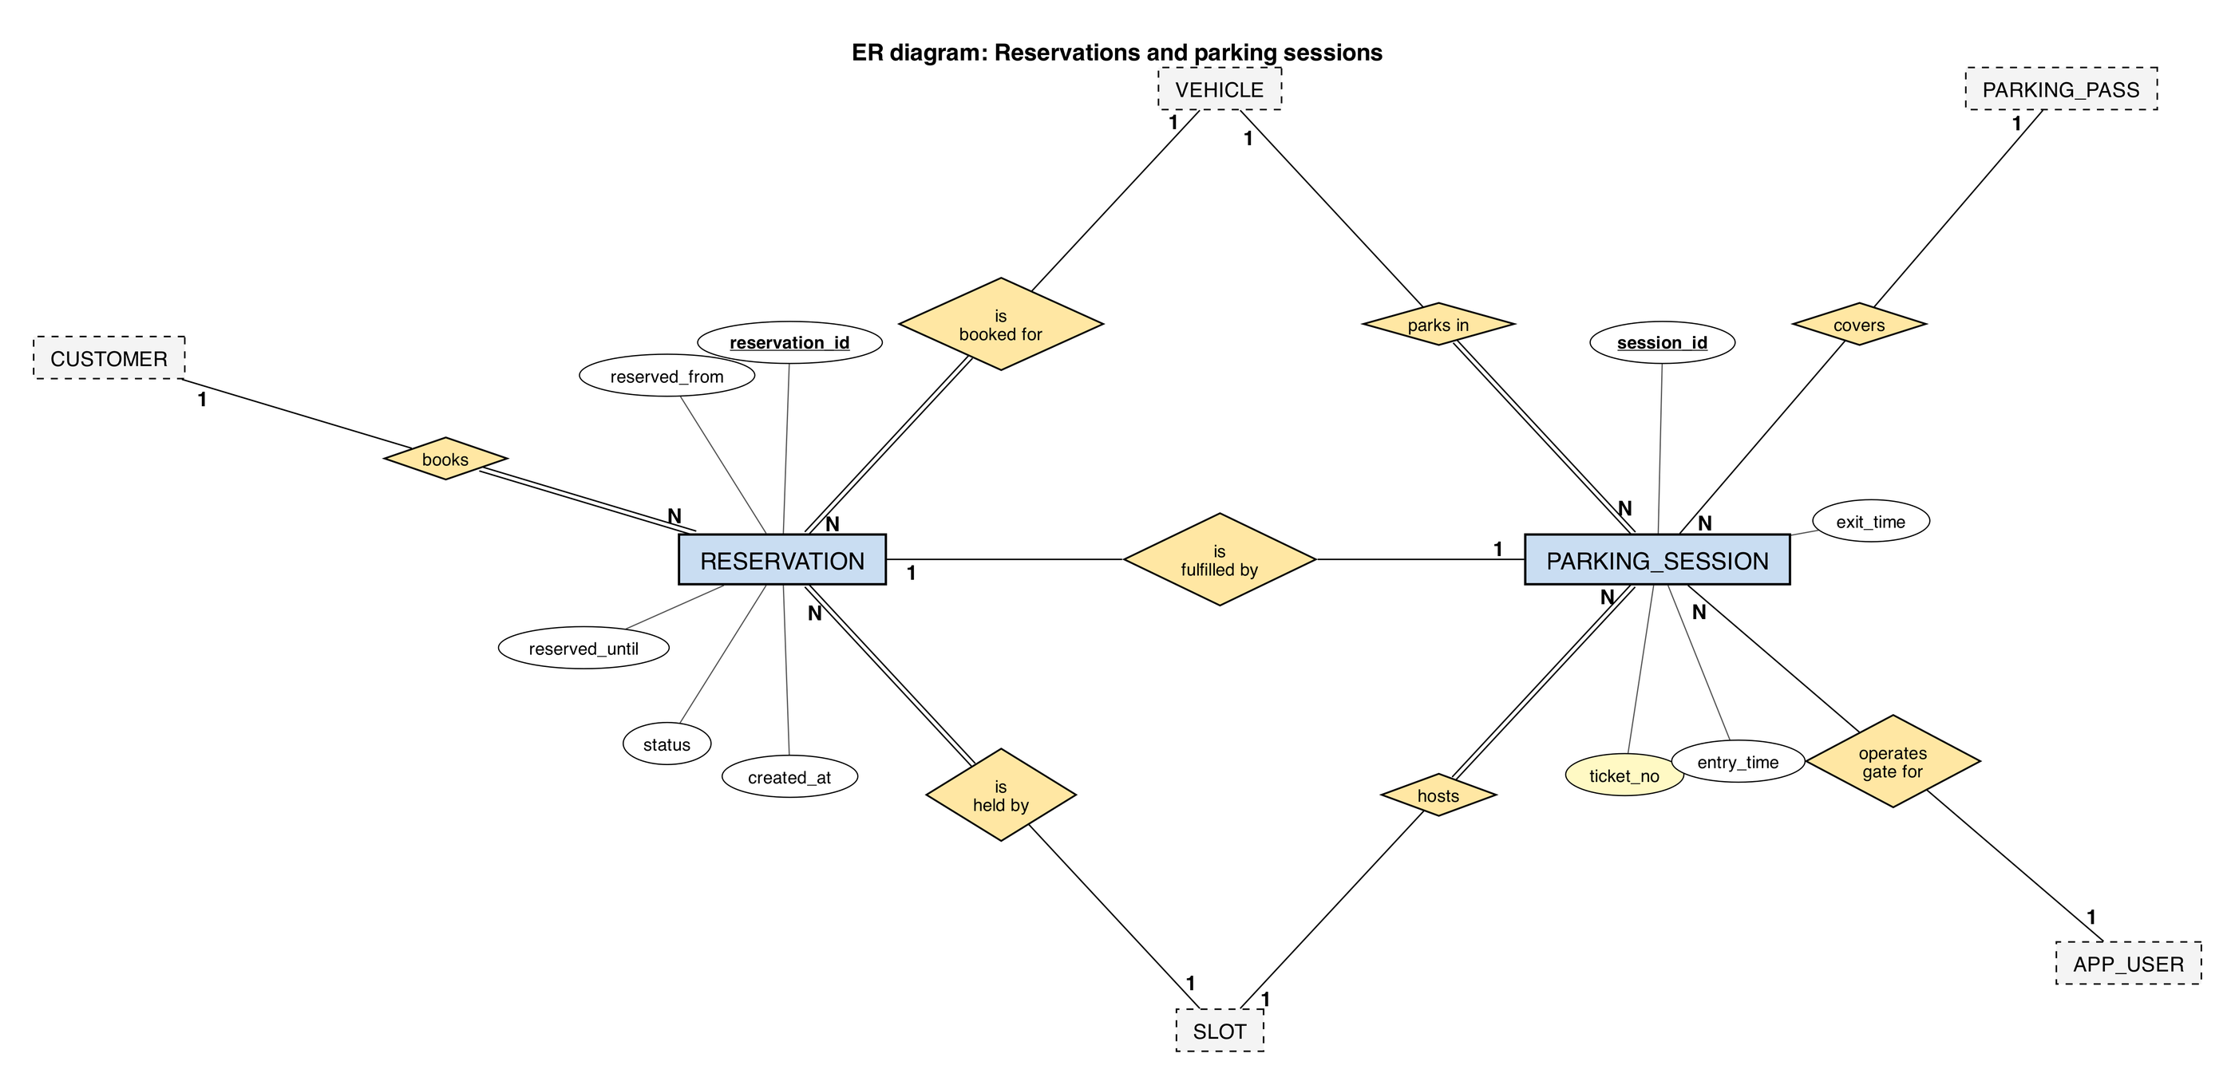
ER Detail: Reservations and parking sessions
Non-overlapping reservations per slot; one active session per slot and vehicle.

Slide 9
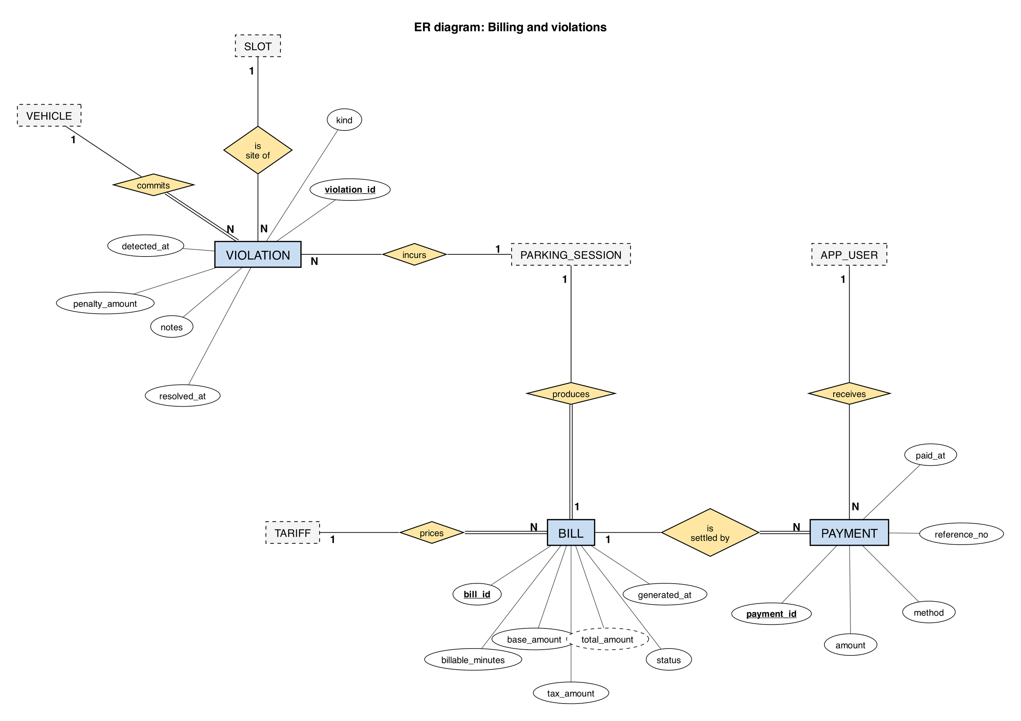
ER Detail: Billing and violations
One bill per session, priced by a tariff; payments settle bills.

Slide 10
Relational Schema and 3NF
Schema group | Main tables | Design point
Physical structure | facility, floor, zone, slot | Each bay resolves to one facility through containment
People and vehicles | app_user, customer, vehicle, vehicle_type | Login identity stays separate from customer record
Operations | reservation, parking_session, parking_pass | Open state derives from time fields and exits
Money | tariff, bill, payment, pass_type | Bills keep the tariff that priced the stay
Control | violation, audit_log | Violations and changes remain queryable
Normalization evidence
1NF
Payments and tariff versions move out of the flat ticket record
2NF
Facility, floor, zone and slot split the composite bay key
3NF
Customer, vehicle type and derived status facts are separated
Deliberate absence: no slot.status column. Slot state is derived from open sessions and live reservations, so the database cannot disagree with itself.
Notes:
Sources: report section 5, docs/database/NORMALIZATION.md, docs/database/DATA_DICTIONARY.md. This slide answers relational schema and normalization up to 3NF.

Slide 11
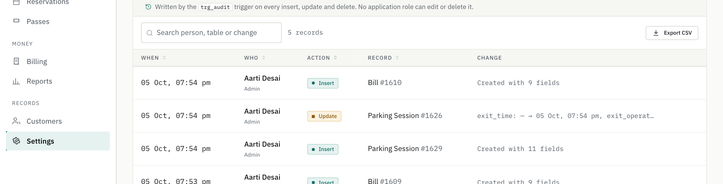
Database Design and Constraints
Verified item | Fresh checkout result
Base tables | 17
Report views | 8
User-defined functions | 16
Triggers | 14
Foreign keys | 36
Indexes | 59
Rules enforced in the database
One active session per slot and per vehicle: partial unique indexes
Slot type must match vehicle type: composite foreign keys
No overlapping reservations, passes or tariffs: GiST exclusion constraints
Exit follows entry: CHECK constraint
Charges come from tariff function, then a trigger overwrites client amounts
Payments cannot exceed bill balance
The professor asks for database and table creation with keys, foreign keys and constraints. This project uses PostgreSQL 17, so the live commands are PostgreSQL SQL rather than MySQL-only syntax.
Notes:
Sources: fresh local setup against smartpark_deck_20261005, repo migrations, docs/REVIEW_MAPPING.md and docs/TESTING.md. PostgreSQL note is included because the faculty PDF mentions MySQL but the final implementation truth is PostgreSQL 17.

Slide 12
Database and Query Evidence
DDL and DML files
Best live SQL to demonstrate
db/migrations/001 to 019
schema, constraints, functions, views, RLS and seed data
docs/database/queries.sql
18 runnable query examples covering joins, aggregate functions, subqueries, views, windows and JSONB
1. Show migrations for CREATE TABLE and constraints
2. Run docs/database/queries.sql for joins and aggregates
3. Run constraint test 8 to prove client-entered billing amount gets corrected
4. Run one report view, such as v_revenue_daily or v_free_slots
Constraint test 8 result
Fresh query output
client claimed: base 1.00, tax 0.00, total 1.00
database stored: base 80.00, tax 14.40, total 94.40
SmartPark Central, Hatchback / Sedan, 52 bays, 1 out of service
SmartPark Riverside, Hatchback / Sedan, 22 bays, 0 out of service
End-to-end run found 41 free car bays before demo inserts
Notes:
Sources: docs/database/queries.sql, db/migrations, fresh bay inventory query, fresh e2e_smoke output, docs/TESTING.md test 8. Do not claim MySQL execution, since the current project uses PostgreSQL.

Slide 13
Transactions and Security
Gate entry as one transaction
Role-level isolation
fn_gate_entry resolves vehicle, honours a live reservation if present, locks a candidate slot, attaches a valid pass, inserts the session and marks the reservation fulfilled.
FastAPI sets the caller identity inside each transaction:
SET LOCAL app.current_user_id
SET LOCAL ROLE parking_operator or parking_customer
Locking detail
Fresh checks
SELECT ... FOR UPDATE SKIP LOCKED
RLS tests completed
Customer sees 3 vehicles while admin sees 47
Operator cannot change tariffs
Only admins can read audit_log
This prevents two operators from receiving the same free bay during concurrent arrivals.
Notes:
Sources: db/migrations/006_gate_transactions.sql, api/db.py, db/tests/rls_tests.sql, fresh e2e_smoke run. Avoid overclaiming hardware or sensor behavior.

Slide 14
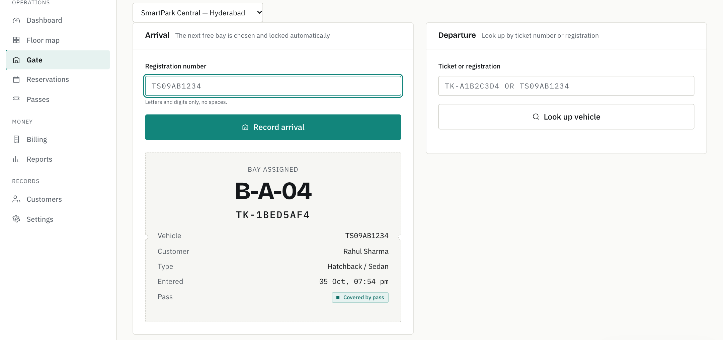
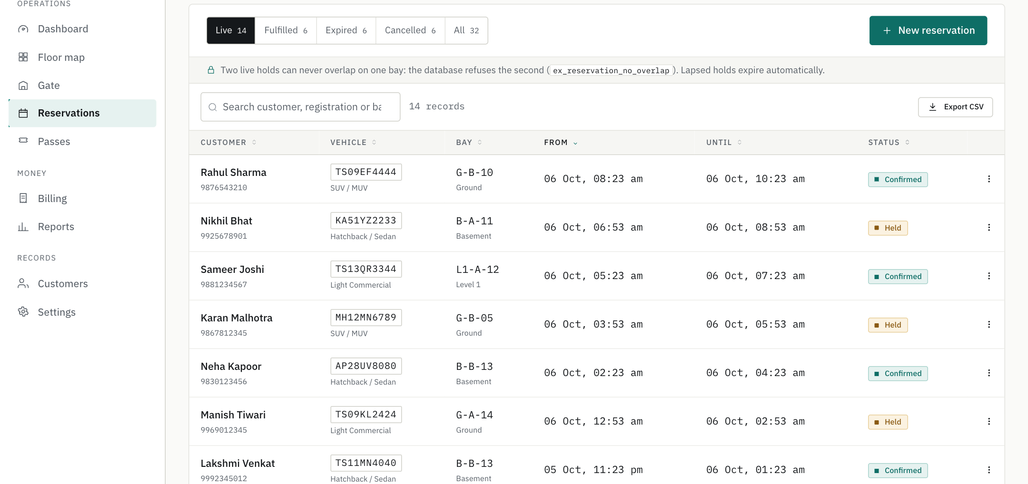
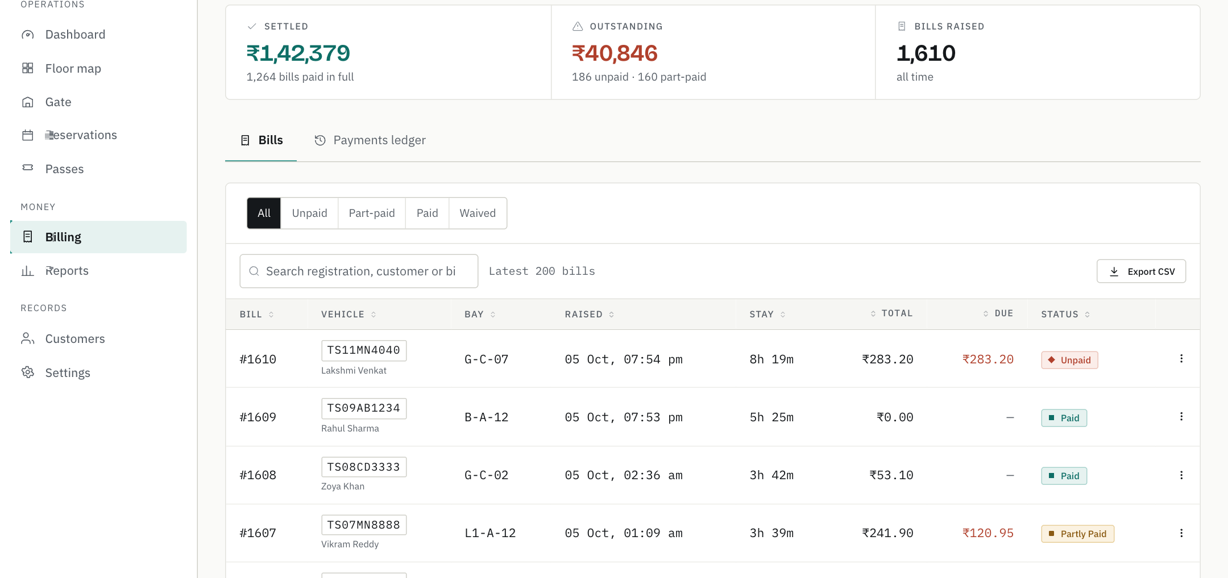
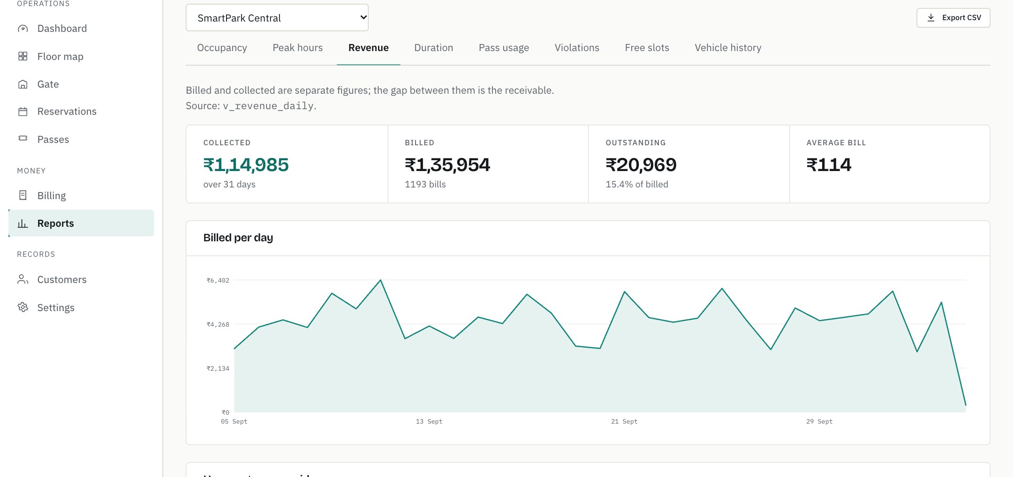
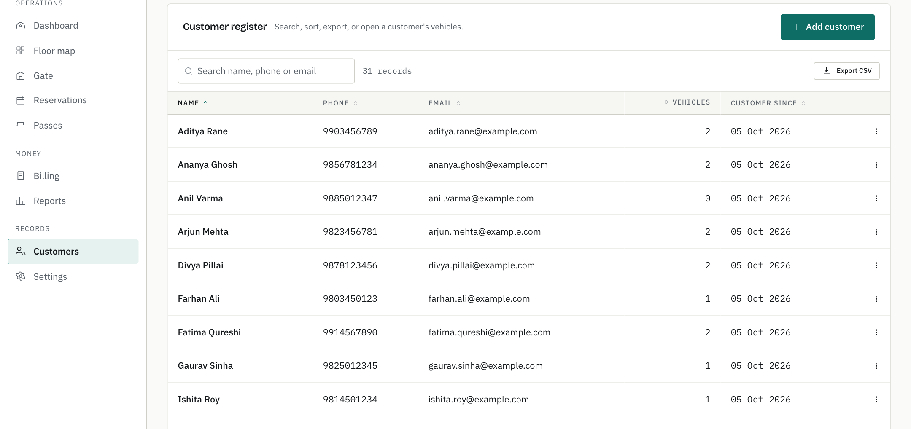
User Interface Demo
Dashboard
Gate entry
Reservations
Billing
Revenue report
Customers
Notes:
Sources: repository docs/screens. The fresh e2e_smoke run covered sign in, free-slot search, customer and vehicle insert, validation, reservation, gate entry and exit, payment and seven reports.

Slide 15
Verification Results
Check | Fresh result from this checkout
Database setup | PostgreSQL 17.11, 19 migrations, 134 bays, 1,541 sessions, 1,521 bills
Constraint tests | Completed, deliberate violations refused or corrected by database
Lifecycle tests | 5 lifecycle groups passed, rolled back after execution
RLS tests | Completed, audit trail restricted, facility and customer scoping held
Import check | 14 local modules, 24 files scanned, every named import resolves
End-to-end smoke | All checks passed, sign-in to reports through real API
API pytest | Not run here, pytest is not installed by the standard setup venv
Notes:
Sources: local command outputs in work/*.out, setup output, schema_counts.tsv, user_functions.out. Mention the pytest limitation if asked rather than hiding it.

Slide 16
Questions
Likely viva questions
One-line answers to keep ready
Why PostgreSQL instead of MySQL?
Which constraints stop double booking?
How does 3NF apply to the schema?
Why is slot status derived?
How does row-level security affect customers and operators?
How do we know billing cannot be typed manually?
The database owns correctness.
The UI calls functions and views, but keys, constraints, row locks, triggers and RLS keep the data valid even if a client makes a bad request.
The live demo should prove insert, view and database reflection, then stop.
Notes:
Sources: faculty PDF questions section, repo DEMO_GUIDE.md and verified implementation. This final slide is for Q&A, not another feature list.

