Slide 1

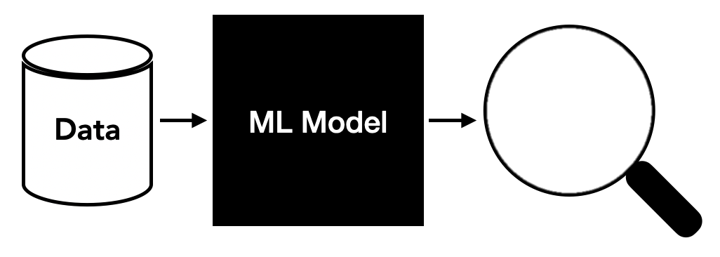
> Objectives of The Project
Part 1: Create a deep learning algorithm using neural networks to classify sensor images into quality groups, like copper-bad or tin-good.
Part 2:
Use XGBoost and Random Forest models for image classification.
Use PCA and SMOTE to check how they improve the model and avoid overfitting.
Part 3:
Separate mixed sounds using Independent Component Analysis (ICA).
Study how well this method works for separating audio signals.
Overall Goal: Show how machine learning and deep learning can help in checking the quality of sensors and how they can be useful in real-life tasks.
CLASSIFY

Slide 2
> Introduction to Convolutional Neural Networks (CNN)
What is a CNN?
CNNs process grid-structured data, like images, making them ideal for tasks in computer vision.
Dataset preparation:
Images resized to 128x128 pixels.
Encoded labels help models classify accurately.
Importance of CNNs:
Hierarchical feature extraction enables image classification, object detection, and more.
Resembles human visual systems for better visual data learning.

Slide 3
> Model Training and Architecture
Training Process:
70% data for training, 30% for testing.
Data augmentation (rotations, flips) improves robustness.
Class weights address under-represented classes.
Constructing the CNN:
Convolutional Layers: Extract features like edges.
Pooling Layers: Reduce feature map size to prevent overfitting.
Flatten Layers: Convert 2D maps into 1D vectors.
Dense Layers: Introduce non-linearity to learn complex patterns.
epochs=18, batch_size=32

Slide 4
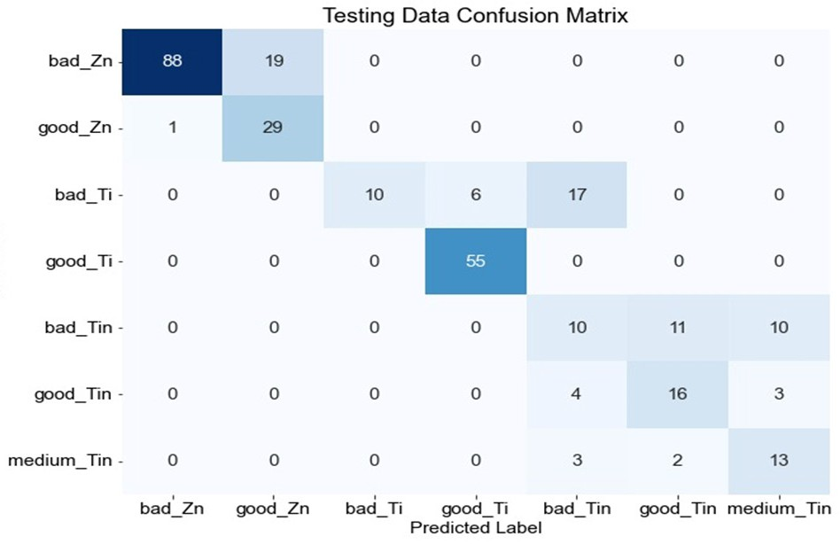
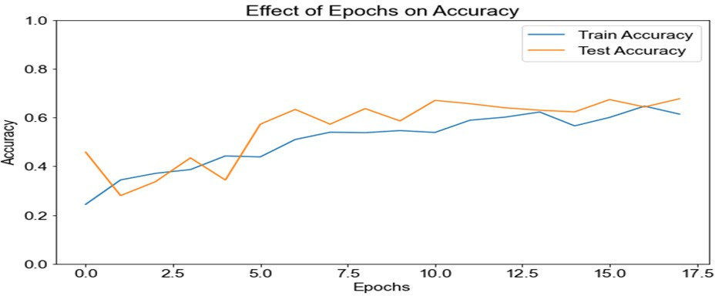
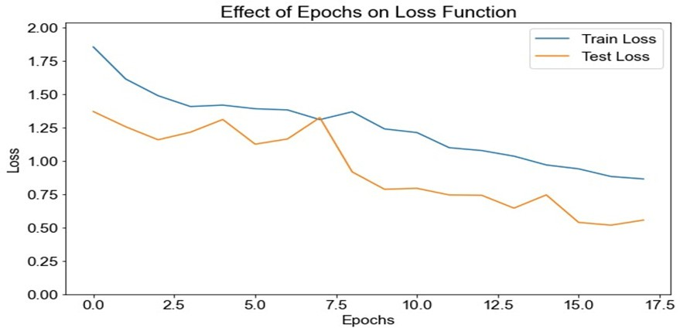
> Model Evaluation and Performance Metrics
Evaluation Metrics:
Accuracy: Proportion of correct predictions.
Training Data: 76%
Testing Data: 74%
F1 Score: Balances precision and recall.
Training Data: 75%
Testing Data: 74%
Recall: Measures how well relevant data is identified.
Performance Visualization:
Confusion Matrix: Shows classification performance for
each class.
Accuracy vs. Epochs: Tracks accuracy trends during training.
Loss Function Analysis: Tracks learning efficiency over epochs.

Slide 5
> Introduction to Image Classification
Overview:
Fundamental computer vision task with applications in medical imaging and industrial automation.
Project Goals:
Classify seven image types: bad_Zn, good_Zn, bad_Ti, good_Ti, bad_Tin, good_Tin, medium_Tin.
Build a pipeline for image preprocessing, feature extraction, dimensionality reduction, and classification using Random Forest and XGBoost.

Slide 6
> Feature Extraction and Dimensionality Reduction
Feature Extraction:
Images converted to grayscale and resized.
Extracted statistical measures like mean, standard deviation.
Used Sobel gradients and Canny edge detection for edge features.
Data Preparation:
Normalized features stored in a DataFrame.
SMOTE addressed class imbalance.
Results:
Balanced dataset improved learning.
Visual validation confirmed feature uniqueness.

Slide 7
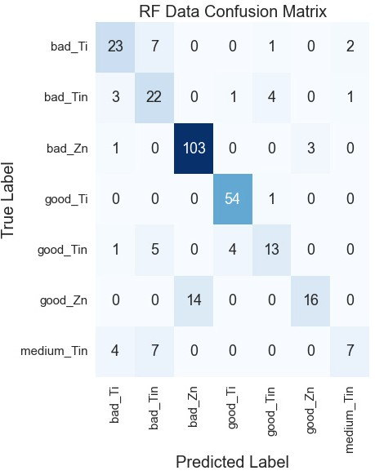
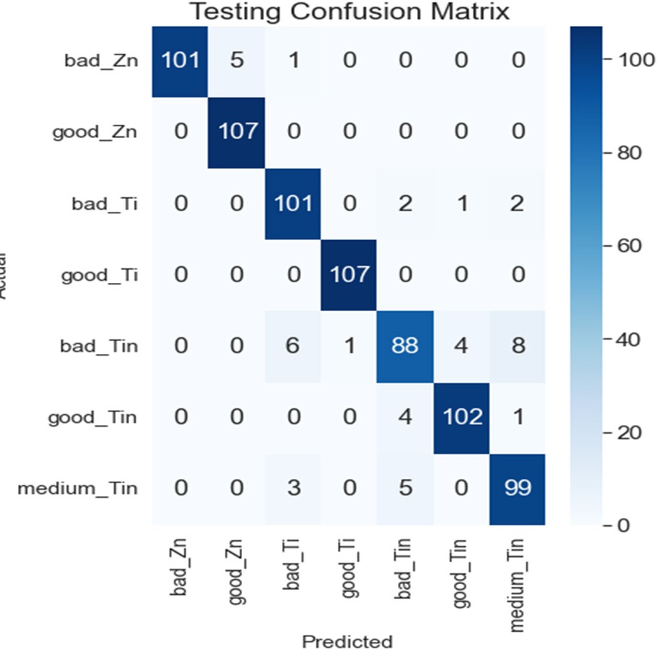
> Model Development and Evaluation
Baseline Random Forest Model:
80% training, 20% testing.
Performance: Accuracy: 78.37%, Precision: 76.95%, Recall: 78.37%, F1 Score: 76.93%.
Confusion matrix revealed misclassifications in similar classes.
Hyperparameter Tuning:
Optimized n_estimators, max_depth, and min_samples_split using GridSearchCV.
Performance for Test Data:
Accuracy:80.13%, Precision : 75.38%, Recall: 69.12%,
F1 Score: 70.82%.
Decreased majority class misclassification.
Advanced Model (XGBoost):
Train Accuracy: 100%, Test Accuracy: 94%, F1 Score: 94%.
Confusion matrix showed fewer misclassifications.
Random Forest Confusion Matrix After Hyperparameter Tuning:
XGBOOST Confusion Matrix After Hyperoarameter Tuning:

Slide 8
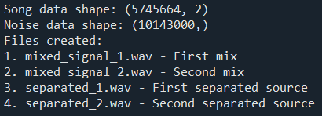
> Introduction to Independent Component Analysis (ICA)
Understanding the Challenge:
Separating overlapping sounds in noisy environments.
What is ICA?
A method for separating mixed signals into independent sources.
Project Overview:
Mixed music and noise to apply ICA.
Benchmarking ICA's effectiveness in real-world audio scenarios.
Applying Data:
“Song data shape: (5745664, 2)” This expression represents the size of the data in the song variable. (5745664, 2) means that the audio file consists of 5,745,664 samples (sampling points) and is a stereo audio file (2 channels: left and right). “Noise data shape: (10143000,)” This expression represents the size of the data in the noise variable. “(10143000,)” means that the audio file consists of 10,143,000 samples and is a mono audio file (single channel). Even though the music signal still had a little bit of noise, it worked effectively.

Slide 9
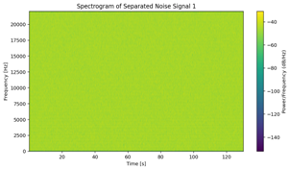
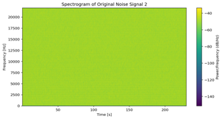
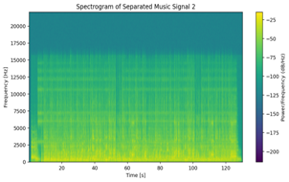
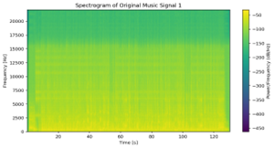
> Methods and Results of ICA Application
Methods:
Prepared stereo music and mono noise signals of equal length.
Mixed signals using a mixing matrix.
Used FastICA to separate the signals.
Results:
Separated signals closely resembled original sources.
Music and noise were clearly distinguished.
Challenges: Minor residual noise in the music signal.
We also checked the frequency of the separated signals using spectrograms, and they matched the original sounds. However, the music signal still had a little bit of noise. Overall, ICA worked well and successfully separated the signals

Slide 10
> Conclusion
This project used CNN, XGBoost, and ICA to solve problems in quality control and sound separation. It achieved 94% accuracy and separated signals well. It shows how machine learning can help in real life.
To sum Up!

Slide 11
> Thank You

