Slide 1


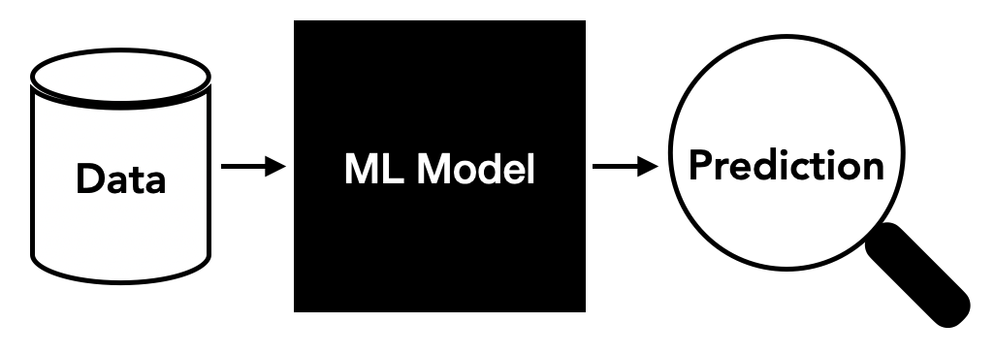
> Purpose of The Project
This study looks at how factors like temperature, wind speed, and solar noon distance affect solar energy production in Berkeley, California.
The main goals are:
Analyze the relationship between environmental factors (temperature, wind speed,
solar noon distance) and solar energy production.
Perform exploratory data analysis to uncover trends and patterns in power generation.
Handle missing data and preprocess the dataset to ensure accuracy and consistency.
Build and optimize machine learning models for predicting solar energy output.
Evaluate model performance using metrics such as Mean Squared Error (MSE)
and R-squared (R²).

Slide 2
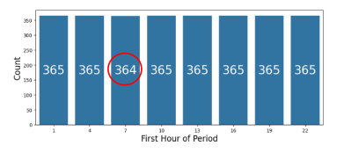
> Exploratory Data Analysis(EDA)
Objective of EDA:
Understand data distribution and identify potential data issues.
Handle missing values and prepare data for model training.
Understand the factors that effect power generation of solar panels.
Feature Analysis and Handling Missing Data:
Firstly, the dataset was analysed to ensure that all features were represented by appropriate data types.
A missing value inspection revealed one missing data in the "Average Wind Speed (Period)" column. This single missing value accounted for 0.03% of the dataset, a seemingly unnecessary proportion. However, removing the observation would disrupt the dataset's structure so that the missing value was imputed using the column's mean value rather than deleting the observation.
Column | Data Type | Missing Values
Day of Year | int64 | 0
Year | category | 0
Month | int64 | 0
Day | int64 | 0
First Hour of Period | category | 0
Is Daylight | category | 0
Distance to Solar Noon | float64 | 0
Average Temperature (Day) | int64 | 0
Average Wind Direction (Day) | int64 | 0
Average Wind Speed (Day) | float64 | 0
Sky Cover | category | 0
Visibility | float64 | 0
Relative Humidity | int64 | 0
Average Wind Speed (Period) | Float64 | 1
Average Barometric Pressure (Period) | float64 | 0
Power Generated | int64 | 0

Slide 3
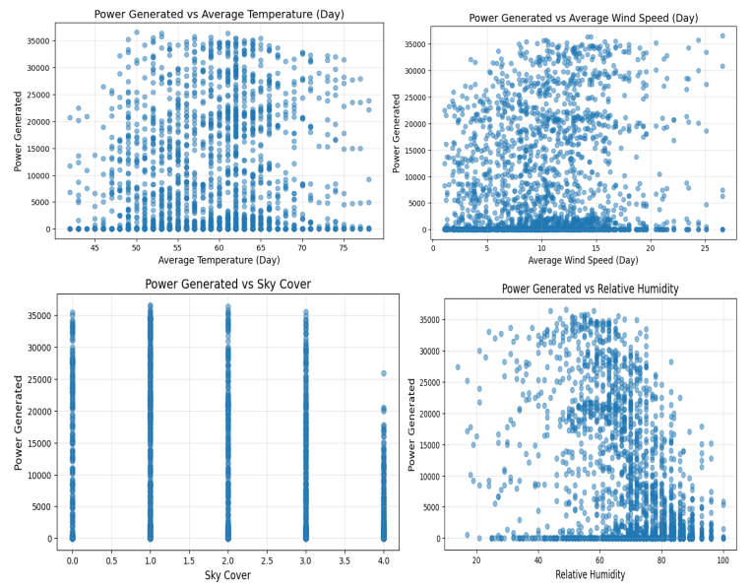
> Exploratory Data Analysis(EDA)
Enviromental Factors
The scatter plots reveal the relationships between environmental factors and power generation. Power output is highest at moderate temperatures (55–65°C), while extremely high or low temperatures are less available. Wind speed shows minimal impact, with most data clustering below 15 m/s. Power generation decreases as sky cover increases, confirming the negative effect of clouds. Moderate humidity (50–70%) aligns with higher outputs, while high humidity reduces energy production.

Slide 4
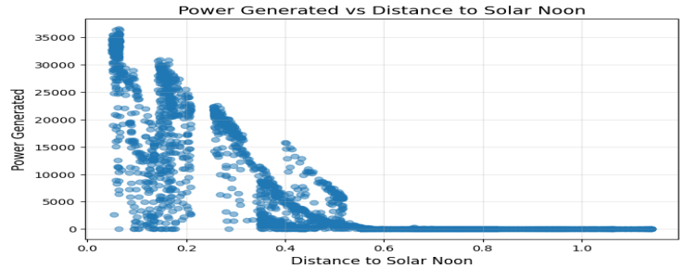
> Exploratory Data Analysis(EDA)
Enviromental Factors
A strong negative relationship is seen with distance to solar noon, where power peaks near noon and declines as the distance increases. These insights highlight key factors affecting solar energy efficiency.

Slide 5
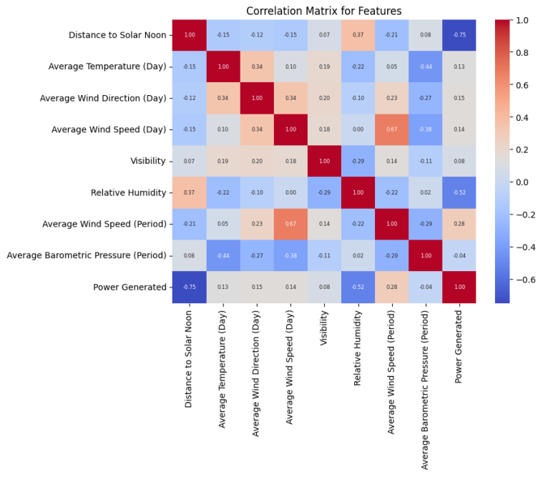
> Exploratory Data Analysis(EDA)
The correlation matrix provides insights into the relationships between numerical features and power generation.
A strong negative correlation (-0.75) exists between Distance to Solar Noon and Power Generated, confirming that energy production is highest near solar noon. Average Temperature (Day) has a weak positive correlation (0.13) with power generation, suggesting a minor influence. Relative Humidity shows a moderate negative correlation (-0.52), indicating its negative impact on energy output. Other variables, such as wind speed and barometric pressure, show minimal correlation with power generation. These findings highlight key predictors for solar energy production and guide feature selection for modeling.

Slide 6
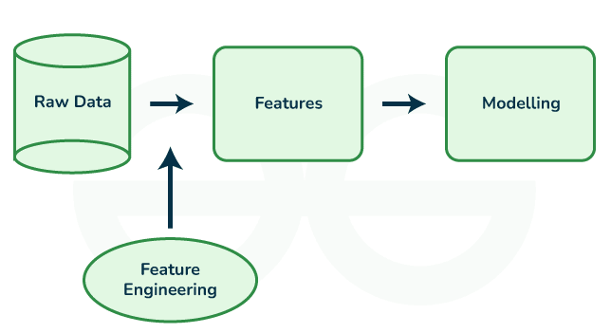
> Data Preprocessing and Feature Engineering
def get_season(month):
if month in [12, 1, 2]:
return 'Winter'
elif month in [3, 4, 5]:
return 'Spring'
elif month in [6, 7, 8]:
return 'Summer'
else:
return 'Autumn'
#-----------------------------------------------------
def time_of_day(hour):
if hour < 6:
return 'Night'
elif hour < 12:
return 'Morning'
elif hour < 18:
return 'Afternoon'
else:
return 'Evening'
#-------------------------------------------------------
def solar_proximity(distance):
if distance < 0.2:
return 'Near Noon'
elif distance < 0.5:
return 'Midday'
else:
return 'Far from Noon'
df['season'] = df['month'].apply(get_season)
df['time of day'] = df['first hour of period'].apply(time_of_day)
df['solar proximity'] = df['distance to solar noon'].apply(solar_proximity)
1. Three different functions created to feature engineering, such as create season, time of day and solar proximity

Slide 7
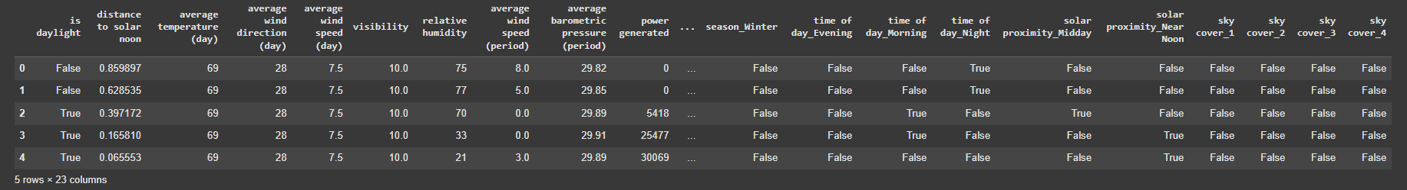
> Feature Engineering and Feature Engineering
2. One-hot encoding applied for these new features.
df = pd.get_dummies(df, columns=['season', 'time of day', 'solar proximity','sky
cover'], drop_first=True)
3. Drops unnecessary columns such as year, month, day, day of year, and first hour of period
since new features (season, time of day) already incorporate this information.
columns_to_drop = ['year', 'month', 'day', 'day of year','first hour of period']
df.drop(columns=[col for col in columns_to_drop if col in df.columns], inplace=True)
df.head()
4. dataset columns are standardized to lowercase.
print("\nOriginal Column Names:")
print(df.columns.tolist())
df.columns = df.columns.str.strip().str.lower()
print("\nColumn Names after standardization:")
print(df.columns.tolist())

Slide 8
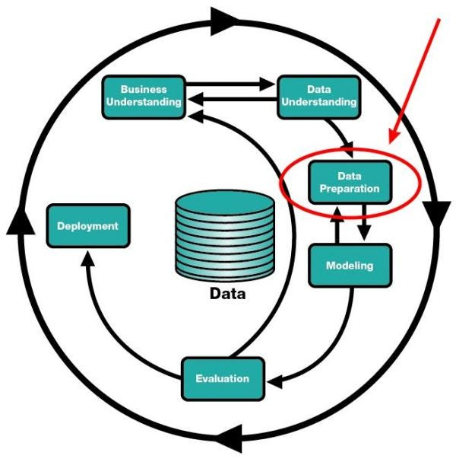
> Creation of Prediction Model
Preparation
Firstly, I need to split the dataset into training and testing subsets, which is crucial for building and evaluating machine learning models:
X_train, X_test, y_train, y_test = train_test_split(X, y, test_size=0.2, random_state=42)
This split ensures a balanced evaluation of the model by using part of the data for training and reserving another part for validation. Standardization of the numerical variables in the dataset, as following step is an essential preprocessing step for many machine learning algorithms.
scaler = StandardScaler()
X_train = scaler.fit_transform(X_train)
X_test = scaler.transform(X_test)

Slide 9
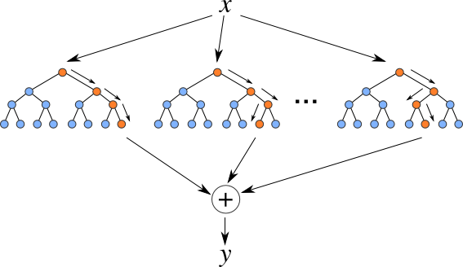
> Creation of Prediction Model
Prediction Model
The Prediction model that I used is "Random Forest Regressor", I chose that because:
- It is particularly effective when dealing with non-linear relationships in the data, as it can capture complex patterns.
There are 2 metrics to interpret outputs:
1. MSE:
-Useful to understand the magnitude of errors.
-However, looking at MSE alone is not enough because this value varies with the magnitude of the target variable.
2. R²:
-Useful to understand how well the model explains the target variable.
-Since it is dimensionless, it is more useful for comparing different models.

Slide 10
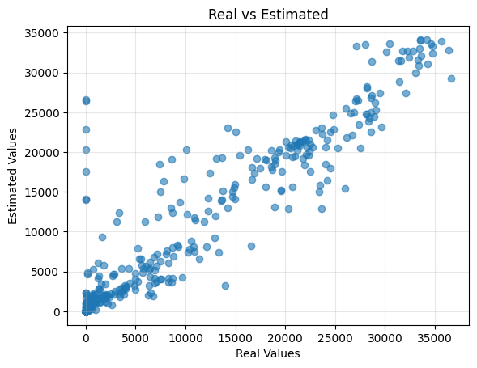
> Creation of Prediction Model
Scatter Plot shows that the Random Forest model shows good performance, with an R² score of about 0.89. This matches the close alignment between actual and predicted values

Slide 11
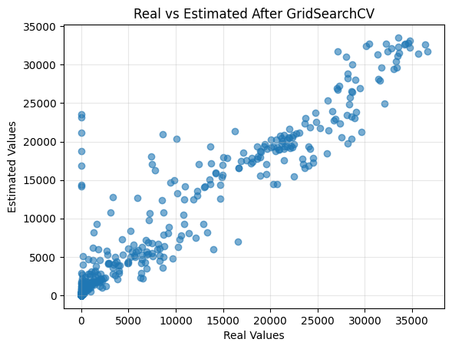
> Improvement of Prediction Model
The hyperparameter tuning process using GridSearchCV optimized the Random Forest model by testing various parameter combinations. The best configuration included 200 trees (n_estimators), a maximum tree depth of 20 (max_depth), a square root strategy for feature selection (max_features='sqrt'), and specific criteria for node splitting and leaf size. The optimized model achieved a Mean Squared Error (MSE) of 9834850.31 and an R² Score of 0.9061, indicating that it explains 90.61% of the variance in the data. This represents a significant improvement in predictive performance compared to the default settings, highlighting the effectiveness of hyperparameter tuning in enhancing model accuracy.

Slide 12
> CONCLUSION
This study looked at the solar energy production system in Berkeley, California, using machine learning to predict future energy outputs. By analyzing the data, cleaning it, and creating useful features, we found important environmental factors that affect energy generation.
A Random Forest model was chosen because it handles complex relationships well and works effectively even with outliers. The model’s first performance, with an R² score of 0.8976, showed strong predictive ability. After tuning the model’s settings using GridSearchCV, the R² score improved to 0.9061, and prediction errors were reduced, as seen in the lower Mean Squared Error (MSE). This shows how important it is to fine-tune machine learning models for better accuracy.

Slide 13
> Thank You

