Slide 1
STA321-Project Report
Group30: 胡嘉维(50%) 张弛(50%)

Slide 2
Problem Description
Given the Order data and Trade data, compute the lowest transaction price level K of each recorded market order using HDFS and MapReduce.
Task Comprehension
The key is to use the primary key `ApplSeqNum` to link the two part of data.

Slide 3
Difficulties
In the reduce phase, how to select the records from Traded for counting and ignore others?
An order is released before 09:30 but traded in the continuous auction period. How to ignore these orders?
how to sort the transaction data first by `TIMESTAMP` and second by `ApplSeqNum`?

Slide 4
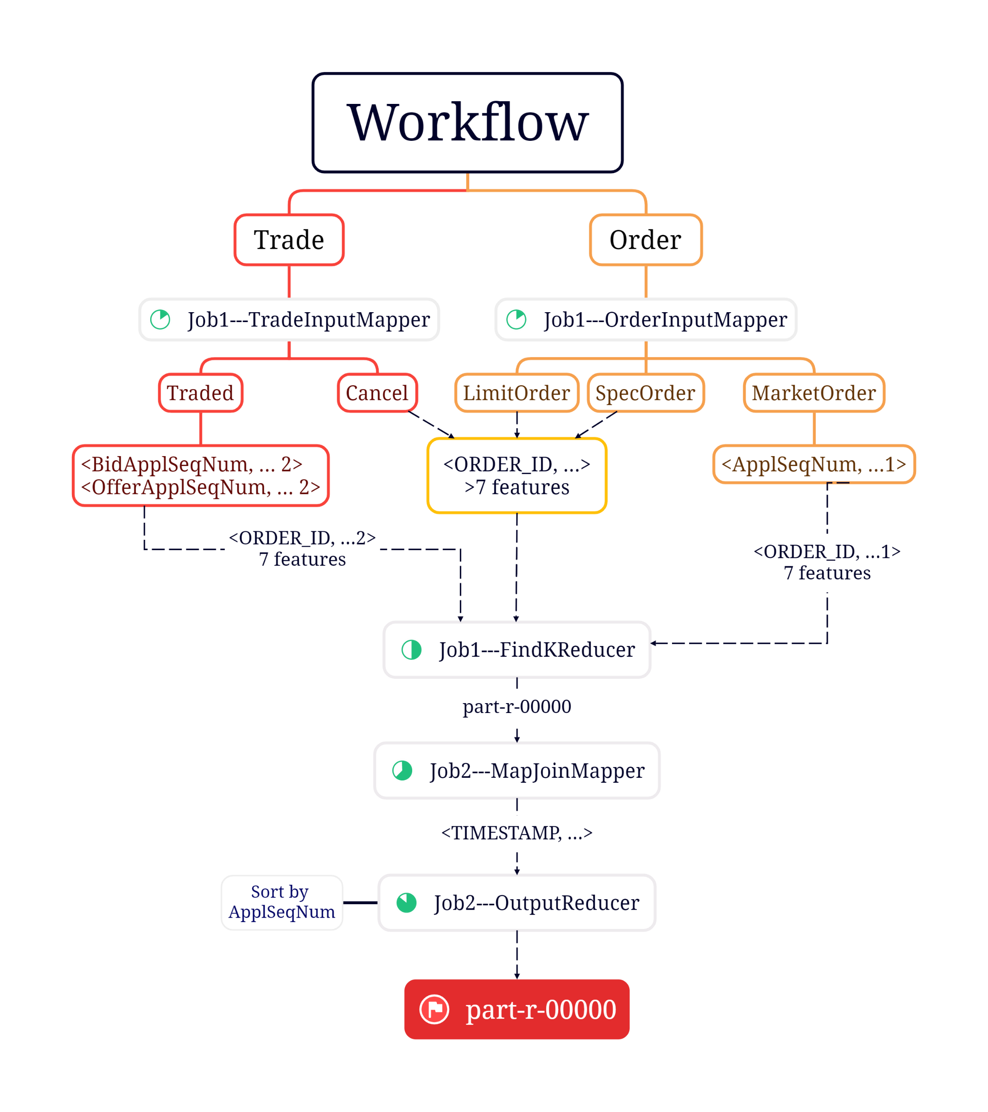

Slide 5
Solutions for Difficulties
In the reduce phase, how to select the records from Traded for counting and ignore others?
7 features or more? (8 or 9 features)

Slide 6
Solutions for Difficulties
An order is released before 09:30 but traded in the continuous auction period. How to ignore these orders?
<ApplSeqNum, … 1> and <Bid/OfferApplSeqNum, … 2>
Check whether an order has the former.

Slide 7
Solutions for Difficulties
How to sort the transaction data first by `TIMESTAMP` and second by `ApplSeqNum`?
Time order: TIMESTAMP as key
ApplSeqNum order: sort in OutputReducer

Slide 8
THANKS

