Slide 1
STA321-Project Report
Member: 张弛 胡嘉维

Slide 2
Problem Description
Given the Order data and Trade data, compute the lowest transaction price level K of each recorded market order using HDFS and MapReduce.

Slide 3
Task Comprehension
The key is to use the primary key `ApplSeqNum` to link the two part of data.

Slide 4
Difficulties
1. In the reduce phase, how to select the records from Traded for counting and ignore others?
2. An order is released before 09:30 but traded in the continuous auction period. How to ignore these orders?
3. how to sort the transaction data first by `TIMESTAMP` and second by `ApplSeqNum`?

Slide 5
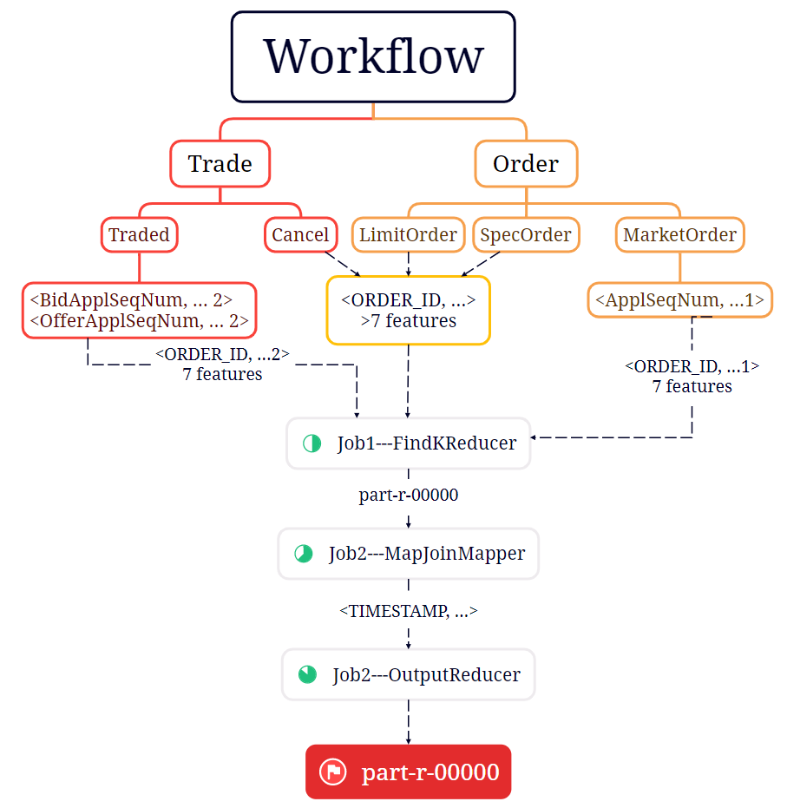

Slide 6
Solutions for Difficulties
1. In the reduce phase, how to select the records from Traded for counting and ignore others?
· 7 features or more? (8 or 9 features)

Slide 7


Solutions for Difficulties
2. An order is released before 09:30 but traded in the continuous auction period. How to ignore these orders?
· <ApplSeqNum, … 1> and <Bid/OfferApplSeqNum, … 2>
· Check whether an order has the former.

Slide 8
Solutions for Difficulties
3. how to sort the transaction data first by `TIMESTAMP` and second by `ApplSeqNum`?
· Time order: TIMESTAMP as key
· ApplSeqNum order: sort in OutputReducer

Slide 9
THANKS

