Slide 1
Portfolio Construction Strategies
Summary of Portfolio Optimization Research
Thanh Doan

Slide 2
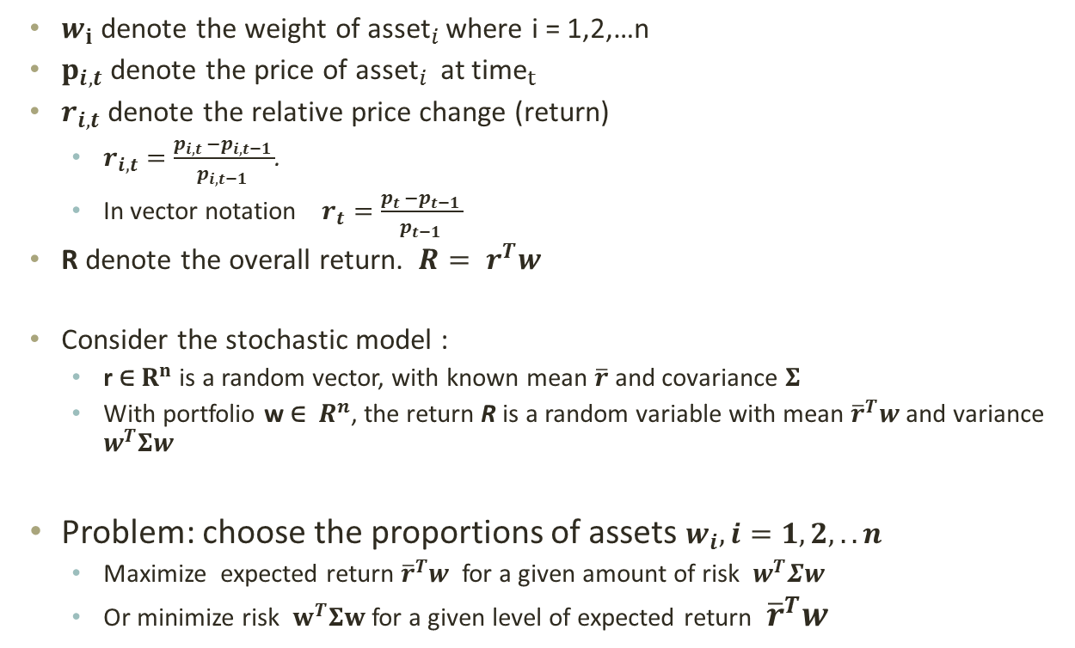
Problem definition
Optimize the allocation of n assets held over a period of time
$w_{i}$ denote the weight of ${\text{asset}}_{i }$where i = 1,2,…n
$p_{i,t}$denote the price of ${\text{asset}}_{i }$at ${\text{time}}_{t }$
$r_{i,t}$denote the relative price change (return)
$r_{i,t}=\frac{p_{i,t }−p_{i,t−1 }}{p_{i,t−1 }}$.
In vector notation $r_{t}=\frac{p_{t }−p_{t−1 }}{p_{t−1 }}$
R denote the overall return. $R= r^{T}w$
Consider the stochastic model :
r ∈ $R^{n}$ is a random vector, with known mean $\overline{r}$ and covariance $Σ$
With portfolio w ∈ $R^{n}$, the return R is a random variable with mean ${\overline{r}}^{T}w$and variance $w^{T}Σw$
Problem: choose the proportions of assets $w_{i}, i=1,2,..n$
Maximize expected return ${\overline{r}}^{T}w$for a given amount of risk $w^{T}Σw$
Or minimize risk $w^{T}Σw$ for a given level of expected return ${\overline{r}}^{T}w$

Slide 3
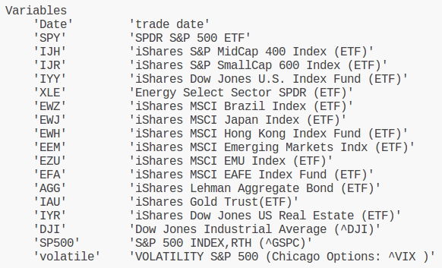
ETF14 Dataset
Universe size n=14 stocks (ETFs)

Slide 4
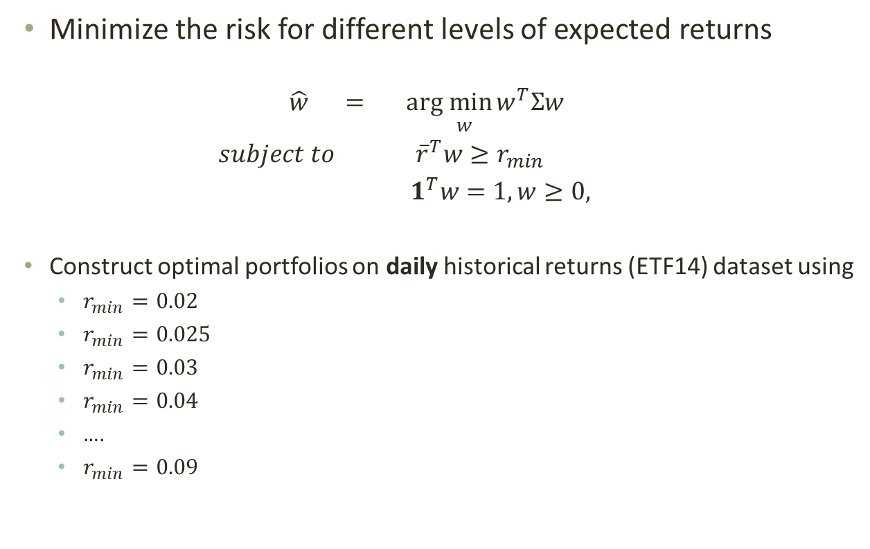
Work done in May 2011
Minimize the risk for different levels of expected returns
$$\hat{w} =\underset{ w}{arg min}{w^{T}Σw}$$
$subject to {\overline{r}}^{T}w≥r_{min}$
${ 1}^{T}w=1, w≥0,$
Construct optimal portfolios on daily historical returns (ETF14) dataset using
$r_{min}=0.02$
$r_{min}=0.025$
$r_{min}=0.03$
$r_{min}=0.04$
….
$r_{min}=0.09$

Slide 5
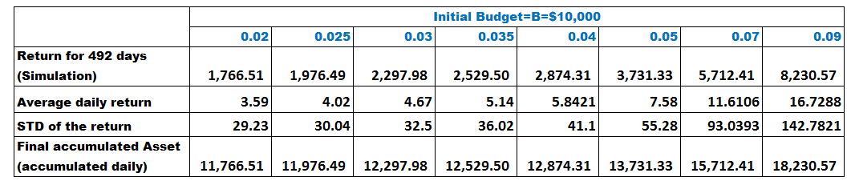

Back-test result (May 2011)
Use ETF14 dataset consisting of 1492 days of historical price changes
For m = 1000 to 1492
Compute $\overline{r} and Σ$ using m-1 days of data
$\overline{r}={\sum_{t=1}^{m−1}{ r_{t} }}/{m−1}$
Use QP optimization solver to solve for $\hat{w}$ given $r_{min}=0.02$,.. 0.09
Use weight vector $\hat{w}$ and budget B= $10,000 to simulate the daily return using the price on day m
The simulation result is:

Slide 6
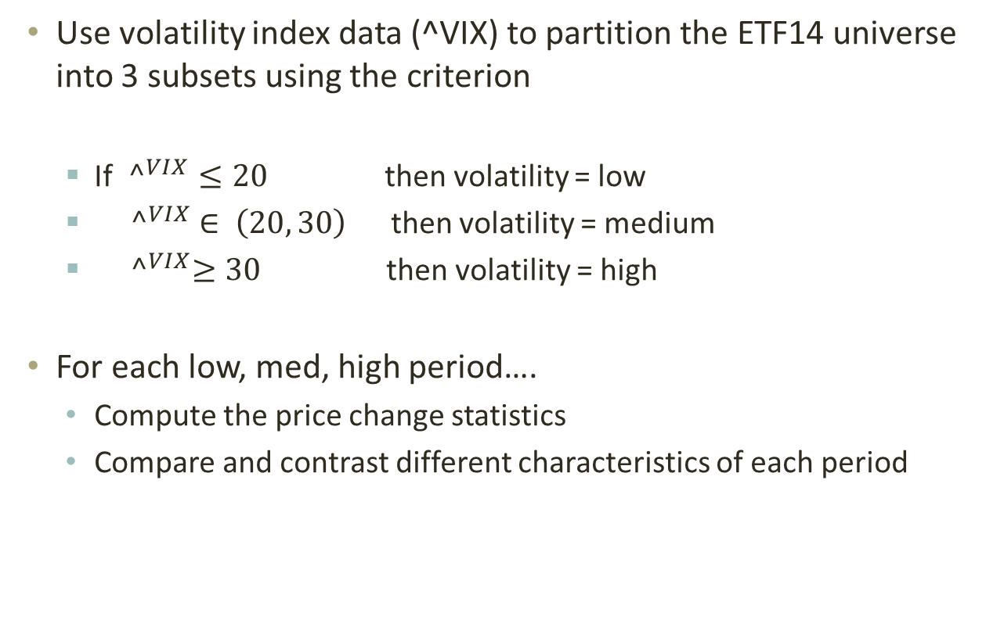
Work done in Sep 2011
Use volatility index data (^VIX) to partition the ETF14 universe into 3 subsets using the criterion
If ${^}_{}^{VIX}≤20$ then volatility = low
${ ^}_{}^{VIX} ∈ \left(20, 30\right)$ then volatility = medium
${ ^}_{}^{VIX}≥30$ then volatility = high
For each low, med, high period….
Compute the price change statistics
Compare and contrast different characteristics of each period

Slide 7
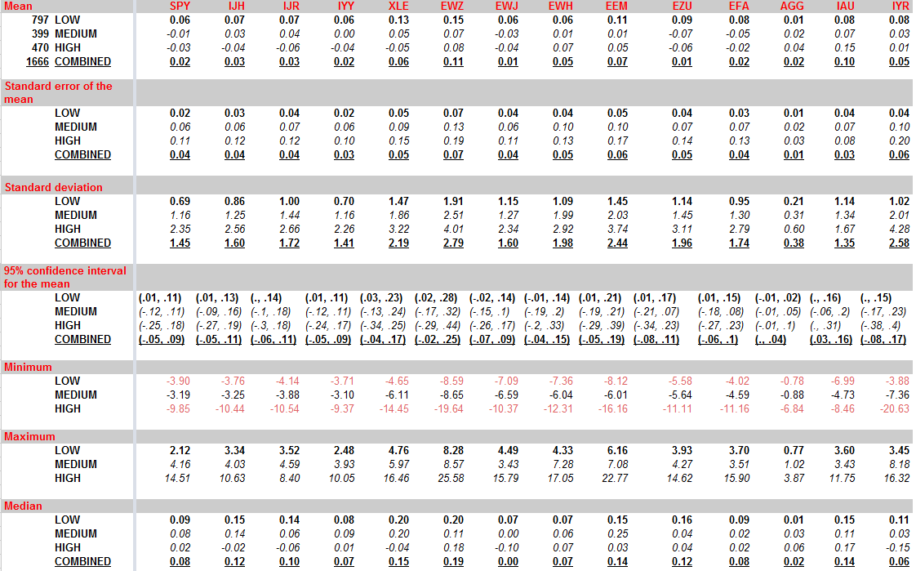
Statistics of price change in volatile periods

Slide 8
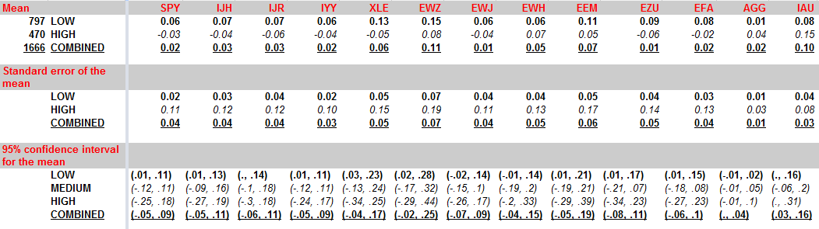
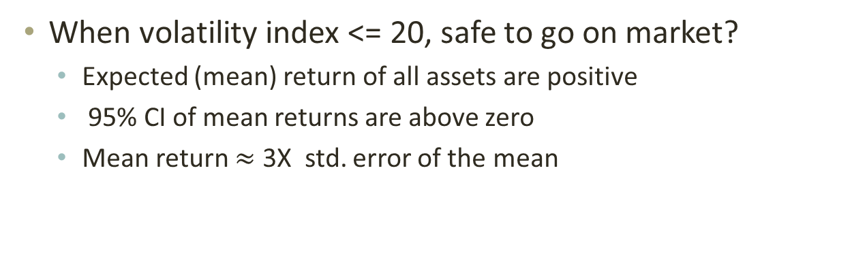
Comments on the statistics
When volatility index <= 20, safe to go on market?
Expected (mean) return of all assets are positive
95% CI of mean returns are above zero
Mean return $≈$ 3X std. error of the mean

Slide 9
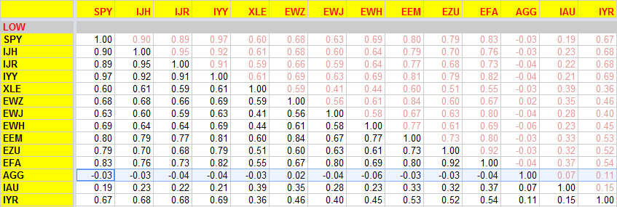
Correlation in low volatile periods
Future work: use copula to study correlation

Slide 10
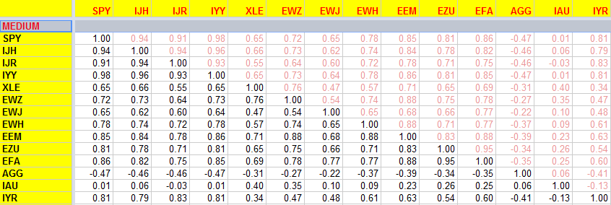
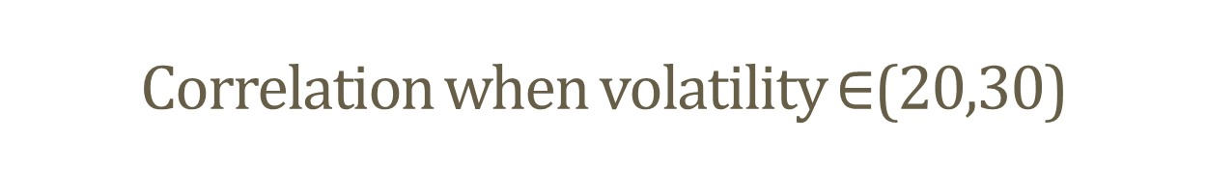
Correlation when volatility $∈$(20,30)

Slide 11
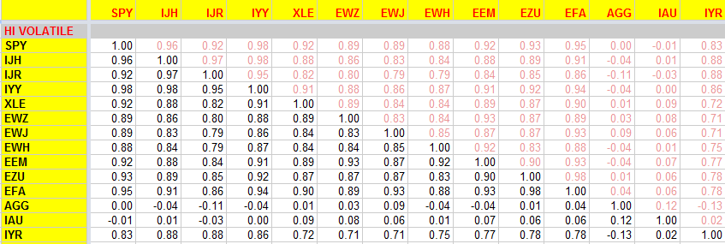
Correlation in high volatile periods

Slide 12
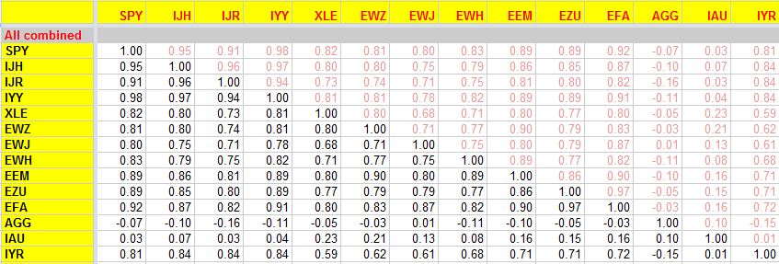
Correlation–whole period Feb2005-Sep2011

Slide 13
Correlation – low vs. medium

Slide 14
Correlation – low vs. high

Slide 15
Work done in Oct 2011
Construct the efficient frontier
A portfolio is "efficient" if it has the best possible expected return for its level of risk
Risk is proxied by the standard deviation of the return.
Efficient frontier is the positively sloped portion of the opportunity set that offers the highest expected return for a given level of risk
Compute the market return and risk and compare with portfolios lying on efficient frontier
Compute Dow Jones Industrial Index mean and std. deviation
Compute the SP500 mean and std. deviation in the same period
Compute the equal-weight portfolio return and risk
Compare with portfolios lying on efficient frontier.

Slide 16
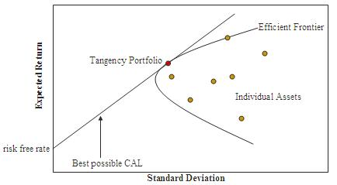
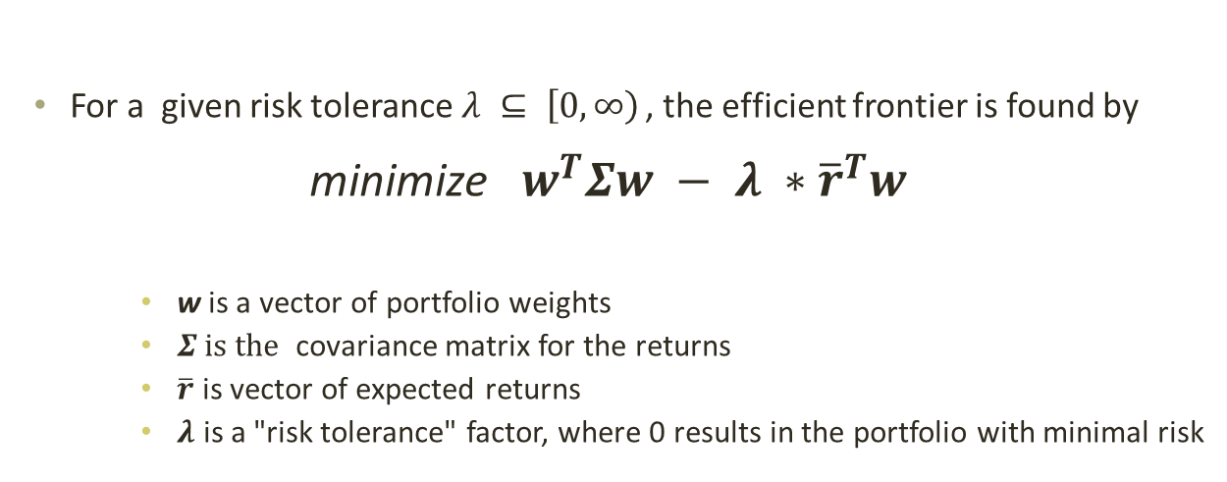
Computation of the efficient frontier
For a given risk tolerance$λ ⊆ \left[0, \left.∞\right)\right.$ , the efficient frontier is found by
minimize $w^{T}Σw − λ ∗{\overline{r}}^{T}w$
w is a vector of portfolio weights
$Σ is the$ covariance matrix for the returns
$\overline{r}$ is vector of expected returns
$λ$ is a "risk tolerance" factor, where 0 results in the portfolio with minimal risk

Slide 17
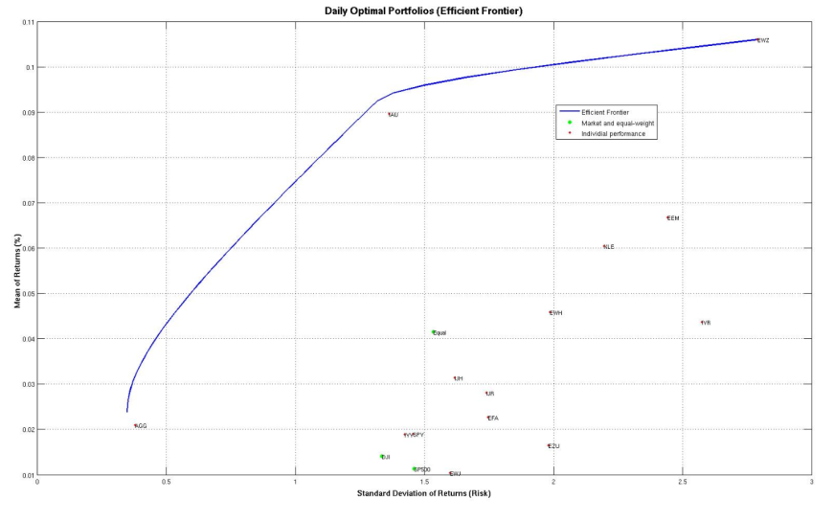
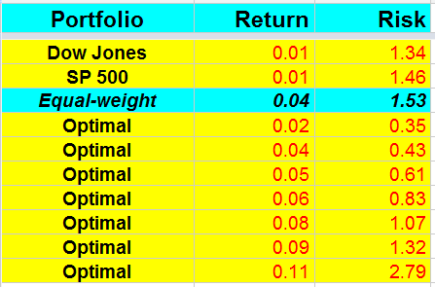
Daily optimal portfolios on efficient frontier

Slide 18
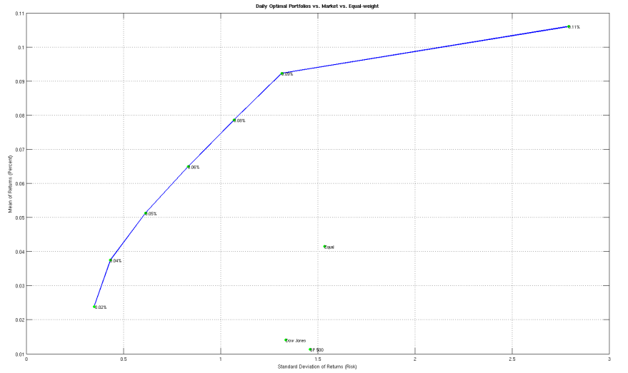
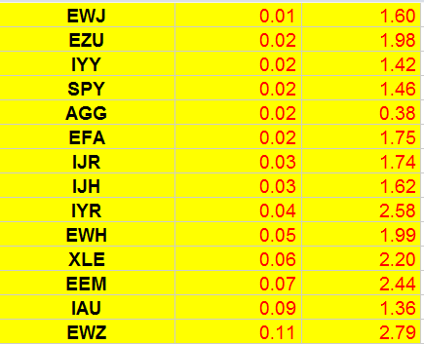
optimal portfolios vs. individual ETF

Slide 19
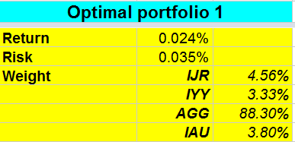
Weights OF daily optimal portfolios

Slide 20
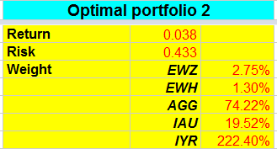
Weights OF daily optimal portfolios

Slide 21
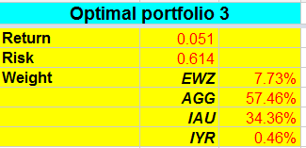
Weights OF daily optimal portfolios

Slide 22
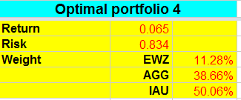
Weights OF daily optimal portfolios

Slide 23
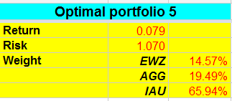
Weights OF daily optimal portfolios

Slide 24
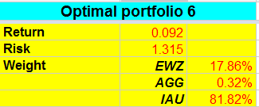
Weights OF daily optimal portfolios

Slide 25
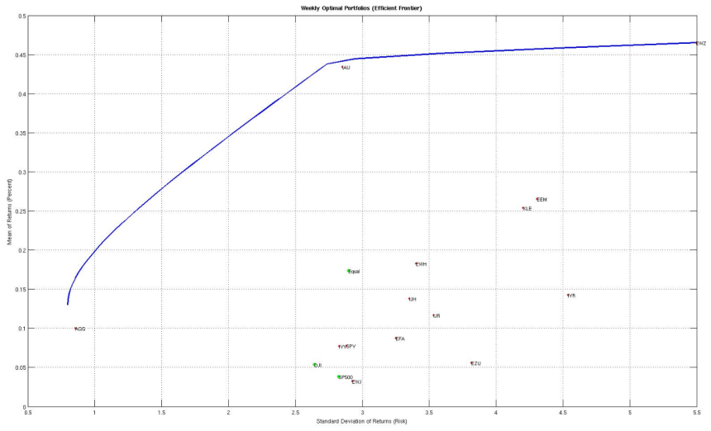
Weekly optimal portfolios

Slide 26
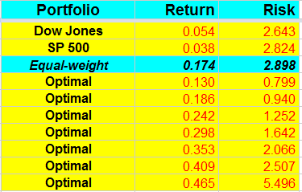
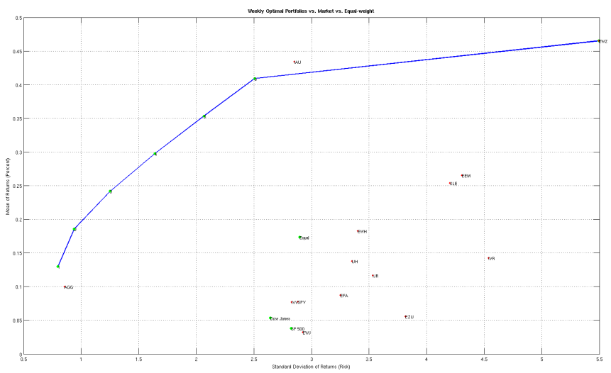
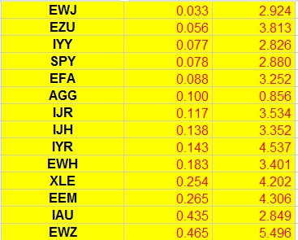
Weekly optimal portfolios vs. other options

Slide 27
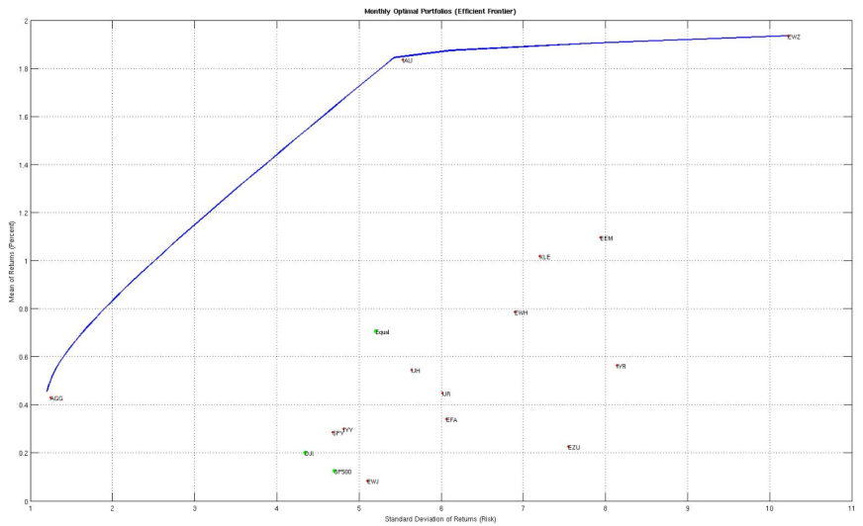
Monthly optimal portfolios

Slide 28
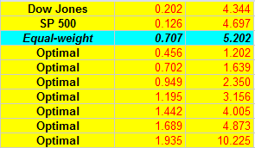
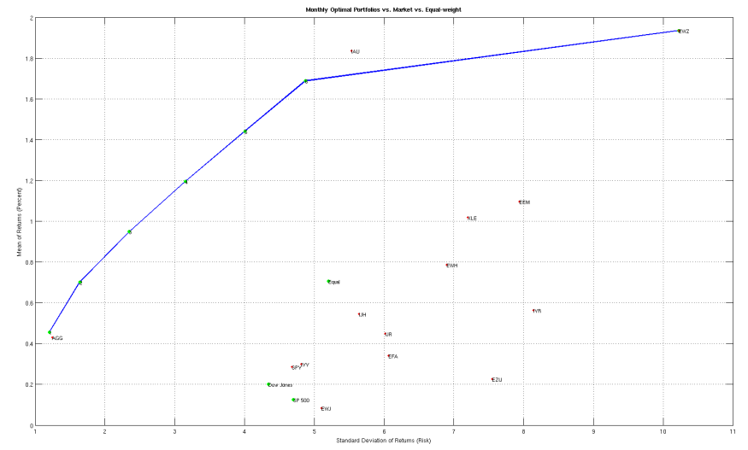
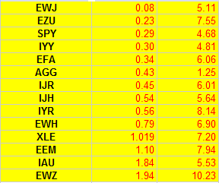
Monthly optimal portfolios vs. individuals

Slide 29
Work done in Oct 2011 (2)
Construct optimal portfolios with more constraints
5% IAU, 0% EWZ
5% IAU, 0% EWZ, 0% AGG
Incorporate dividends into price change & return computation
Not necessary because the adjusted closed price already taken into account dividend payments and stock split actions
Future work: Use out-of-sample data for back-testing and compute the simulation performance result

Slide 30
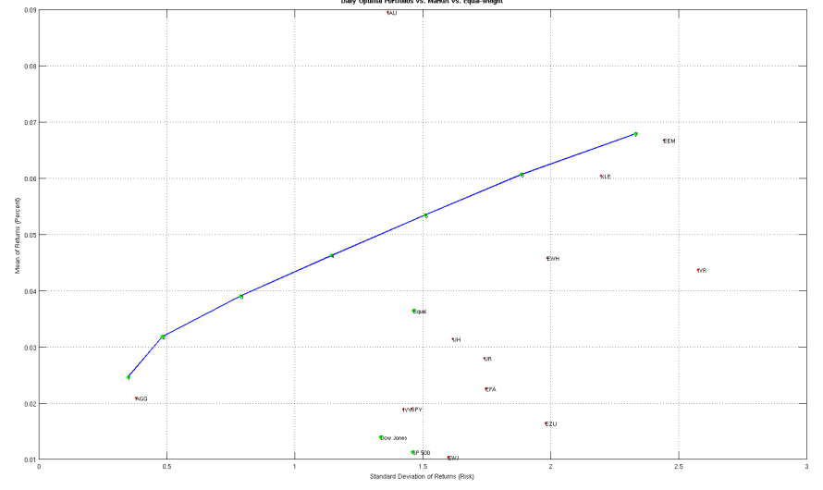
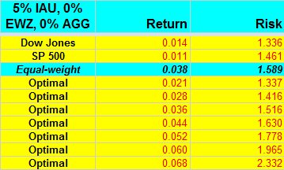
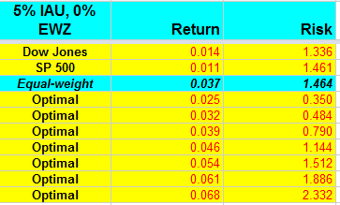
5% gold, 0% EWZ vs. No constraint (Daily)

Slide 31
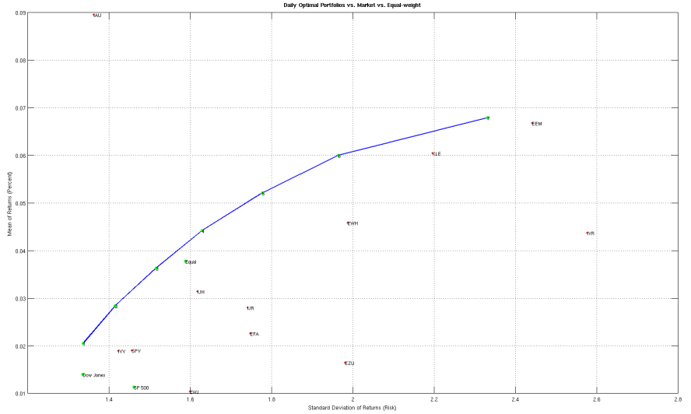
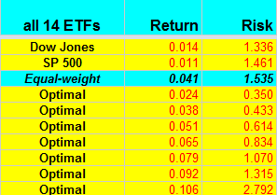
5% gold, 0% EWZ, 0% AGG (Daily)

Slide 32
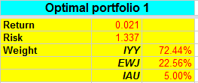
daily optimal portfolios w. constraints

Slide 33
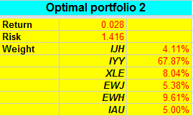
daily optimal portfolios w. constraints

Slide 34
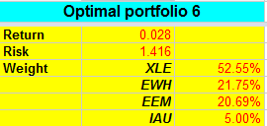
daily optimal portfolios w. constraints

Slide 35

daily optimal portfolios w. constraints

Slide 36
Work done in Oct 2011 (3)
Construct optimal portfolios using Sharpe ratio as the performance measure
Compare maximum Sharpe ratio portfolios on various situations
Future work: construct sparse and stable portfolios using Brodie’s paper
Reformulate the optimization problem as a constrained multiple regression problem. I.e. add regularization terms to optimization function to construct stable and sparse portfolios
Use extreme value theorem to study the tails of the return distribution
Fit 10% lower tail returns to an empirical Pareto distribution
Fit 10% upper tail returns to an empirical Pareto distribution
Regress 80% of interior points using kernel based non-parametric regression
Use copula to study and visualize the dependency structure of various components of the portfolios

Slide 37
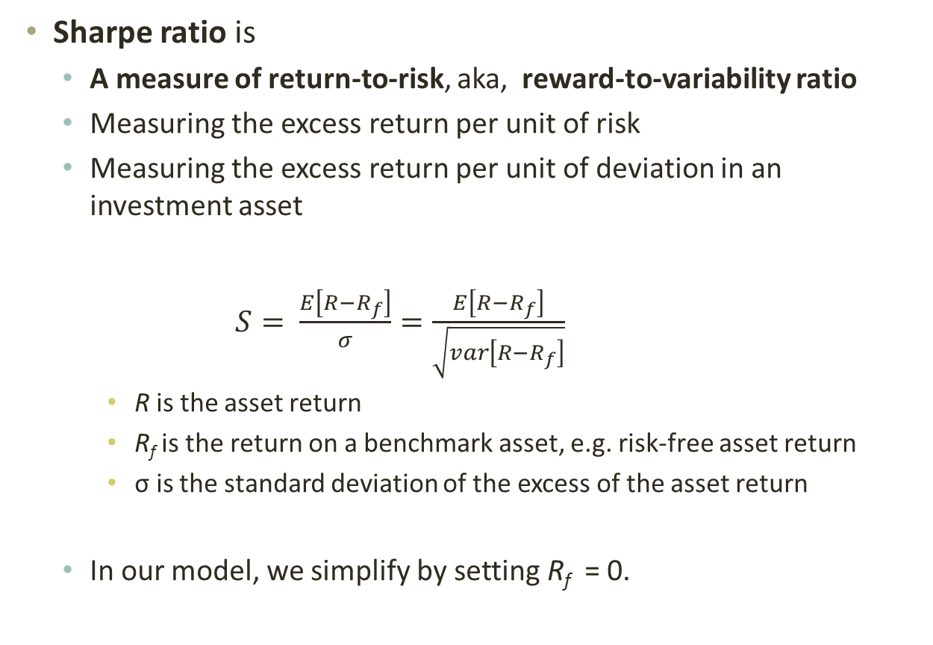
Sharpe Ratio
Sharpe ratio is
A measure of return-to-risk, aka, reward-to-variability ratio
Measuring the excess return per unit of risk
Measuring the excess return per unit of deviation in an investment asset
$S= \frac{E\left[R−R_{f}\right]}{σ}=\frac{E\left[R−R_{f}\right]}{\sqrt{var\left[R−R_{f}\right]}}$
R is the asset return
R_{f} is the return on a benchmark asset, e.g. risk-free asset return
σ is the standard deviation of the excess of the asset return
In our model, we simplify by setting R_{f} = 0.

Slide 38
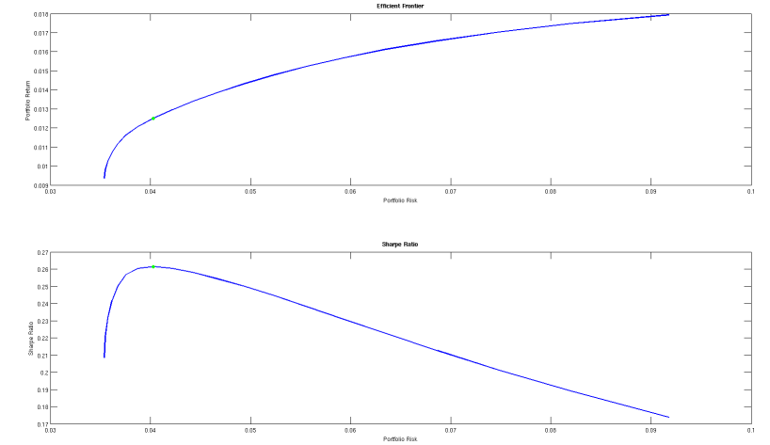
Maximizing Sharpe Ratio
Maximum Sharpe ratio portfolio is on the efficient frontier

Slide 39
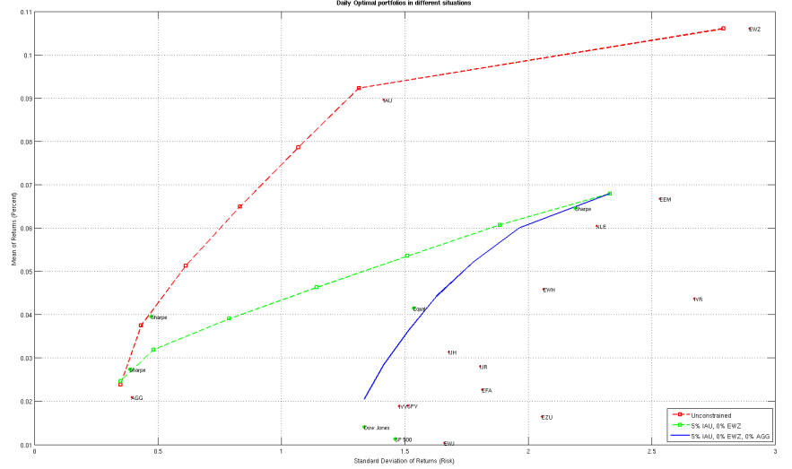
Maximum Sharpe Ratio Portfolios (Daily)

Slide 40
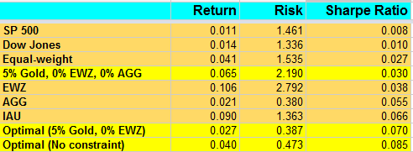
Maximum Sharpe Ratio Portfolios (Daily)

Slide 41
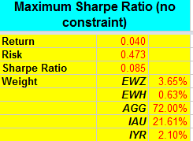
Maximum Sharpe Ratio Portfolios (Daily)

Slide 42
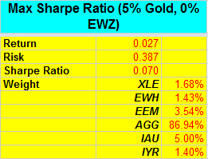
Maximum Sharpe Ratio Portfolios (Daily)

Slide 43
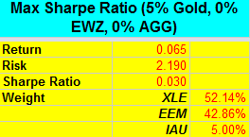
Maximum Sharpe Ratio Portfolios (Daily)

Slide 44
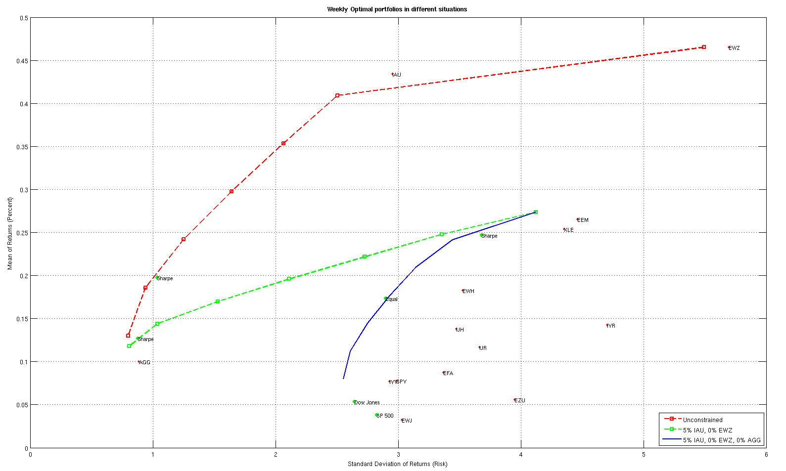

Maximum Sharpe Ratio Portfolios (Weekly)

Slide 45

Maximum Sharpe Ratio Portfolios (Weekly)

Slide 46

Maximum Sharpe Ratio Portfolios (Weekly)

Slide 47

Maximum Sharpe Ratio Portfolios (Weekly)

Slide 48


Maximum Sharpe Ratio Portfolios (Monthly)

Slide 49

Maximum Sharpe Ratio Portfolios (Monthly)

Slide 50

Maximum Sharpe Ratio Portfolios (Monthly)

Slide 51

Maximum Sharpe Ratio Portfolios (Monthly)

