Slide 1
1. Start Window

Slide 2
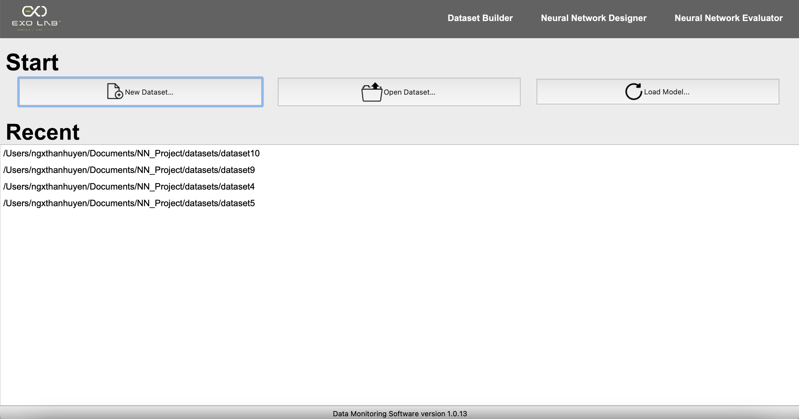
If the user clicks “Load Model…”, Move to 3. NN Designer and 4.NN Evaluator
If the user clicks “New Dataset…”, Move to 2. Dataset Builder
If the user clicks “Open Dataset…”, Move to 3. Neural Network Designer
If the user clicks recent folders, Move to 3. NN Designer

Slide 3
2. Dataset Builder

Slide 4
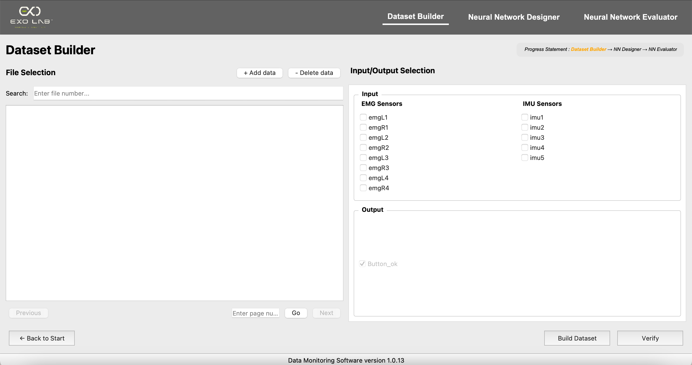
The current page is underlined
The progress indicator to help user keep track of where he is in the process
The current page is highlighted in orange and will turn green once completed
If this button is clicked…
A list of files for building the dataset
Inputs & Outputs of dataset

Slide 5
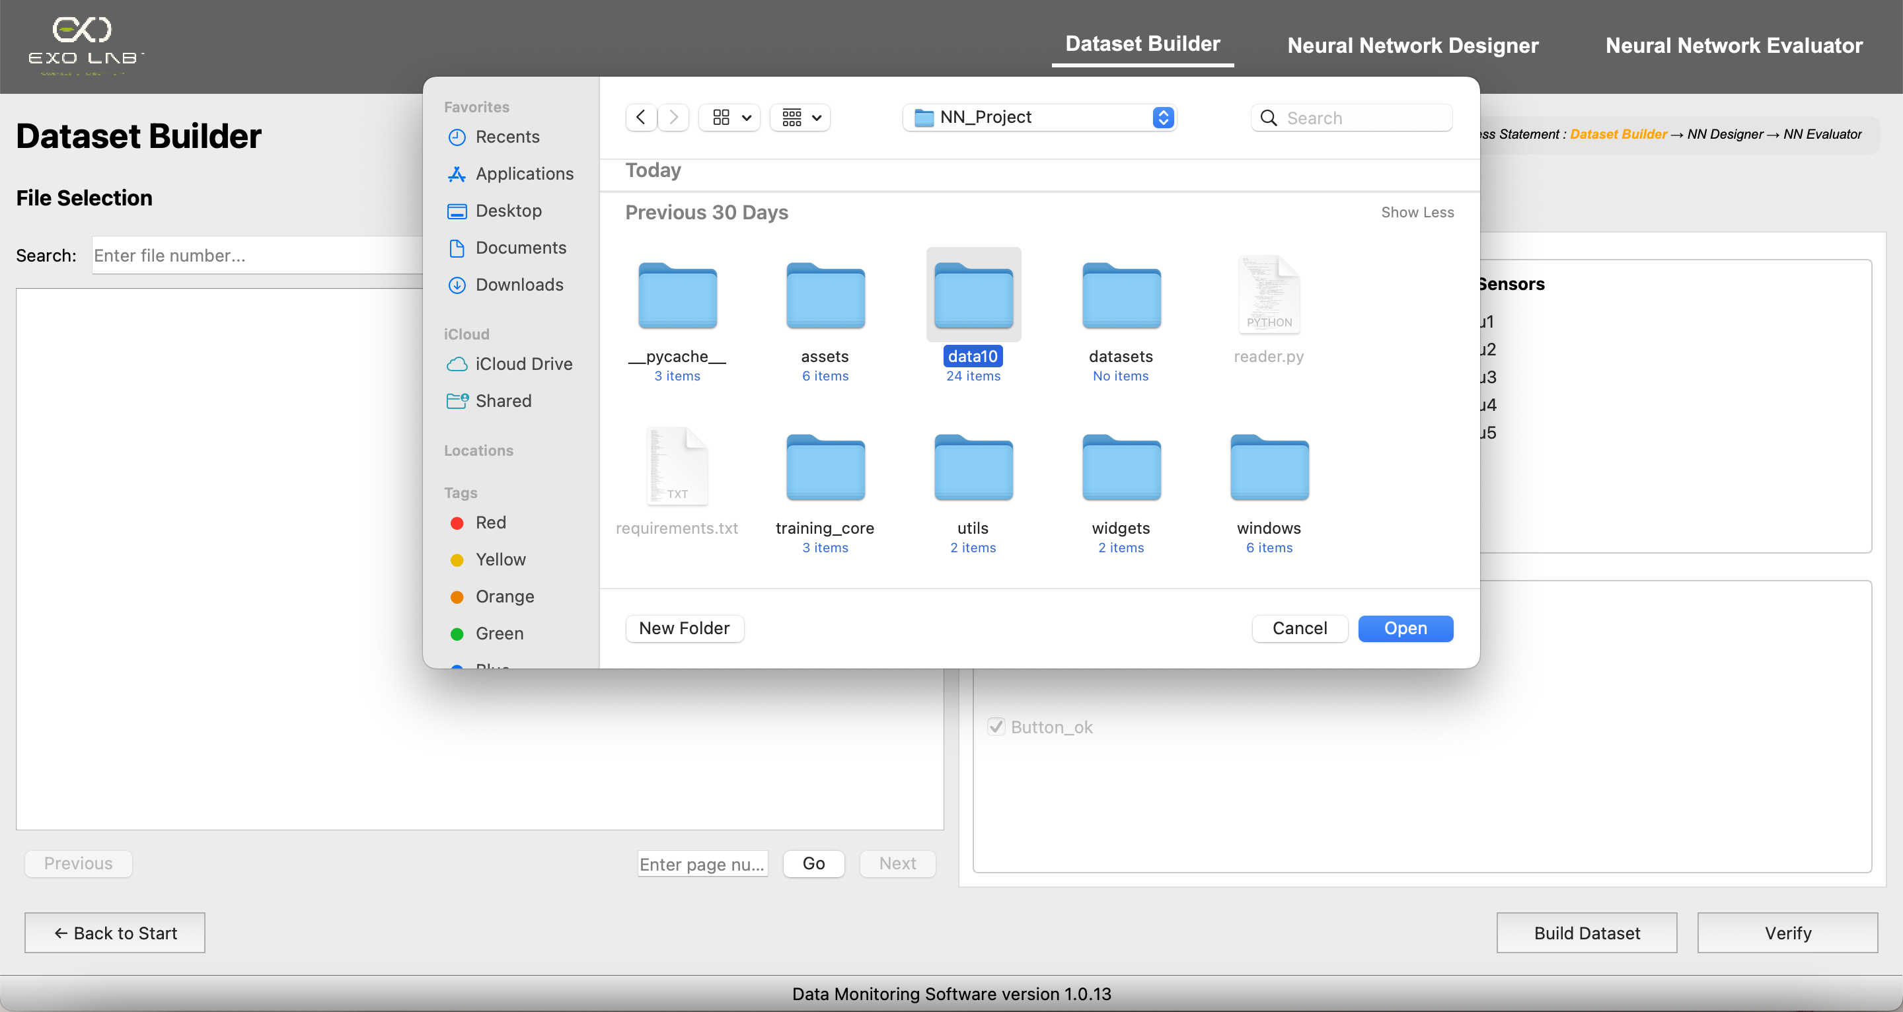
An open folder dialog pops up to select the folder containing the experimental data

Slide 6
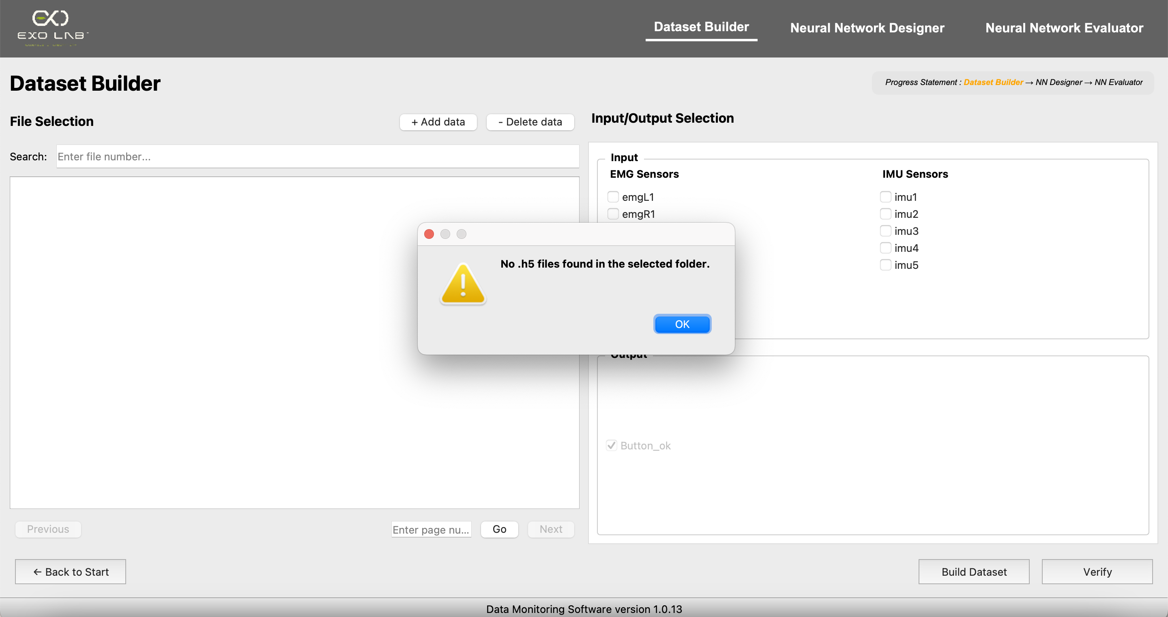
If the user selects a folder that does not contain any .h5 files, this message will appear

Slide 7
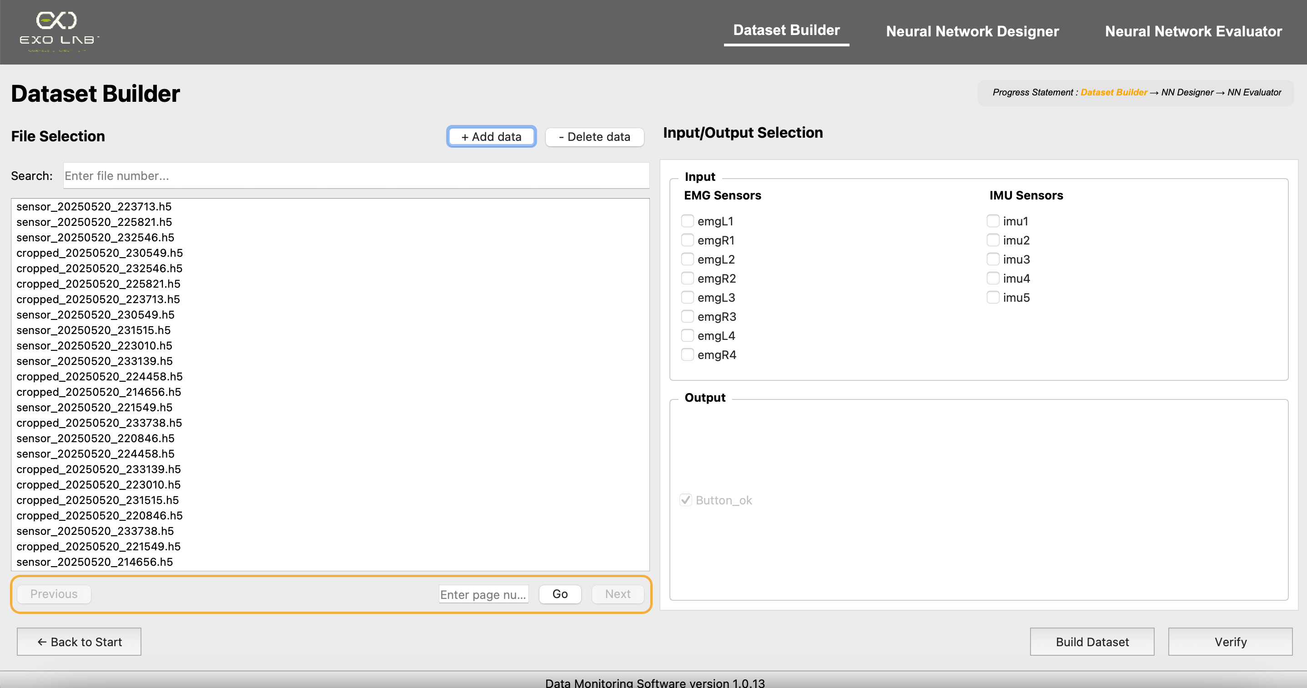
If the user knows exactly the file number to select, just enter it here
A list of .h5 files in the folder appears here. These files contain sensor data
In case there’s a large dataset, we’ve included pagination to help navigate through it

Slide 8
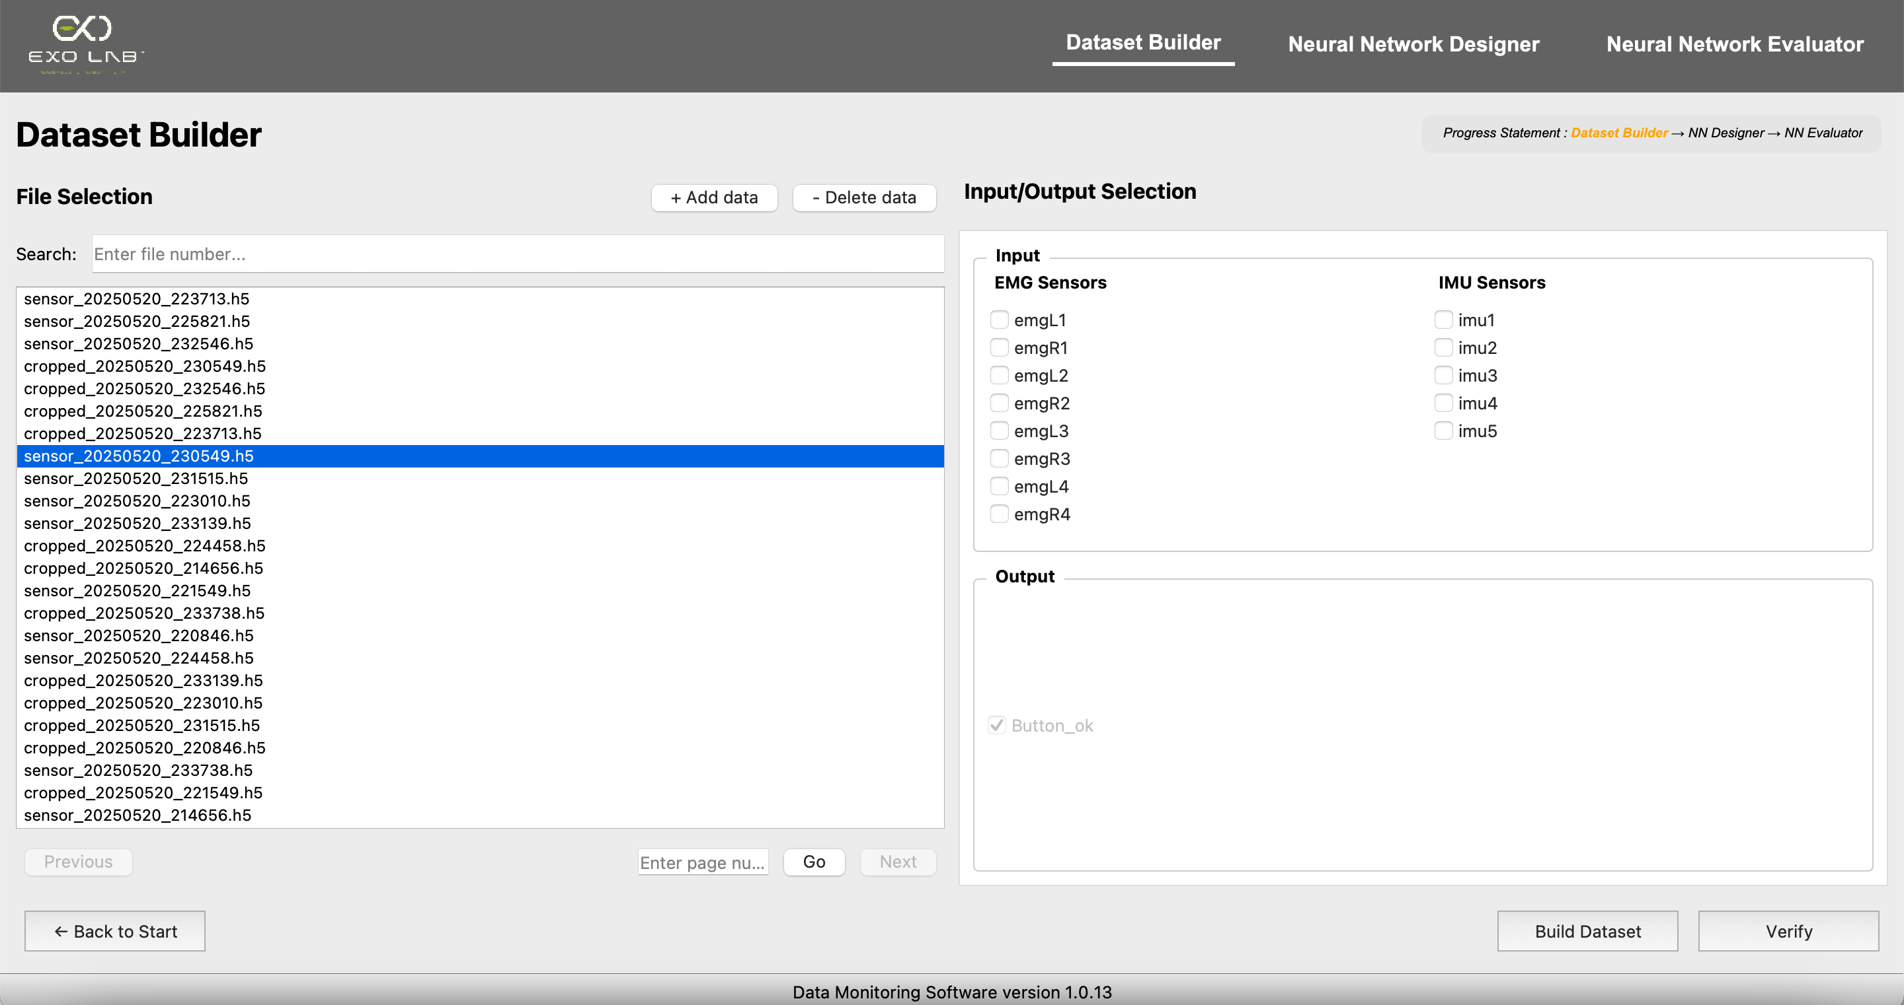
The user can also delete one or more files by selecting them and clicking the 'Delete data' button

Slide 9
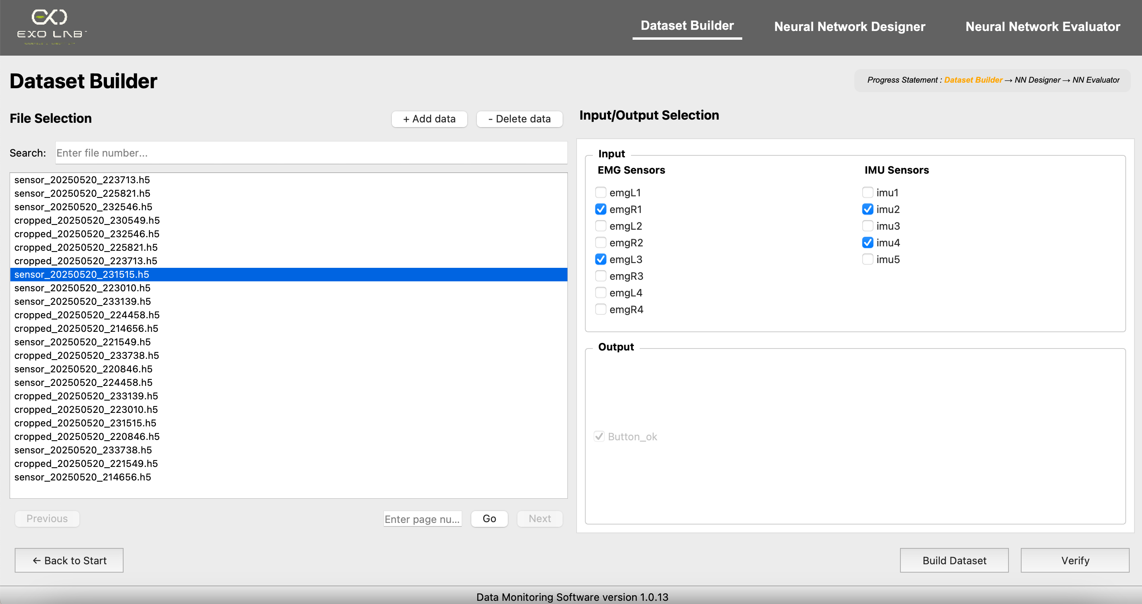
As we can see, the file has been removed
The user chooses which sensors he wants to use as inputs
The output is preselected by default and it represents the button that was pressed during data collection

Slide 10
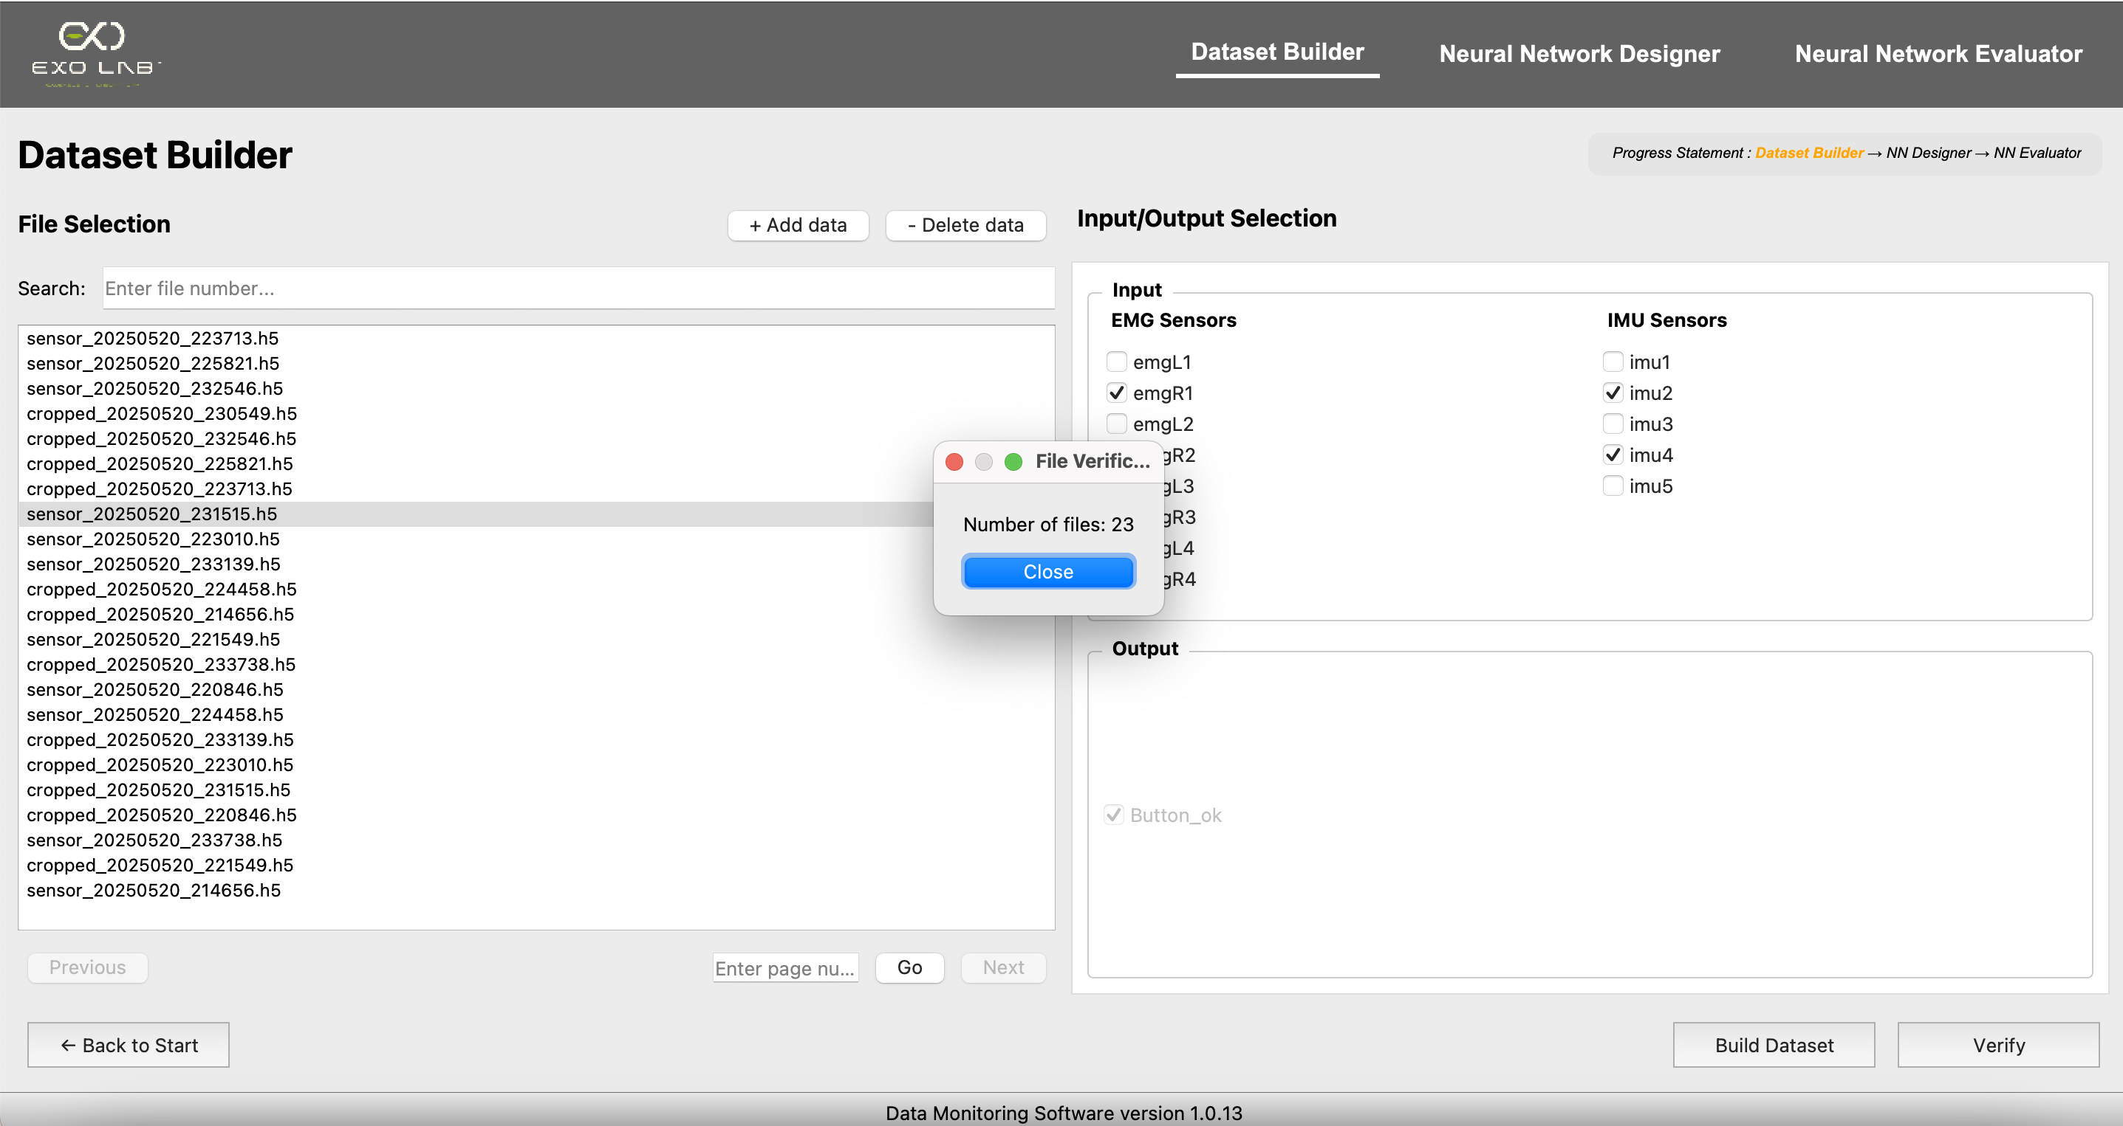
A file verification window pops up with the number of files to make sure that there is no missing file
If this button is clicked

Slide 11
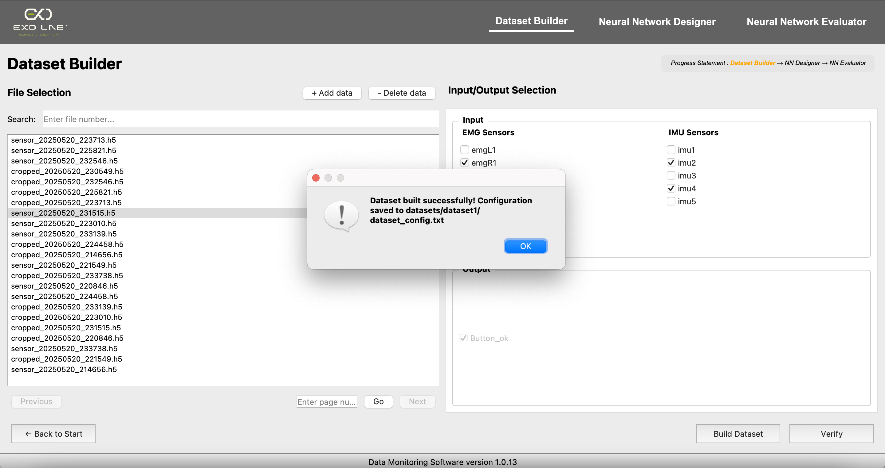
A window appears to confirm if the dataset is built successfully or not
If this button is clicked

Slide 12
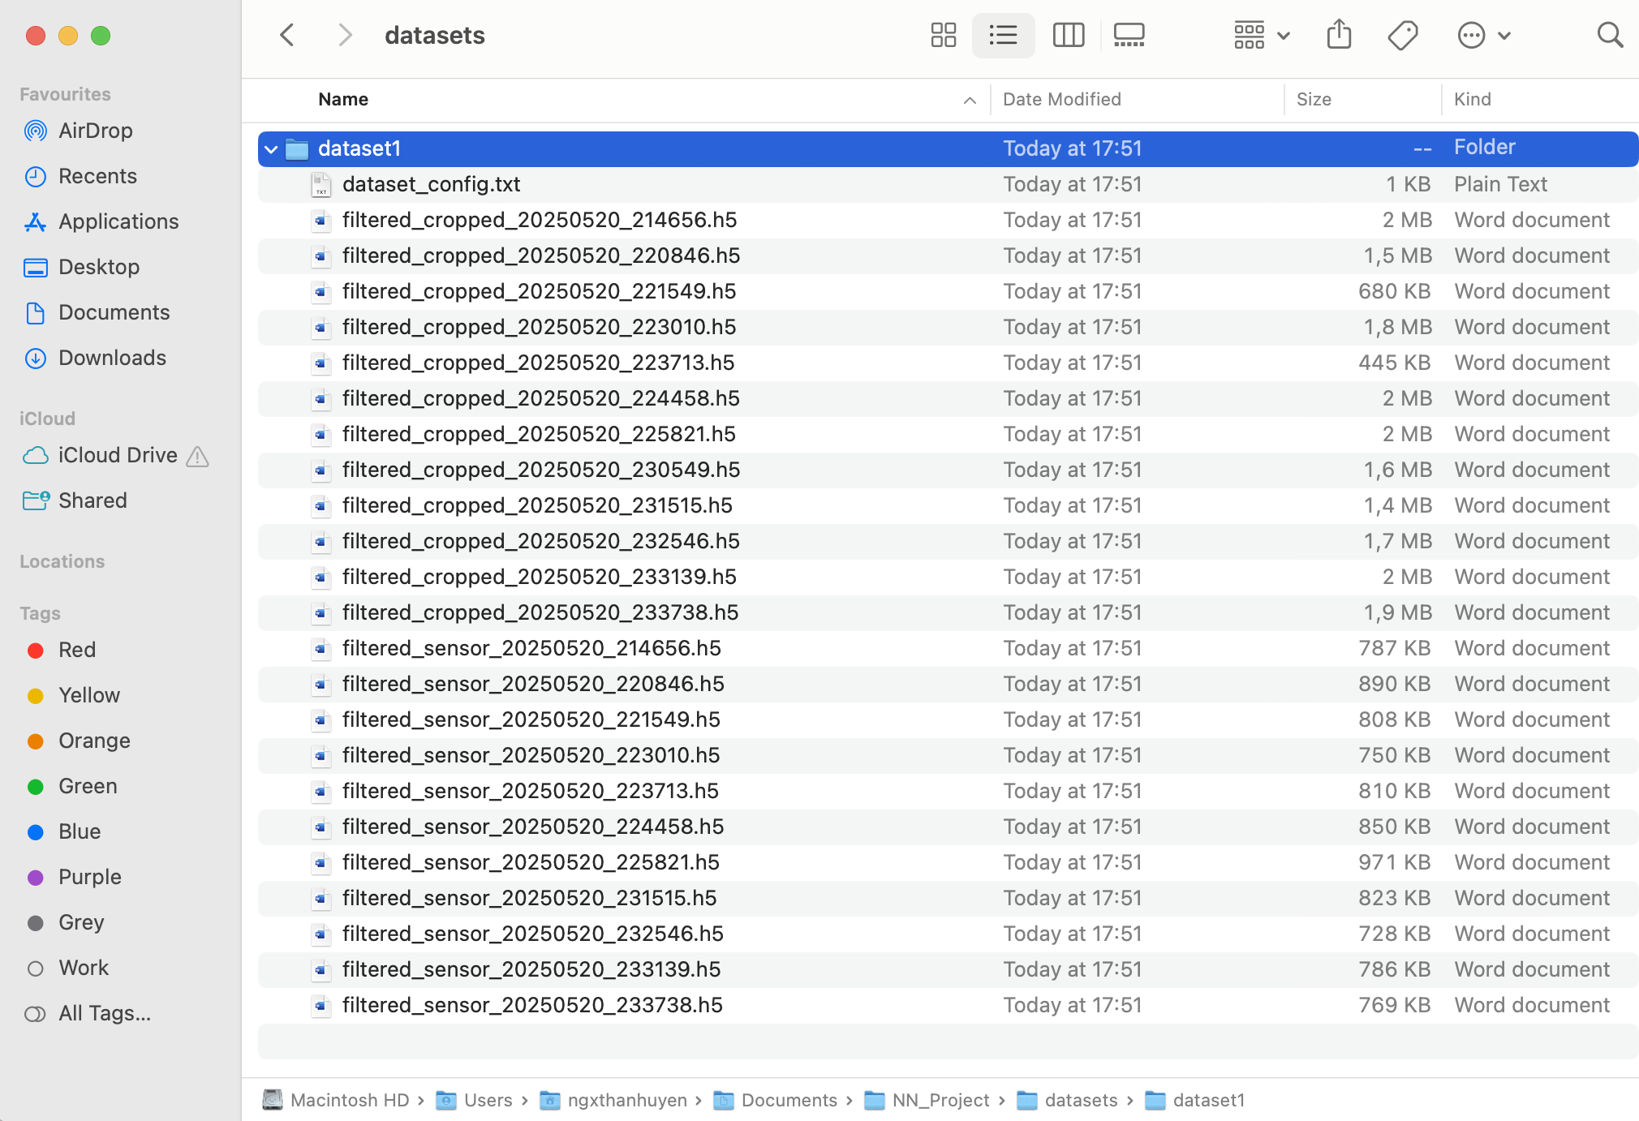
If the dataset is built successfully, it will be saved inside the NN_Project/datasets folder, in a subfolder named dataset followed by its creation number
If we click this txt file

Slide 13
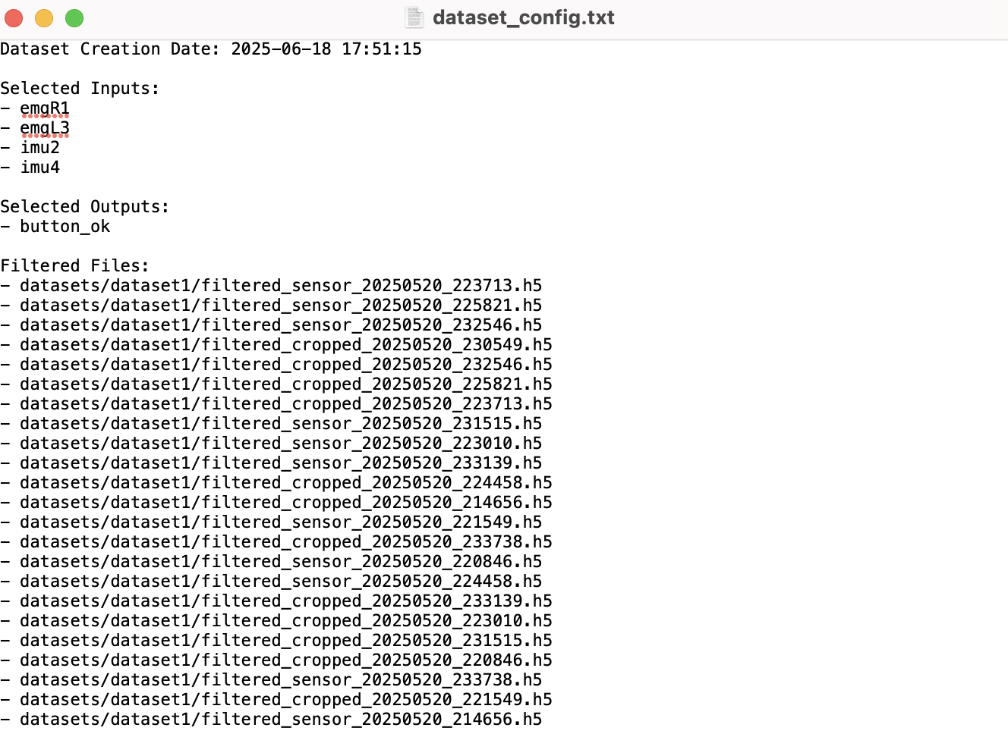
The user dataset’s configurations are saved in this txt file

Slide 14
Then if we press ”OK” button

Slide 15
3. Neural Network Designer

Slide 16
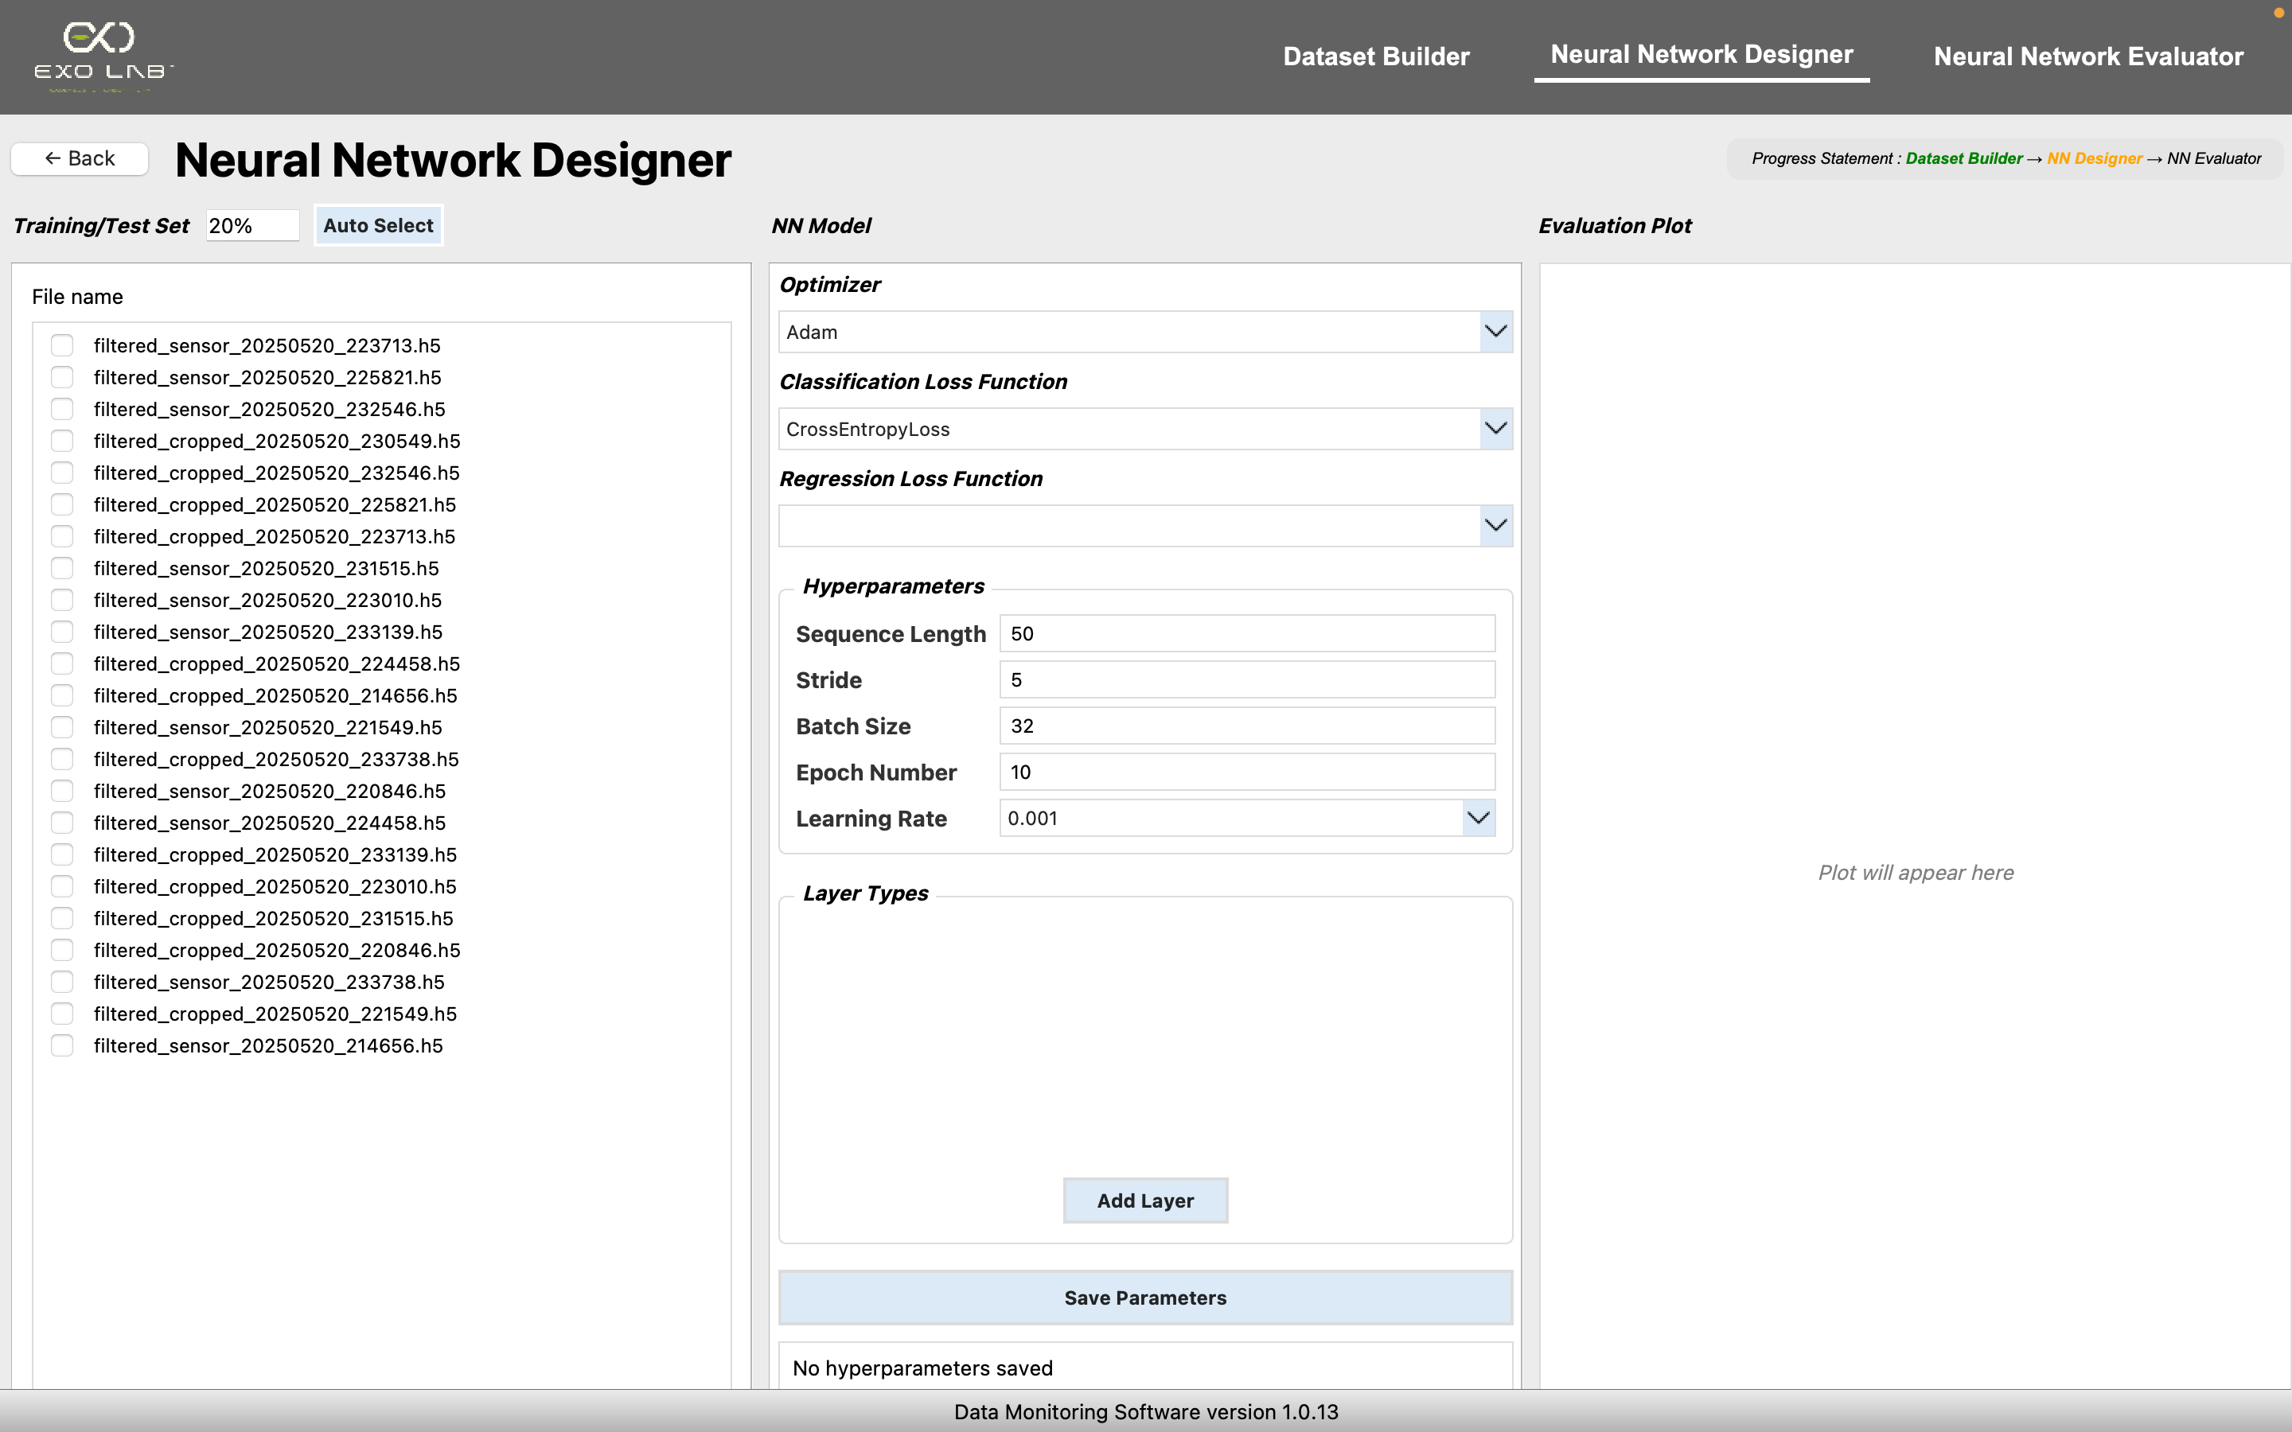
This page will be opened with all filtered files of the dataset

Slide 17
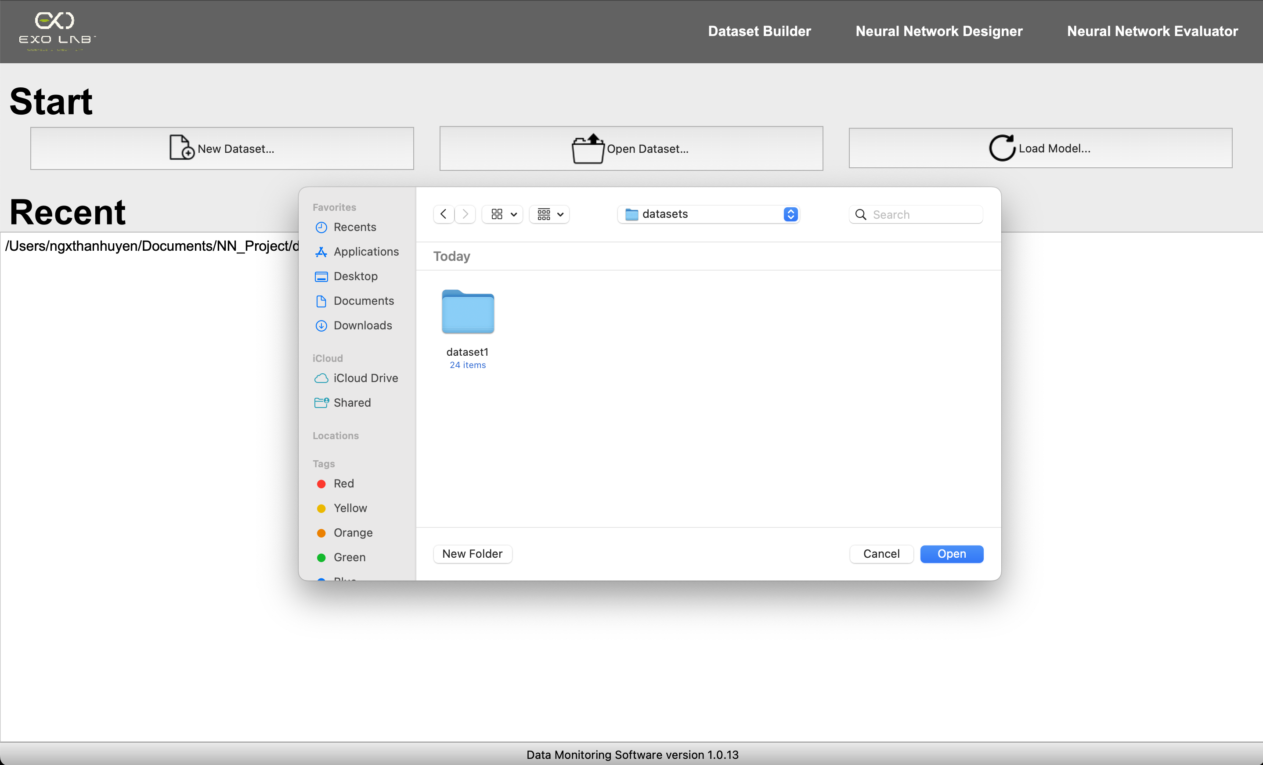

We can also click “Open Dataset…” then select the dataset that we built earlier to navigate directly to the NN Designer window

Slide 18
We already completed this step, that’s why it turned green
The current page is highlighted in orange and will turn green once completed
This page will be opened with all filtered files of the dataset

Slide 19
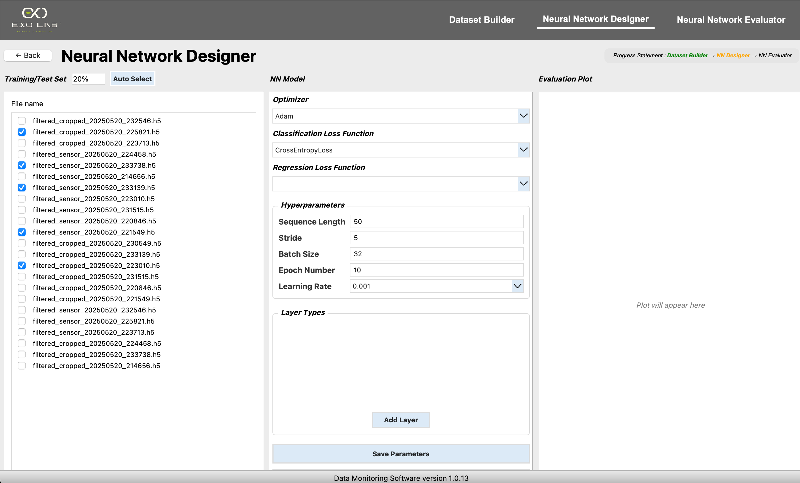
By default, the application randomly selects 20% of all imported files for training and testing. However, we can adjust this percentage using the input field provided
Or click this “Auto Select” button
The user can select files manually

Slide 20
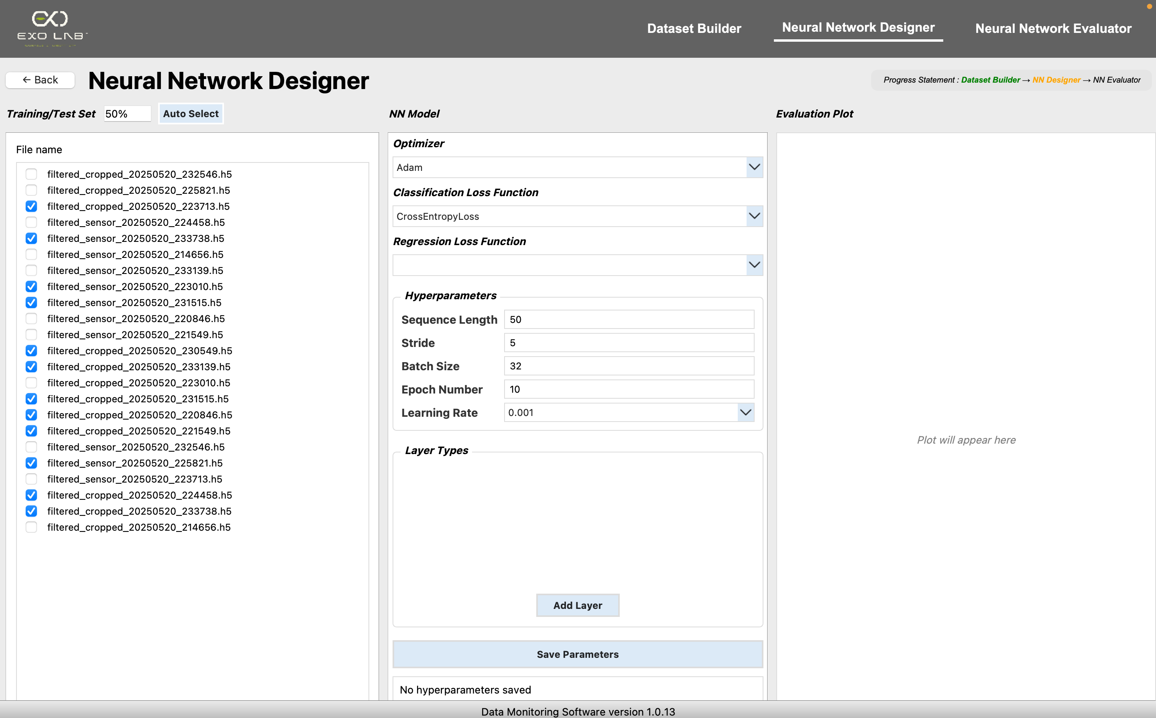
Next, select the parameters to train the model. When you choose a Classification loss function, the Regression loss function is automatically deselected and vice versa. This ensures that only one type of loss function can be selected at a time.
These are already configured by default but the user can easily change it if he wants
Then we click this button to add layer. It is mandatory that we need to add at least one layer
An example when we change the Auto Select to 50%

Slide 21
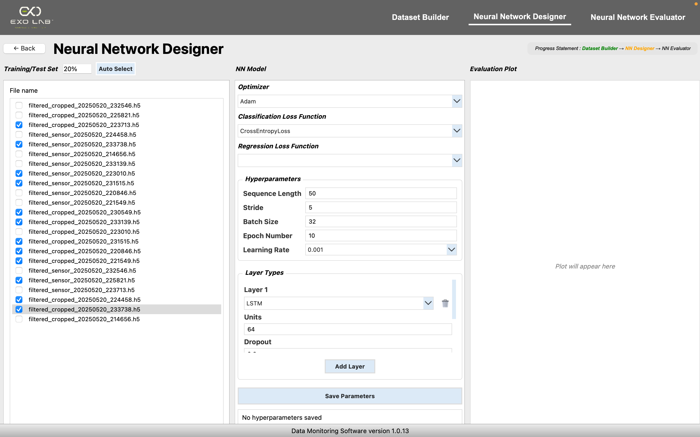
A new layer row is added to the "Layer Types" section in the middle panel. This row lets you choose the layer type (such as LSTM, GRU, RNN, Transformer, or
TinyTransformer) and configure its parameters. We
can add multiple layers and each new layer will be
numbered automatically. Scroll down for more infos
Once we have completed all the configuration, we click this button

Slide 22
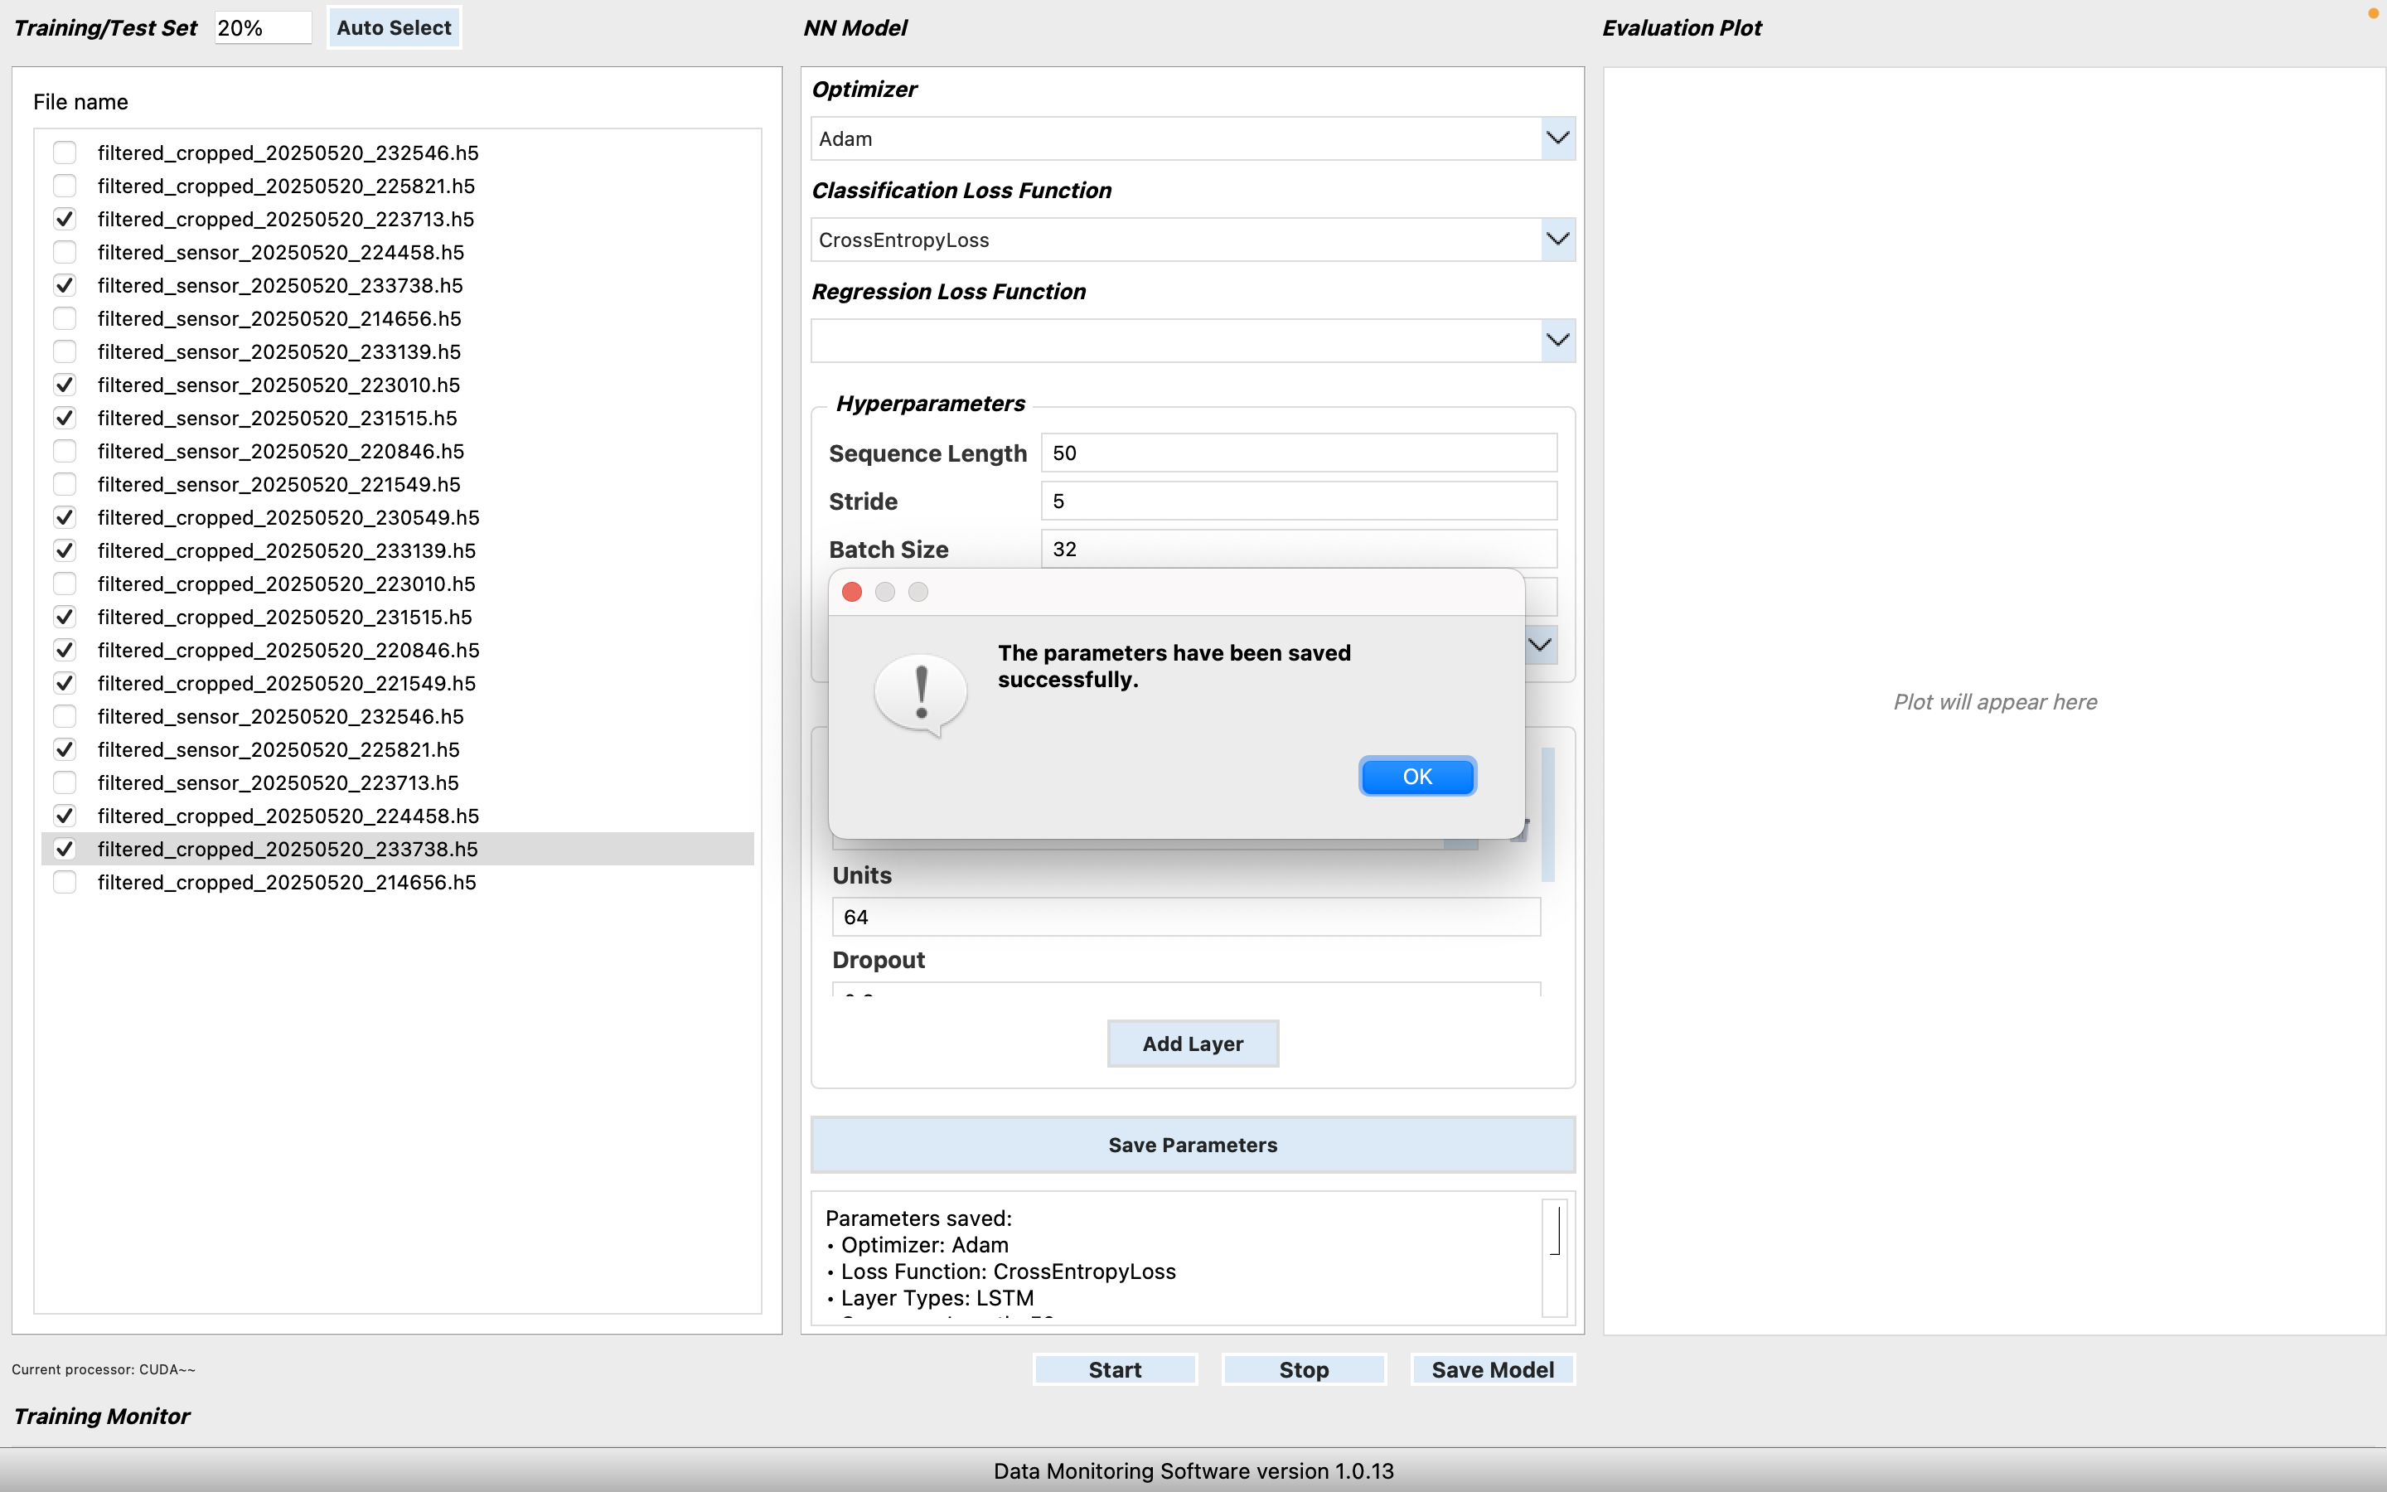
The "Save Parameters" button confirms our current configuration and is
essential to ensure our settings are saved before proceeding to the next step
After saving parameters, we can now start training the model by clicking this button “Start”

Slide 23
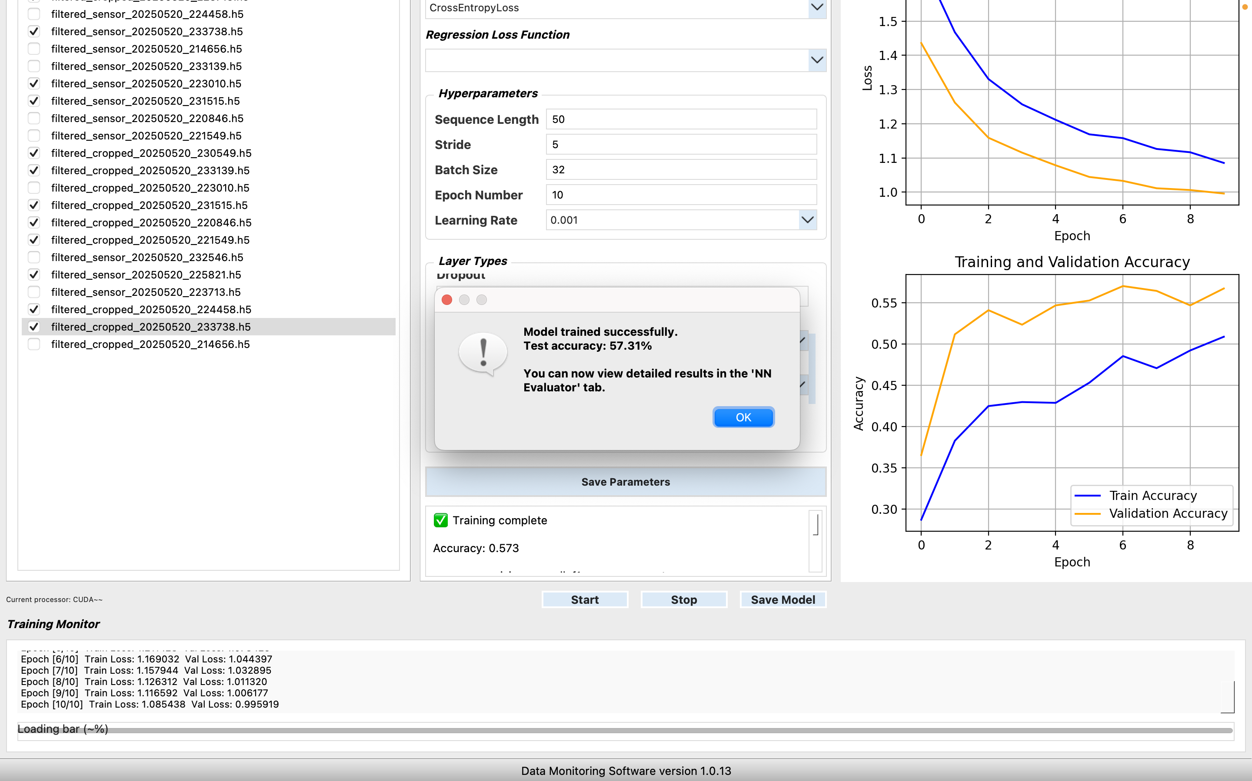
During training, progress and logs are displayed in the UI and the progress bar updates

Slide 24
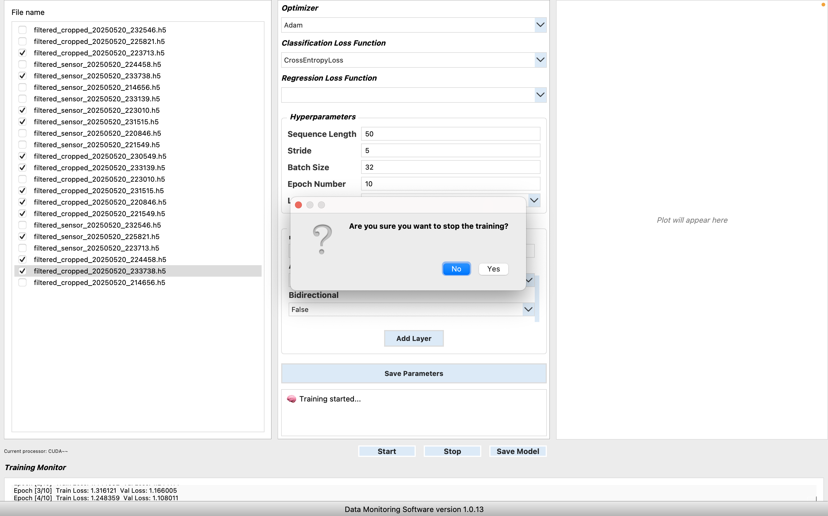
Then if we click “Yes”
When the stop button is pressed, it doesn't terminate immediately—it prompts for confirmation through a popup window.

Slide 25

The training will be forcibly terminated

Slide 26
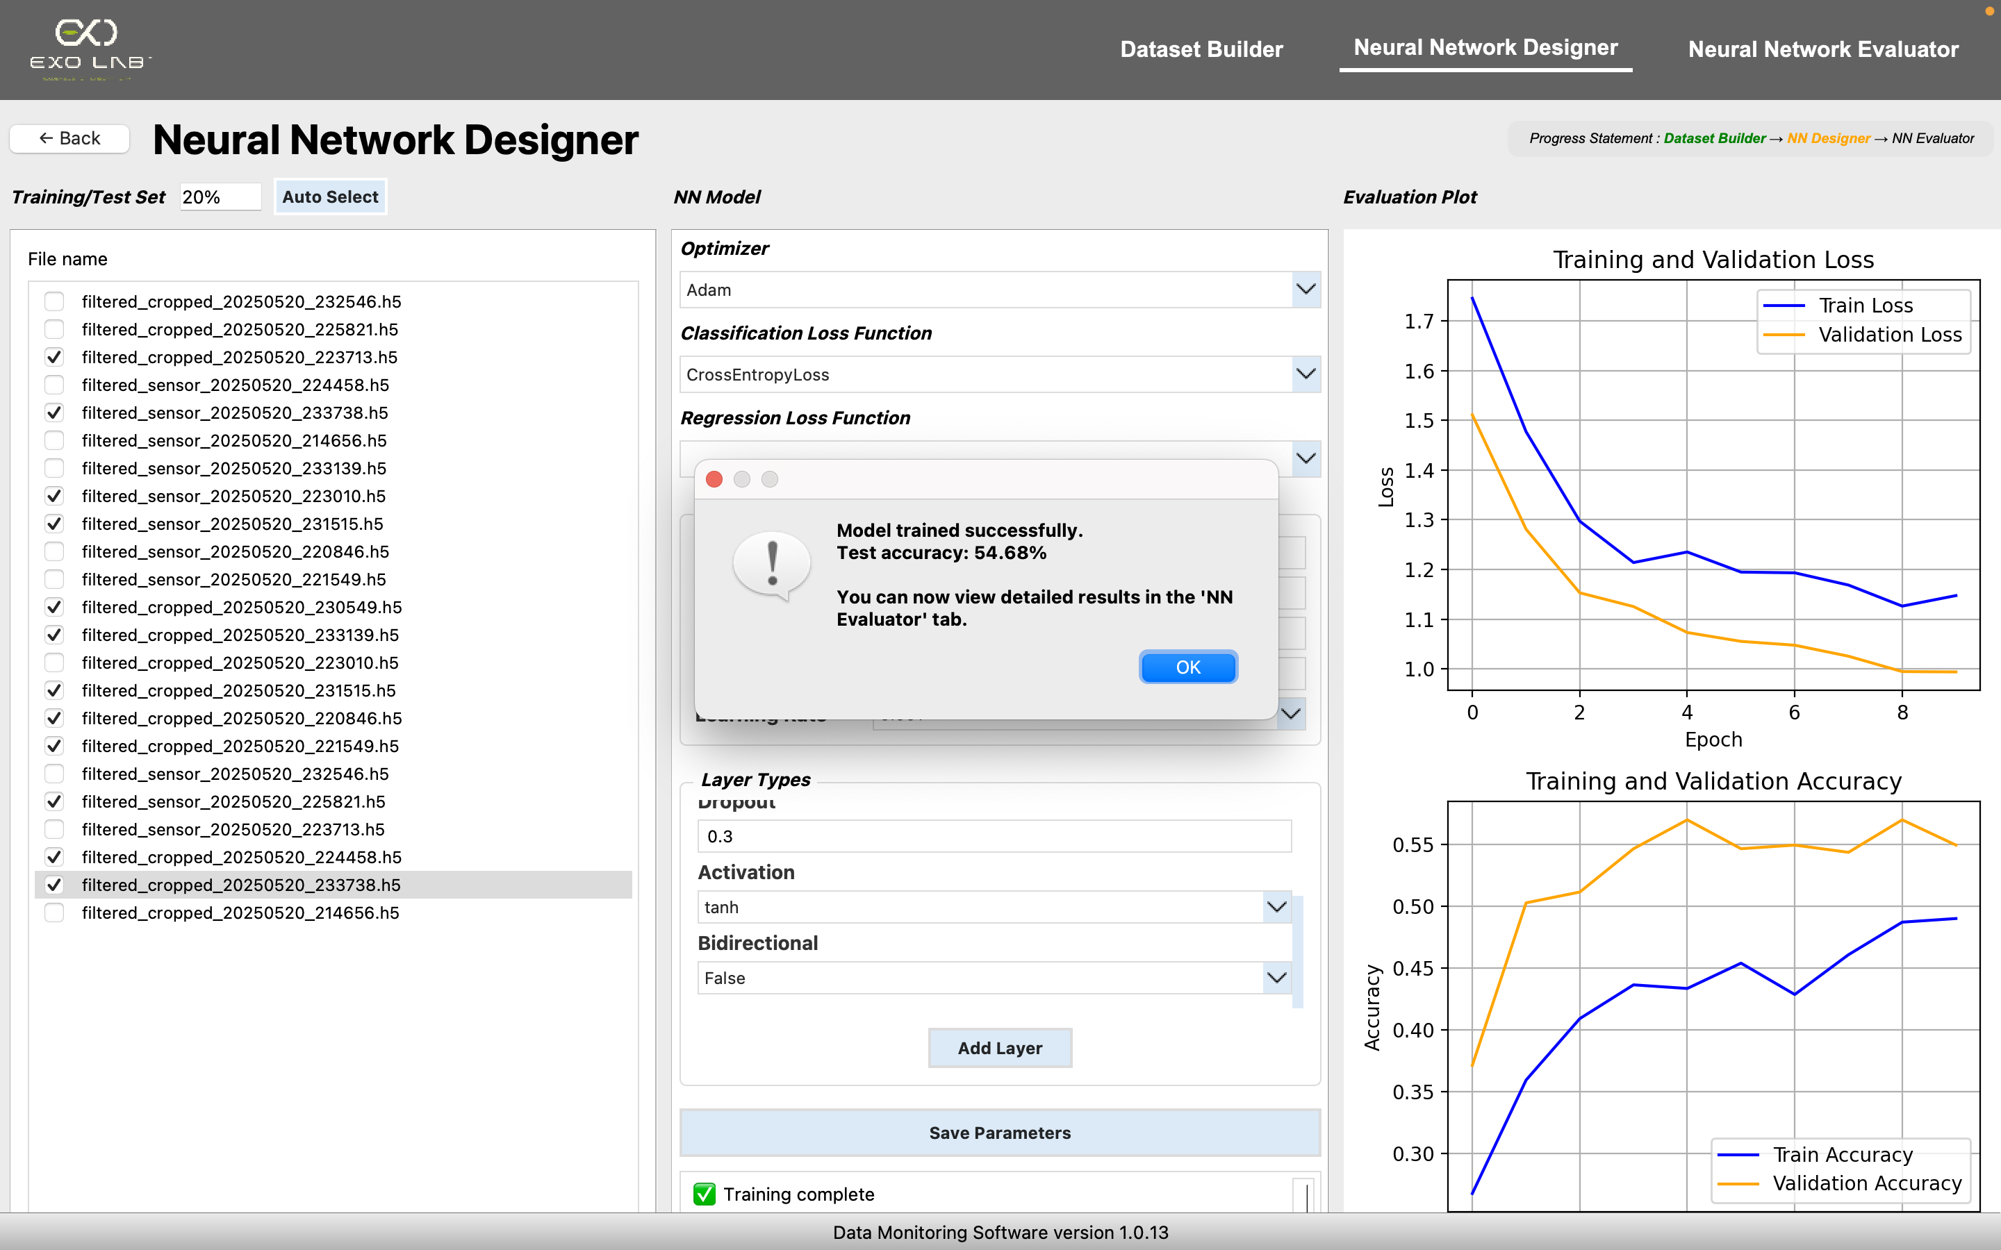
When training finishes, results and plots are shown and the model is ready for evaluation or saving

Slide 27
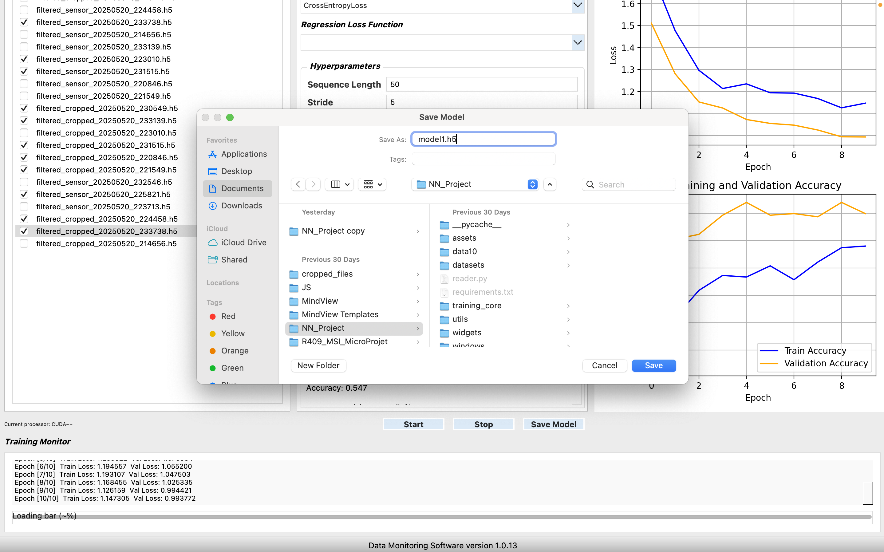
It opens a file dialog to choose where to save the model. The app saves the model configuration, weights, training parameters,
training history, test results and the list of selected files into an
.h5 file
If the user clicks this “Save Model” button

Slide 28
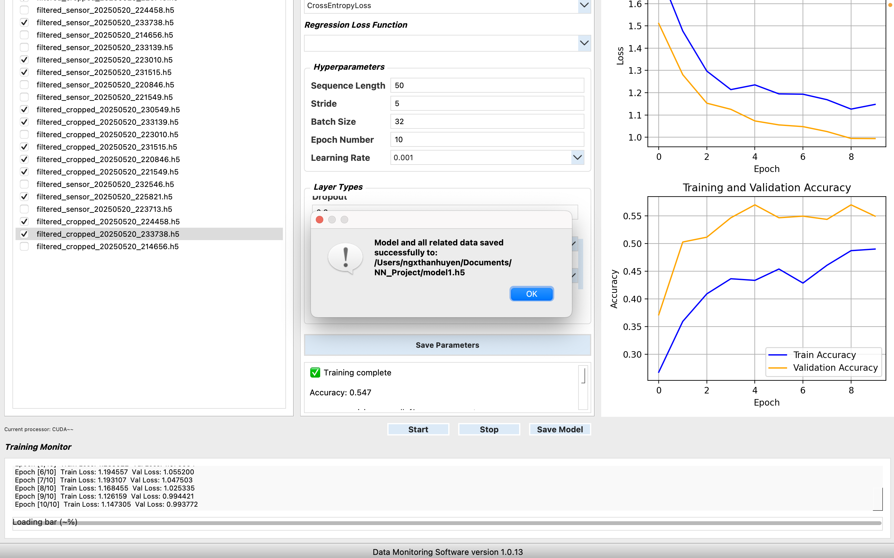
If saving is successful, we get a confirmation message; otherwise, there will be an error message

Slide 29
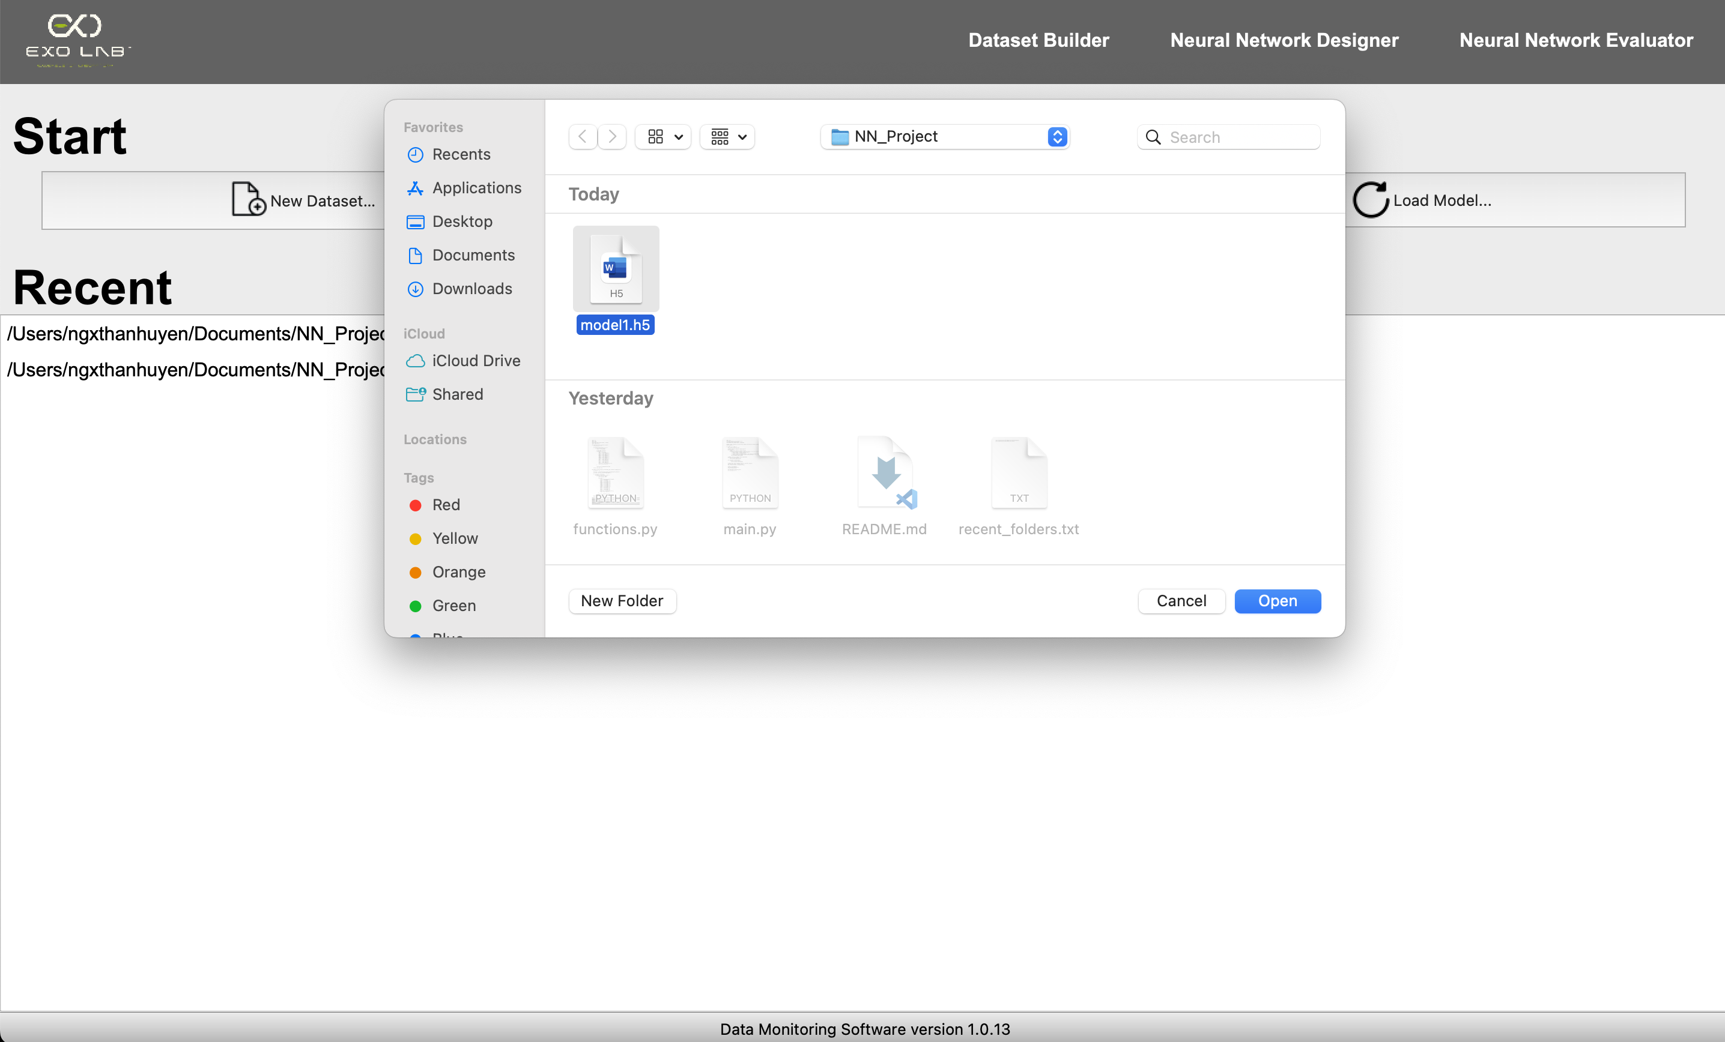
If we go back to the Start window then click this button
A file dialog appears to select a .h5 model file
After selecting the file, we click “Open”

Slide 30
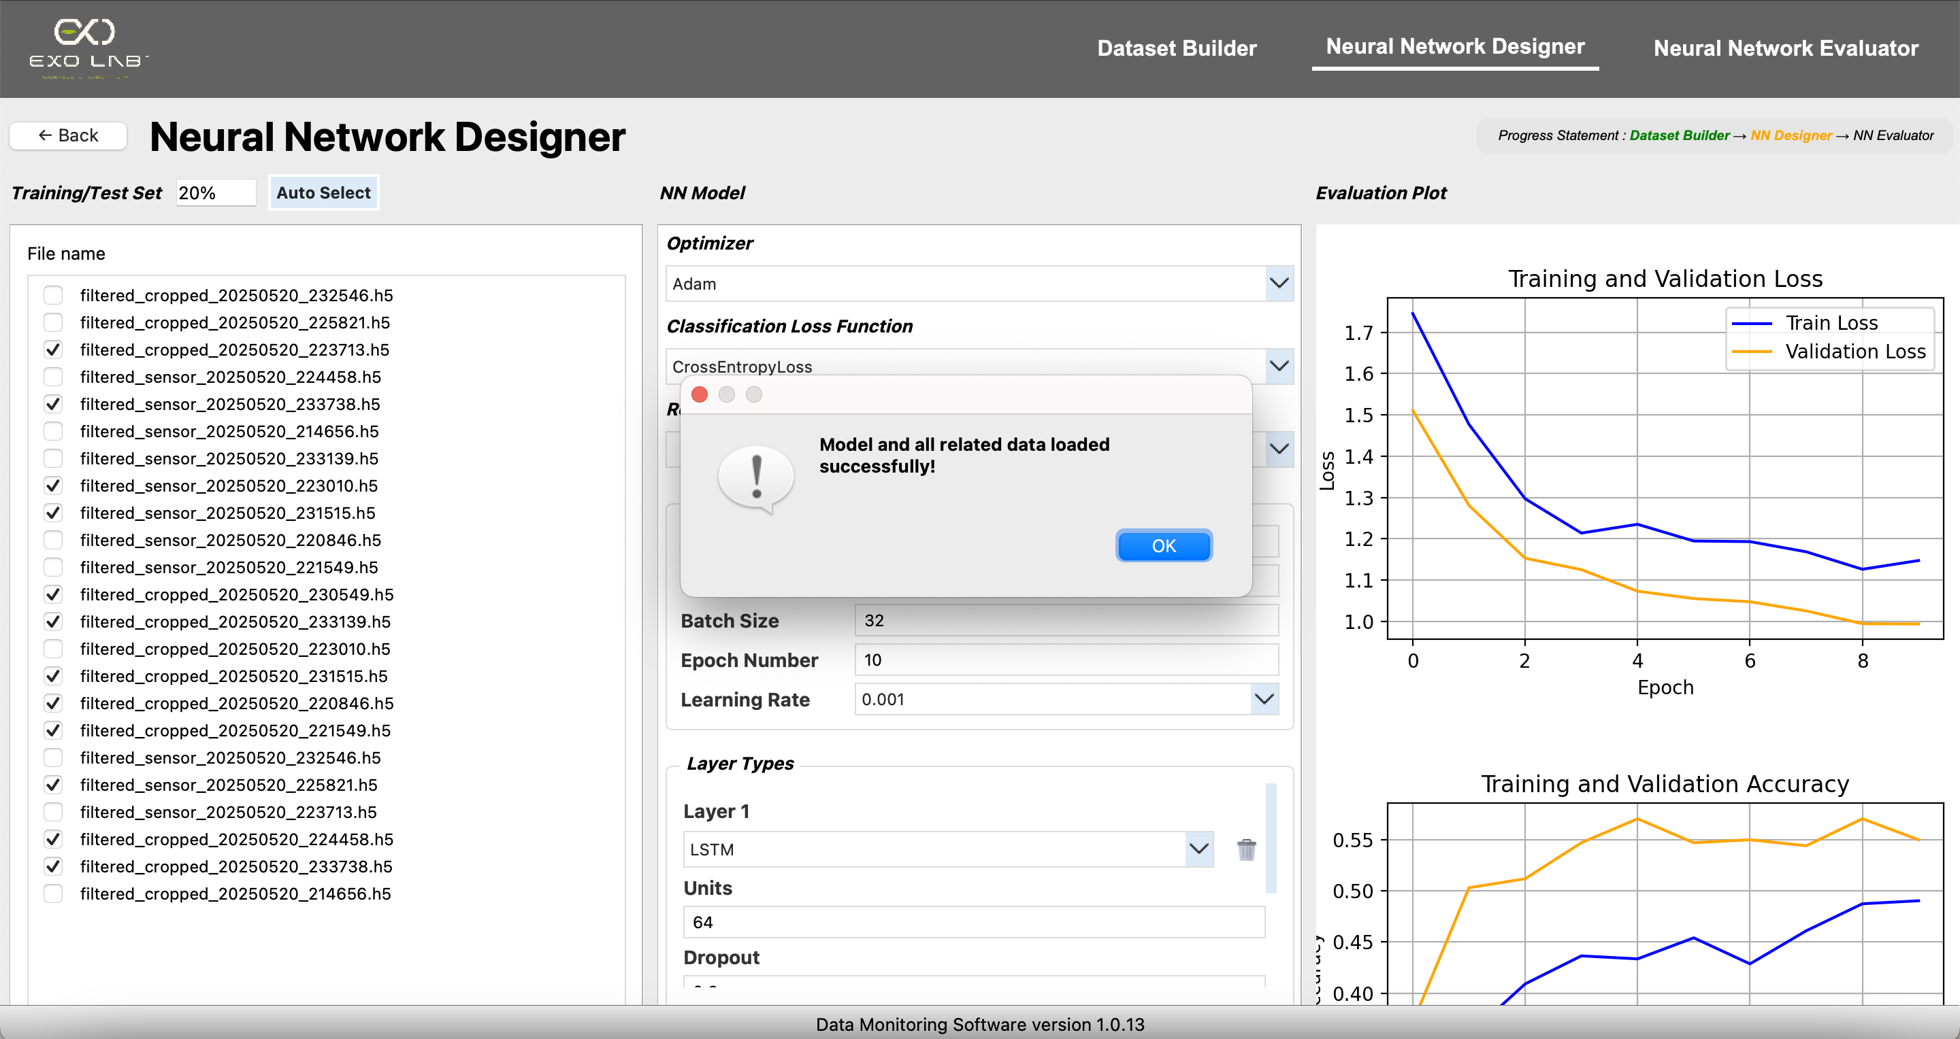
Then we can go to NN Evaluator window
Shows a success message if everything loads correctly
The GUI opens the Neural Network Designer window with all the loaded
information, so we can review, evaluate or continue working with the model

Slide 31
4. Neural Network Evaluator

Slide 32
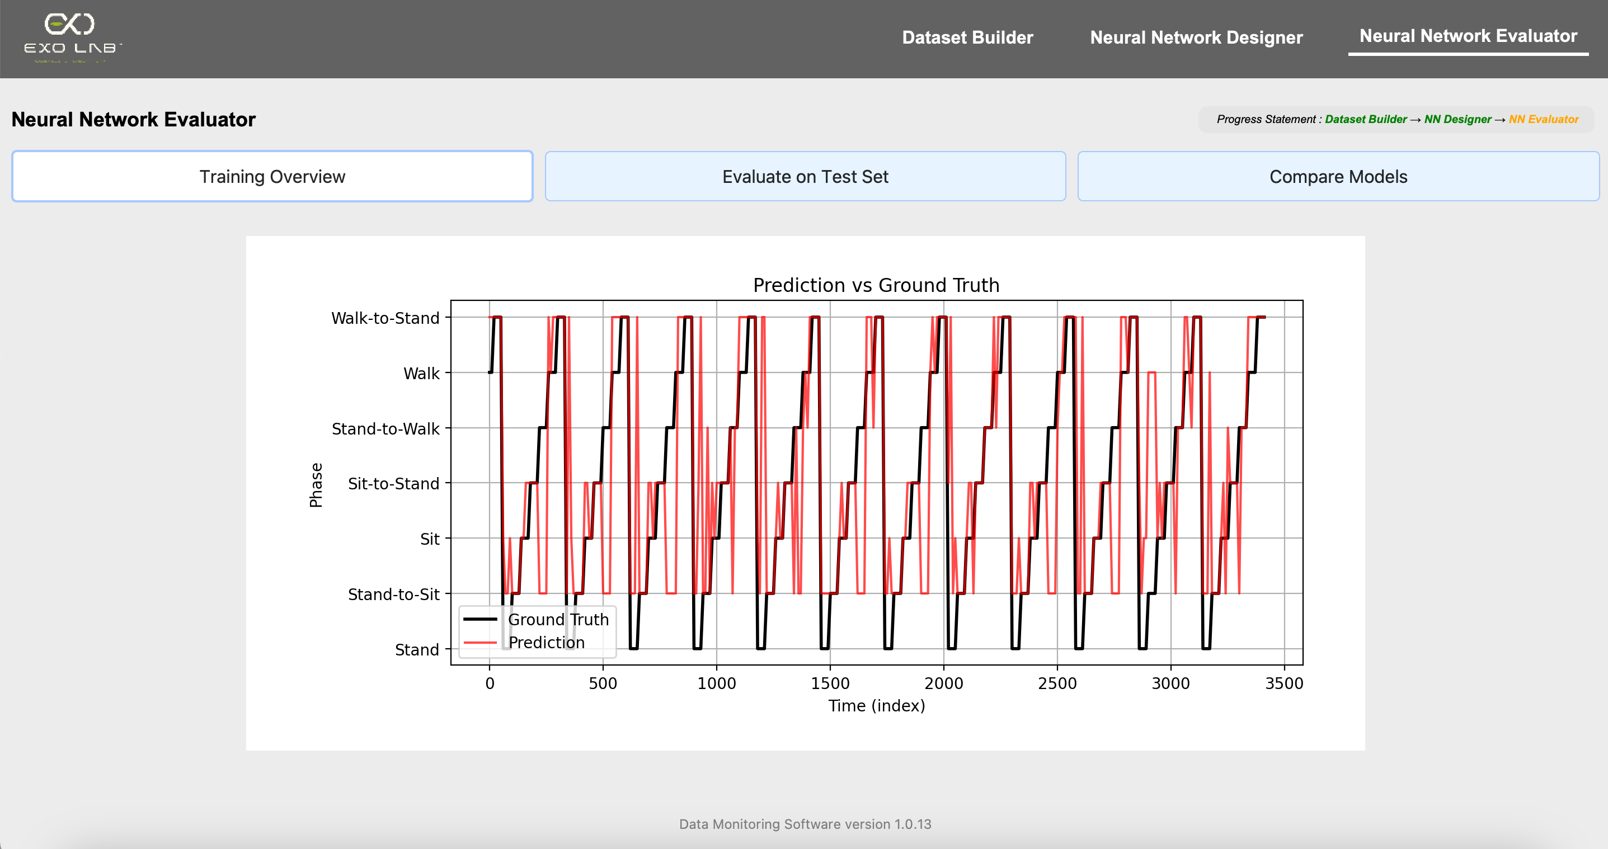
When we save a model, the application also stores all the data and results needed to display the plots and metrics in the NN Evaluator window. This means that when we later load the
model, we will see the same evaluation data, plots and
statistics exactly as they appeared at the time of saving
This plot shows how the model’s predicted phases compare to the actual (ground truth) phases over time. The x-axis represents time (or sample index) and the y-axis shows the different movement phases. It helps the user visually assess how closely the model’s predictions follow the true sequence

Slide 33
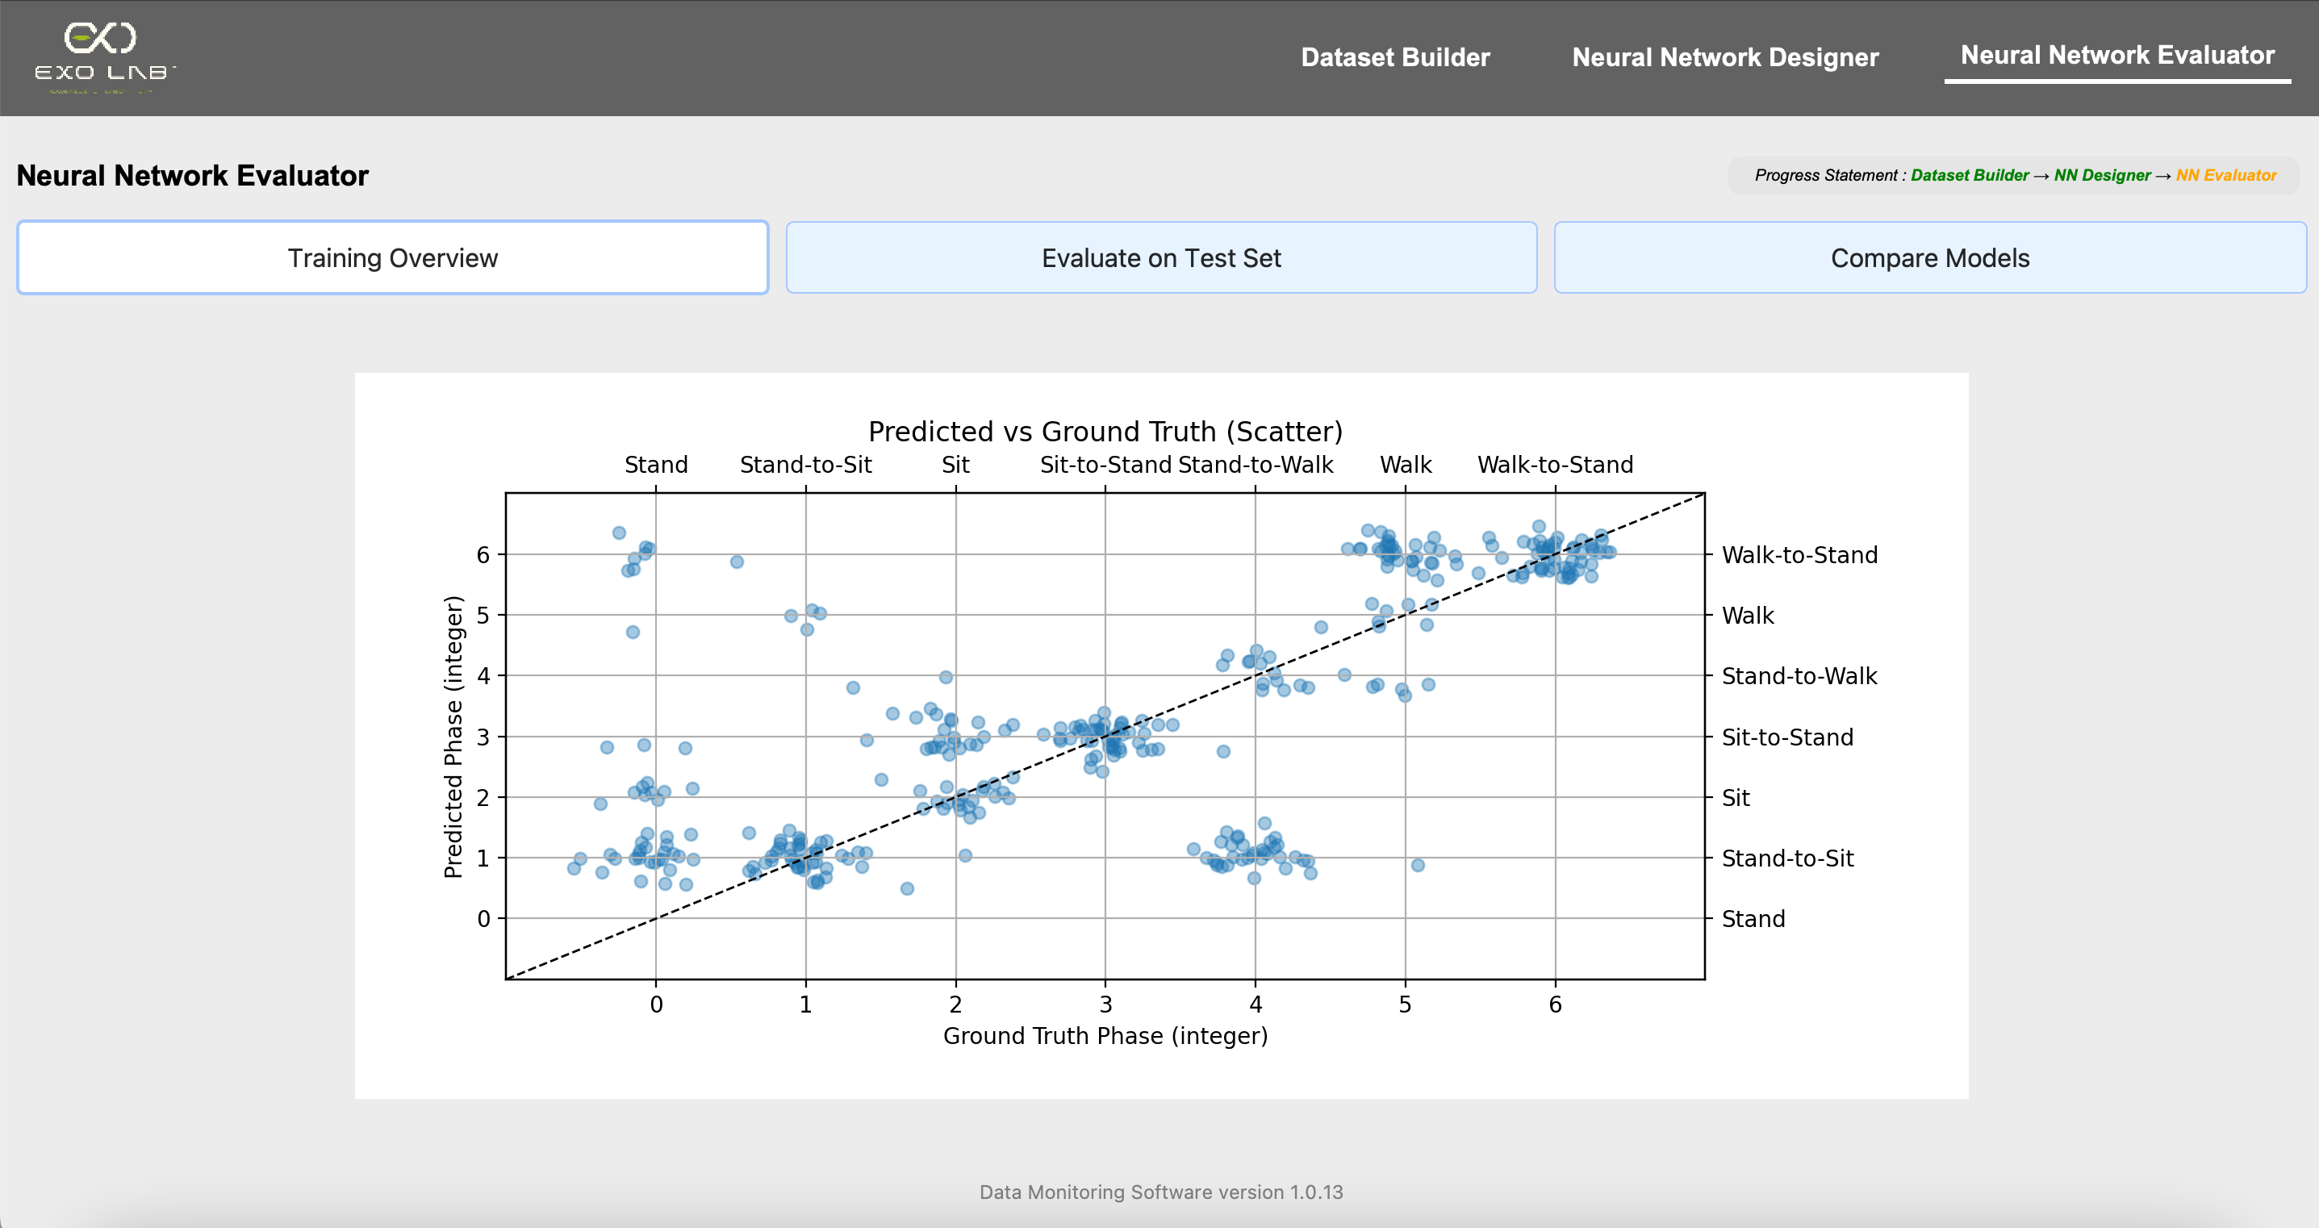
When we scroll down, there is another plot. This scatter plot compares each predicted phase to the corresponding ground truth phase for all test samples. Each point represents a prediction. Points on the diagonal indicate correct
predictions, while off-diagonal points show errors. This plot gives a quick
overview of the model’s classification accuracy and error patterns.

Slide 34
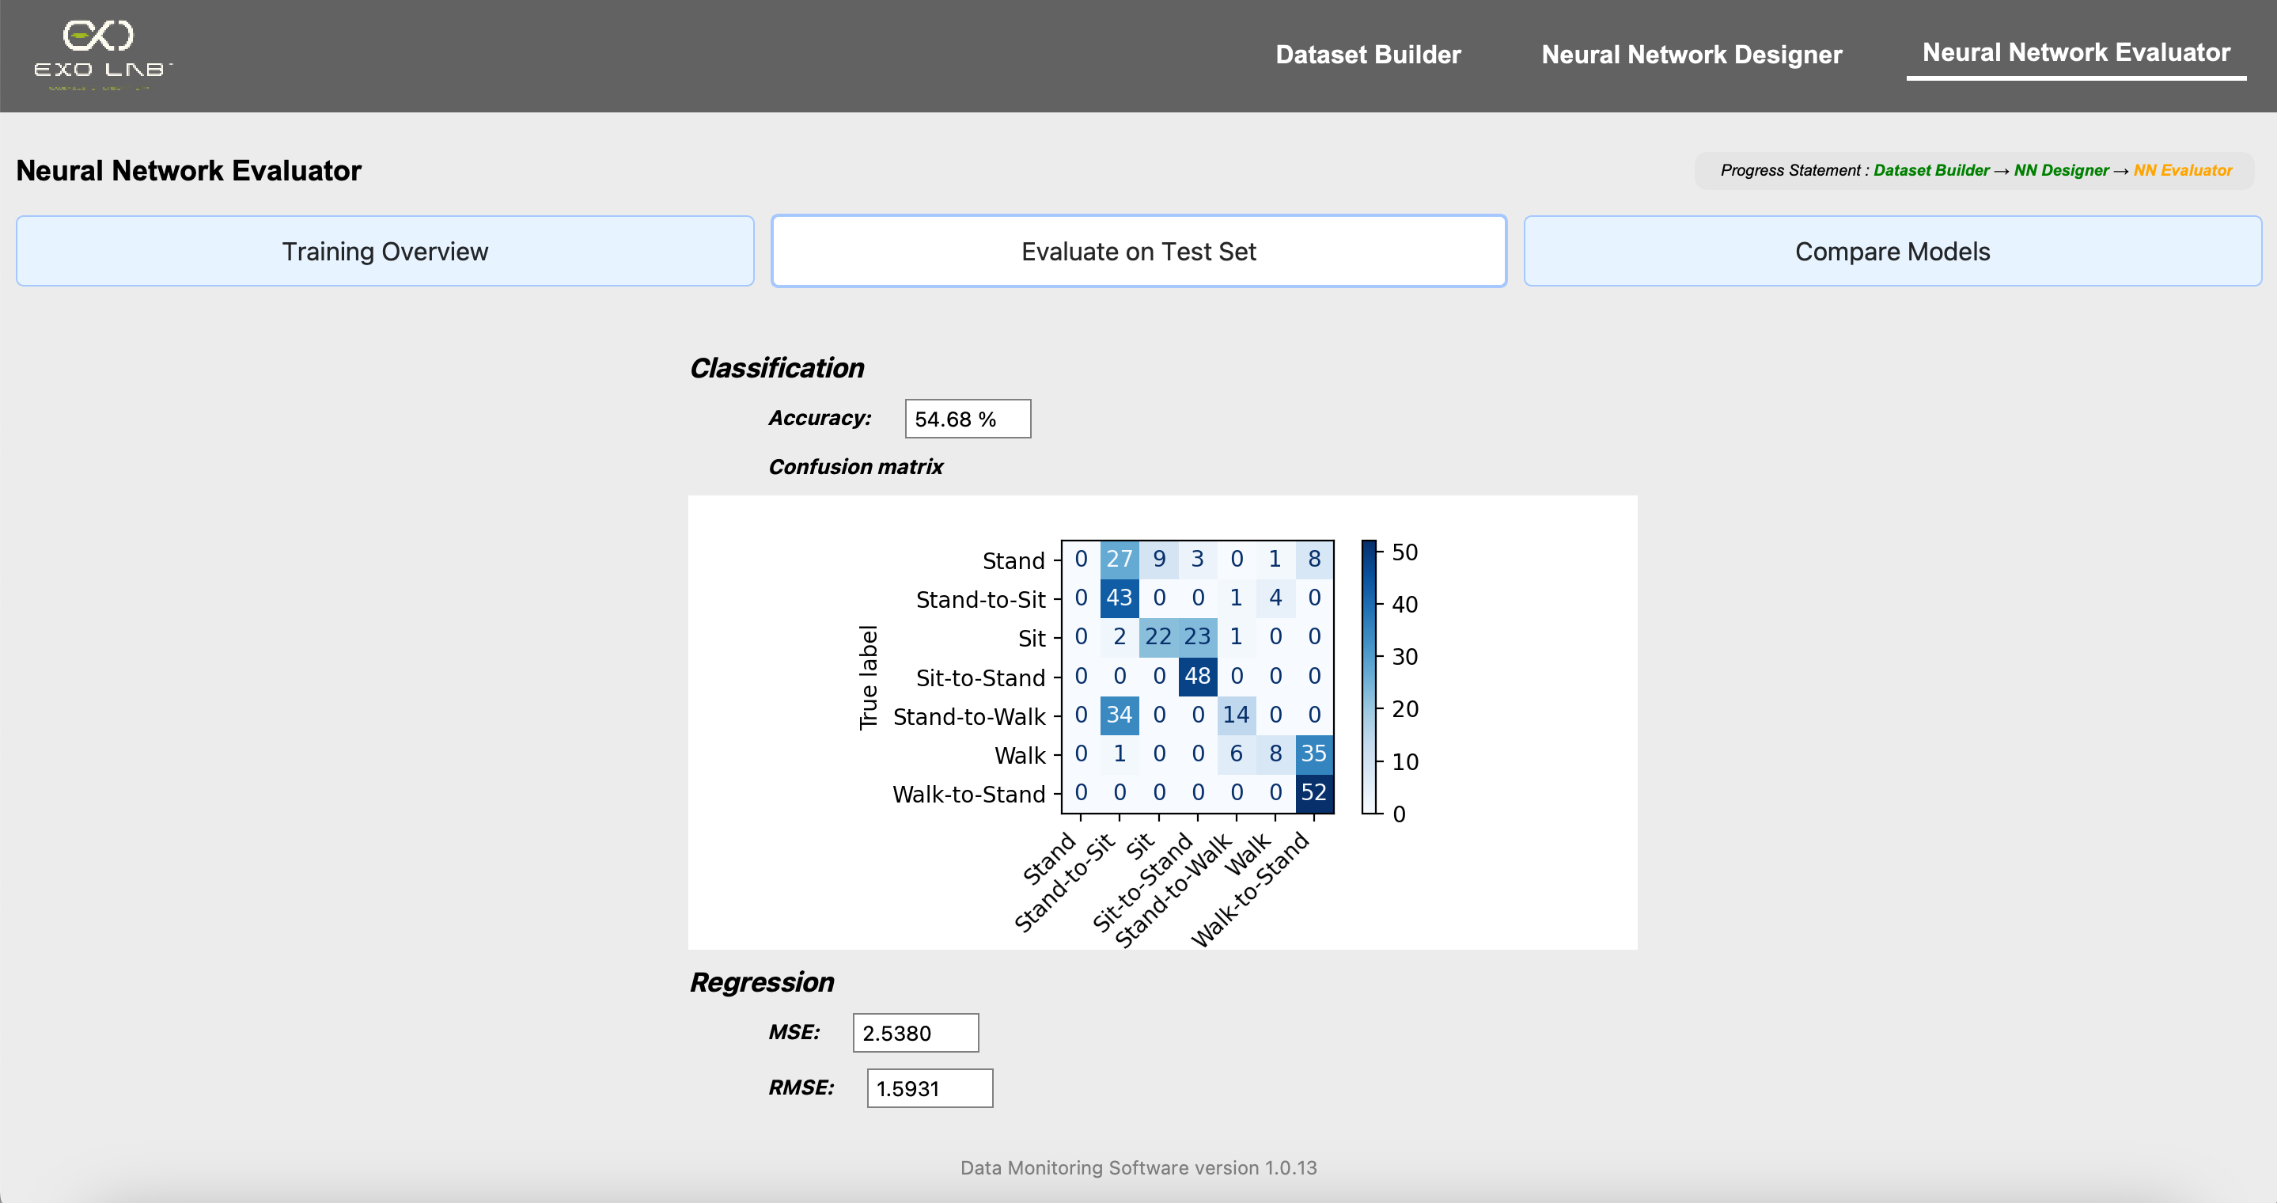
Displays the percentage of correct predictions made by the model on the test set
A visual matrix that shows how often each true phase was predicted as each possible phase. The diagonal cells represent correct predictions, while off-diagonal cells show misclassifications. This helps the user see which phases are most often confused by the model
Mean Squared Error : shows the average squared difference between the predicted and true values. Lower values indicate better performance
Root Mean Squared Error: the square root of MSE, giving an error measure in the same units as the target variable.

Slide 35
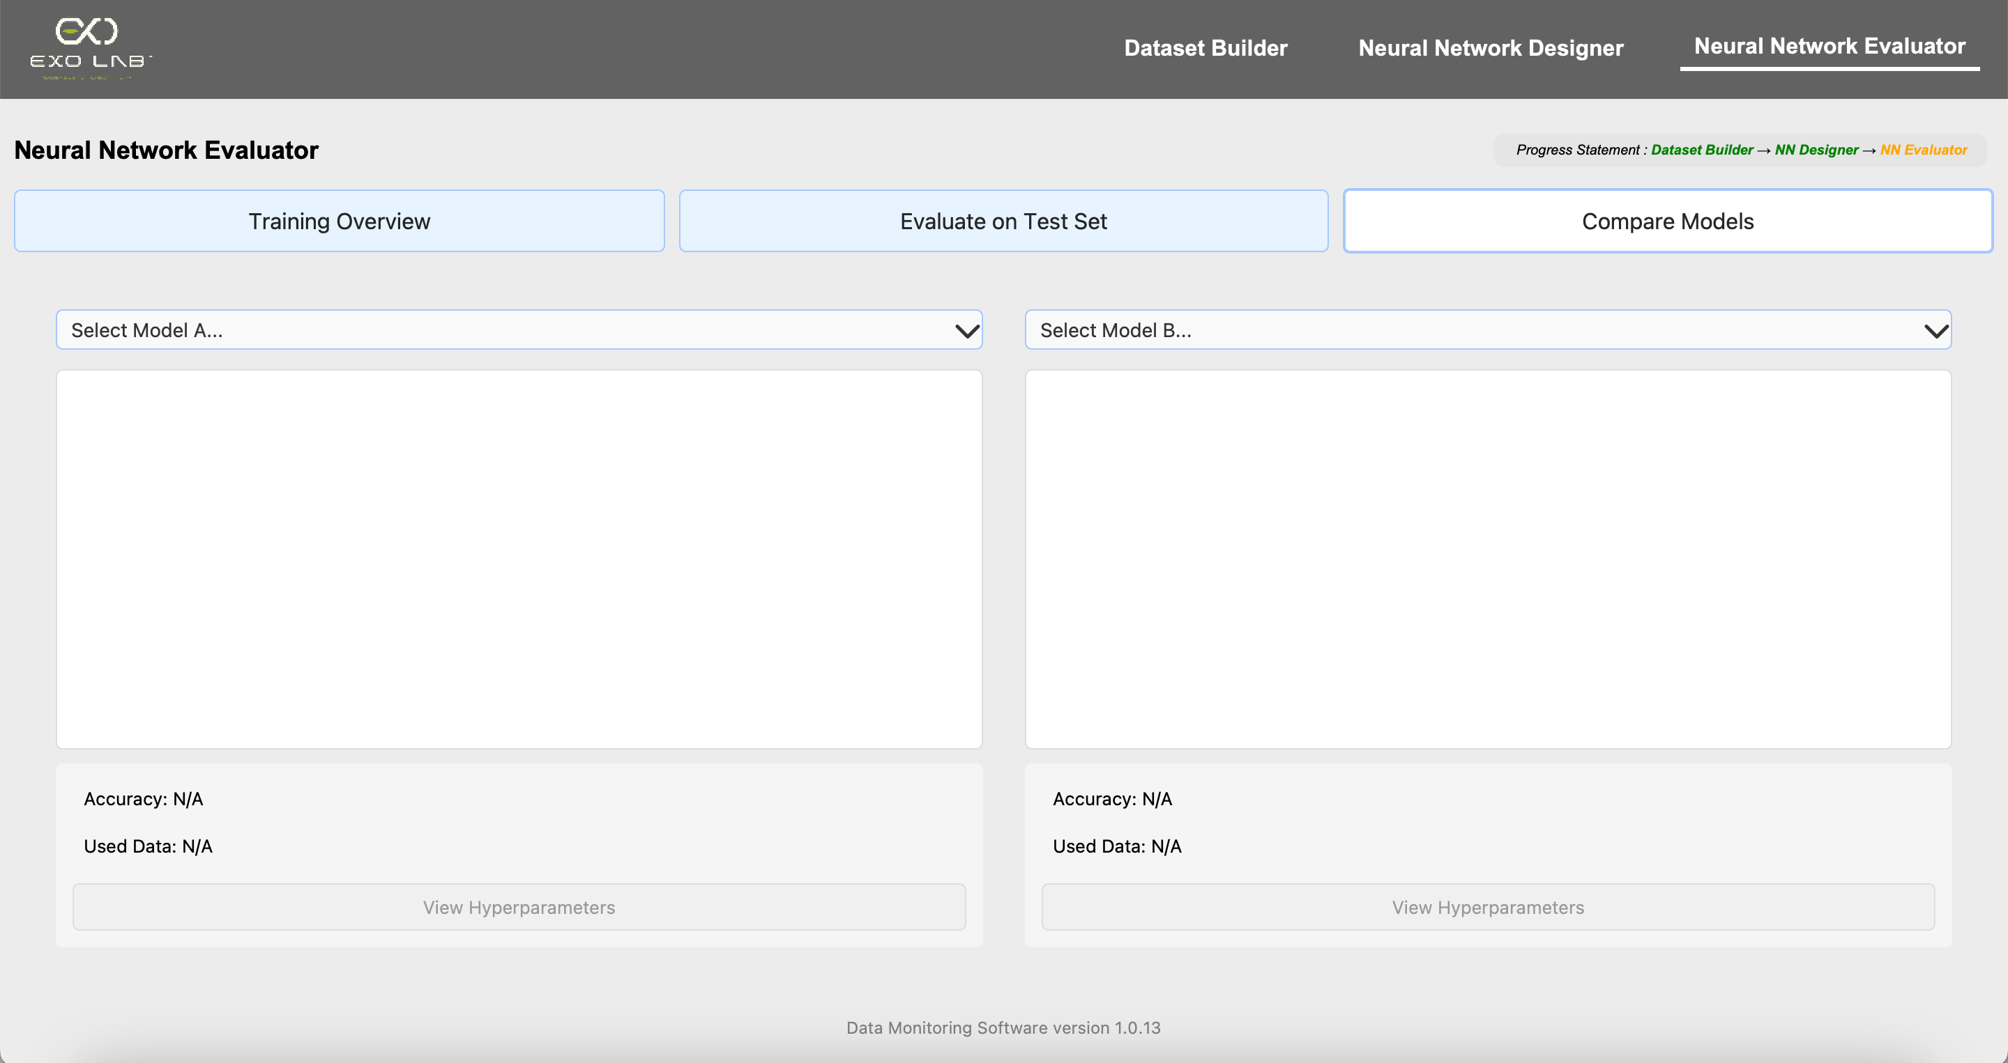
This section lets user compare the performance of two different neural network models saved earlier side by side
Initially, this section is completely blank, with no models or plots displayed

Slide 36
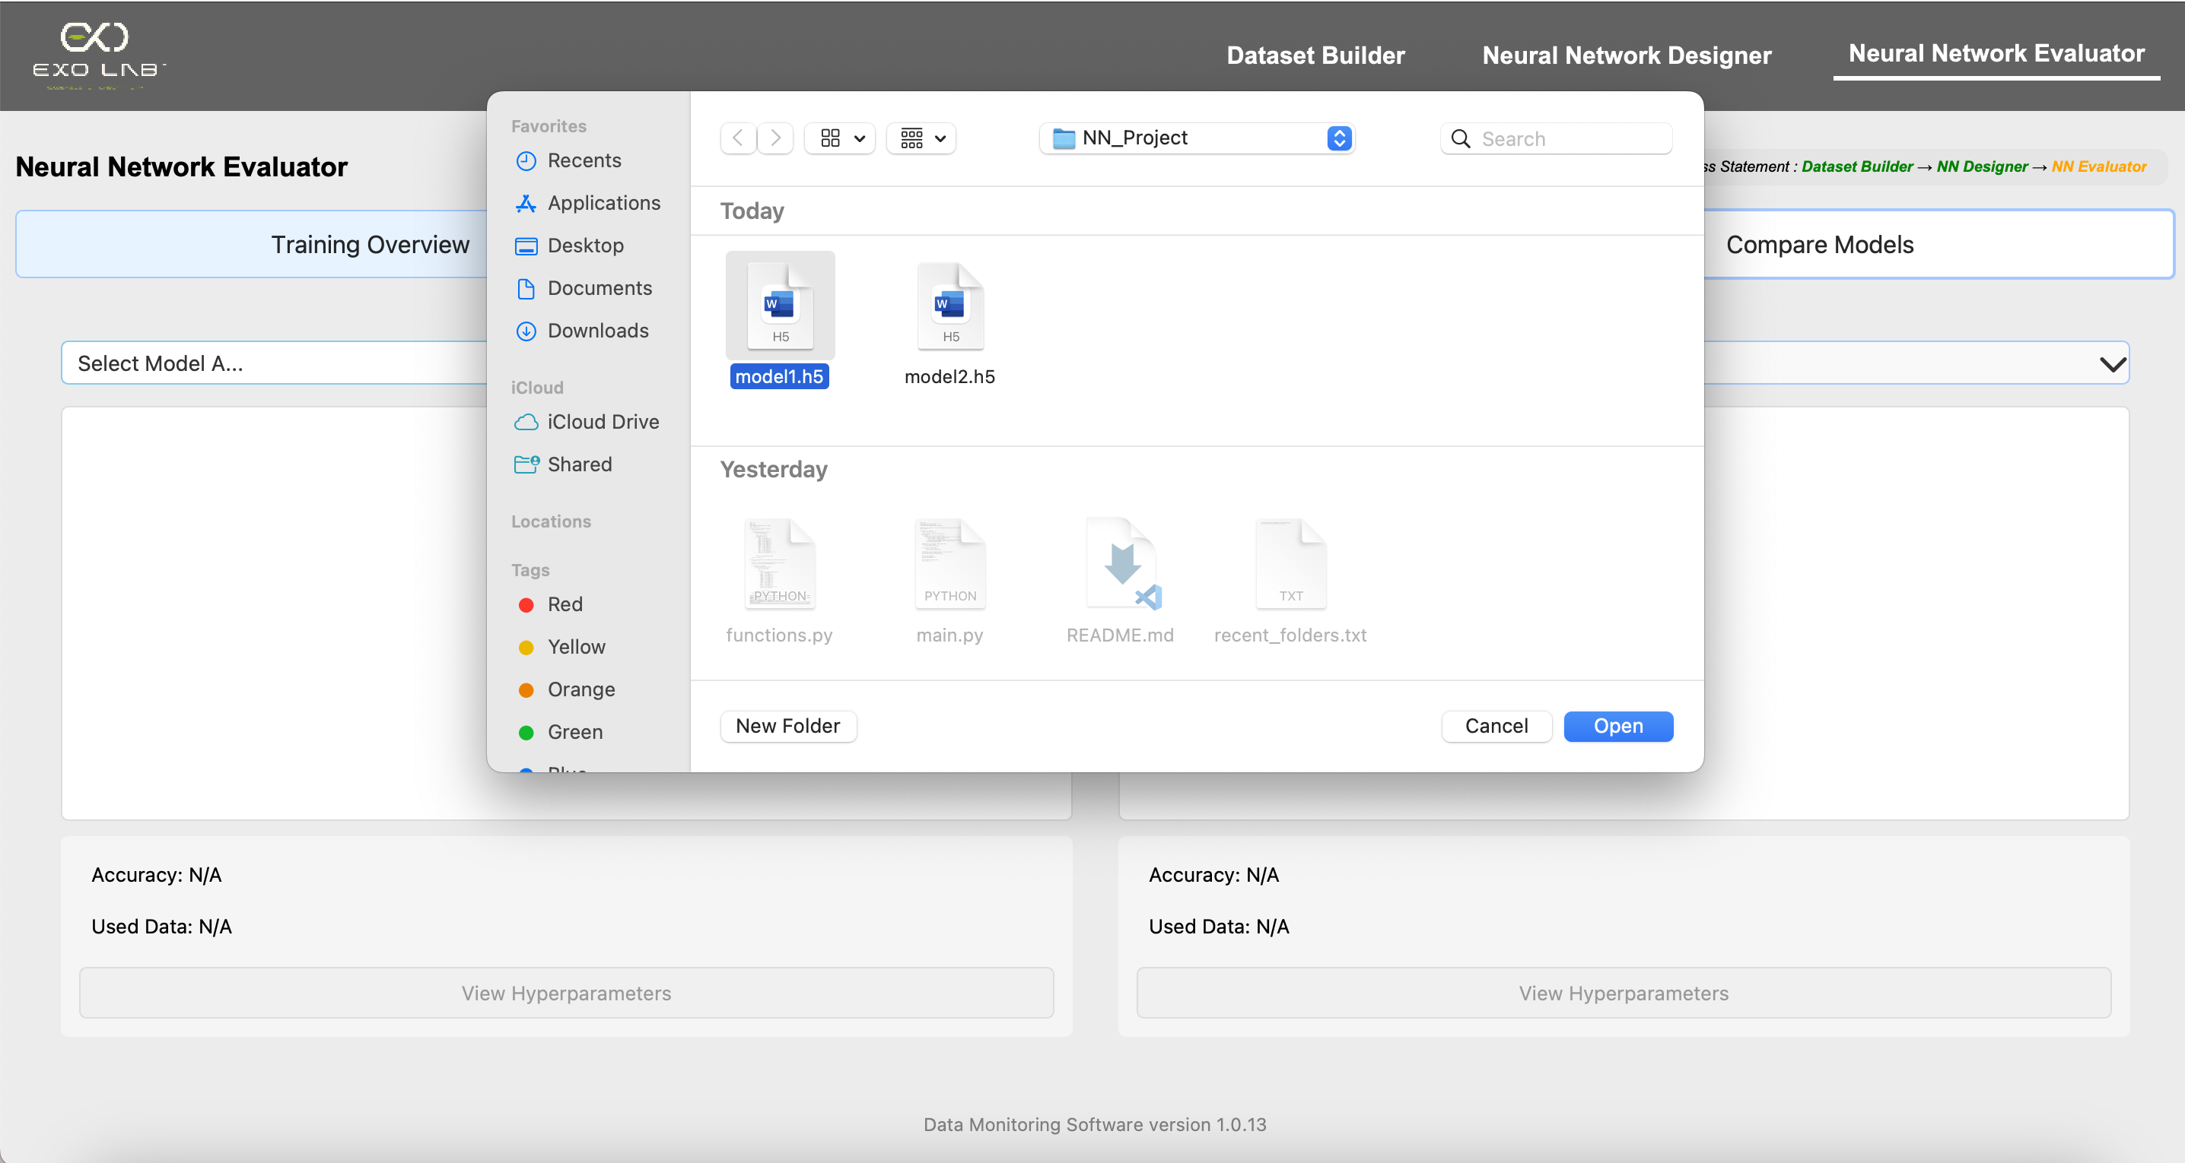
A file dialog appears to select a .h5 model file
If we click here

Slide 37
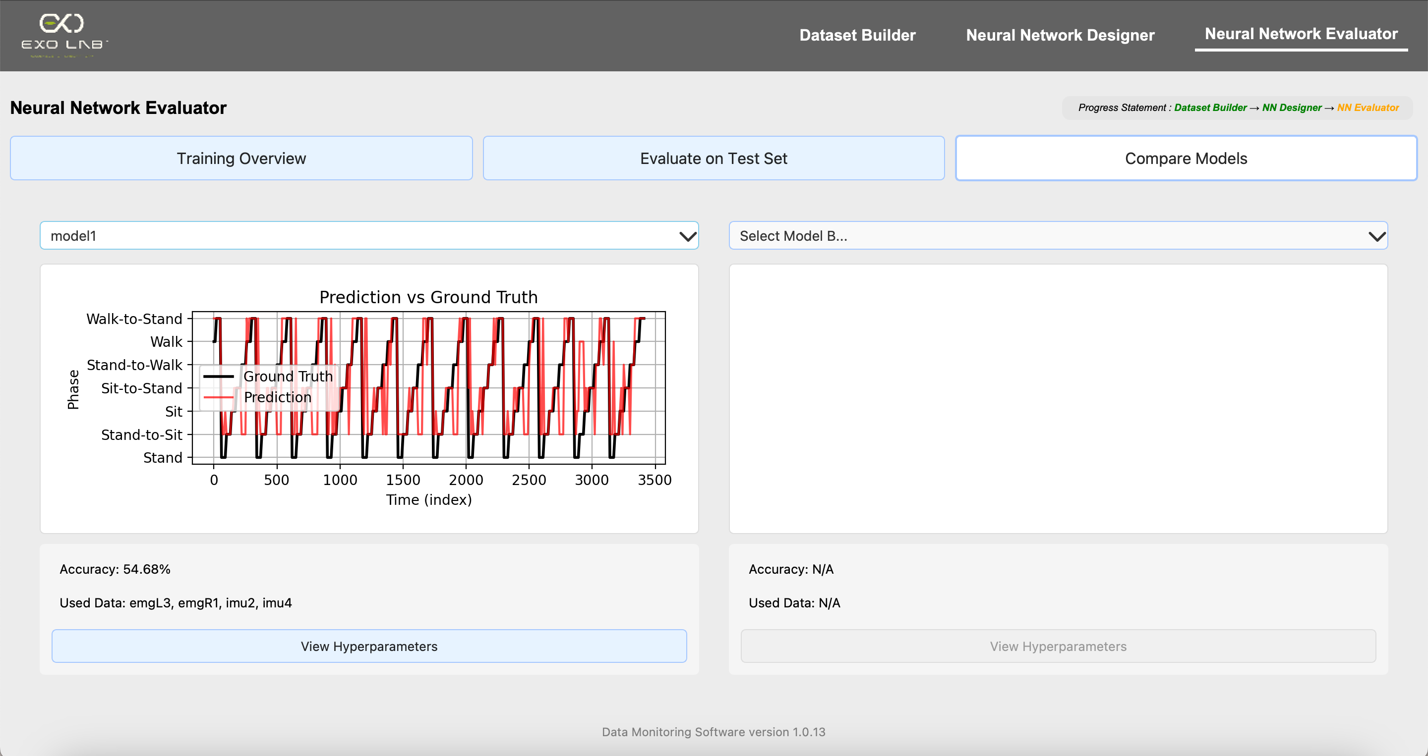
The performance plot for Model A is displayed, showing its predictions versus the ground truth
Model details such as accuracy, used sensor data and a button to view hyperparameters are shown below the plot
If we click this button

Slide 38
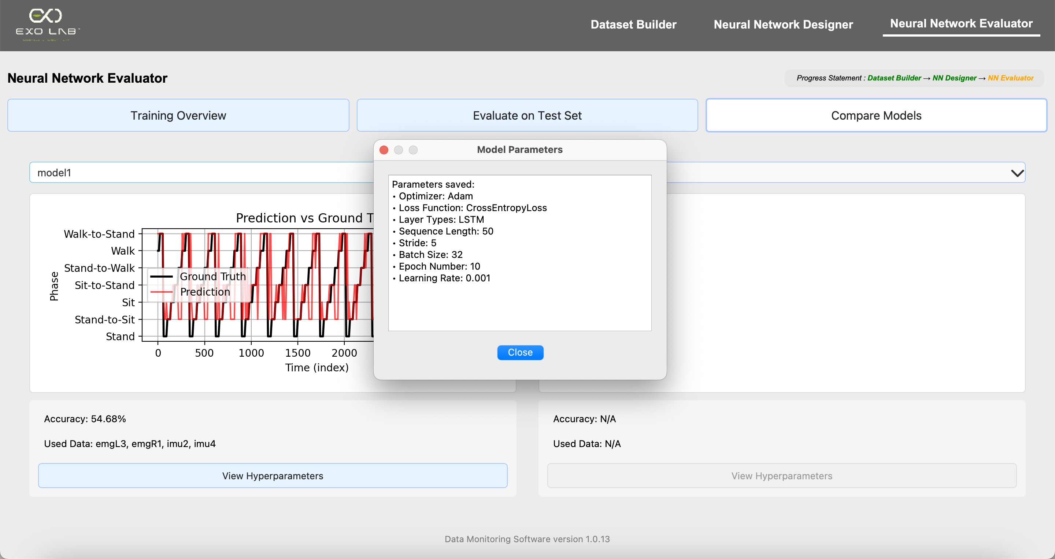
A dialog window appears showing all the training settings and architecture details used for the selected model. This allows the user to review and compare the exact configuration used to train the model

Slide 39
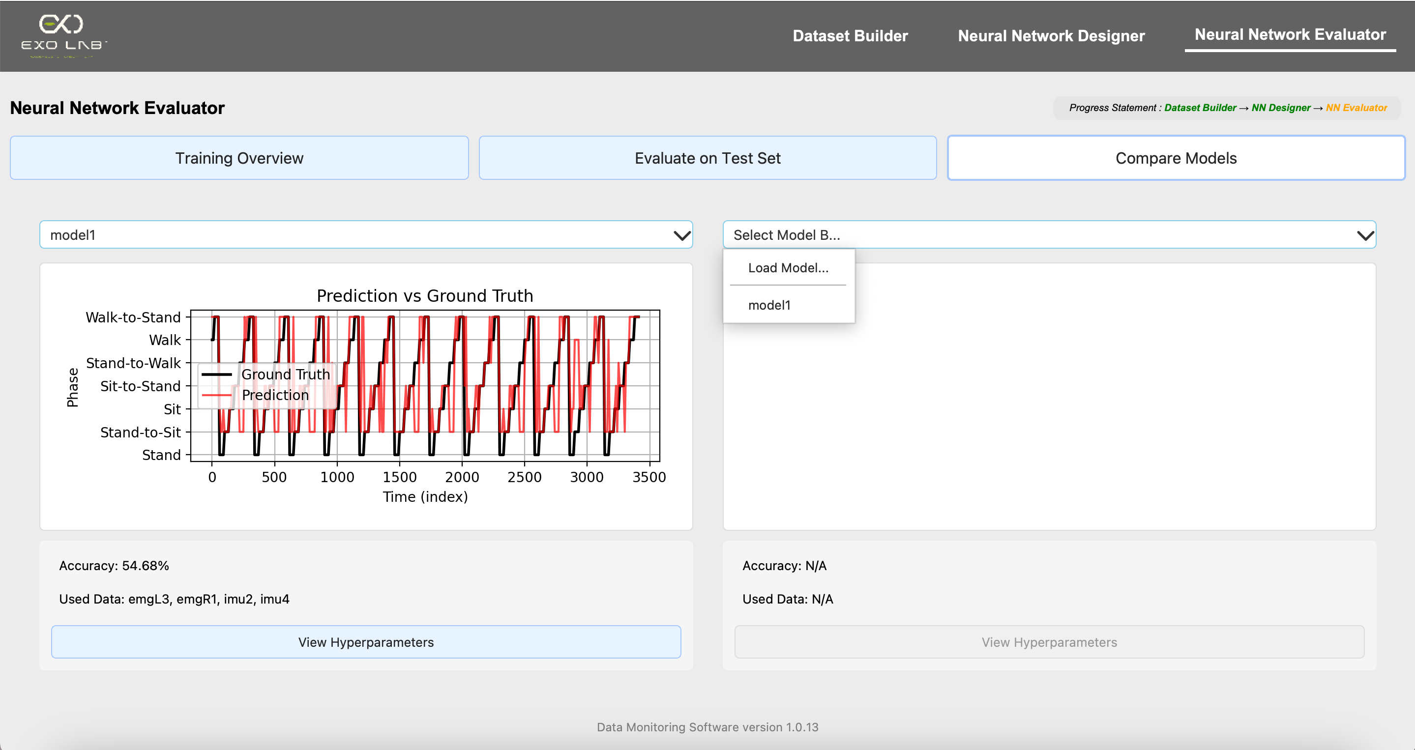
Then we select Model B by clicking this button, the application also suggests the most recently loaded model as a recommended option

Slide 40
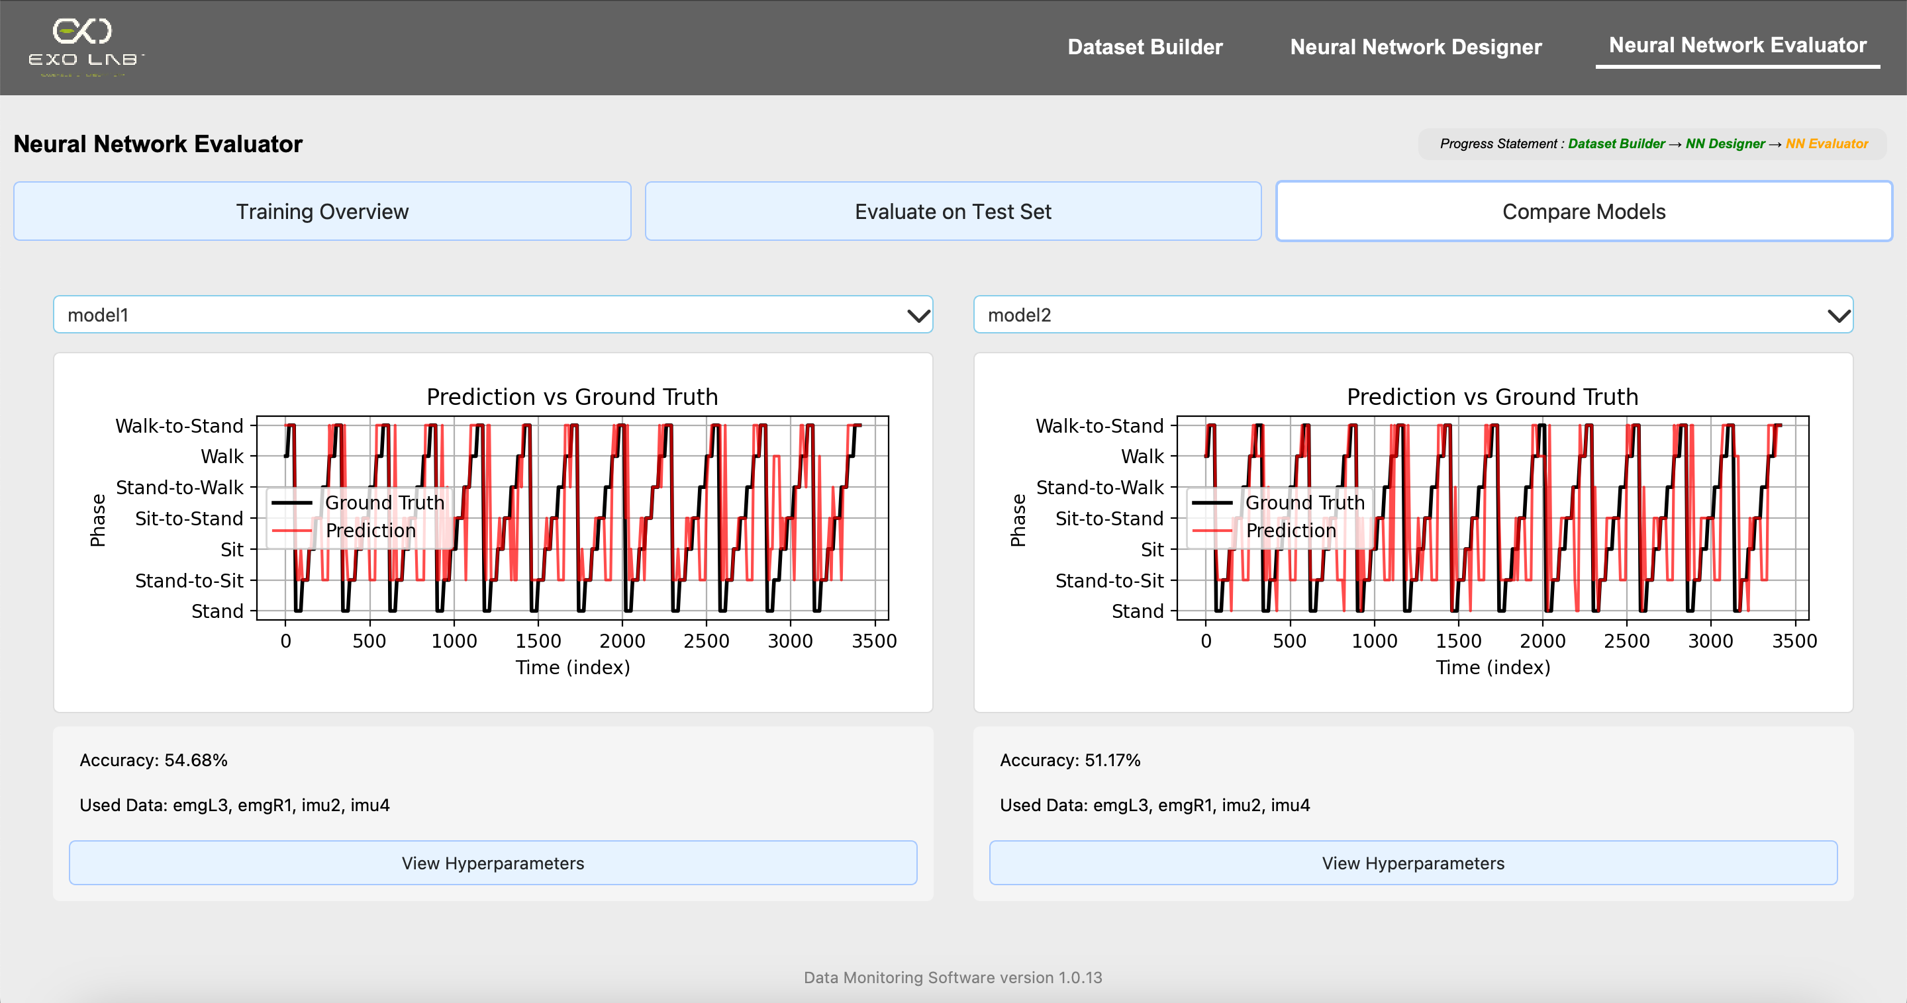
After selecting the second model, the performance plot for Model B is also displayed, showing its predictions versus the ground truth
Model details such as accuracy, used sensor data and a button to view hyperparameters are shown below the plot

Slide 41
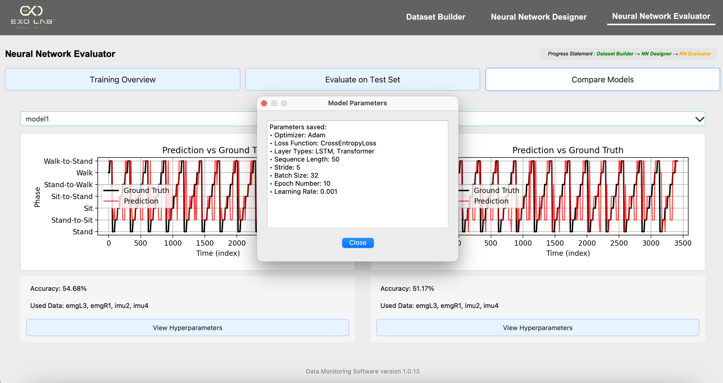
We can also click this to view all the training settings and architecture details used for this model.

