Slide 1
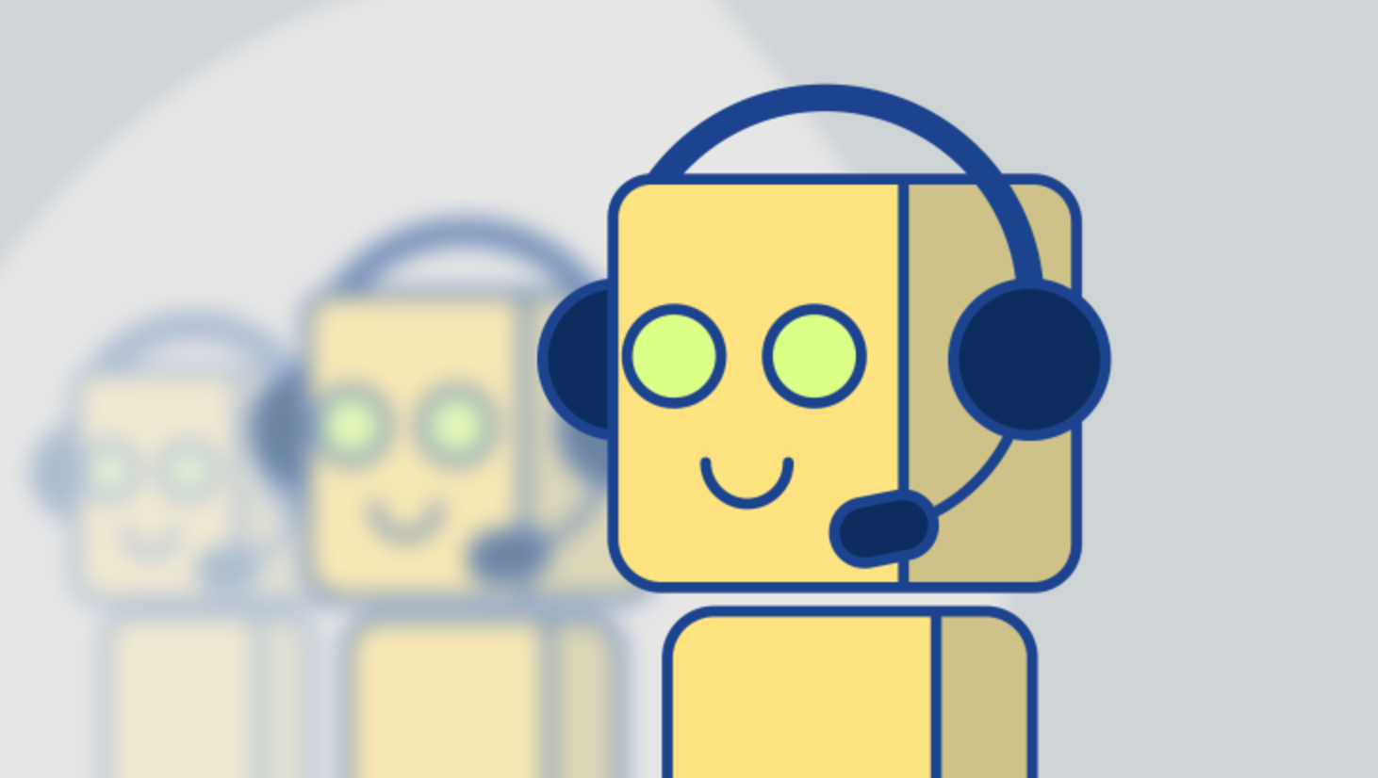
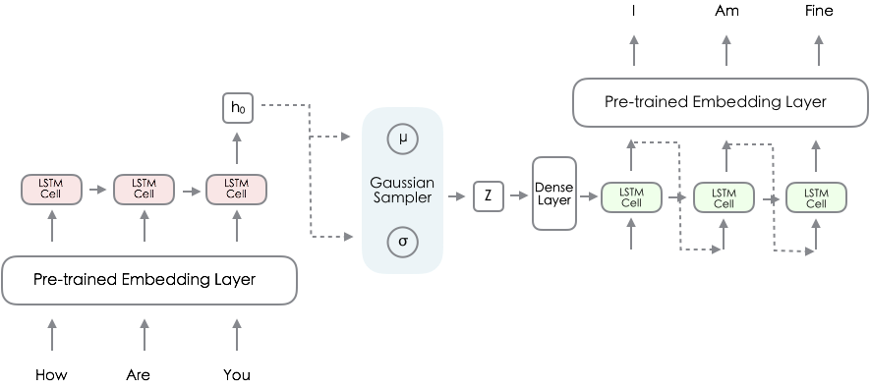
Variational Conversation model
Xupeng Tong, Yikang Li, Chao-Ming Yen

Slide 2
introduction
BACKGROUND
METHOD
RESULT
DEMO TIME
EXISTING PROBLEM
SOLUTIONS FOR THE FUTURE

Slide 3
BACKGROUND

Slide 4
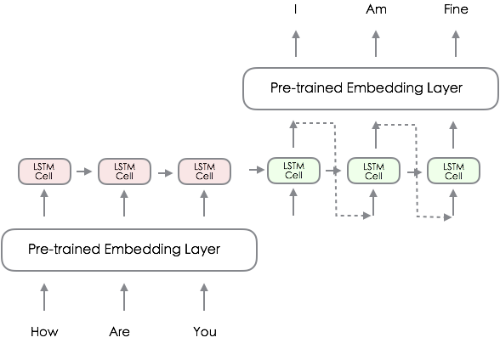
Neural Conversational Model
Sequence to Sequence model
Chatbot:
Auto-encoder
+
Recurrent Neural Network

Slide 5
Variational Recurrent Autoencoder

Slide 6
METHOD

Slide 7
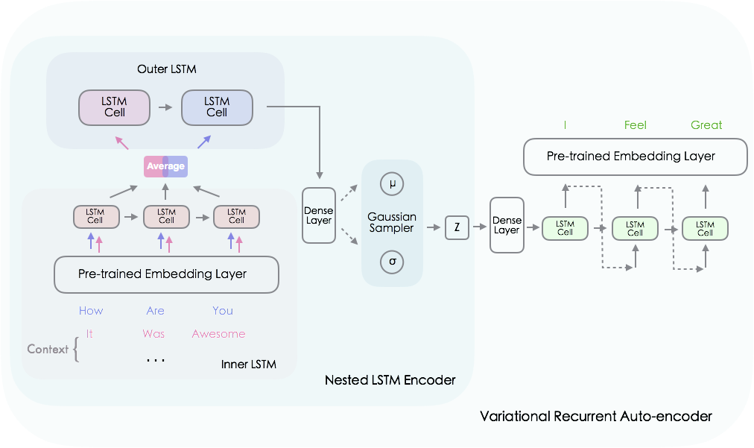
Variational Nested Recurrent Model

Slide 9
Result ANALYSIS

Slide 11
DeMo time!

Slide 12
existing PROBLEM
KL loss is so easy to be pushed to zero.
Solution?
Annealing term!
Convolutional layer instead of LSTM in the decoder phase

Slide 13
SOLUTION FOR THE FUTURE!

Slide 14

Thank you!

