Slide 1
Synthetic Histories
ARMA-ed and dangerous
Paul Talbot, Presentor
INL NHRES Workshop, March 2018

Slide 2
Motivation
Goal: Calculate meaningful impact of installed capacity choices
Problem: Availability in existing year-to-year data
Wind, solar, demand/load
Short recorded history
Missing portions of records
Need: Source of data
Consistent time intervals
Reflects real behavior
Statistically significant (over 100k years)
Solution: Good synthetic histories
Stochastic Modeling

Slide 3
Why Stochastic Modeling
Problems with deterministic dataset
Small sample size
Optimization converges on data, not phenomenon
Benefits of synthetic data
Unbounded sample size
Underlying behavior captured in large statistical sampling
Allows probabilistic analysis of HES and stochastic optimization
Limitations of synthetic data
Each evaluation should statistically conform to real-life data
Each evaluation should be independent

Slide 4
Stochastic Time Series Methods in literature
Artificial Neural Network
Factor Analysis
Gaussian Process
Power Spectrum Density
Numerical Weather Prediction
Autoregressive (AR)
Autoregressive Moving Averaging (ARMA)
Our approach:
Data selection
Fourier de-trending
Residual normalization
ARMA to represent the residuum

Slide 5
Data Selection
We might not have enough data for stochastic optimization
But we might have more than one time period
1st period
2nd period
3rd period
Sub-period
Sub-period
Sub-period
Notes:
Take the sub-period that is statistically closest to the average of all peers

Slide 6
Data Selection Example (Wind)
Month | From Dataset of | Month | From Dataset of
January | 2005 | July | 2006
February | 2006 | August | 2006
March | 2004 | September | 2004
April | 2004 | October | 2004
May | 2006 | November | 2004
June | 2006 | December | 2005

Slide 7
Fourier De-trending
Reconstructing the Signal
Low frequencies
represent a trend (season, day)
Fourier is used
High frequencies
Statistical “noise”
Cases so far examined trends from 15 minutes to 1 year in period
Frequencies are user supplied
Moments are computed using least square linear regression

Slide 8
De-Trending Results: Wind

Slide 9
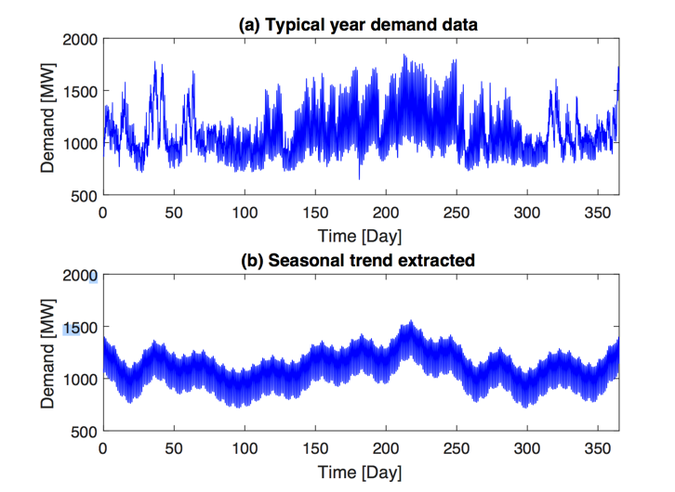
De-Trending Results: Load

Slide 10
Reconstructing High Frequencies
“Noise” overlaid on Fourier trends (residuals)
The residuals are not normally distributed
Before the application of the ARMA need to “whiten” the noise
Reconstructing the full signal
Normal distributed residual
Fourier Component
Inverse Normal CDF
CDF Residual
Original signal

Slide 11
ARMA Training
The normal distributed residuum is used to train an ARMA
The determination of the unknown parameters is based on the Maximum Likelihood Estimation (MLE)
The values of p, q are chosen using the Bayesian information criterion (BIC)

Slide 12
Algorithm Layout

Slide 13
Results Wind Speed
Statistics | Database | Synthetic
Mean (wind speed) | 8.078 | 8.088
Standard deviation (wind speed) | 3.392 | 3.372
Mean (step to step difference) | 0 | 0
Standard deviation (Step to step difference) | 0.659 | 0.642

Slide 14
Results Load
Statistics | Database | Synthetic
Mean (wind speed) | 1102.3 | 1103.4
Standard deviation (wind speed) | 222.2 | 223.8
Mean (step to step difference) | 0 | 0
Standard deviation (Step to step difference) | 48.4 | 54.2

Slide 15
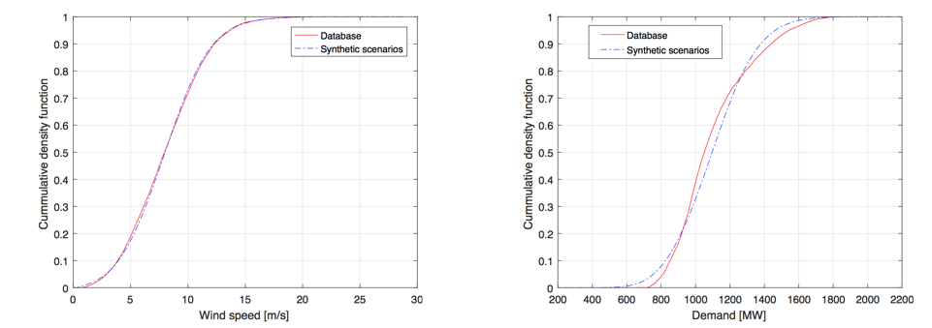
CDF Comparison

Slide 16
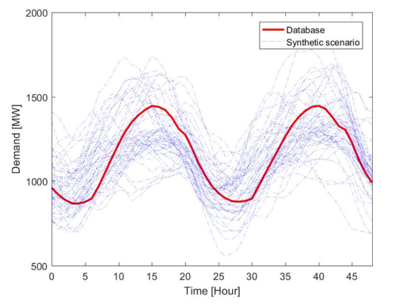
Scenario Generation

Slide 17
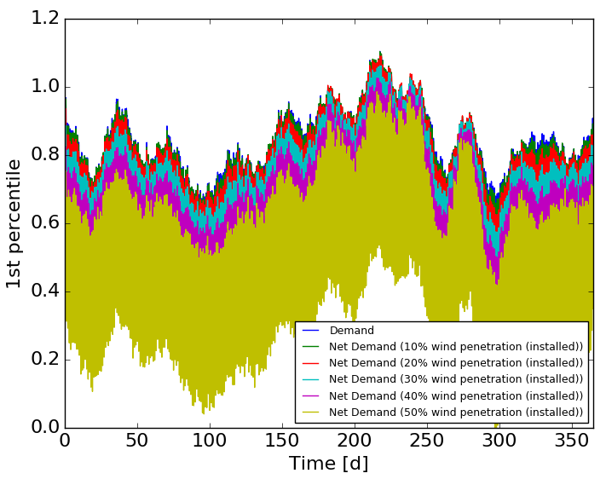
Moving Forward

Slide 18
Break
What we recently talked about:
Synthetic time histories via ARMA
Fourier modes
Residuals
Signal reconstruction
Coming up next:
Practical ARMA application
Real data
Training
Sampling

Slide 19

Your turn …
Workflows
Obtain real data
Train ARMA
Read in data
Preprocess
Train
Serialize
Sample ARMA
Unserialize
Sample
Output
train_arma.xml
sample.xml

