Slide 1
XML Basics
A Linguistics Crash Course

Slide 2
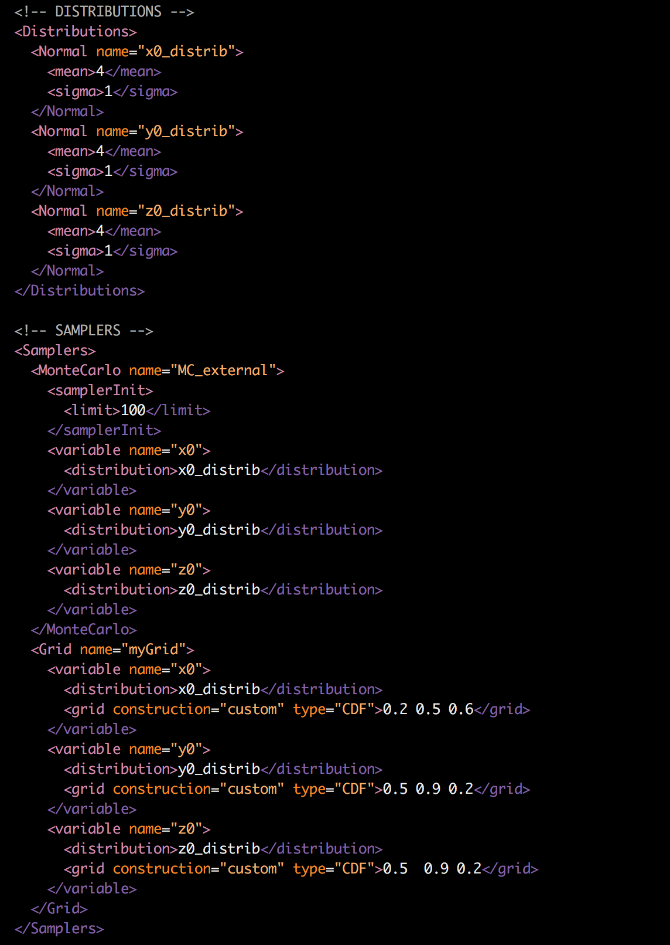
XML and RAVEN
RAVEN uses XML for its input syntax
Step 1: Get a good XML editor!
Sublime
Atom
Vim
Notepad++
Emacs
VisualStudio
Eclipse
… and others
May require a plugin to work

Slide 3
Anatomy of XML
root Node Tag
subnode Tag
subnode Text
subnode Closer
<root>
<subnode attribute1=“1”>nodetext</subnode>
</root>
subnode Attribute
root Closer
subnode Attribute Value

Slide 4
Anatomy of XML
<root>
<subnode attribute1=“1”>nodetext</subnode>
</root>
Node | root | subnode
Tag | root | subnode
Child Nodes | subnode
Text |  | nodetext
Attributes |  | attribute1
Attribute Values |  | 1

