Slide 1

Optimization with RAVEN
RAVEN Workshop

Slide 2
Outline
Brief introduction on Optimization algorithms in RAVEN:
SPSA
Optimization examples
Optimization of a deterministic model
Optimization of a stochastic model

Slide 3

Optimization algorithms in RAVEN
RAVEN currently provides 2 optimizations schemes:
Gradient Descent (Finite Difference)
Simultaneous Perturbation Stochastic Approximation (SPSA)
Embedded de-noising capabilities
Multi-Objective Optimization can be performed with a blend of Optimization and Ensemble Modeling

Slide 4
Stochastic optimization
(X_{n},Y_{n})
Try to fit straight line to a set of points (X_{i}, Y_{i})
Define target function to minimize
For example least squares
Minimize with algorithm
Find “a” and “b” such that T(a,b) is minimal
For example “gradient descent” algorithm move in direction
What if lots of decision variables (T=T(a,b,c, …)) or system is stochastic (X_{i} →Y_{i} not unique)? may be difficult or impossible to evaluate
Stochastic optimization algorithms
Y = aX+b
(X₁,Y₁)

Slide 5
Simultaneous Perturbation Stochastic Approximation (SPSA) Algorithm for Efficient Stochastic Optimization
No gradient formula or gradient measurements needed
Approximate the gradient based on two function evaluations
Simultaneously approximate gradient for all variables
Regardless of the number of decision variables
Converge to optimal in stochastic sense
Inaccurate estimation of gradient may temporarily lead to worse solution
There has been a growing interest in stochastic optimization algorithms that do not depend on direct gradient information or measurements
Applicable in areas such as statistical parameter estimation, (nonlinear) feedback control, simulation-based optimization, signal and image processing, and experimental design
Notes:
Typical optimization algorithms require reliable information knowledge of the system input-output relationships, implying that the gradient-based algorithms may be either infeasible (if no system model is available) or undependable (if a poorer system model is used).
Noisy input information may result in a loss function value that does not improve as the iteration process proceeds.

Slide 6
Advanced SPSA
Stochastic De-noising
Find expected values of points and gradients
Multiple evaluations of each sample taken, which will be used to calculate expected values and reduces the stochastic noise
Multi-trajectory
avoid local minima
Multiple initial starting points to be identified by the user. If one trajectory begins following another trajectory, the first is eliminated and only the second continues
Adaptive Stepping
Slow convergence across a domain
Adaptive step sizing determination algorithm in RAVEN’s SPSA algorithm. Gradient for direction information only. Step size based on previous performance

Slide 7
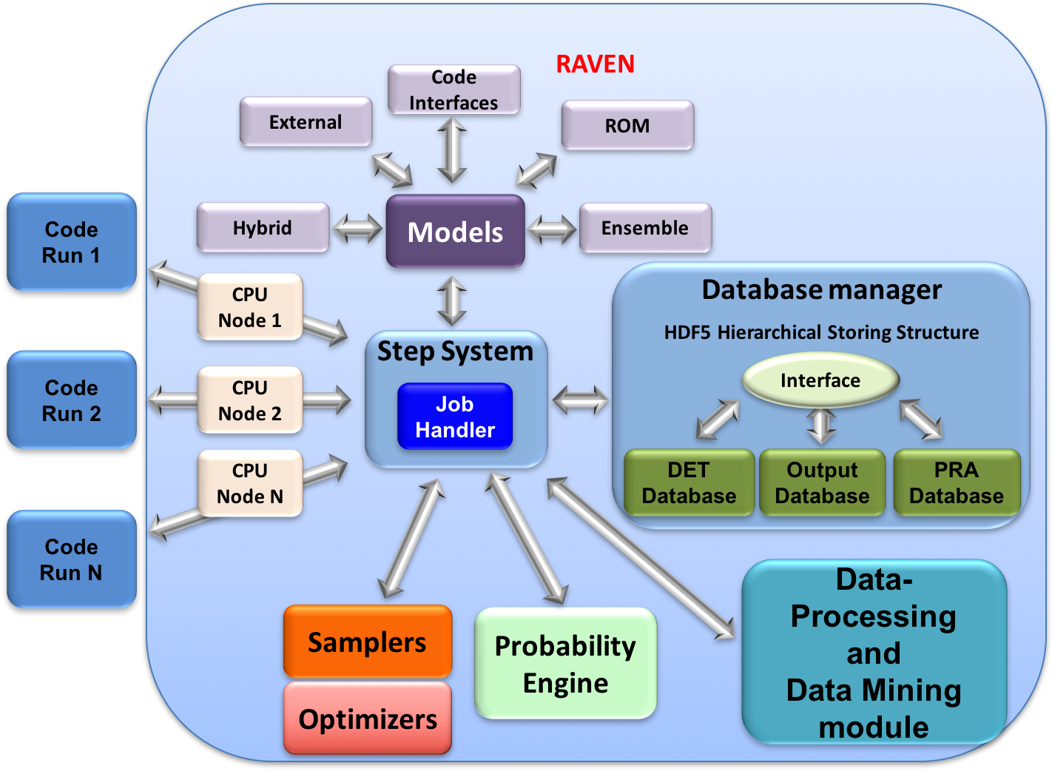
Optimization Modeling Within RAVEN
All modeling steps that involve optimization are available in RAVEN
Set up the optimization problem
Perform optimization of the objective function

Slide 8
RAVEN Examples

Slide 9
Example 1 – No stochasticity

Slide 10
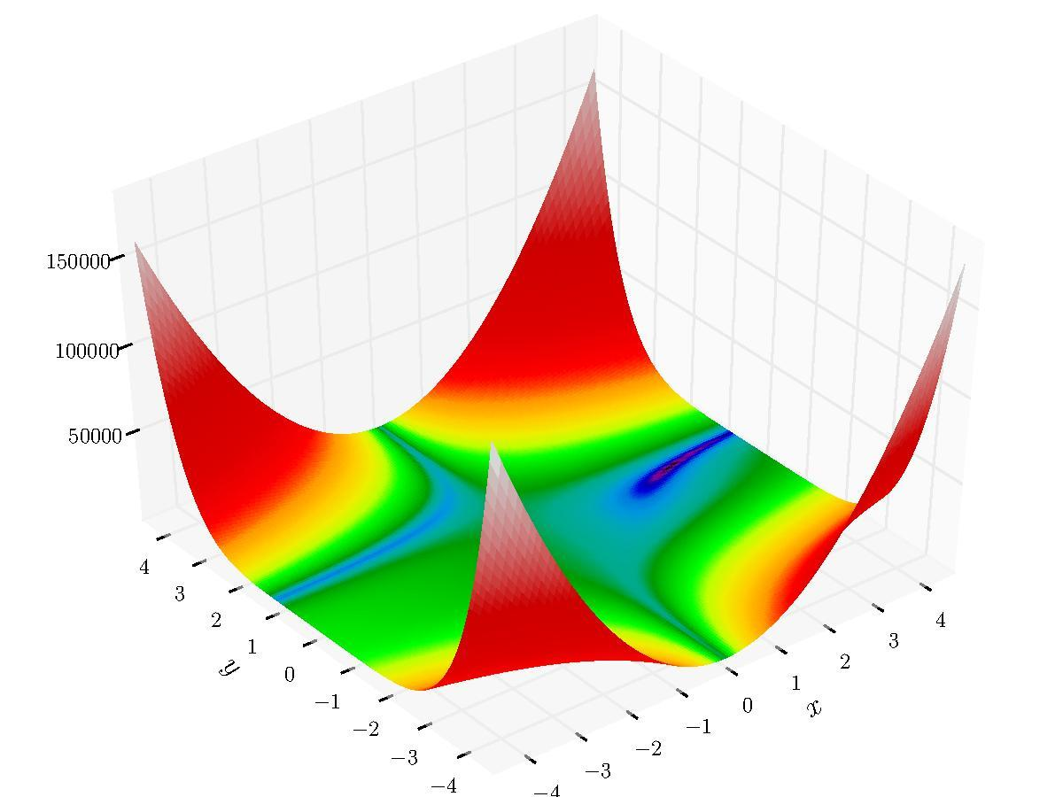
Workflow
External model employed:
beale.py
Optimization Algorithm
Minimum
Optimize
Model
ans
Export the Results
Optimal Minimum: f(3.0,0.5) = 0.0
finite_difference.xml

Slide 11
Construct the Model to optimize
Models
Optimizers
Databases
DataObjects
Steps
<Models>
<ExternalModel ModuleToLoad=”beale" name=”beale" subType="">
<variables>x,y,ans</Features>
</ExternalModel>
</Models>
Beale model
beale.py model:
def evaluate(x,y):
return (1.5 -x +x*y)**2 + (2.25 -x +x*y*y)**2 + (2.625 -x +x*y*y*y)**2
def run(self,inputs):
self.ans = evaluate(self.x,self.y)
Input file name: finite_difference.xml

Slide 12
Select the optimization strategy
Models
Optimizers
Databases
DataObjects
Steps
<Optimizers>
<FiniteDifferenceGradientOptimizer name=”opter">
<initialization>
<limit>2000</limit> <initialSeed>02201986</initialSeed>
<thresholdTrajRemoval>1.e-5</thresholdTrajRemoval>
<writeSteps>every</writeSteps>
</initialization>
<convergence>
<gradientThreshold>1e-1</gradientThreshold>
<realtiveThreshold>1e-7</realtiveThreshold>
<gainGrowthFactor>1.5</gainGrowthFactor>
<gainShrinkFactor>1.25</gainShrinkFactor>
</convergence>
<variable name=”x">
<upperBound>4.5</upperBound><lowerBound>-4.5</lowerBound>
<initial>3.0</initial>
</variable>
<variable name=”y">
<upperBound>4.5</upperBound><lowerBound>-4.5</lowerBound>
<initial>3.0</initial>
</variable>
<TargetEvaluation class=”DataObjects” type=”PointSet">optOut</TargetEvaluation>
<objVar>ans</objVar>
</FiniteDifferenceGradientOptimizer>
</Optimizers>
Optimizer Type
Convergence Settings
Parameter Space
Objective
Inform RAVEN where the output is stored
Input file name: finite_difference.xml
Input file name: finite_difference.xml

Slide 13
Set up the data containers
Models
Optimizers
Databases
DataObjects
Steps
<DataObjects>
<PointSet name=inputPlaceHolder'>
<Input>x,y</Input>
</PointSet>
<PointSet name=optOut'>
<Input>x,y</Input>
<Output>ans</Output>
</PointSet>
<PointSet name=opt_export'>
<Input>trajID</Input>
<Output>x,y,ans,varsUpdate</Output>
</PointSet>
</DataObjects>
Input
Output Model
Optimization Export
Input file name: finite_difference.xml

Slide 14
Ready to Run?
RUN?

Slide 15
Example 2 – Intrinsic stochasticity

Slide 16
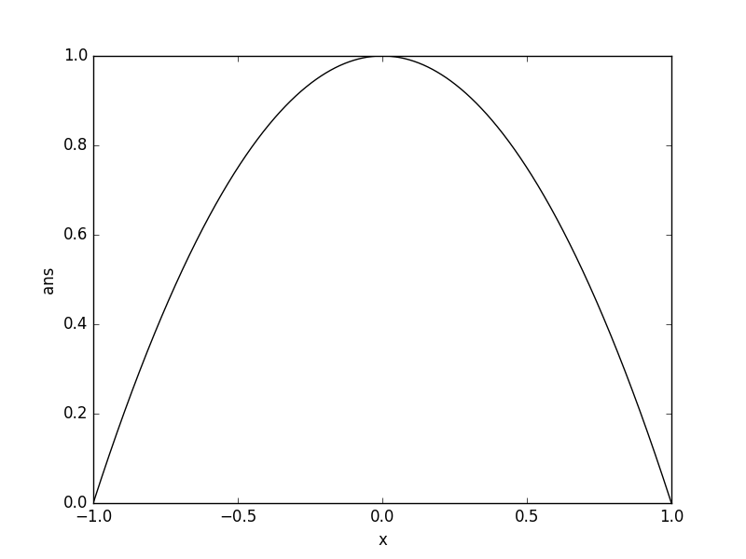
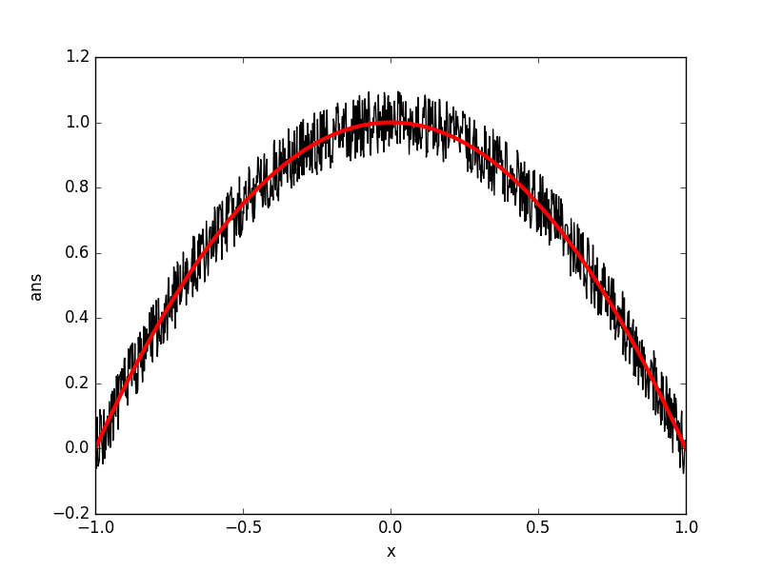
Workflow
External model employed:
stoch_parabola.py
Optimization Algorithm
Optimize
Model
Maximum
Export the Results
Optimal Maximum: f(0.0) = 1.0
spsa_stochastic.xml

Slide 17
Construct the Model to optimize
Models
Optimizers
Databases
DataObjects
Steps
<Models>
<ExternalModel ModuleToLoad=”stoch_parabola" name=”parabola" subType="">
<variables>x,ans</Features>
</ExternalModel>
</Models>
Beale model
beale.py model:
def evaluate(x,y):
return (1.5 -x +x*y)**2 + (2.25 -x +x*y*y)**2 + (2.625 -x +x*y*y*y)**2
def run(self,inputs):
self.ans = evaluate(self.x,self.y)
Input file name: finite_difference.xml

Slide 18
Select the optimization strategy
Models
Optimizers
Databases
DataObjects
Steps
<Optimizers>
<FiniteDifferenceGradientOptimizer name=”opter">
<initialization>
<limit>2000</limit> <initialSeed>02201986</initialSeed>
<thresholdTrajRemoval>1.e-5</thresholdTrajRemoval>
<writeSteps>every</writeSteps>
</initialization>
<convergence>
<gradientThreshold>1e-1</gradientThreshold>
<realtiveThreshold>1e-7</realtiveThreshold>
<gainGrowthFactor>1.5</gainGrowthFactor>
<gainShrinkFactor>1.25</gainShrinkFactor>
</convergence>
<variable name=”x">
<upperBound>4.5</upperBound><lowerBound>-4.5</lowerBound>
<initial>3.0</initial>
</variable>
<variable name=”y">
<upperBound>4.5</upperBound><lowerBound>-4.5</lowerBound>
<initial>3.0</initial>
</variable>
<TargetEvaluation class=”DataObjects” type=”PointSet">optOut</TargetEvaluation>
<objVar>ans</objVar>
</FiniteDifferenceGradientOptimizer>
</Optimizers>
Optimizer Type
Convergence Settings
Parameter Space
Objective
Inform RAVEN where the output is stored
Input file name: finite_difference.xml
Input file name: finite_difference.xml

Slide 19
Set up the data containers
Models
Optimizers
Databases
DataObjects
Steps
<DataObjects>
<PointSet name=inputPlaceHolder'>
<Input>x,y</Input>
</PointSet>
<PointSet name=optOut'>
<Input>x,y</Input>
<Output>ans</Output>
</PointSet>
<PointSet name=opt_export'>
<Input>trajID</Input>
<Output>x,y,ans,varsUpdate</Output>
</PointSet>
</DataObjects>
Input
Output Model
Optimization Export
Input file name: finite_difference.xml

Slide 20
Ready to Run?
RUN?

Slide 21
Optimize a Model and Create a Database
Models
Optimizers
Databases
DataObjects
Steps
<Steps>
<MultiRun name=”optimize">
<Input class="DataObjects" type="PointSet" >inputPlaceHolder</Input>
<Model class="Models" type="ExternalModel">beale</Model>
<Optimizer class=”Optimizers" type=”FiniteDifferenceGradientOptimizer”>opter</Optimizer>
<SolutionExport class="DataObjects" type="PointSet">opt_export</SolutionExport>
<Output class="DataObjects" type="PointSet">optOut</Output>
</MultiRun>
<IOStep name=”print">
<Input class="DataObjects" type="PointSet" >opt_export</Input>
<Output class=”OutStreams" type=”Print” >opt_export_fd</Output>
<Output class=”OutStreams" type=”Plot”>
optimization_history_input_space_fd
</Output>
<Output class=”OutStreams" type=”Plot”>
optimization_history_iterations_fd
</Output>
</IOStep>
</Steps>
Input file name: finite_difference.xml

Slide 22
Optimize a Model and Create a Database
Models
Optimizers
Databases
DataObjects
Steps
<Steps>
<MultiRun name="FirstMRun">
<Input class="DataObjects" type="PointSet" >inputPlaceHolder</Input>
<Model class="Models" type="ExternalModel">PythonModule</Model>
<Sampler class="Samplers" type="Grid" >Grid_function</Sampler>
<Output class="DataObjects" type="PointSet" >outGRID</Output>
<Output class="Databases" type="HDF5" >out_db</Output>
<Output class="OutStreams" type="Print" >out_dump</Output>
<Output class="OutStreams" type="Plot" >plotResponseFunction</Output>
</MultiRun>
</Steps>
Model file
Step
Database
Model info
Sampler
DataObjects
Input file name: sample_Function.xml

Slide 23
Sample a Model and Create a Database
Models
Optimizers
Databases
DataObjects
Steps
<Steps>
<MultiRun name="FirstMRun">
<Input class="DataObjects" type="PointSet" >inputPlaceHolder</Input>
<Model class="Models" type="ExternalModel">PythonModule</Model>
<Sampler class="Samplers" type="Grid" >Grid_function</Sampler>
<Output class="DataObjects" type="PointSet" >outGRID</Output>
<Output class="Databases" type="HDF5" >out_db</Output>
<Output class="OutStreams" type="Print" >out_dump</Output>
<Output class="OutStreams" type="Plot" >plotResponseFunction</Output>
</MultiRun>
</Steps>
Model file
Step
Database
Model info
Sampler
DataObjects
Input file name: sample_Function.xml

Slide 24
Sample a Model and Create a Database
Models
Optimizers
Databases
DataObjects
Steps
<Steps>
<MultiRun name="FirstMRun">
<Input class="DataObjects" type="PointSet" >inputPlaceHolder</Input>
<Model class="Models" type="ExternalModel">PythonModule</Model>
<Sampler class="Samplers" type="Grid" >Grid_function</Sampler>
<Output class="DataObjects" type="PointSet" >outGRID</Output>
<Output class="Databases" type="HDF5" >out_db</Output>
<Output class="OutStreams" type="Print" >out_dump</Output>
<Output class="OutStreams" type="Plot" >plotResponseFunction</Output>
</MultiRun>
</Steps>
Model file
Step
Database
Model info
Sampler
DataObjects
Input file name: sample_Function.xml

Slide 25
Train and Sample a ROM
Distributions
Models
Samplers
Databases
DataObjects
Steps
<Models>
<ROM name="ROM4" subType="NDinvDistWeight">
<Features>x1,x2,x3</Features>
<Target>y4</Target>
<p>3</p>
</ROM>
</Models>
Multi-dimensional interpolator (CROW)
Input file name: sample_ROM.xml

Slide 26
Train and Sample a ROM
Distributions
Models
Samplers
Databases
DataObjects
Steps
<Samplers>
<Grid name="Grid_ROM">
<variable name="x1">
<distribution>normal_trunc</distribution>
<grid type="value" construction="equal" steps="10">0.0 1.0</grid>
</variable>
<variable name="x2">
<distribution>normal</distribution>
<grid type="value" construction="equal" steps="10">1.5 2.5</grid>
</variable>
<variable name="x3">
<distribution>uniform</distribution>
<grid type="value" construction="equal" steps="10">1.0 4.0</grid>
</variable>
</Grid>
</Samplers>
Finer grid
Input file name: sample_ROM.xml

Slide 27
Train and Sample a ROM
Distributions
Models
Samplers
Databases
DataObjects
Steps
<Steps>
<IOStep name="extract_data4">
<Input class="Databases" type="HDF5" >out_db</Input>
<Output class="DataObjects" type="PointSet" >outGRID_y4</Output>
</IOStep>
<RomTrainer name="rom_trainer4">
<Input class="DataObjects" type="PointSet" >outGRID_y4</Input>
<Output class="Models" type="ROM" >ROM4</Output>
</RomTrainer>
<MultiRun name="RunRom4">
<Input class="DataObjects" type="PointSet" >Data1</Input>
<Model class="Models" type="ROM" >ROM4</Model>
<Sampler class="Samplers" type="Grid" >Grid_ROM</Sampler>
<Output class="DataObjects" type="PointSet" >outROM_y4</Output>
</MultiRun>
...
</Steps>
Input file name: sample_ROM.xml

Slide 28
Workflow
Sample model Create database
sample_Function.xml
Train a ROM
Pickle ROM
Train a ROM
Sample ROM
rom_trainer.xml
sample_ROM.xml
Load ROM
Sample ROM
sample_pROM.xml

Slide 29
Train and Pickle a ROM
Models
Databases
DataObjects
Steps
<Models>
<ROM name="ROM3" subType="SciKitLearn">
<Features>x1,x2,x3</Features>
<Target>y3</Target>
<SKLtype>linear_model|LinearRegression</SKLtype>
<fit_intercept>True</fit_intercept>
<normalize>False</normalize>
</ROM>
</Models>
Inputs / Output
ROM type and parameters
Input file name: rom_trainer.xml
Notes:
Add multi target ROM

Slide 30
Train and Pickle a ROM
Models
Databases
DataObjects
Steps
Create a DataObject from the Dababase
<Steps>
<IOStep name="extract_data3">
<Input class="Databases" type="HDF5" >out_db</Input>
<Output class="DataObjects" type="PointSet" >outGRID_y3</Output>
</IOStep>
<RomTrainer name="rom_trainer3">
<Input class="DataObjects" type="PointSet" >outGRID_y3</Input>
<Output class="Models" type="ROM" >ROM3</Output>
</RomTrainer>
<IOStep name="pkDump3">
<Input class="Models" type="ROM" >ROM3</Input>
<Output class="Files" type="" >ROM3pk</Output>
</IOStep>
</Steps>
Create and train a ROM from the DataObject
Pickle the ROM and save it as a file
Input file name: rom_trainer.xml

Slide 31
Workflow
Sample model Create database
sample_Function.xml
Train a ROM
Pickle ROM
Train a ROM
Sample ROM
rom_trainer.xml
sample_ROM.xml
Load ROM
Sample ROM
sample_pROM.xml

Slide 32
Load and Sample a Pickled ROM
Distributions
Models
Samplers
DataObjects
Steps
<Models>
<ROM name="ROM3" subType="SciKitLearn">
<Features>x1,x2,x3</Features>
<Target>y3</Target>
<SKLtype>linear_model|LinearRegression</SKLtype>
<fit_intercept>True</fit_intercept>
<normalize>False</normalize>
</ROM>
</Models>
Inputs / Output
ROM type and parameters
Input file name: sample_pROM.xml

Slide 33
Load and Sample a Pickled ROM
Distributions
Models
Samplers
DataObjects
Steps
Load the pickled ROM
<Steps>
...
<IOStep name="pk3Load">
<Input class="Files" type="" >ROM3pk</Input>
<Output class="Models" type="ROM" >pROM3</Output>
</IOStep>
<MultiRun name="RunPROM3">
<Input class="DataObjects" type="PointSet" >Data1</Input>
<Model class="Models" type="ROM" >pROM3</Model>
<Sampler class="Samplers" type="Grid" >Grid_ROM</Sampler>
<Output class="DataObjects" type="PointSet" >outPROM_y3</Output>
<Output class="Databases" type="HDF5" >out_ROM3_db</Output>
</MultiRun>
...
</Steps>
Input file name: sample_pROM.xml

