Slide 1

Reduced Order Models (ROMs)
RAVEN Workshop

Slide 2
Outline
Brief introduction on ROMs
Application examples of ROMs
ROMs and RAVEN
Available ROMs
RAVEN ROM workflow
RAVEN examples
Create ROMs
Perform sampling of ROMs

Slide 3
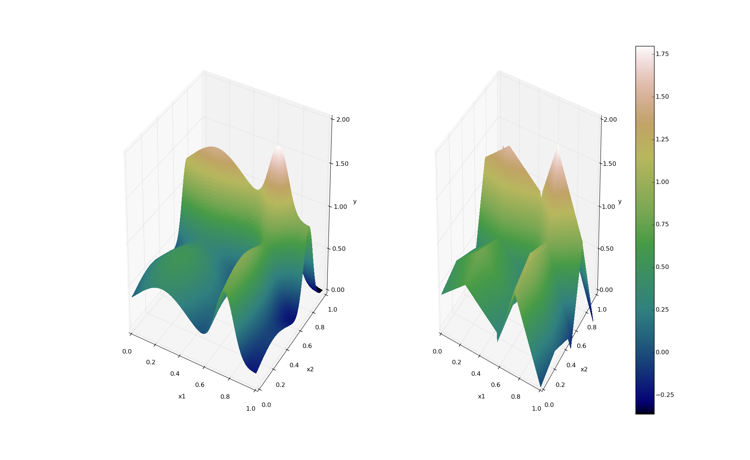
ROMs: a Quick Introduction
Output: Simulation outcome (success/failure, max clad temperature)
Consider a set of N data points
Build a surrogate model
Reduced Order Model
DataObjects
(PointSet)
Inputs: Initial and boundary conditions
≅

Slide 4
ROMs: a Quick Introduction
Basically we are trying to reduce the complexity of the original model
Pros:
Much faster computation of the output variable
Cons:
Presence of error in the ROM computed values
ROM (e.g., quadratic regressor)
≅
Original data (e.g., RELAP5)

Slide 5
Classes of ROMs
Model-Based
Prediction is performed using a blend of interpolation and regression algorithms
Examples:
Gaussian Process Models (GPMs)
Support Vector Machines (SVM)
Data-Based
Prediction is performed by solely considering the input data by using data searching algorithms
Example:
K nearest neighbor (KNN)

Slide 6
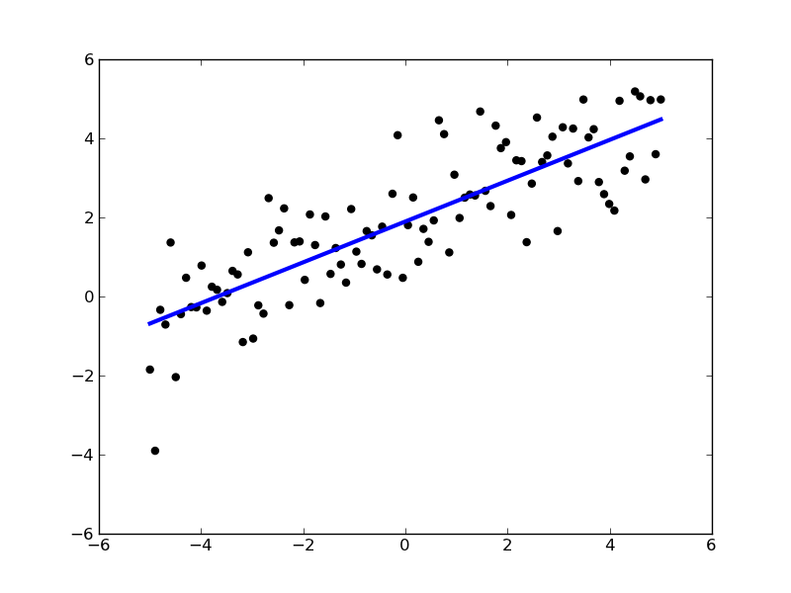
ROMs: Applications
Basic steps:
Sample original model
Train the ROM
Perform desired analysis with the ROM
instead of the original model
Range of applications:
Uncertainty quantification / Sensitivity analysis
Probabilistic Risk Analysis (PRA)
Accelerator for stochastic analysis (adaptive sampling)
Prediction models
Output y
Input x

Slide 7
ROMs Available in RAVEN
External dependency: Scikit-learn (http://scikit-learn.org)
Open source machine learning library for Python
Library for data mining and data analysis
Built on NumPy and SciPy
Internally C++ developed libraries: CROW
Generalized Polynomial Chaos
Multi-dimensional interpolators
Synthetic Time-Series Algorithms (e.g. F-ARMA)
Dynamic Mode Decomposition-based algorithms
Polynomial Regression (Poly-Tensor spline, Poly-exponential, etc.)

Slide 8
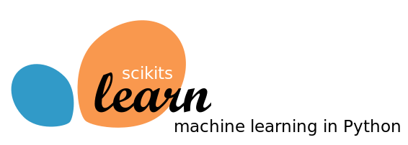
Supervised and Unsupervised Library
Available:
Classification: identifying to which category an object belongs
Regression: predicting a continuous-valued attribute
Data clustering: grouping similar objects into sets
Dimensionality reduction: reducing the number of random variables
Data pre-processing: feature extraction and normalization
Examples:
Linear regression models
Support Vector Machines
Multi-Class classifiers
Naïve Bayes
Neighbors classifiers
Tree classifiers
Notes:
Add backup slides for some algorithms GPM and SVM

Slide 9
Supervised and Unsupervised Library
Classification
Starting point: set of data points with labels
[features, class]_{i}
Objective: identify which class a new point [features] belong
Clustering
Starting point: set of data points
[features]_{I}
Objective: group data points based on a specific distance metrics
Y
(μ₁,σ₁²)
(μ₂,σ₂²)
X
Notes:
Add backup slides for some algorithms GPM and SVM

Slide 10
Supervised and Unsupervised Library
Starting point: set of data points
[features]_{i}
Cardinality reduction
Objective: identify the most relevant features that keep data points unique
Outcome: Location of the points on the reduced space (e.g., line)
Regression
Objective: estimate the relationships among variables via a statistical process
Outcome: coefficients of the reduced space (e.g., m and c for linear interpolator )
Source: scikit-learn.org
Notes:
Add backup slides for some algorithms GPM and SVM

Slide 11
Generalized Polynomial Chaos
Objective: overcome limitations of Monte-Carlo sampling
High number of samples
Computationally expensive
Polynomial representation of an output variable
Simpler to evaluate
Easy to get statistical moments
Less effort and more accurate than Monte Carlo
index set of all desired polynomial orders up to order L

Slide 12
Multi-Dimensional Interpolators
CROW: Internally developed C++ library
Interpolation on any dimension
Response surface is created as an interpolation function given a set of data points defined on:
Sparse grid
Cartesian grid
Extension of the known 1-D interpolation schemes

Slide 13
ROM Modeling Within RAVEN
All modeling steps that involve ROMs are available in RAVEN
Create ROMs from a database
Perform statistical analysis using ROMs

Slide 14
ROM Modeling Within RAVEN
Create a Database (PointSet)

Slide 15
ROM Modeling Within RAVEN
Create and train a ROM from a Database

Slide 16
ROM Modeling Within RAVEN
Perform statistical analysis using the ROM

Slide 17
ROM Pickle
Compression/serialization scheme
Pickled object contains all the information necessary to reconstruct the object in another python script
Pickled object can be saved as a file
RAVEN ROMs can be pickled
Applications:
Perform statistical analysis on a ROM after they have been generated and/or on a different machine
Use pickled ROMs on separate python script (external model for RAVEN)
Stochastic analysis for different distributions

Slide 18
RAVEN Examples

Slide 19
Workflow
External model employed:
workshop_model.py
Sample model Create database
sample_Function.xml
Train a ROM
Pickle ROM
Train a ROM
Sample ROM
rom_trainer.xml
sample_ROM.xml
Load ROM
Sample ROM
sample_pROM.xml

Slide 20
Workflow
Sample model Create database
sample_Function.xml
Train a ROM
Pickle ROM
Train a ROM
Sample ROM
rom_trainer.xml
sample_ROM.xml
Load ROM
Sample ROM
sample_pROM.xml

Slide 21
Sample a Model and Create a Database
Distributions
Models
Samplers
Databases
DataObjects
Steps
<Steps>
<MultiRun name="FirstMRun">
<Input class="DataObjects" type="PointSet" >inputPlaceHolder</Input>
<Model class="Models" type="ExternalModel">PythonModule</Model>
<Sampler class="Samplers" type="Grid" >Grid_function</Sampler>
<Output class="DataObjects" type="PointSet" >outGRID</Output>
<Output class="Databases" type="HDF5" >out_db</Output>
<Output class="OutStreams" type="Print" >out_dump</Output>
<Output class="OutStreams" type="Plot" >plotResponseFunction</Output>
</MultiRun>
</Steps>
Model file
Step
Database
Model info
Sampler
DataObjects
Input file name: sample_Function.xml

Slide 22
Workflow
Sample model Create database
sample_Function.xml
Train a ROM
Pickle ROM
Train a ROM
Sample ROM
rom_trainer.xml
sample_ROM.xml
Load ROM
Sample ROM
sample_pROM.xml

Slide 23
Train and Sample a ROM
Distributions
Models
Samplers
Databases
DataObjects
Steps
<Models>
<ROM name="ROM4" subType="NDinvDistWeight">
<Features>x1,x2,x3</Features>
<Target>y4</Target>
<p>3</p>
</ROM>
</Models>
Multi-dimensional interpolator (CROW)
Input file name: sample_ROM.xml

Slide 24
Train and Sample a ROM
Distributions
Models
Samplers
Databases
DataObjects
Steps
<Samplers>
<Grid name="Grid_ROM">
<variable name="x1">
<distribution>normal_trunc</distribution>
<grid type="value" construction="equal" steps="10">0.0 1.0</grid>
</variable>
<variable name="x2">
<distribution>normal</distribution>
<grid type="value" construction="equal" steps="10">1.5 2.5</grid>
</variable>
<variable name="x3">
<distribution>uniform</distribution>
<grid type="value" construction="equal" steps="10">1.0 4.0</grid>
</variable>
</Grid>
</Samplers>
Finer grid
Input file name: sample_ROM.xml

Slide 25
Train and Sample a ROM
Distributions
Models
Samplers
Databases
DataObjects
Steps
<Steps>
<IOStep name="extract_data4">
<Input class="Databases" type="HDF5" >out_db</Input>
<Output class="DataObjects" type="PointSet" >outGRID_y4</Output>
</IOStep>
<RomTrainer name="rom_trainer4">
<Input class="DataObjects" type="PointSet" >outGRID_y4</Input>
<Output class="Models" type="ROM" >ROM4</Output>
</RomTrainer>
<MultiRun name="RunRom4">
<Input class="DataObjects" type="PointSet" >Data1</Input>
<Model class="Models" type="ROM" >ROM4</Model>
<Sampler class="Samplers" type="Grid" >Grid_ROM</Sampler>
<Output class="DataObjects" type="PointSet" >outROM_y4</Output>
</MultiRun>
...
</Steps>
Input file name: sample_ROM.xml

Slide 26
Workflow
Sample model Create database
sample_Function.xml
Train a ROM
Pickle ROM
Train a ROM
Sample ROM
rom_trainer.xml
sample_ROM.xml
Load ROM
Sample ROM
sample_pROM.xml

Slide 27
Train and Pickle a ROM
Models
Databases
DataObjects
Steps
<Models>
<ROM name="ROM3" subType="SciKitLearn">
<Features>x1,x2,x3</Features>
<Target>y3</Target>
<SKLtype>linear_model|LinearRegression</SKLtype>
<fit_intercept>True</fit_intercept>
<normalize>False</normalize>
</ROM>
</Models>
Inputs / Output
ROM type and parameters
Input file name: rom_trainer.xml
Notes:
Add multi target ROM

Slide 28
Train and Pickle a ROM
Models
Databases
DataObjects
Steps
Create a DataObject from the Dababase
<Steps>
<IOStep name="extract_data3">
<Input class="Databases" type="HDF5" >out_db</Input>
<Output class="DataObjects" type="PointSet" >outGRID_y3</Output>
</IOStep>
<RomTrainer name="rom_trainer3">
<Input class="DataObjects" type="PointSet" >outGRID_y3</Input>
<Output class="Models" type="ROM" >ROM3</Output>
</RomTrainer>
<IOStep name="pkDump3">
<Input class="Models" type="ROM" >ROM3</Input>
<Output class="Files" type="" >ROM3pk</Output>
</IOStep>
</Steps>
Create and train a ROM from the DataObject
Pickle the ROM and save it as a file
Input file name: rom_trainer.xml

Slide 29
Workflow
Sample model Create database
sample_Function.xml
Train a ROM
Pickle ROM
Train a ROM
Sample ROM
rom_trainer.xml
sample_ROM.xml
Load ROM
Sample ROM
sample_pROM.xml

Slide 30
Load and Sample a Pickled ROM
Distributions
Models
Samplers
DataObjects
Steps
<Models>
<ROM name="ROM3" subType="SciKitLearn">
<Features>x1,x2,x3</Features>
<Target>y3</Target>
<SKLtype>linear_model|LinearRegression</SKLtype>
<fit_intercept>True</fit_intercept>
<normalize>False</normalize>
</ROM>
</Models>
Inputs / Output
ROM type and parameters
Input file name: sample_pROM.xml

Slide 31
Load and Sample a Pickled ROM
Distributions
Models
Samplers
DataObjects
Steps
Load the pickled ROM
<Steps>
...
<IOStep name="pk3Load">
<Input class="Files" type="" >ROM3pk</Input>
<Output class="Models" type="ROM" >pROM3</Output>
</IOStep>
<MultiRun name="RunPROM3">
<Input class="DataObjects" type="PointSet" >Data1</Input>
<Model class="Models" type="ROM" >pROM3</Model>
<Sampler class="Samplers" type="Grid" >Grid_ROM</Sampler>
<Output class="DataObjects" type="PointSet" >outPROM_y3</Output>
<Output class="Databases" type="HDF5" >out_ROM3_db</Output>
</MultiRun>
...
</Steps>
Input file name: sample_pROM.xml

