Slide 1
Synthetic Histories
ARMA-ed and dangerous
Paul Talbot, Presentor
INL NHRES Workshop, March 2018

Slide 2
Motivation
Goal: Calculate meaningful impact of installed capacity choices
Problem: Availability in existing year-to-year data
Wind, solar, demand/load
Short recorded history
Missing portions of records
Need: Source of data
Consistent time intervals
Reflects real behavior
Statistically significant (over 100k years)
Solution: Good synthetic histories
Stochastic Modeling

Slide 3
Why Stochastic Modeling
Problems with deterministic dataset
Small sample size
Optimization converges on data, not phenomenon
Benefits of synthetic data
Unbounded sample size
Underlying behavior captured in large statistical sampling
Allows probabilistic analysis of HES and stochastic optimization
Limitations of synthetic data
Each evaluation should statistically conform to real-life data
Each evaluation should be independent

Slide 4
Stochastic Time Series Methods in literature
Artificial Neural Network
Factor Analysis
Gaussian Process
Power Spectrum Density
Numerical Weather Prediction
Autoregressive (AR)
Autoregressive Moving Averaging (ARMA)
Our approach:
Data selection
Fourier de-trending
Residual normalization
ARMA to represent the residuum

Slide 5
Data Selection
We might not have enough data for stochastic optimization
But we might have more than one time period
1st period
2nd period
3rd period
Sub-period
Sub-period
Sub-period
Notes:
Take the sub-period that is statistically closest to the average of all peers

Slide 6
Data Selection Example (Wind)
Month | From Dataset of | Month | From Dataset of
January | 2005 | July | 2006
February | 2006 | August | 2006
March | 2004 | September | 2004
April | 2004 | October | 2004
May | 2006 | November | 2004
June | 2006 | December | 2005

Slide 7
Fourier De-trending
Reconstructing the Signal
Low frequencies
represent a trend (season, day)
Fourier is used
High frequencies
Statistical “noise”
Cases so far examined trends from 15 minutes to 1 year in period
Frequencies are user supplied
Moments are computed using least square linear regression

Slide 8
De-Trending Results: Wind

Slide 9
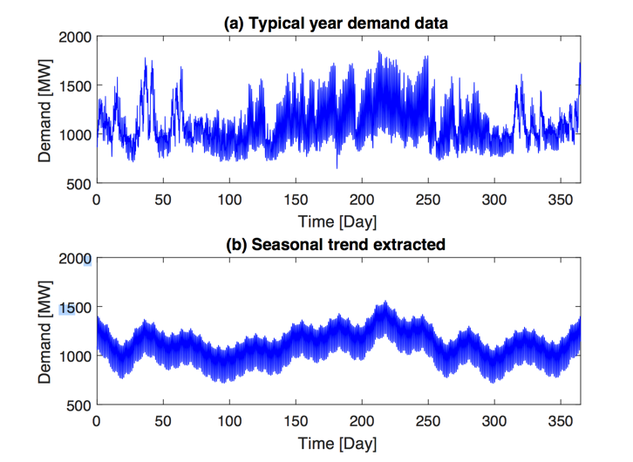
De-Trending Results: Load

Slide 10
Reconstructing High Frequencies
“Noise” overlaid on Fourier trends (residuals)
The residuals are not normally distributed
Before the application of the ARMA need to “whiten” the noise
Reconstructing the full signal
Normal distributed residual
Fourier Component
Inverse Normal CDF
CDF Residual
Original signal

Slide 11
ARMA Training
The normal distributed residuum is used to train an ARMA
The determination of the unknown parameters is based on the Maximum Likelihood Estimation (MLE)
The values of p, q are chosen using the Bayesian information criterion (BIC)

Slide 12
Algorithm Layout

Slide 13
Results Wind Speed
Statistics | Database | Synthetic
Mean (wind speed) | 8.078 | 8.088
Standard deviation (wind speed) | 3.392 | 3.372
Mean (step to step difference) | 0 | 0
Standard deviation (Step to step difference) | 0.659 | 0.642

Slide 14
Results Load
Statistics | Database | Synthetic
Mean (wind speed) | 1102.3 | 1103.4
Standard deviation (wind speed) | 222.2 | 223.8
Mean (step to step difference) | 0 | 0
Standard deviation (Step to step difference) | 48.4 | 54.2

Slide 15
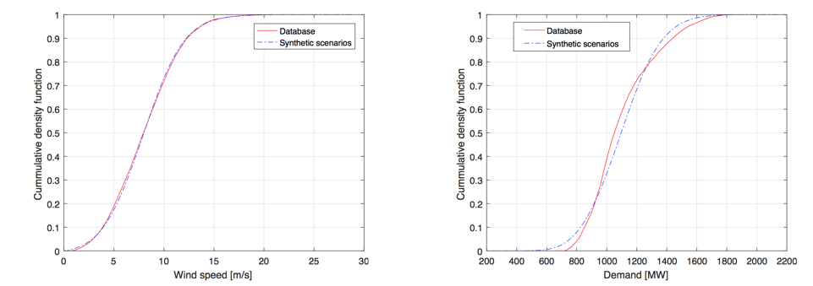
CDF Comparison

Slide 16
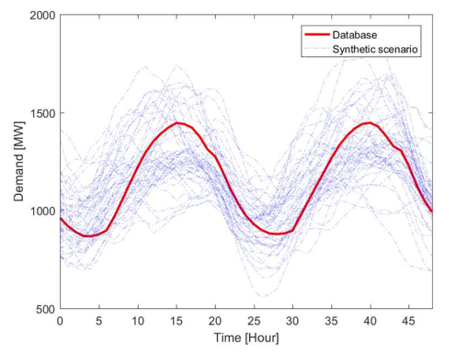
Scenario Generation

Slide 17
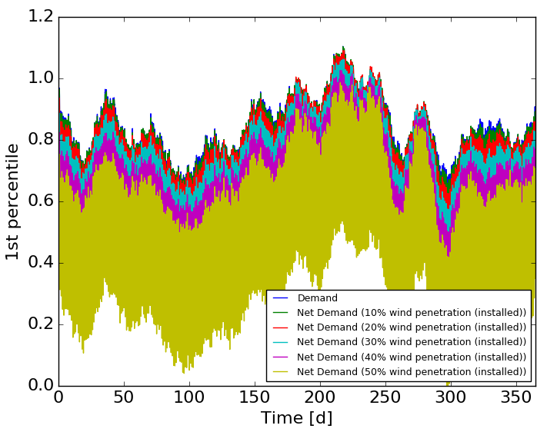
Moving Forward

Slide 18
Break
What we recently talked about:
Synthetic time histories via ARMA
Fourier modes
Residuals
Signal reconstruction
Coming up next:
Practical ARMA application
Real data
Training
Sampling
Statistics

Slide 19

Your turn …
Workflows
Obtain training data
Train ARMA
Read in data
Preprocess
Train
Serialize
Sample ARMA
Unserialize
Sample
Output
train_arma.xml
sample.xml
git pull
git checkout workshop_201803
raven/docs/workshop/ARMA/exercise

Slide 20
Hands-On: Obtaining Real Data
Find an online source of data (e.g. NREL)
Collect data into RAVEN-friendly form
History set of linked CSVs
Must have consistent time step throughout
No time steps can be missing
Each period must be identical in length
Each period must have identical time stamps
Example script:
Example data (wind speeds near Idaho Falls from NREL):
Example RAVEN-compatible data:
raven/docs/workshop/ARMA/raw_data/parse_nrel.py
raven/docs/workshop/ARMA/raw_data/101645-*.csv
raven/docs/workshop/ARMA/raw_data/raw_data*.csv

Slide 21
Hands-On: Training ARMA Walkthrough
raven/docs/workshop/ARMA/exercise/train_arma.xml
Read in data
TypicalHistory Preprocess
Train ARMA
Serialize ARMA
<IOStep name=“readInData”>
<PostProcess name=“typicalHistory”>
<RomTrainer name=“train”>
<RomTrainer name=“train”>

Slide 22
Hands-On: Training ARMA Exercises
raven/docs/workshop/ARMA/exercise/train_arma.xml
Fill in the following:
RunInfo
Sequence
DataObjects
Input
Output
pivotParameter
Files
Raw data file
Serialized ARMA file
Typical History PostProcessor
Subsequence length (1 day)
Output Length (1 week)
PivotParameter
ARMA ROM
Target
Features
pivotParameter
Each task is marked with a
<!–- TODO ... -->
After you finish, try running!
../../../../raven_framework train_arma.xml

Slide 23
Hands-On: Sampling ARMA Walkthrough
raven/docs/workshop/ARMA/exercise/sample_arma.xml
Unserialize
Sample
Print/Plot
<IOStep name=“load”>
<PostProcess name=“sample”>
<RomTrainer name=“output”>

Slide 24
Hands-On: Sampling ARMA Exercises
raven/docs/workshop/ARMA/exercise/sample_arma.xml
Fill in the following:
RunInfo
Sequence
DataObjects
Input
Output
pivotParameter
Files
Serialized ARMA file
Samplers
Number of Samples
Seed
ARMA ROM
Target
Features
pivotParameter
Each task is marked with a , ignore
<!–- TODO -->
<!–- EXTRA -->
After you finish, try running!
../../../../raven_framework sample_arma.xml

Slide 25
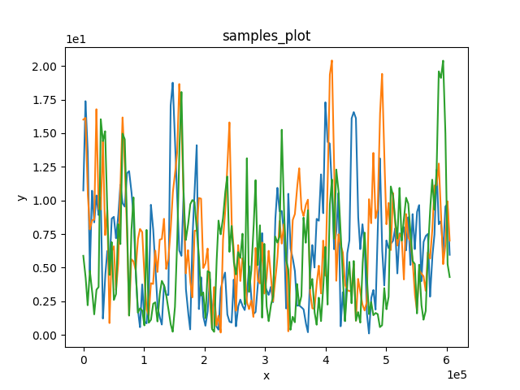
Hands-On: Sampling ARMA Results
raven/docs/workshop/ARMA/exercise/rundir/samples_plot_line.png
Note: depends on your seed, number of samples
I used seed = 31415 with 3 samples

Slide 26
Hands-On: Running Some Statistics
Calculate and plot the mean and 5,95 percentiles for samples
Same input file
Create a new PostProcess step
Input is the history set
Model is the ”stats_calc” postprocessor
Output is data object “stats”
Create a new Output step
Input is “stats” data object
Output is outstream print “stats_out”
Add both steps to the RunInfo sequence
Each task is marked with a
Better stats: increase the number of MonteCarlo samples (>50)
sample_arma.xml
<!–- EXTRA -->

Slide 27
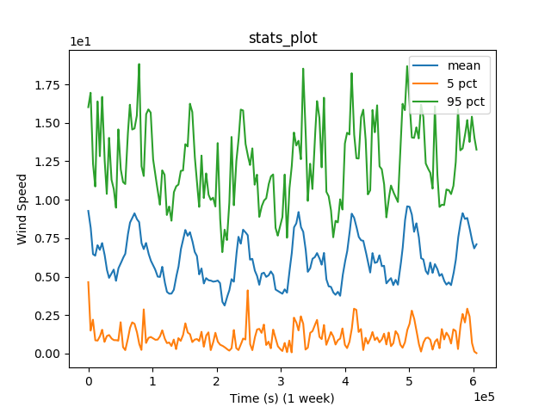
Hands-On: Statistics Results
50 MC samples, seed 31415, percentile 5|95 and mean

Slide 28
Hands-On: Beyond the Scope
Other things to try
Run it in local parallel
RunInfo: batchSize, maxQueueSize
Compare stats at 10 samples and 1000 samples
Start over with new ARMA
Change subsequence length (maybe 1 week)
Change output length (1 month or 1 year)
Change number of interpolation points on plots if needed

