Slide 1

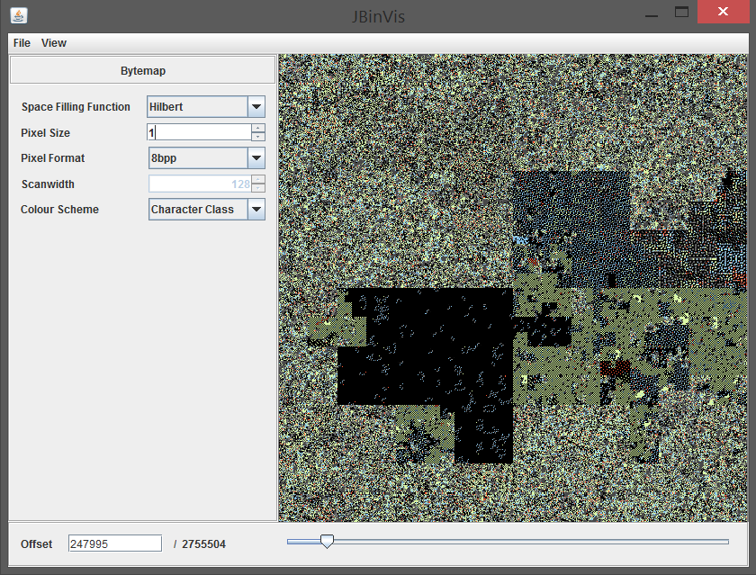

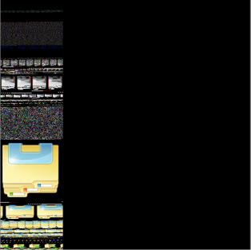
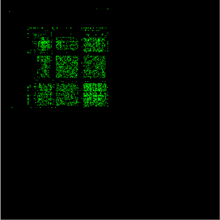
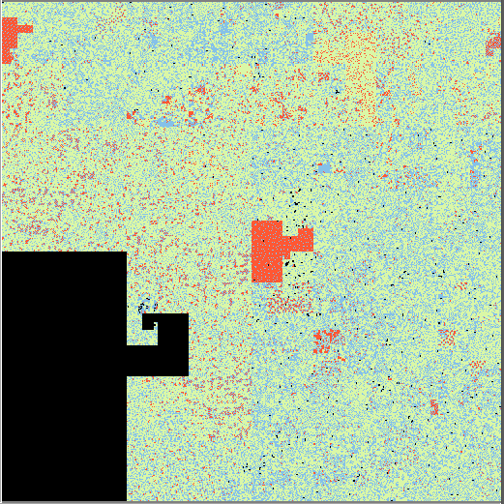


URECA
Undergraduate Research Experience on CAmpus
Category: 4 Student: Ong Bee Lee Project ID: SCSE16075
School of Computer Science and Engineering
Cross-Platform Binary Visualisation Tool
Motivation
Design Goals
File type identification is crucial in software security.
File analysis through visual means, with no regards to file name extensions or magic numbers¹ is a valuable tool.
Detection of malformed/malicious embedded data is critical in cyber security.
Currently many available tools only target single platform.
To emulate the lessons from the aforementioned tools and improve upon them.
Real Time²
Use of established algorithms to ensure efficient data processing.
Maintain at least 25 frames per second to reduce perceived flicker for satisfactory user experience.
Large File³ Support
Improvements in storage technology and connectivity mean larger files are being dealt with everyday.
Many similar tools currently available do not handle large files elegantly and efficiently.
Tools / Libraries Required
Extensible
Java Development Kit
OpenGL (2.0 or above)
Java OpenGL Library (JOGL)
Loosely-coupled architecture to promote future extensions for the application.
Results
Future Work
Many common file types have visually distinctive signatures.
‘Scrubbing’ through a file generates animated visuals which show more details than a static visual.
Possibly supplement the application with some intelligence to aid the user.
Add support to parse machine codes (whether embedded or otherwise).
More visualisations
Figure 2. (left) Digraph plot showing signature of an embedded bitmap within an executable. (right) The bitmap image resolved in the bytemap view.
Figure 3. (left) Digraph plot of a HTML source file. The structure seen is typical of printable ASCII character sequences. (right) Bytemap of the same file. The vibrant colours are used to classify the printable ASCII characters.
Figure 1. Main window of application, displaying the bytemap of an executable file (explorer.exe)
Some common file types have pre-defined sequence of bytes, usually placed in their headers to aid file identification.
Changes in visualization parameters should be reflected in the generated visuals immediately.
Files larger than 1 GB
Project Title: SCSE Innovation Fellowship Project (VI) - Binary Visualisation Tools
Supervisor: Assoc Prof Yeo Chai Kiat
www.ntu.edu.sg/ureca

