Slide 1
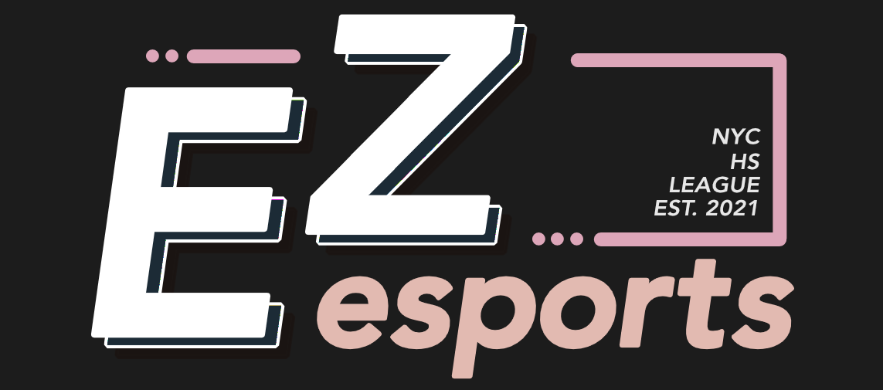
NEW EMPLOYEE ONBOARDING
Development
Team
The essential handbook for the Development Team of EZ Esports
Simon Chen · Lead Product Engineer
ezesports.org

Slide 2







WELCOME
You're in.
1
Dev Overview
2
Responsibilities
Happy to have you on the dev team — here's what we'll walk through.
3
Company Structure
4
Tech Stack & Tools
5
Coding Standards & Conventions
6
Current Projects & Roadmap
7
Environment & Setup
EZ Esports · Dev Onboarding

Slide 3


DEV OVERVIEW
Who leads the team
The dev team builds and maintains the EZ Esports website — the public site, the internal admin dashboard staff use to manage league data, and the pipeline that keeps everything from schools to leadership bios accurate.
Simon Chen
Lead Product Engineer
You report to Simon
day-to-day direction and code review
Reports up through the Director of Technical Product
Reach out anytime
questions go to Simon on Discord, or in the staff server
EZ Esports · Dev Onboarding

Slide 4





WHAT YOU'LL DO
Responsibilities
Site Features & UI
Admin Tools
Data & ETL Pipeline
Public pages — leagues, schools, leadership, news — in Next.js, React, and Tailwind
Internal pages staff use to manage content, rosters, and results
Raw SharePoint exports → clean data via the bronze/silver/gold seed pipeline
Database & Backend
Bug Fixes & Maintenance
Code Review & Testing
Schema, migrations, and seed scripts against Supabase/Postgres
Dependency updates, security patches, UI consistency fixes
PR review, Vitest/Playwright tests, keeping the codebase healthy
EZ Esports · Dev Onboarding

Slide 5
WHERE DEV FITS
Company Structure
President — Edison Zhong
Game Divisions
Functional Divisions
Director of
League of Legends
Director of
Valorant
Director of
(other games)
Production
Marketing
Technical Product
Legal
Finance & Biz Dev
→ Associate Directors under each
→ Associate Directors under each · supports every Game Division
EZ Esports · Dev Onboarding

Slide 6







TECH STACK & TOOLS
What we build with
Next.js
React
TypeScript
Tailwind CSS
React Aria
Supabase
Drizzle ORM
Vercel
GitHub
EZ Esports · Dev Onboarding

Slide 7

TECH STACK, IN DETAIL
Frontend & Framework
Next.js (custom fork)
Tailwind CSS v4
APIs differ from defaults — read node_modules/next/dist/docs before writing new code
utility-first styling across the site
React 19
Framer Motion
with React Aria Components for accessible UI primitives
animation and interaction polish
EZ Esports · Dev Onboarding

Slide 8

TECH STACK, IN DETAIL
Data, Backend & Infra
Supabase / Postgres
.env points straight at production — there is no separate environment
Drizzle ORM
schema + migrations — db:generate, db:push, db:migrate
Seed pipeline
db:seed / db:seed:gold, gated by assertSeedTargetAllowed()
Vercel
hosting, deploys, the Data Cache, analytics
GitHub
pull requests, code review, version control
Vitest + Playwright
unit and end-to-end testing
EZ Esports · Dev Onboarding

Slide 9





HOW WE WORK
Coding Standards & Conventions
.env is production
Treat any script that reads it as capable of touching live data — confirm with a lead before any seed or migration, even though the code gate would technically allow it.
The Data Cache survives redeploys
After anything that changes row UUIDs, call revalidateTag explicitly. A redeploy alone will not clear stale cached ids.
PII stays gitignored
sharepoint/ and db/backups/ carry student PII — check nested folders aren't slipping through root-anchored ignore patterns before a broad git add.
Don't trust a comment as proof
Verify safety claims against the live database before relying on them for anything destructive.
Read before you write
This Next.js is customized — check node_modules/next/dist/docs first, APIs may differ from what you expect.
EZ Esports · Dev Onboarding

Slide 10

WHAT'S ACTIVE RIGHT NOW
Current Projects & Roadmap
We are actively building the site.
Public Website
Admin Dashboard
Data Pipeline
League & school pages
Leadership directory
Homepage sections
Content management
Roster & results tools
Cache revalidation
Bronze / silver / gold ETL
SharePoint exports → Postgres
Cleaning & structuring
RECENT FOCUS
UI standardization
Leadership data modeling
Dependency & security fixes
EZ Esports · Dev Onboarding

Slide 11


FINAL STEPS
Environment & Access Setup
$ Clone the repo and run npm install
$ Use your own local Postgres with an explicit DATABASE_URL when testing seed/migration changes — never the live .env
$ Join the staff Discord and the EZ Esports server, introduce yourself in the staff channel
$ Set up introduction meetings with other departments
DISCLAIMER
Feel free to use any editor or tools you're comfortable with — these are just what the team currently uses, not a requirement.
EZ Esports · Dev Onboarding

Slide 12
Thank
You
Simon Chen · Lead Product Engineer
ezesports.org

