Slide 1


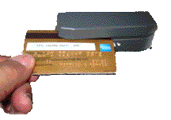

Purchase Auto Show Tickets Here
To Start
TOUCH SCREEN
Or
SWIPE CARD

Slide 2
Purchase Auto Show Tickets Here
SWIPE CREDIT CARD
To
Purchase Tickets

Slide 3


Slide 4
