Slide 1
Data-Driven (Direction) to Alleviate Voter Suppression
By Watson's Wizards: Team 30

Slide 2
Our Vision... Format
We are trying to even the playing field when it comes to citizen's voting experience
To do this we leverage AI with Polling data and certain Demographic Features to quantify and predict polling effectiveness
With our solution, reformative electoral institutions (Election Management Bodies) can identify successful strategies and apply them to marginalized communities of voters

Slide 3
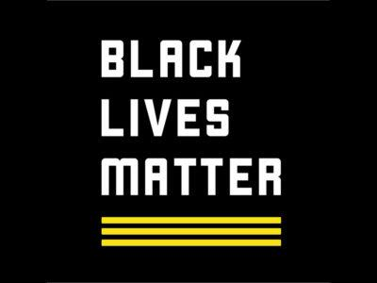
Why Voter Suppression?
Obama Quote???
The BLM Movement has identified voter suppression as its number one Campaign Goal
The Vote, as the cornerstone of democracy, would be strengthened by the assurance that each citizen has an equal ability to speak their mind. (vote their mind not speak their mind?)
https://calendarmedia.blob.core.windows.net/assets/0ac6ee8a-37b8-4ddf-9f42-29e159971ad8.jpg

Slide 4
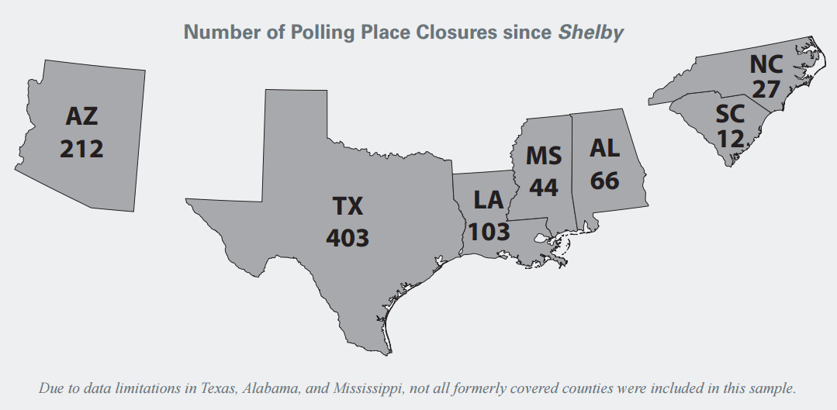
Impact of Voter Suppression... Reduce, Visualize
What is the current state of voter suppression, what are the tangible, real-life effects of it?
When Aracely Calderon went to the polls to vote in the 2016 presidential primary, she waited for 5 hours in a line of 700 people that stretched around four city blocks.
This injustice is nothing new and affects countless Americans who try to vote. This problem has been intensified by a 2013 Supreme court decision allowing certain states to make un-supervised polling changes.
Following this decision many Southern states saw a dramatic decrease in available polling locations, some counties had their only polling location removed. Texas alone removed 400 polling locations across the state.
Insert Graphics below that you had mentioned Ethan, cite like 3
Notes:
When Aracely Calderon, a naturalized US citizen from Guatemala, went to vote in downtown Phoenix just before the polls closed in Arizona’s March 22 presidential primary, there were more than 700 people in a line stretching four city blocks. She waited in line for five hours, becoming the last voter in the state to cast a ballot at 12:12 am. “I’m here to exercise my right to vote,” she said shortly before midnight, explaining why she stayed in line. Others left without voting because they didn’t have four or five hours to spare.
Maricopa County, the largest in the state, reduced the number of polling places by 70 percent from 2012 to 2016, from 200 to just 60—one polling place per 21,000 registered voters. Previously, Maricopa County would have needed federal approval to reduce the number of polling sites, because Arizona was one of 16 states where jurisdictions with a long history of discrimination had to submit their voting changes under Section 5 of the Voting Rights Act. This part of the VRA blocked 3,000 discriminatory voting changes from 1965 to 2013. That changed when the Supreme Court gutted the law in the June 2013 Shelby County v. Holder decision.

Slide 5
Our Contribution... Format, Visualize
How does this hackathon project fit into the bigger picture of reducing voter suppression?
Our Solution could point reformative institutions at counties across the country that are using effective polling strategies
An effective implementation of these successful strategies in less effective counties would improve the nation's ability to poll its citizens equally and fairly

Slide 6
Our Solution... Format
Our solution: Use AI to identify which counties do this most effectively, and which would benefit from adjustments.
At scale: Our solution can scale with the data in real time. When provided Demographic data for a county, we can predict polling effectiveness.

Slide 7
Our Method... Visualize
Show Demogaphic Variables
Hypothesis: The reduced access to polling locations has disproportionately affected marginalized communities.
Testing Procedure: We gathered Demographic data and election day Polling data from 213 Counties in Texas.
Results: Our Demographics alone showed little to no correlation with Counties' allotment of time to poll each voter
Demographic Correlation Graphic
Show map visual

Slide 8
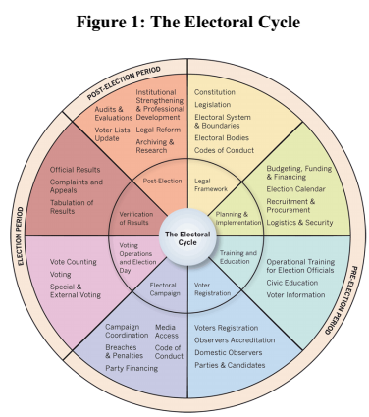
Looking Ahead... Format
With More Data …
we could identify more impactful variables to input into the model
We could identify trends over the years by observing data from past elections
With additional and diversified training data sources(ie. More counties)…
With a Revamped Effectiveness measurement
We could apply the same technology to other parts of the Electoral Cycle
By Adapting the Model
We could not only identify counties with weak polling but provide recommendations based on effective counties with similar demographics

