Slide 1
Assignment 4
Assignment 4.1: Eigenfunctions of an LTI system
Assignment 4.2: Scattering from a multilayered earth –
a numerical solution by finite differences

Slide 2
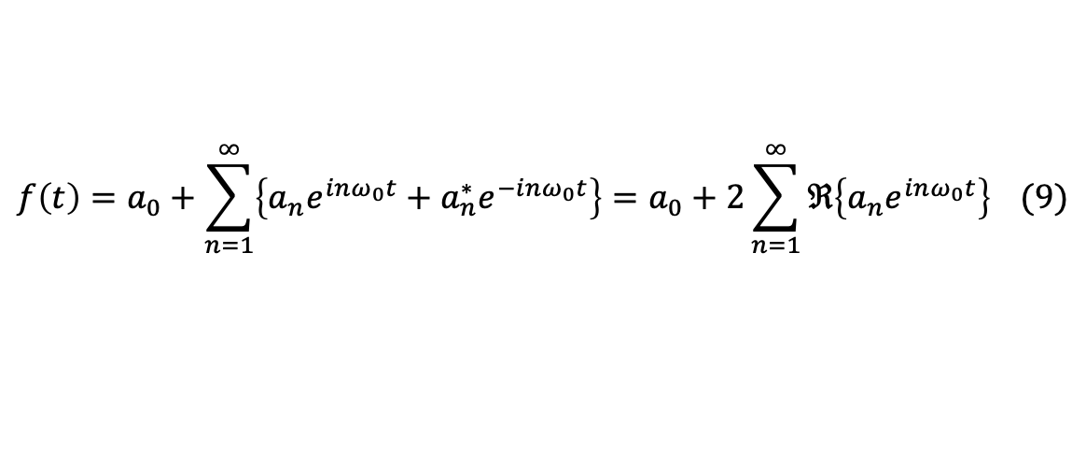
Assignment 4.1: Eigenfunctions of an LTI system
Starts with an introduction to
eigenfunctions and eigenvalues
Fourier series representation
$$f\left(t\right)=a_{0}+\sum_{n=1}^{∞}{\left\{a_{n}e^{inω_{0}t}+a_{n}^{∗}e^{−inω_{0}t}\right\}}=a_{0}+2\sum_{n=1}^{∞}{ℜ\left\{a_{n}e^{inω_{0}t}\right\}} (9)$$
Notes:
Fourier series representation is already known to you from Evert’s lectures, but the assignment recaps it. (click for animation) Note that equation 9 shows why we were having equal positive and negative frequencies. Vice versa, it also shows why we were taking 2 times Re part of the results from the ifft.

Slide 3
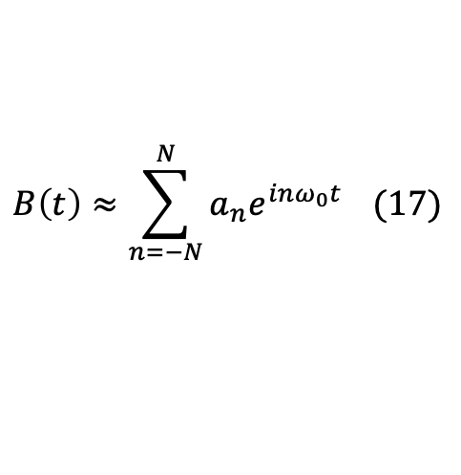
Assignment 4.1: Eigenfunctions of an LTI system
Plot the box function using ones and zeros as a function of time for 201 points from
-T₀/2 < t < T₀/2 for T₀ = 4T₁ and T₀ = 4.
Does this function satisfy the three Dirichlet conditions? Explain why.
Compute the coefficients for n = 0; 1; 2; … ; 80. Now we approximate B(t) by a finite number N, because we cannot compute until infinity, as
1
0
$$B\left(t\right)≈\sum_{n=−N}^{N}{a_{n}e^{inω_{0}t}} (17)$$
Notes:
After that are coming the tasks for this part of the assignment, which are given in bold in the text. Here is their summary as well. Using ones and zeros really means just that, as I am showing here to the right.
When you compute the coefficients, note that this is an exercise for working with matrices, because this is what you were taught during the course. So, search for a matlab command that could repeat a value.
There are other ways as well. All are ok, as I am evaluating here logic more than optimization.
After you compute the coefficients, you can compute the approximate box function using (click for animation)

Slide 4
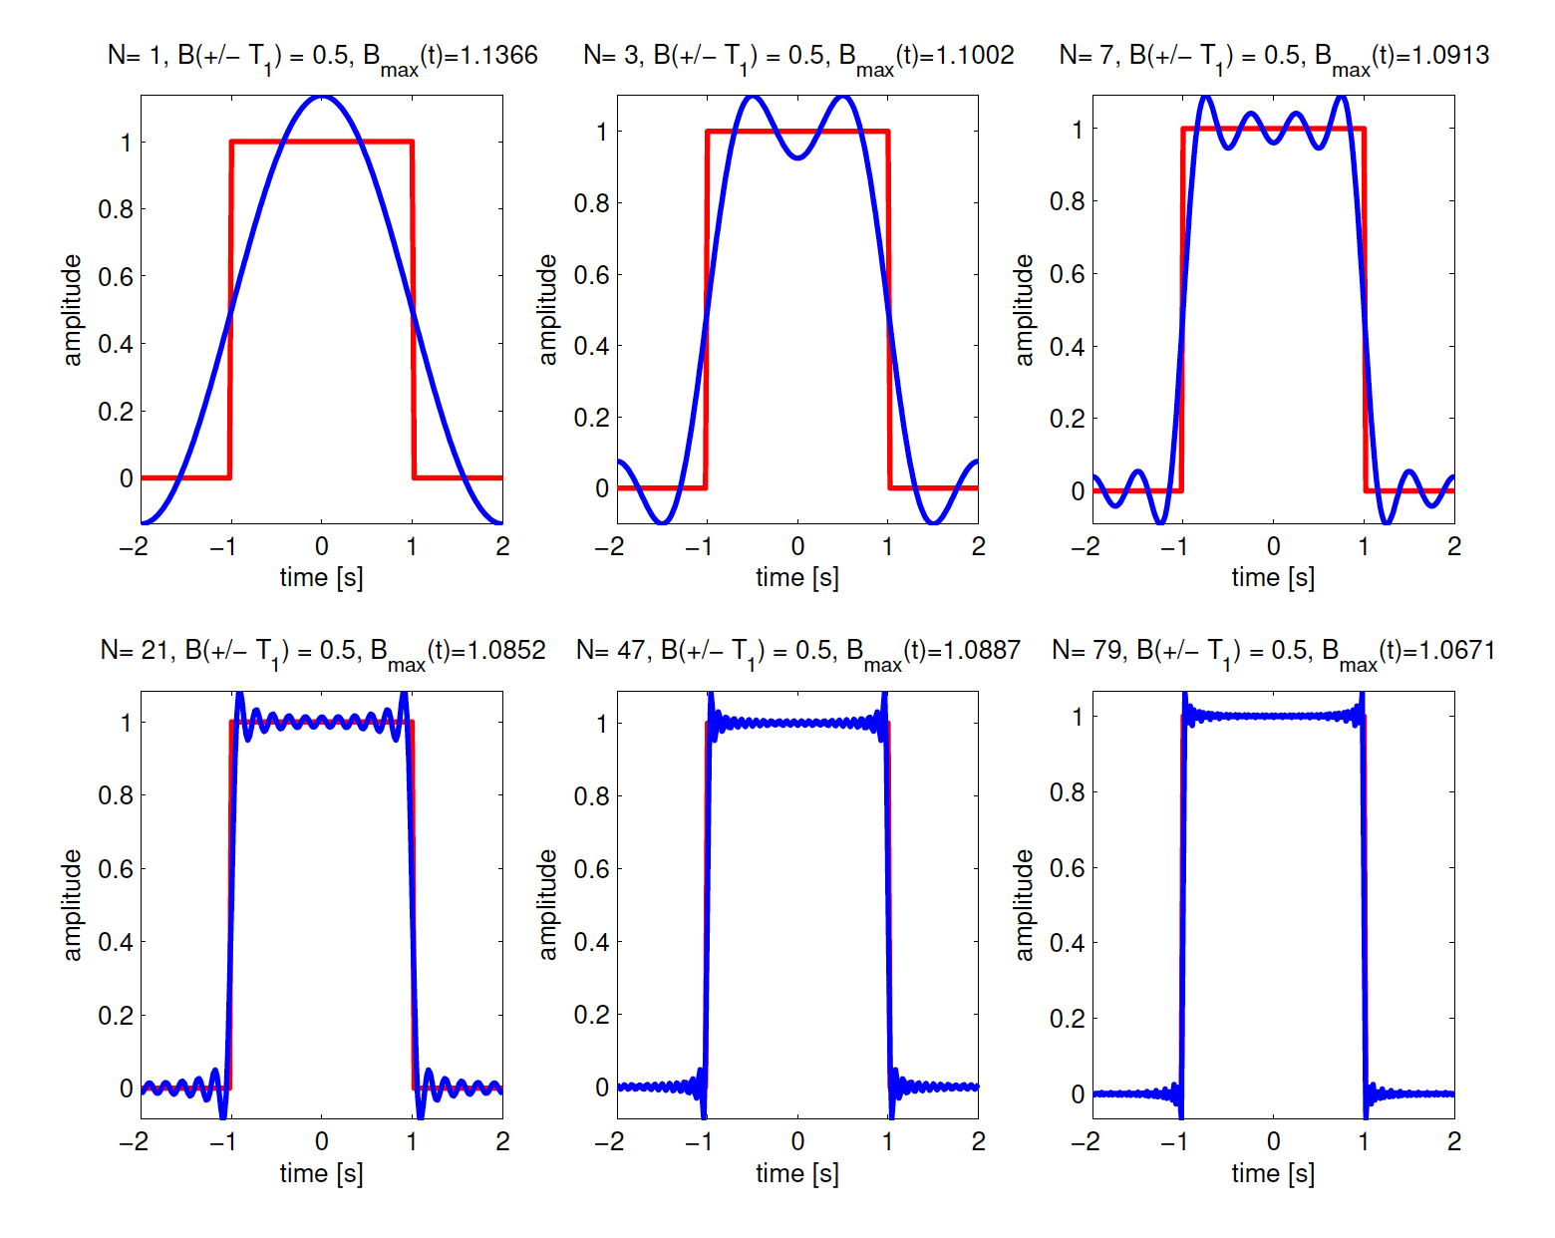
Assignment 4.1: Eigenfunctions of an LTI system
Plot the exact box function and the approximate B(t) results for N = 1; 3; 7; 21; 47; 79 for each value of N in a different plot, as shown in Figure 1. What is the value of your result at the locations t = ±T₁, does it change with N? What is the peak value, does it change with N? Show these answers in the plotted figure.
Notes:
Then you have to plot the comparison of the exact and computed approximate Box function. Figure 1 is what I am showing here to the right.

Slide 5
Assignment 4.1: Eigenfunctions of an LTI system
Compute the sum of the squares of the local differences between the numerical approximate Fourier series representation B(t) and the exact box function as a function of N. This sum of squared differences is called the energy in the difference. Use this notion to explain what happens to your results when N changes. Show this change in a figure.
What happens when you would take T₀ = 6T₁ in comparison to the case when T₀ = 4T₁? Explain this also by showing figures like for T₀ = 4T₁.
Make a flowchart of the code (of course, before you start coding).
Notes:
And here are the rest of the tasks for this part of the assignment. .

Slide 6
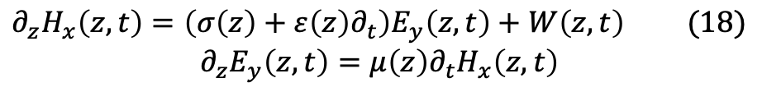
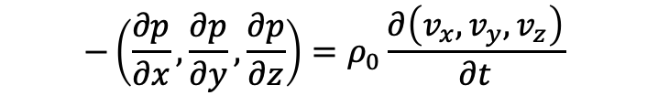
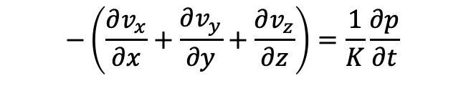
Assignment 4.2: Scattering from a multilayered earth –
a numerical solution by finite differences
For this part of the assignment, we will use the electromagnetic wave equation
$$∂_{z}H_{x}\left(z,t\right)=\left({σ\left(z\right)+ε\left(z\right)∂}_{t}\right)E_{y}\left(z,t\right)+W\left(z,t\right) (18)$$
$$∂_{z}E_{y}\left(z,t\right)={μ\left(z\right)∂}_{t}H_{x}\left(z,t\right)$$
$$−\left(\frac{∂p}{∂x},\frac{∂p}{∂y},\frac{∂p}{∂z}\right)=ρ_{0}\frac{∂\left(v_{x},v_{y},v_{z}\right)}{∂t}$$
$$−\left(\frac{∂v_{x}}{∂x}+\frac{∂v_{y}}{∂y}+\frac{∂v_{z}}{∂z}\right)=\frac{1}{K}\frac{∂p}{∂t}$$
Notes:
For those of you who are not too familiar with it, this is exactly like the wave equation (click for animation) with particle velocity and pressure (like in the course of Kees Weemstra). In Evert’s course on electromagnetic exploration methods, you will learn more about equation 18.

Slide 7

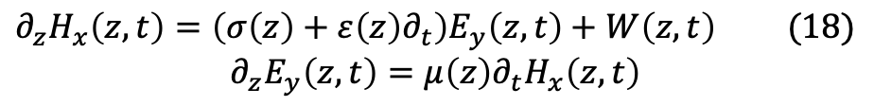

Assignment 4.2: Scattering from a multilayered earth –
a numerical solution by finite differences
-z
$$D_{1} −homogeneous \left(air\right);source only here$$
0
$$D_{2} −inhomogeneous$$
d
$$D_{3} −homogeneous halfspace$$
+z
$$∂_{z}H_{x}\left(z,t\right)=\left({σ\left(z\right)+ε\left(z\right)∂}_{t}\right)E_{y}\left(z,t\right)+W\left(z,t\right) (18)$$
$$∂_{z}E_{y}\left(z,t\right)={μ\left(z\right)∂}_{t}H_{x}\left(z,t\right)$$
Notes:
We want to evaluate equations 18 in this medium (click for animation), using a discrete method – finite differences.

Slide 8
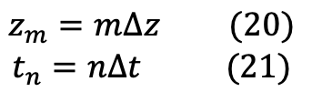
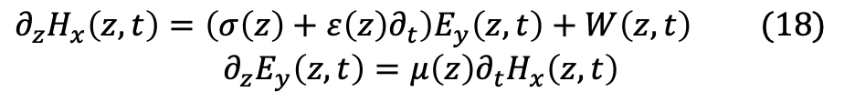
Assignment 4.2: Scattering from a multilayered earth –
a numerical solution by finite differences
$$∂_{z}H_{x}\left(z,t\right)=\left({σ\left(z\right)+ε\left(z\right)∂}_{t}\right)E_{y}\left(z,t\right)+W\left(z,t\right) (18)$$
$$∂_{z}E_{y}\left(z,t\right)={μ\left(z\right)∂}_{t}H_{x}\left(z,t\right)$$
$$z_{m}=m∆z (20)$$
$$t_{n}=n∆t (21)$$
Using discretization with central differences, we obtain equation 24.
Notes:
To discretize the space and time, we divide the space and time into equal intervals (click for animation)

Slide 9
Assignment 4.2: Scattering from a multilayered earth –
a numerical solution by finite differences
Ricker wavelet (a poor artist’s impression)
Notes:
To discretize the space and time, we divide the space and time into equal intervals (click for animation)

Slide 10
Assignment 4.2: Scattering from a multilayered earth –
a numerical solution by finite differences
-z
$$D_{1} −homogeneous \left(air\right);source only here$$
0
d1
d
$$D_{3} −homogeneous halfspace$$
+z
Notes:
We need to sample the shortest distance with for sure two points. If your spatial grid is a bit less than d1, like the two points I show, we will sample the layer only with one point. So, we want to have at least three points per layer (click for animation).

