Slide 1
Assignment 3.1

Slide 2
Assignment 3.1
Task 1
Write a function to read the binary file with the reflection data
use this function in the main programme
visualize the data
Notes:
(click for next slide)

Slide 3
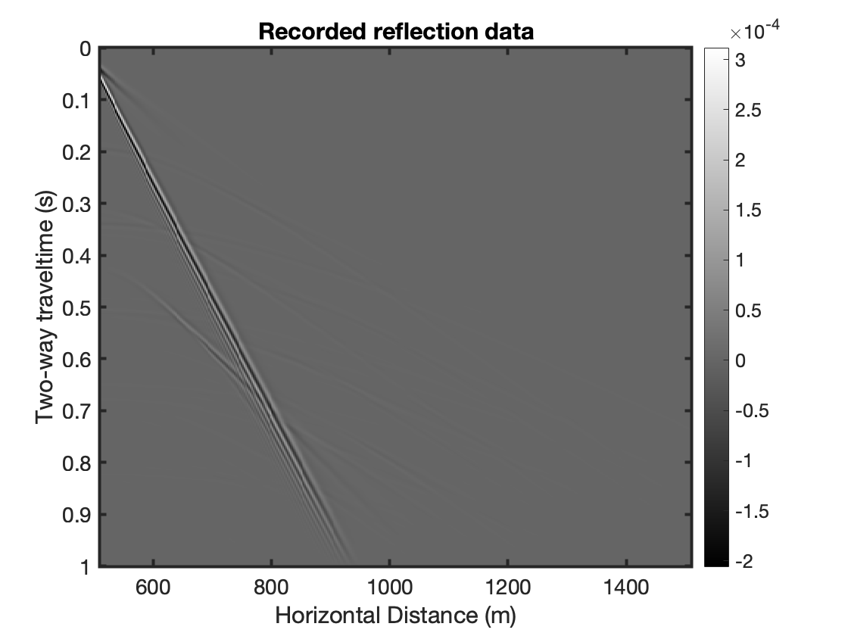
Notes:
Note at the bottom of the time axes that the arrivals are muted (to lower the ringing in the frequency domain). (click for next slide)

Slide 4
Assignment 3.1
Task 2
Transform the reflection data from the time-space to the frequency-wavenumber domain
using a double Fourier transform
one transform should be using fft(), the other – ifft()
explain which should be which.
Notes:
Visualize the data in the f-k domain. (click for next slide)

Slide 5
Assignment 3.1
Task 3
Perform f-k filtering
using muting and an estimate of the propagation velocity of the surface waves.
Notes:
You can estimate the velocity in the t-x domain, but you can also do it here. How? (click for next slide)

Slide 6
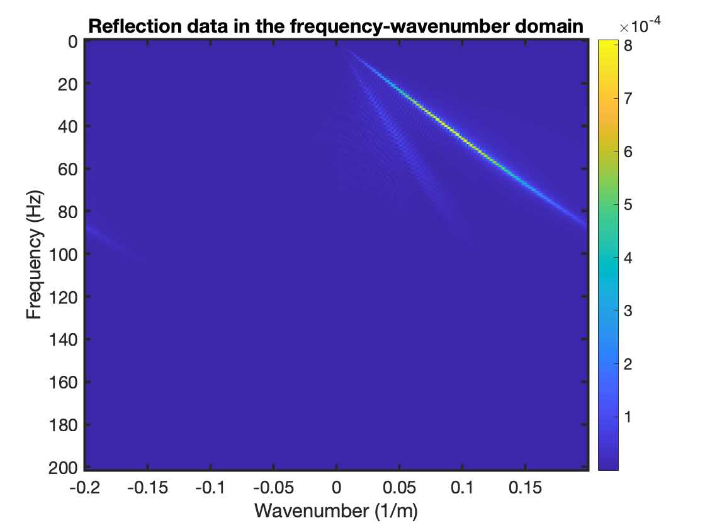
Notes:
Plane waves with different angles relative to the horizontal. High amplitude here, high amplitude in the t-x domain. So the high amplitude corresponds to the surface waves. Their velocity is dist/time. And here? f/k

Slide 7
Assignment 3.1
Task 3
Perform f-k filtering
decide what velocity you want to use to suppress the surface-wave energy
mute above that line to preserve the energy inside the cone the muting will form.
Notes:
For the muting, use as basis the low-cut filter you wrote for Assignment 2. (click for next slide)

Slide 8
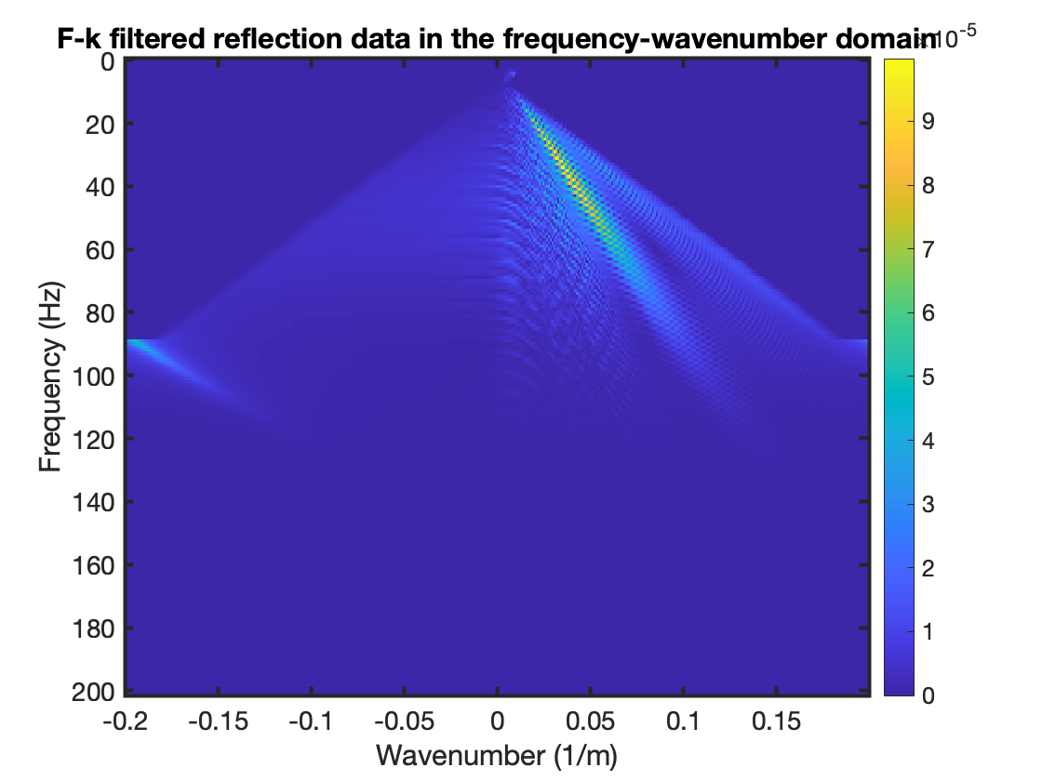
Notes:
You can apply it per k or per f, up to you. When applying it per k value, it will be in fact a what? A high-cut filter.
For filtering, explain about choosing a point to taper from: going to the inside of the cone and then applying a taper. One could search for a maximum, but should take care to still guide the search by an estimated velocity to avoid finding a wrap-around maximum.

Slide 9
Assignment 3.1
Task 4
Transform back to the t-x domain
what do you observe about the quality of the surface-wave events when comparing them to the events in the original gather?
Notes:
Read the question and (click for next slide)

Slide 10
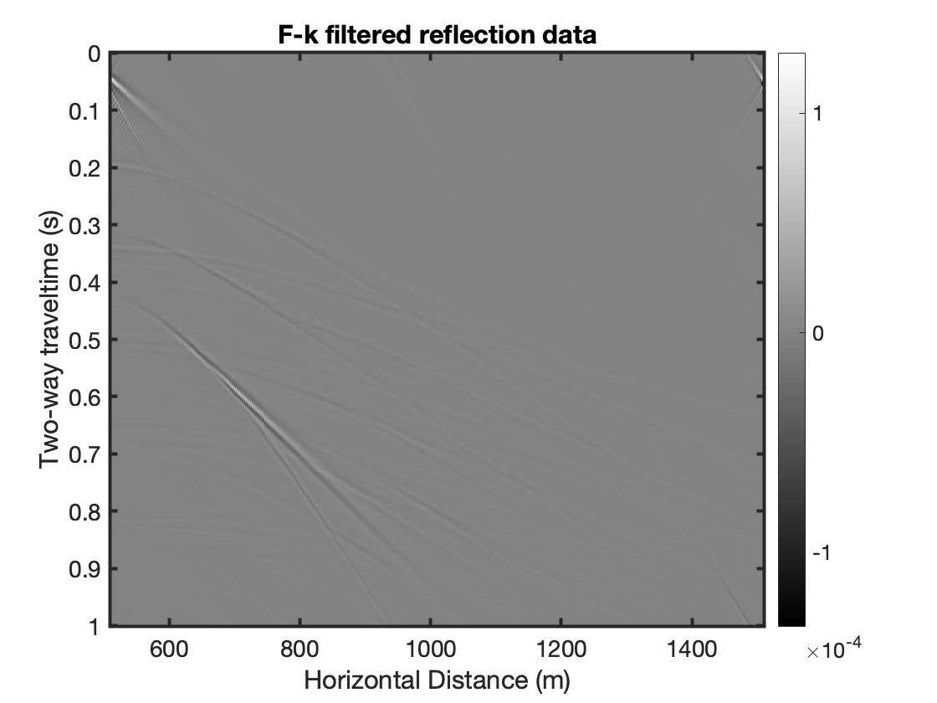
Notes:
Explain to the students about the linear events, that they are typical results form f-k filtering, which could be suppressed by making the taper slope gentle, but that would lead either to leftover surface waves or to loss of other events.
Feedback session: Showing the figure, explain to the students about the wrap-around. Adding zeros avoids that.

Slide 12
Assignment 3.2
Notes:
Explain that in 3.1 we were doing the transformation looking for a domain where two signals are separated with minimum overlap so that we could filter one of them out. In 3.2, we are transforming to a new domain so that our computations could be faster. But if we are to do only modelling, we can directly start in the frequency domain and model a signal using logarithmic frequency distribution, which will safe a lot of time. But to go back to the time domain, we cannot use logarithmic scale, we need a regular frequency scale due to the requirement of the integral to integrate points at regular distances (\delta f).

Slide 13
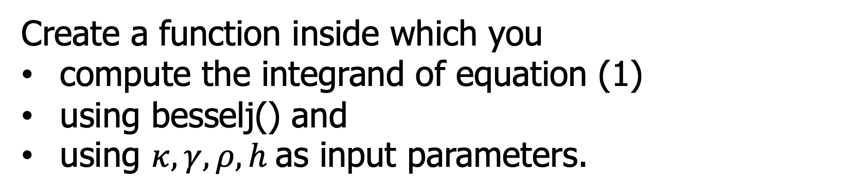
Assignment 3.2
Task 1
Create a function inside which you
compute the integrand of equation (1)
using besselj() and
using $κ, γ, ρ, h$ as input parameters.

Slide 14
Assignment 3.2
Task 2
Using quadgk()
compute the integral of equation (1) with the integration routine using the function from Task 1.
With equation (2), compute the same result
using besseli() and besselk().
Display the error between the two results on screen.
Notes:
In quadgk, you have to specify which is the integration parameter. Which one is that?
So, how you compare the two calculations? (click for next slide)

Slide 15
equation 1 using quadgk
equation 2
using
besseli and besselk
§
Log(f)
Notes:
Just print to screen the error.

Slide 16
Assignment 3.2
Task 3
Create a discrete frequency axis
with a logarithmic spacing from f=10^(-2.5) Hz to f=10^2.5
this spans 5 decades (5 powers of 10)
use 2 points per decade.
Compute the field using quadgk() for all frequencies
using a for() loop and store the result.
Notes:
(click for next slide)

Slide 17
§
p. 1
p. 2
p. 3
p. 4
p. 5
p. 6
p. 7
p. 8
p. 9
p. 10
p. 11
10^(-2.5)
10^(2.5)
Log(f)

Slide 18
Assignment 3.2
Task 4&5
Remove field values at even points
Notes:
(click for next slide)

Slide 19
§
p. 1
p. 2
p. 3
p. 4
p. 5
p. 6
p. 7
p. 8
p. 9
p. 10
p. 11
10^(-2.5)
10^(2.5)
Log(f)

Slide 20
§
p. 1
p. 2
p. 3
p. 4
p. 5
p. 6
p. 7
p. 8
p. 9
p. 10
p. 11
10^(-2.5)
10^(2.5)
Log(f)

Slide 21
Assignment 3.2
Task 4&5
Compute the field at the even points by interpolation
using pchip().
Calculate the normalized error at the even points.

Slide 22
First iteration
p. 1
p. 2
p. 3
p. 4
p. 5
p. 6
p. 7
p. 8
p. 9
p. 10
p. 11
10^(-2.5)
10^(2.5)
Log(f)
Notes:
Say here that the comparison criteria needs two checks to be fulfilled simultaneously. The absolute amplitude is needed to avoid adjusting the function at non-important points. The error is needed for obvious reasons.

Slide 23
Assignment 3.2
Task 4&5
If the normalized value does not meet the criterium
use that point as a new known (odd point) for the following iteration.

Slide 24
Second iteration
§
p. 1
p. 2
p. 3
p. 4
p. 5
p. 6
p. 7
p. 8
p. 9
p. 10
p. 11
10^(-2.5)
10^(2.5)
Log(f)

Slide 25
Second iteration
§
p. 1
p. 3
p. 5
p. 6
p. 7
p. 8
p. 9
p. 10
p. 11
p. 12
p. 13
p. 2
p. 4
10^(-2.5)
10^(2.5)
Log(f)

Slide 26
Assignment 3.2
Task 4&5
Repeat for all even point during the first iteration.
After reaching a final result
plot the result showing the real and imaginary parts.

Slide 27
Assignment 3.2
Task 6
Compute the field for linear frequencies from 10^(-2.5) to 10^(2.5) with a step of 10^(-2.5)
using pchip() and the values at the points you defined that you need in Tasks 4&5;
add at the beginning the value at f=0, which is 0.

Slide 28
Assignment 3.2
Task 7
Visualize the result in the time domain.
Task 8
Flowchart

