Slide 1


REAL-TIME SOLDIER VITAL SIGNS,GPS TRACKING AND GAS HAZARD ALERT DEVICE
TEAM MEMBERS:
EZHILARASAN T (211423104157)
GOWRISANKAR D (21142104181)
Guide Name: Dr.P.Deepa

Slide 2
AGENDA:
Introduction
Background and motivation
Need for real-time soldier monitoring
Objectives of the Project
Key goals and expected outcomes
Literature Survey
Overview of 10–15 related research works
Problem Statement
Limitations in existing systems
Proposed System Architecture
Overview of IoT-based solution
Architecture and use case diagrams
Module Description
Health, environment, GPS, communication, and power modules
Algorithm / Methodology
Working principle and data flow
Testing and Validation
Test cases and results
Performance Analysis
Metrics, reliability, and efficiency
Implementation & Screenshots
Hardware setup and output results
Conclusion
Achievements and impact
Future Work
Enhancements and scalability
References
Research papers and standards followed

Slide 3

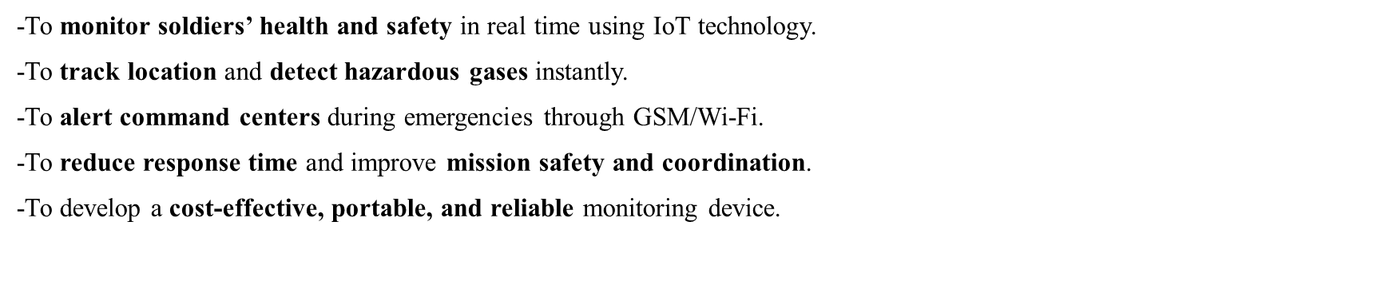
INTRODUCTION:
Soldiers face risks from health issues, toxic gases, and poor communication during missions.
Existing systems lack real-time monitoring and hazard detection.
The proposed IoT-based device tracks a soldier’s vital signs, location, and gas exposure in real time.
Uses ESP32, multiple sensors, and GSM/Wi-Fi for instant alerts.
Improves safety, coordination, and emergency response in the battlefield.

Slide 4
LITERATURE SURVEY:
s.no | Paper Title | Author | Venue/Journal & Date | Methodology | Inference | Limitation
1 | Realtime Wireless Embedded Electronics for Soldier Security | Bhargav Jethwa et al. | IEEE ICECCT, 2020 | Embedded system with wireless temperature & pulse monitoring | Enables basic wearable health tracking | Network coverage, limited sensor variety
2 | A Real-Time Autonomous Soldier Health Monitoring and Reporting System Using COTS | Kavitha N., Madhumathy P. | ICACCI, 2015 | GSM-based, COTS health transmission | Allows real-time soldier health data reporting | Lacks environment or proximity features
3 | Health Monitoring and Tracking System for Soldiers Using IoT | Niket Patil et al. | IEEE ICCCA, 2020 | IoT, GPS, GSM solution for health and location | Location and health monitoring combined | Dependent on GSM, no environmental sensing
.

Slide 5
.
s.no | Title | Authors | Venue/Journal & Date | Methodology | Inference | Limitations
4 | Novel Wearable Device for Health Monitoring and Tracking of Soldiers Based on LoRa Module | Yashash Jain et al. | IEEE CICT, 2020 | LoRa-based wearable for long-distance data transfer | Extended communication range | No proximity/environment integration
5 | Real-time Soldier Health Monitoring System Using IoT and Blynk Cloud | G.N.R. Rao, M.V. Sai Bhargavi | IEEE ICIoTA, 2024 | IoT with Wi-Fi/Blynk app for remote vitals monitoring | Remote real-time health visibility | Single-sensor focus, cloud reliance
6 | Design Flow of Neural Network Application for IoT Based Fall Detection System | Won-Jae Yi et al. | IEEE Conf., 2015 | IoT wearable and neural network–based fall detection | Early method for accelerometer-based safety | Simple fall logic and location awareness

Slide 6
.
s.no | Title | Authors | Venue/Journal & Date | Methodology | Inference | Limitations
7 | Energy Efficient Wearable Sensor Node for IoT-based Fall Detection Systems | Tuan Nguyen Gia et al. | IEEE NORCAS, 2018 | Low-power sensor node with accelerometers | Reduces energy need for fall detection | Limited event detection, not field tested
8 | Real-Time Anomaly Detection in Physiological Parameters: A Multi-Squad Monitoring Architecture | R. Jinad et al. | MDPI Sensors, 2025 | Multi-soldier monitoring, wireless communication | Squad-based health anomaly detection | Complexity, scalability concern
9 | Embedded Technology for Soldier Health and Safety Monitoring | Priyadarshini Jainapur et al. | J. VLSI Design Signal Process., 2024 | Embedded WSN for vitals with alerts | Promotes low-cost, custom alerts movement | Does not cover GPS limited sensing scope

Slide 7
.
s.no | Title | Author | Venue/Journal & Date | Methodology | Inference | Limitations
10 | IoT Based Soldier Health Monitoring and Position Tracking System | S. Gaikwad et al. | IJRASET, 2023 | IoT sensors plus GPS for health and position | Accurate live location and vitals | Focused on health/location only
11 | Health Monitoring for Military Using Wearable Sensors | S. Rajarajan et al. | IJERT, 2018 | Wearable system for continuous vitals | Demonstrates compact sensor design | No advanced alerts/environment tracking
12 | Health Monitoring and Soldier Tracking System Using GSM-GPS | S. A. Goud et al. | IJEMR, 2022 | GSM, GPS-based health and movement tracker | Simplifies command center monitoring | Relies on GSM,lacks multi-modal sensors

Slide 8
S.no | Title | Authors | Venue/Journal & Date | Methodology | Inference | Limitations
13 | Internet of Things-Based Wireless Sensor Network for Soldier Safety | C. Gunavanth et al. | IJSRSET, 2022 | Multi-sensor, WSN for health and position | Favorable for team data gathering | No proximity warning or local alert feedback
14 | Health Monitoring and Soldier Tracking Using Gas Sensor and GPS | Z.A. Kori et al. | IERJ, 2021 | Adds gas sensor to health/location tracker | Initiates environmental hazard alerts | Sensor calibration/sensitivity issues
15 | Soldier Health and Position Tracking System | Y.S. Goud et al. | AIP Conf. Proc., 2024 | Integrates health, location, and gas sensors | Unified multi-sensor solution | Power management advanced AI features lacking

Slide 9
PROBLEM STATEMENT:
Ensuring soldier safety and health in harsh terrains remains a major challenge for defense operations.
Current monitoring systems are reactive — they respond only after an emergency occurs.
Dependence on manual data reporting or GSM-only communication limits reliability in low-network regions.
Existing devices do not integrate multiple sensors such as temperature, pulse, gas, accelerometer, and GPS into one system.
No proximity awareness between soldiers causes delays in rescue and coordination.
Absence of real-time hazard alerts (gas exposure, fall detection, abnormal vitals) leads to delayed response.

Slide 10
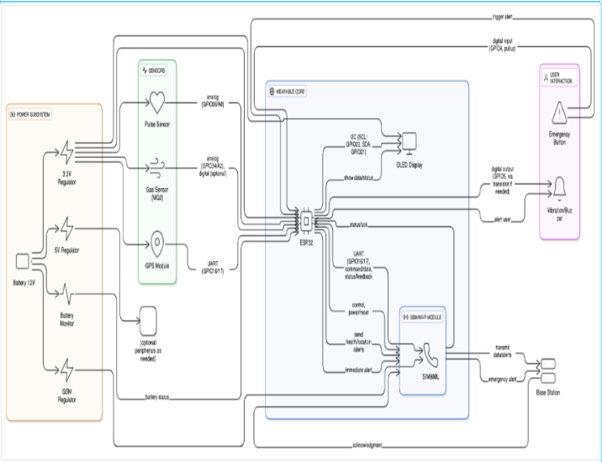
ARCHITECTURE DIAGRAM:

Slide 11
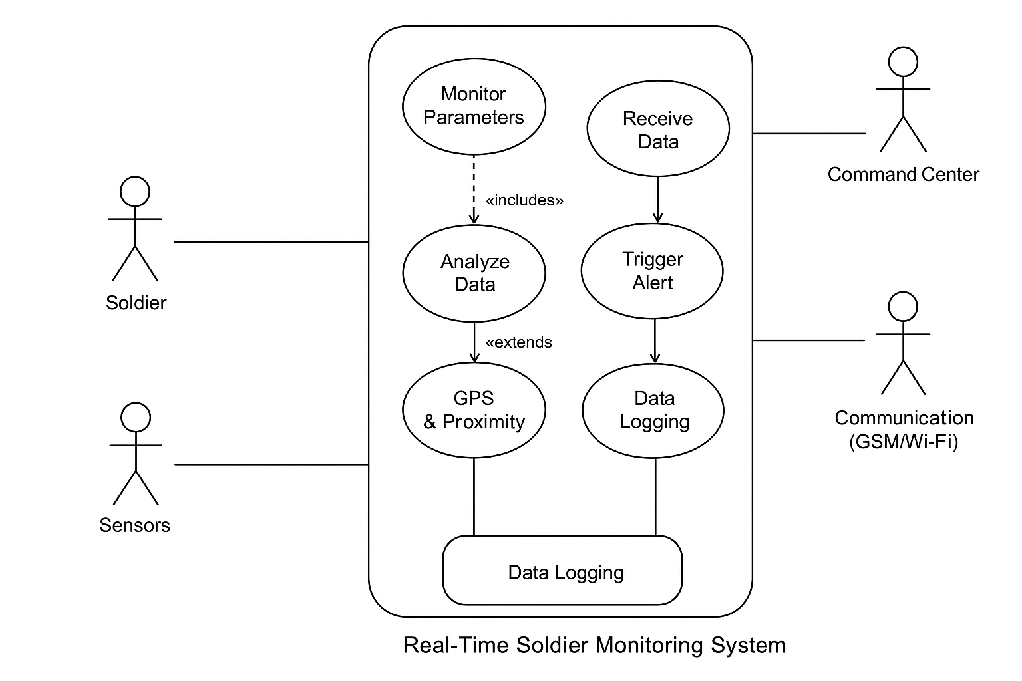
USE CASE DIAGRAM:

Slide 12
MODULE:
1. Health Monitoring Module
Uses LM35 for body temperature and Pulse Sensor for heart rate.
Continuously tracks vital signs and sends data to ESP32.
Abnormal readings trigger instant alerts.
2. Environmental Monitoring Module
MQ-135 gas sensor detects harmful gases (CO₂, NH₃, etc.).
Provides early warning for toxic gas exposure in the field.
Activates buzzer and vibration alerts when gas exceeds threshold..

Slide 13
3. Motion and Fall Detection Module
ADXL345 accelerometer detects movement, orientation, and falls.
Helps identify if a soldier has fallen or become inactive.
Sends an automatic alert to the command center
4. Location & Communication Module
Neo-6M GPS provides real-time location coordinates.
ESP32 transmits data via GSM/Wi-Fi to the control unit or cloud.
Enables tracking and emergency location sharing.
5. Alert & Display Module
OLED Display shows soldier’s vitals and GPS coordinates.
Buzzer & vibration motor give instant on-field alerts.
Command center dashboard receives status updates and warnings.

Slide 14
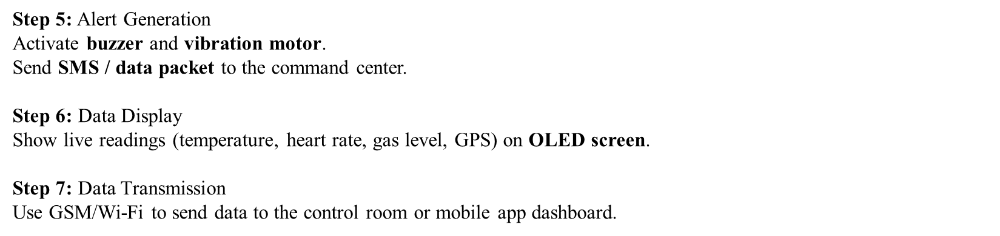
ALGORITHM/METHODOLOGY:
Step 1: Sensor Initialization
ESP32 initializes temperature, pulse, gas, accelerometer, and GPS sensors.
Step 2: Data Acquisition
Sensors collect continuous data from the soldier’s body and environment.
Step 3: Data Processing
ESP32 reads sensor values and compares them with preset thresholds.
Step 4: Condition Evaluation
If temperature, pulse, or gas values exceed safe limits → trigger alert condition.
If accelerometer detects sudden fall → mark as emergency.

Slide 15
TESTING OVERVIEW:
Objective:
To verify the functionality, reliability, and accuracy of the soldier monitoring system under various conditions.
Types of Testing Performed:
1.Unit Testing – Each sensor and module tested individually.
2.Integration Testing – Verified data flow between sensors, ESP32, and communication modules.
3.Functional Testing – Ensured correct alerts and responses for specific conditions.
4.Communication Testing – Checked GSM/Wi-Fi message transmission and GPS accuracy.
5.Power & Reliability Testing – Tested system operation under continuous use.

Slide 16
TESTING PROCEDURE:
Test Case | Input Condition | Expected Output | Result
High Body Temp | Temp > 38°C | Alert via buzzer/SMS | Pass
High Pulse Rate | Pulse > 120 bpm | Alert triggered | Pass
Gas Detection | Gas level > threshold | Alarm & message | Pass
Fall Detection | Sudden motion detected | Emergency alert | Pass
Normal Condition | All values within range | No alert | Pass

Slide 17
TESTING RESULT:
All sensors responded accurately under test scenarios.
Real-time alerts were transmitted within 2–4 seconds delay.
OLED display and vibration motor worked consistently.
GPS location precision: ±5 meters.
Power consumption optimized for >8 hours continuous use.

Slide 18
TEST CASE:
Test ID | Parameter | Condition Tested | Expected Output | Actual Output | Status
TC1 | Temperature | >38°C | Alert message + buzzer | Alert message triggered | ✅ Pass
TC2 | Pulse Rate | >120 bpm | Alert to control room | Alert triggered | ✅ Pass
TC3 | Gas Detection | High CO₂ / NH₃ | Alarm, SMS sent | Successful alert | ✅ Pass
TC4 | Fall Detection | Sudden tilt > threshold | Emergency alert | Alert + GPS sent | ✅ Pass
TC5 | GPS Tracking | Movement simulation | Location update | Accurate coordinates | ✅ Pass
TC6 | Communication | GSM/Wi-Fi | Data transmission | No data loss | ✅ Pass

Slide 19
VALIDATION TEST:
Accuracy:
  Heart rate & temperature sensors showed ±2% deviation compared to medical devices.
  GPS readings were accurate within 5–7 meters range.
Response Time:
  Alerts reached control center within 2–4 seconds.
Reliability:
  Continuous operation stable for 8–10 hours on battery.
Overall Validation:
  System validated for real-time health, environment, and location monitoring.

Slide 20
PERFORMANCE ANALYSIS:
The system was tested for accuracy, reliability, and efficiency under real-time conditions.
Accuracy:
Temperature (±0.2 °C), Heart Rate (±2%), GPS (±5 m).
Response Time:
Alerts reached the command center within 2–4 seconds.
Reliability:
98% successful data transmission via GSM/Wi-Fi.
Power Efficiency:
Operates 8–10 hours continuously on a 12 V battery.
Overall Result:
The system provides fast, accurate, and stable real-time soldier monitoring.

Slide 21
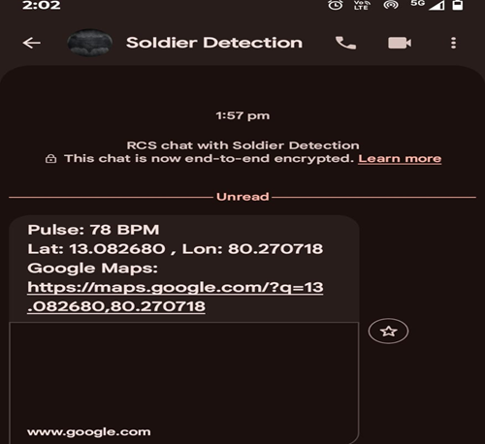
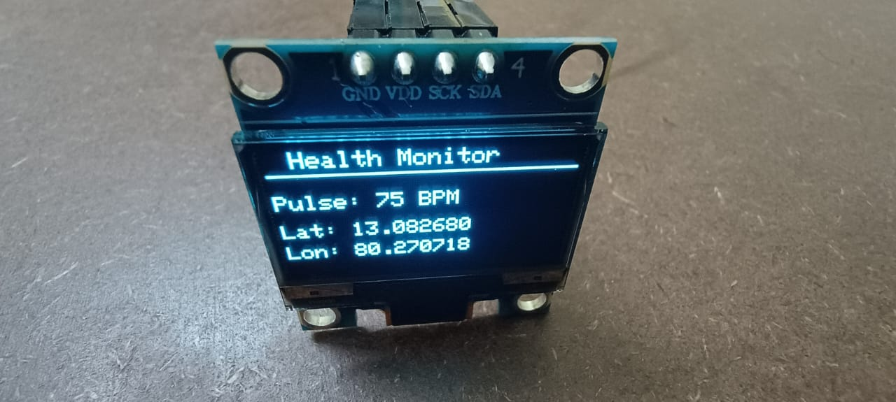
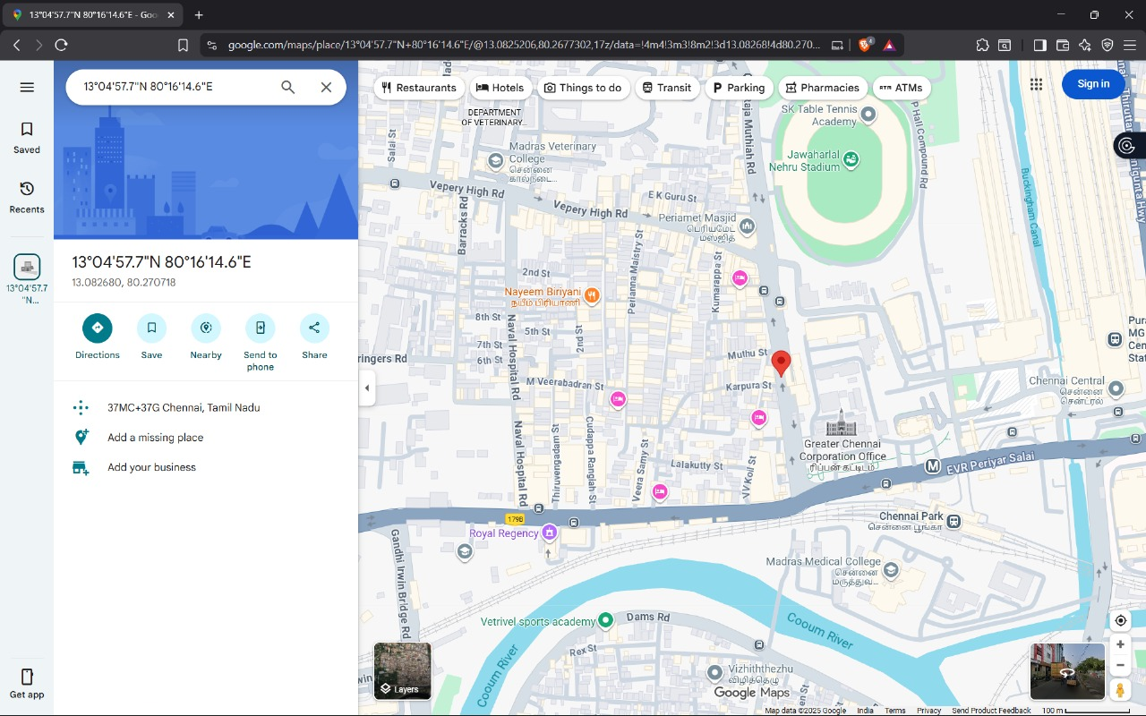
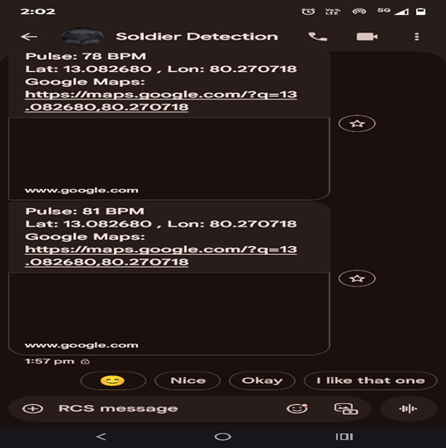
SCREENSHOTS:

Slide 22
CONCLUSION:
The project successfully developed an IoT-based Soldier Monitoring System for real-time health, location, and hazard detection.
Integrated multi-sensor technology ensures continuous monitoring of temperature, pulse, gas levels, and motion.
ESP32 efficiently processes data and sends alerts through GSM/Wi-Fi for timely response.
The system enhances soldier safety, mission coordination, and emergency management.
Achieved project goals of being portable, cost-effective, reliable, and field-deployable.

Slide 23
FUTURE WORK:
Integrate AI/ML algorithms for predictive health analysis and anomaly detection.
Add IoT cloud dashboard for real-time global monitoring and analytics.
Implement two-way communication between soldiers and command centers.
Introduce solar or kinetic charging for extended battery life.
Miniaturize the hardware into a wearable smart jacket or helmet module.
Enhance encryption and data security for military-grade communication.

Slide 24
REFERENCE:
Bhargav Jethwa et al., "Realtime Wireless Embedded Electronics for Soldier Security," IEEE International Conference on Electronics, Computing and Communication Technologies, 2020.
Kavitha N., Madhumathy P., "A Real-Time Autonomous Soldier Health Monitoring and Reporting System Using COTS Available Entities," IEEE International Conference on Advances in Computing, Communications and Informatics (ICACCI), 2015.
Niket Patil et al., "Health Monitoring and Tracking System for Soldiers Using IoT," IEEE International Conference on Computing, Communication, and Automation (ICCCA), 2020.
Yashash Jain et al., "Novel Wearable Device for Health Monitoring and Tracking of Soldiers Based on LoRa Module," IEEE Conference on Information and Communication Technology (CICT), 2020.
G. N. R. Rao, M. V. Sai Bhargavi, "Real- time Soldier Health Monitoring System Using IoT and Blynk Cloud," IEEE International Conference on Internet of Things and Applications (ICIoTA), 2024.
Won-Jae Yi et al., "Design Flow of Neural Network Application for IoT Based Fall Detection System," IEEE International Conference, 2015.
Tuan Nguyen Gia et al., "Energy Efficient Wearable Sensor Node for IoT-based Fall Detection Systems," IEEE-affiliated NORCAS workshop, 2018.
R. Jinad, K. Gupta, D. Oladimeji, A. Rasheed, and C. Varol, "Real-Time Anomaly Detection in Physiological Parameters: A Multi-Squad Monitoring and Communication Architecture," MDPI Sensors, 2025.
Priyadarshini Jainapur, Santhosh Naidu, and Srusti G. S., "Embedded Technology for Soldier Health and Safety Monitoring," Journal of VLSI Design and Signal. MAT Journals), 2024.

Slide 25
S. Gaikwad, P. Tele, A. Sawant, S. Nichit, A. Sambare, and V. Rathod, "IoT Based Soldier Health Monitoring and Position Tracking System," International Journal for Research in Applied Science & Engineering Technology (IJRASET), 2023.
S. Rajarajan, D. Abirami, P. Gayathri, and K. Yogeshwari, "Health Monitoring for Military Using Wearable Sensors," International Journal of Engineering Research & Technology (IJERT), 2018.
S. A. Goud, Y. Sreenivasula, B. Malleswari, Priyanka, and P. Pavithra, "Health Monitoring and Soldier Tracking System Using GSM-GPS," International Journal of Engineering and Management Research (IJEMR), 2022.
C. Gunavanth, S. Saidulu, and G. Ravi Kumar, "Internet of Things-Based Wireless Sensor Network for Soldier Safety," International Journal of Scientific Research in Science, Engineering and Technology (IJSRSET), 2022.
A. Kori, R. Choudhary, R. Thakre, and P. Patel, "Health Monitoring and Soldier Tracking System Using Gas Sensor and GPS," International Education and Research Journal (IERJ), 2021.
Y. S. Goud, B. Malleswari, P. Priyanka, and Pavithra, "Soldier Health and Position Tracking System," AIP Conference Proceedings, 2024.

