Slide 1
Cat Image Classification
Group 4:
Isaiah Martinez, Joycelyn Tuazon

Slide 2
NOTES
Add slide # to each slide
Edit thank you slide
Add questions slide
15 min max w/ 5 min questions
We are the first to present on 11/29
Don’t add too much text
Big pictures that are legible
Add images of eval metrics
Add final resulting accuracy

Slide 3
Table of contents
Data Visualization
Data Cleaning
Data Preparation
ML Models:
SVM – Isaiah
CNN – Joycelyn
Model Evaluation
Conclusion

Slide 4
Data visualization
Insert sample of each class of images
Size of each class of images

Slide 5
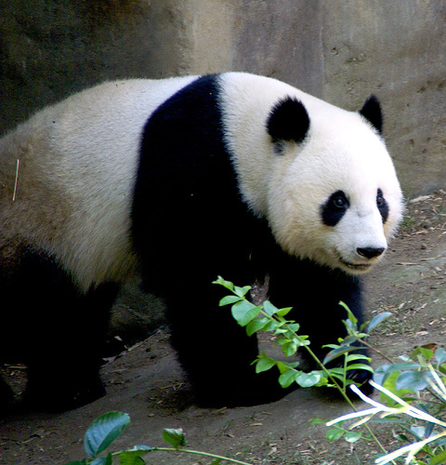
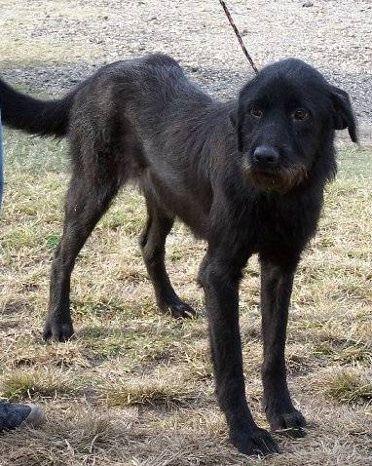
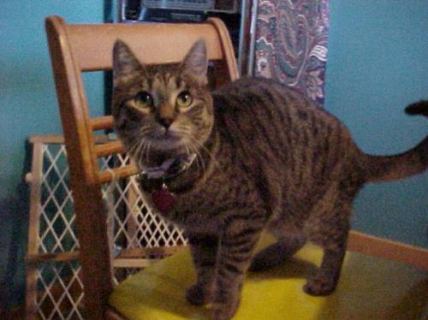
Dataset Sample
Cat Image 1
Dog Image 1
Panda Image 1
2

Slide 6
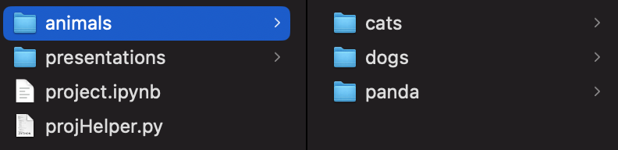
Dataset
Dataset name: Animal Image Dataset (DOG, CAT and PANDA)
Link to Dataset: https://www.kaggle.com/datasets/ashishsaxena2209/animal-image-datasetdog-cat-and-panda
3 folder structure:
Cat
Dog
Panda
Folder Structure
1

Slide 7
Data visualization
Show conversion of img to array

Slide 8
Data Cleaning
Got rid of bad images meeting any of the following criteria:
Criteria…
Criteria…
Show a single img that was cut out

Slide 9

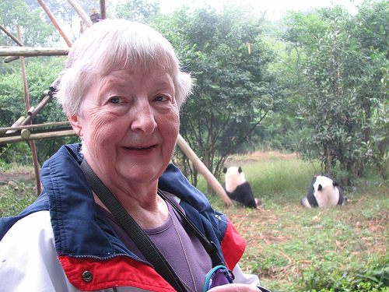

Dataset Cleaning
We are considering:
Standardizing image size ~(500,500)
Removing non-photograph images of animals
Removing photographs with difficult to spot subjects
Cat image 374
Cat image 556
Panda Image 475
4

Slide 10
Data preparation
Any algorithm used in data prep:
GLCM (RGB → Grayscale)
Class Balancing for Model
???

Slide 11
Machine Learning Models - SVM

Slide 12
Model Evaluation - SVM

Slide 13
Machine Learning Model - CNN
CNN models apply convolution operations to input data to learn feature and patterns
Filters and kernels in the convoluted layers capture these features and patterns
MaxPooling layers retain important features and patterns
Connected layers combine these features for the model to learn relationships between them
CNN models are good for image classification because of these methods of capturing and learning features and patterns

Slide 14
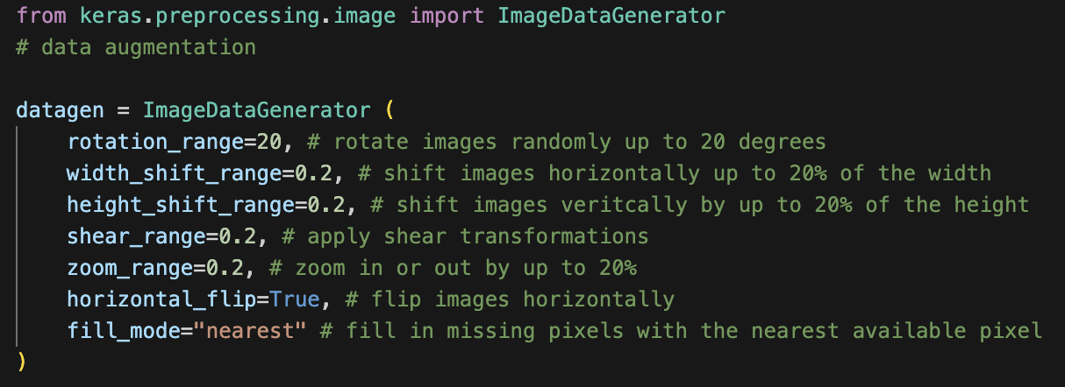
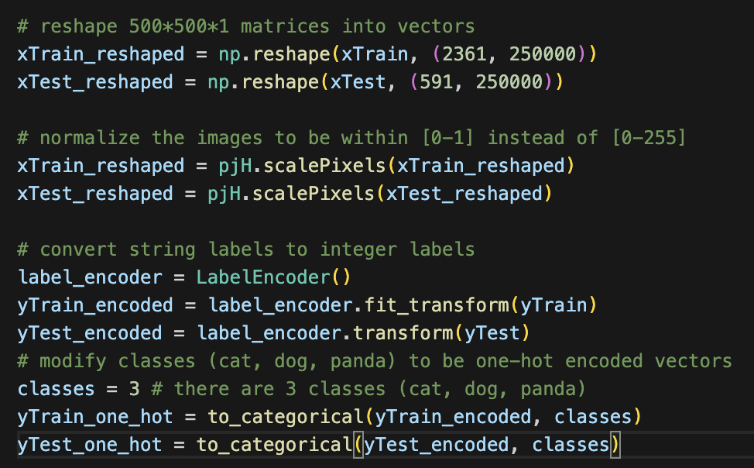
Machine Learning Model - CNN
Before applying the CNN model, we must reshape the images to fit the expected formats
Apply data augmentation to the data set to increase variance within the data

Slide 15
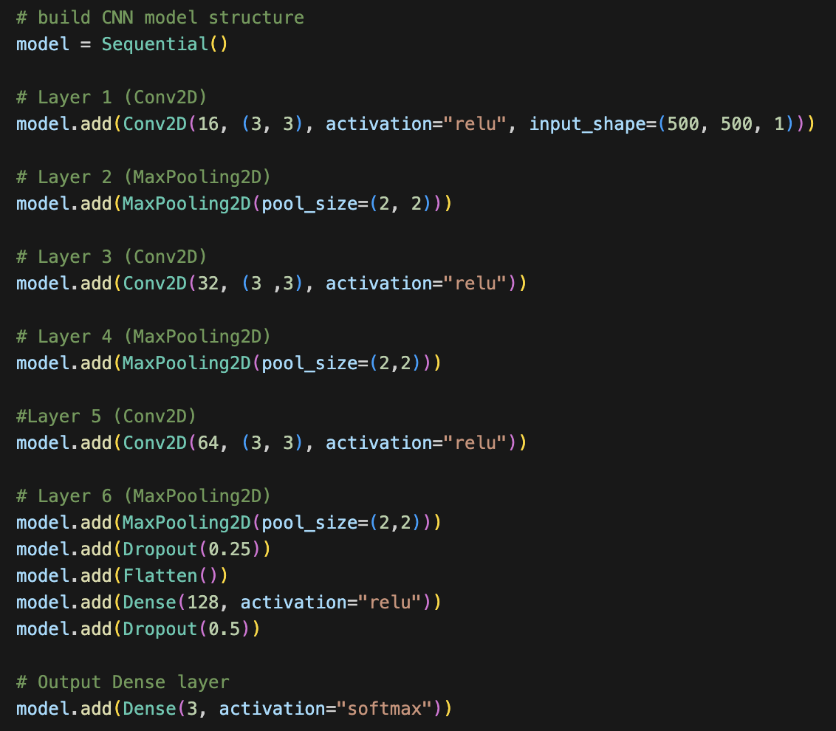
Machine Learning Model - CNN
Input layer is a Conv2D layer with 16 filters of size 3x3
Next layer is a MaxPooling layer with window size 2x2
MaxPooling retains the max value within the 2x2 window, and discards the rest
Retaining important features and discarding the rest makes the model more computationally efficient
Dropout layers are used to help prevent overfitting by randomly dropping neurons during training
We flatten the output from the previous convoluted layer into a one dimensional vector before moving onto the fully connected layer
Dense adds a fully connected layer
Output layer is a fully connected layer with 3 neurons (one for each class)

Slide 16
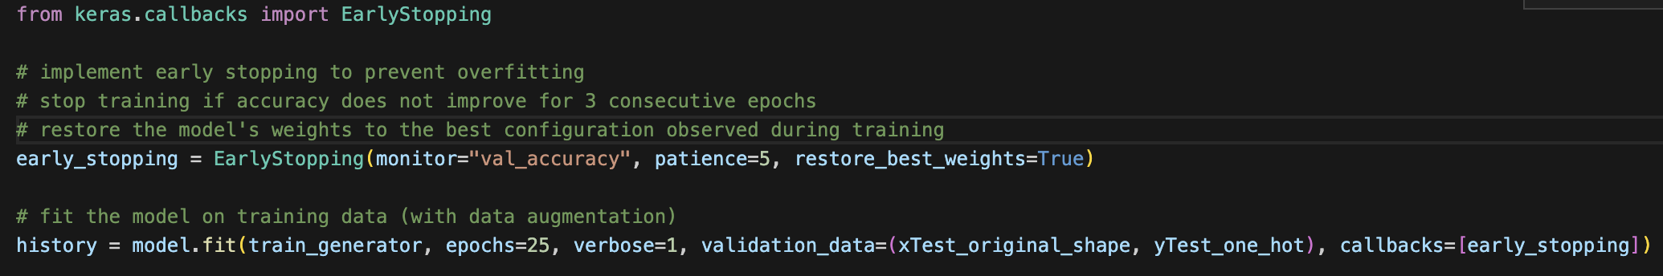
Machine Learning Model - CNN
Train generator is used to generate augmented batches of data
Fit the model and implement early stopping with a significant epoch size to prevent underfitting/overfitting

Slide 17
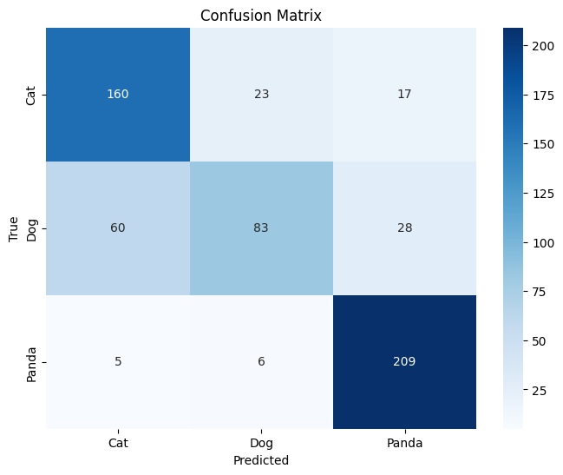
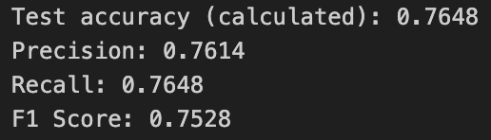
Model Evaluation - CNN
Most runs would reach between 60-70% accuracy
Applying data augmentation seemed to be what increased performance the most
Model consistently had the most difficulty classifying dogs and the most success classifying pandas

Slide 18
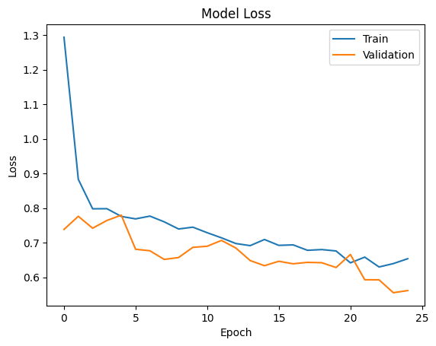
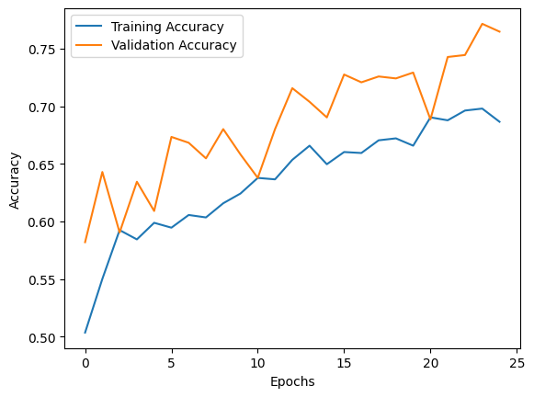
Model Evaluation - CNN
Both training and validation accuracy generally seem to increase after each epoch, but the oscillations in the validation accuracy may indicate unstable learning
Evaluating the loss functions, there is no clear sign of stabilization but it seems like there are brief moments of it when the loss functions converge

Slide 19
Machine Learning Model – VGG16
VGG16 is a pretrained image classification CNN model that can be accessed through TensorFlow
Pretrained on large datasets such as ImageNet
16 layers (13 convoluted layers, 3 fully connected layers)
Input layer designed to take in images of size (224, 224, 3)
224x224 pixels with 3 color channels (RGB)

Slide 20
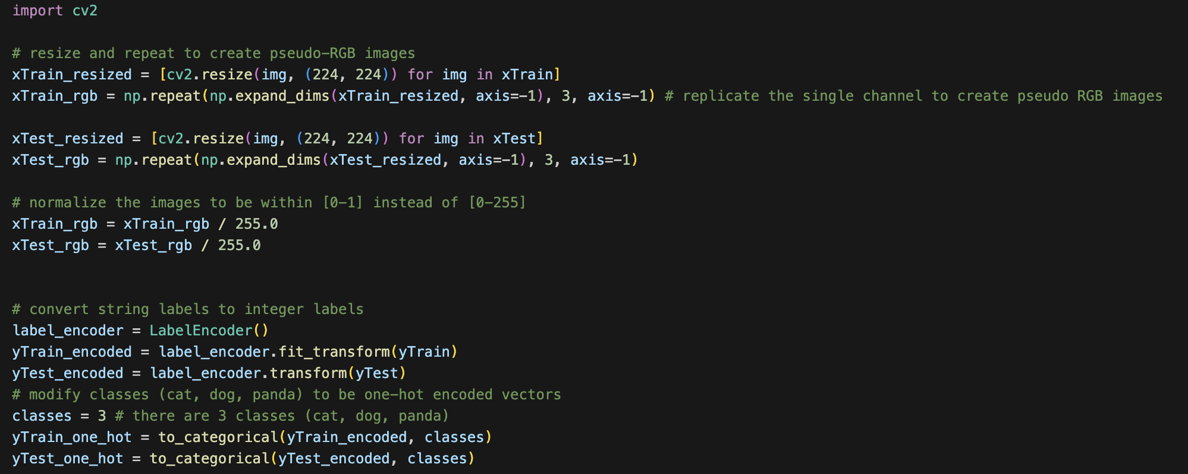
Machine Learning Model – VGG16
Our data consists of grayscale images of size (500, 500, 1), we must resize the images in preprocessing
VGG16 is already computationally expansive, if we don’t resize training time takes longer

Slide 21
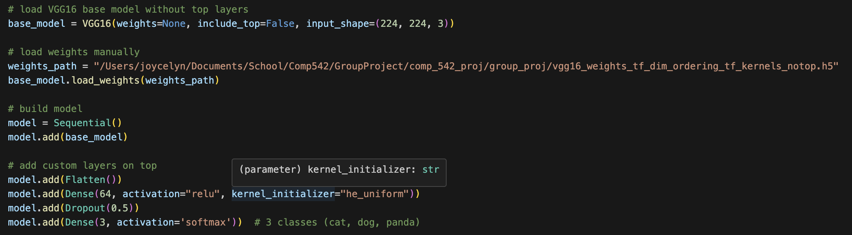
Machine Learning Model – VGG16
Load base model from TensorFlow without the top layers
Load the pretrained weights manually
Try to keep the top layers simple as we have a smaller dataset

Slide 22
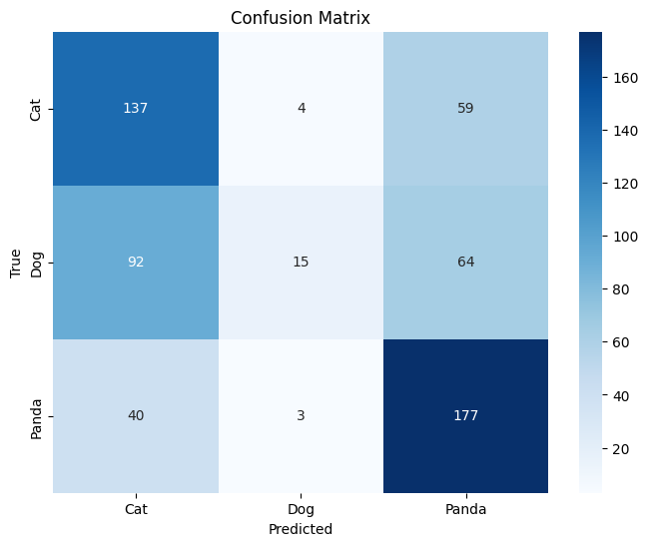
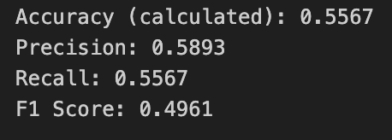
Model Evaluation – VGG16
Most runs stayed between 50-60% accuracy
Overall performance not great
This may be because our dataset is small which makes the model prone to overfitting
VGG16 was pretrained on images with 3 color channels

Slide 23
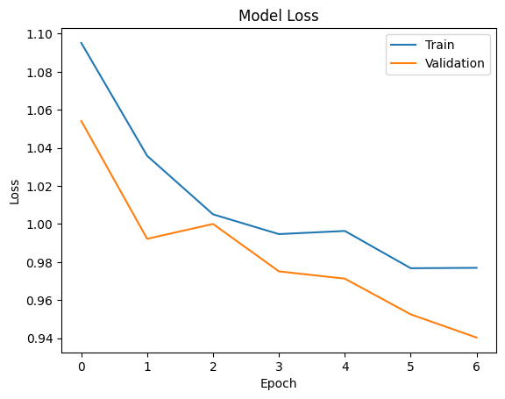
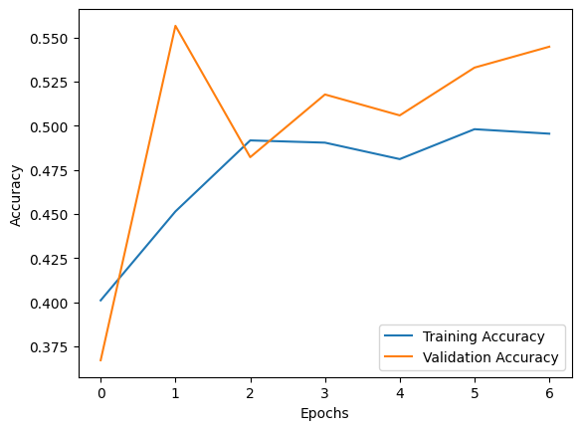
Model Evaluation – VGG16
The dramatic increase in validation accuracy before dropping back down and plateauing may indicate instability
Evaluating the loss functions, it looks like the training process may be unstable
This may be because our dataset is too small for a complex model like VGG16

Slide 24
Future Works
Increase dataset size and diversity
A larger dataset may allow CNN models to achieve learning stability, increasing overall performance
This would particularly be useful while applying the VGG16 model, as it is more computationally expansive and was pretrained on larger datasets
For CNN models built from scratch, more layers, filters, and neurons may need to be added to increase complexity, ensuring that the intricate features and patterns of a large and diverse dataset are captured

Slide 25
Conclusion

Slide 26
Thank You

