Slide 1
Animal Image Classification
Group 4:
Isaiah Martinez, Joycelyn Tuazon

Slide 2
NOTES
Add slide # to each slide
15 min max w/ 5 min questions
We are the first to present on 11/29
Don’t add too much text
Big pictures that are legible
Add images of eval metrics
Plot loss function for
Add final resulting accuracy
Add name of presenter in top right corner of each slide

Slide 3
Table of contents
Dataset Overview
Data Visualization
Data Cleaning
Data Preparation
ML Models
Model Evaluation
Model Performance Comparison
Future Work
Conclusion

Slide 4
Dataset Overview
Guiding Questions:
Where did the given data come from?
What did the given data look like?
What is the structure of the given data?

Slide 5
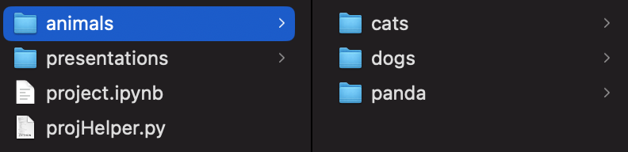
Dataset overview
Dataset name: Animal Image Dataset (DOG, CAT and PANDA)*
Link to Dataset:
https://www.kaggle.com/datasets/ashishsaxena2209/animal-image-datasetdog-cat-and-panda
3 folder structure:
cats
dogs
panda
Folder Structure
2
Notes:
* Verbatim

Slide 6
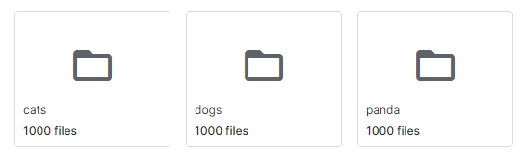
Dataset Overview
Each animal/directory had 1000 images
Image size was highly varied:
Smallest images were 55 x 75 pixels and 94 x 69 pixels
Largest image was 1600 x 1200 pixels
Avg image dimensions were
431 x 372 pixels
Files per Directory

Slide 7
Data visualization

Slide 8
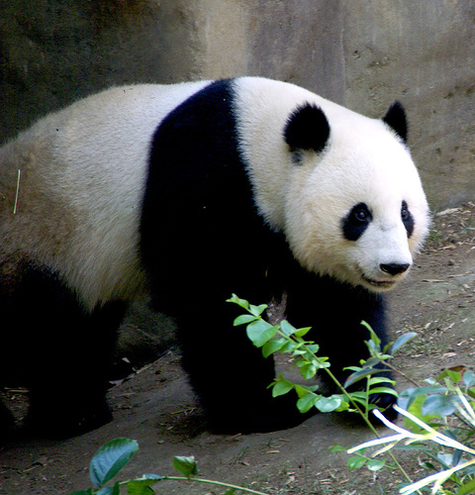
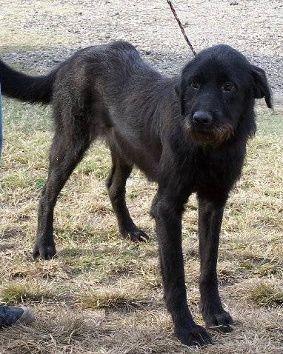
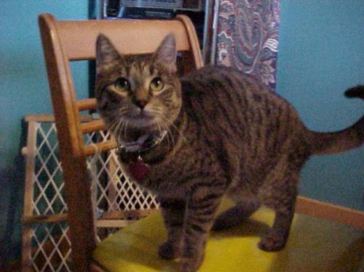
Data Visualization
Cat Image 1
Dog Image 1
Panda Image 1
2

Slide 9
Data cleaning
Guiding Questions:
Were there “bad” images?
What was the criteria used?
What are some examples of “bad” images?

Slide 10

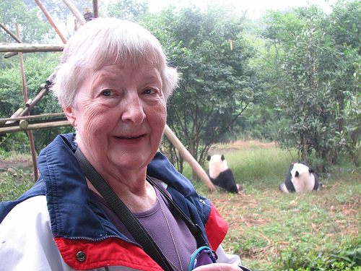

Data Cleaning
Cleaned manually
Got rid of “bad” images meeting any of the following criteria:
Multiple interested animal species within the same image
Too small of image size (< 100 x 100)
Difficult to view subject
Image does not contain subject
Cat image 374
Cat image 556
Panda Image 475

Slide 11
Data preparation
Guiding Questions:
Could the cleaned images be used as is?
What are some examples of the images used to train the models?

Slide 12
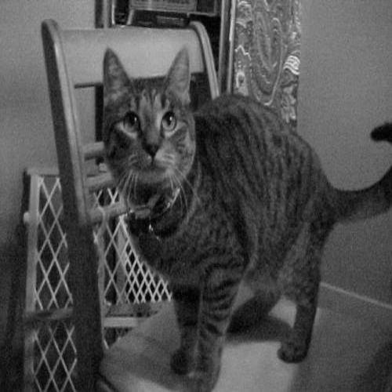
Data preparation
Several ideas employed:
Resize to 500 x 500 pixels
Convert to Grayscale
Convert images to flattened arrays
Resize to 224 x 224 pixels
Generate new images using image augmentation
GS Cat Image 1
Cat Image 1

Slide 13
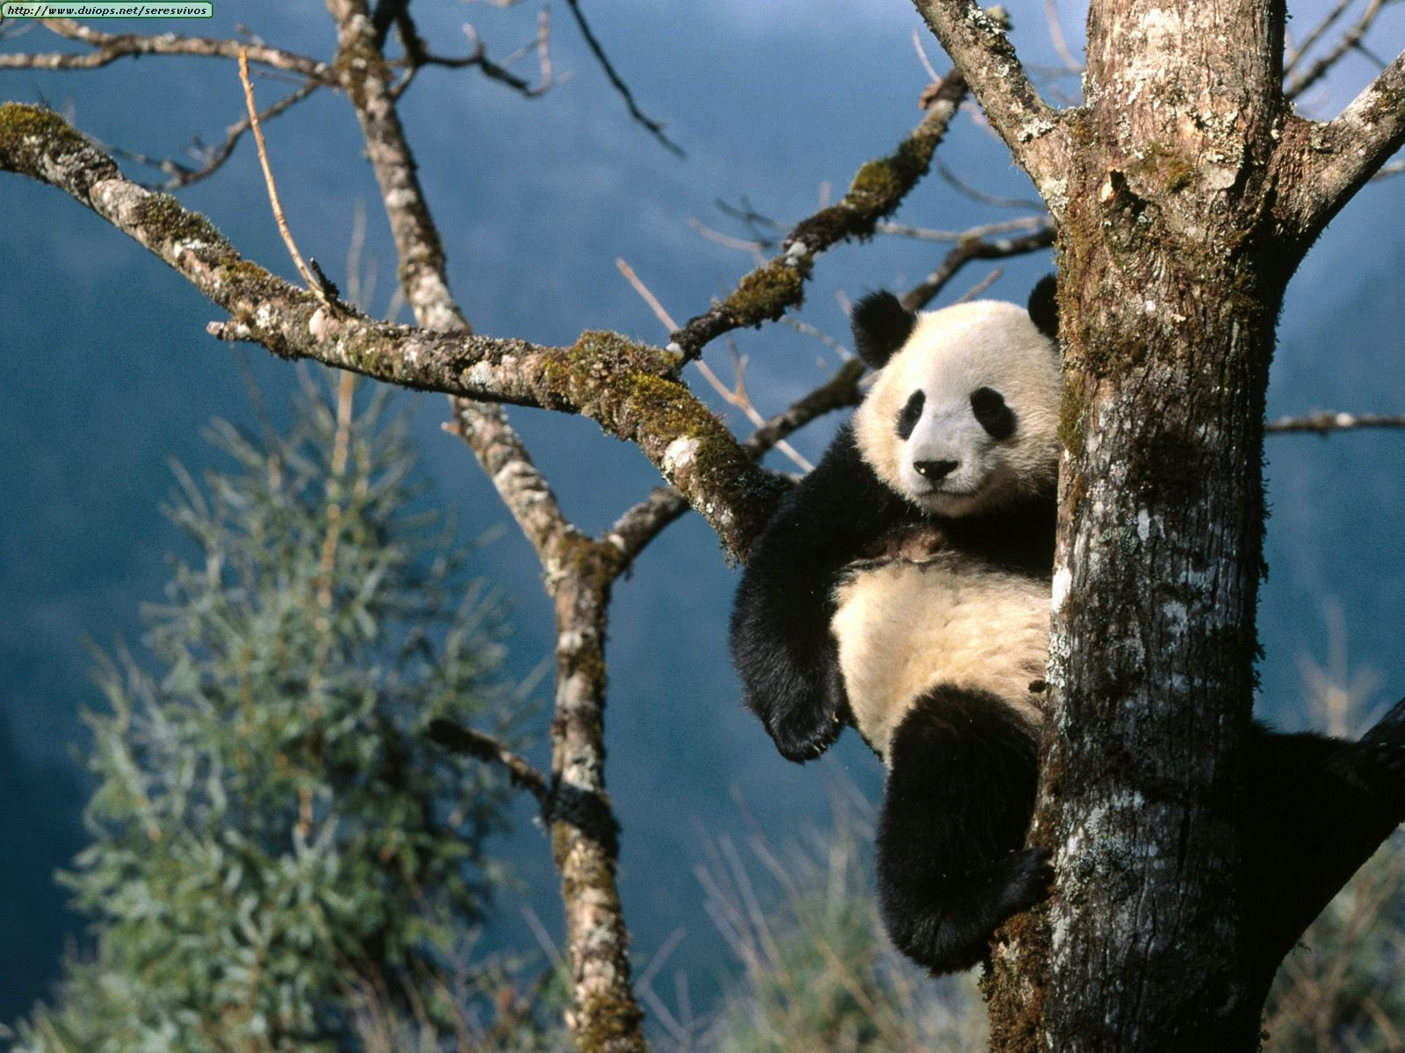
Data Preparation
Sample conversion to array:
[[[159 155 128] [162 161 131] [165 169 134] ... [120 141 162] [118 138 162] [119 139 163]] [[136 136 112] [154 157 128] [158 165 131] ... [124 144 168] [123 143 167] [125 145 169]] [[124 133 112] [127 137 112] [148 163 132] ... [132 154 178] [133 155 179] [135 157 181]] ... [[ 31 51 58] [ 26 46 53] [ 22 42 51] ... [ 53 55 42] [ 49 52 41] [ 48 51 40]] [[ 33 52 59] [ 29 48 55] [ 24 44 53] ... [ 50 52 41] [ 47 50 41] [ 47 50 41]] [[ 34 53 60] [ 29 48 55] [ 25 45 54] ... [ 45 47 36] [ 42 45 36] [ 43 46 37]]]
Panda Image 880
Panda Image 880 as an array

Slide 14
ML algorithms
List of ML algorithms used:
Isaiah:
SVM Classifier
Res Net 50
Zero-Shot Prediction with CLIP **
Joycelyn:
CNN
VGG16
Notes:
** Not for grade

Slide 15
Model: SVM

Slide 16
Model Evaluation: SVM
Took a long time to run

Slide 17
Model: Res Net 50

Slide 18
Model Evaluation: res net 50

Slide 19
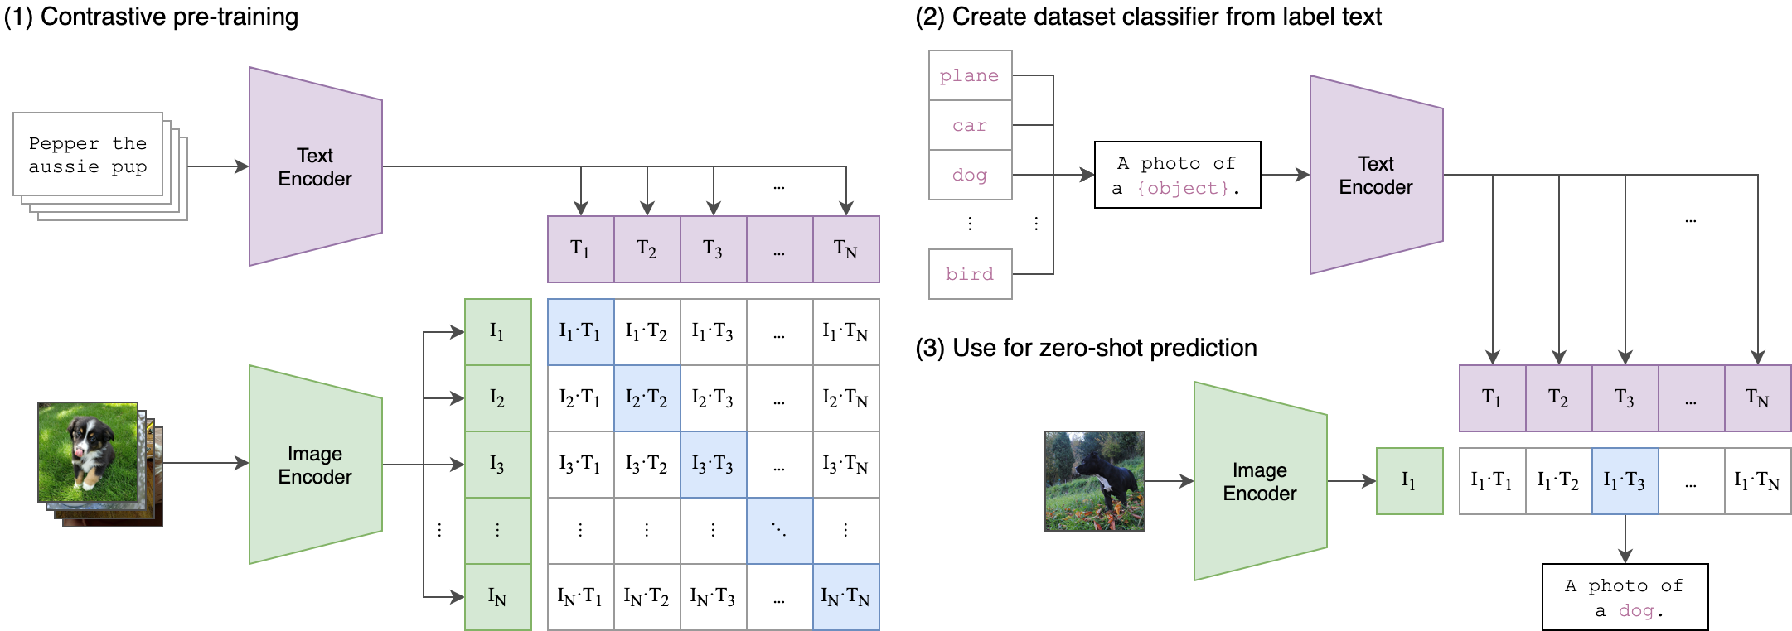
Model: CLIP
How CLIP works with ZSP
Notes:
https://github.com/openai/CLIP/tree/main

Slide 20
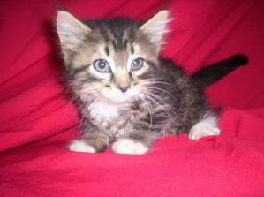

Model: CLIp
Zero-Shot Prediction:
Can a model make accurate predictions about instances without being trained on any part of the desired dataset?
Operates like the following example:
Step 1: Show an image of an animal to a person
Step 2: Ask them to determine what animal is being shown
An extreme alternative to not using labeled data
(Cat Image 461)
Step 1
Step 2
I guess that this image contains a cat!
Visual Example
Notes:
https://deepchecks.com/glossary/zero-shot-learning/
https://blog.roboflow.com/zero-shot-learning-computer-vision/
https://www.freeiconspng.com/img/1682

Slide 21
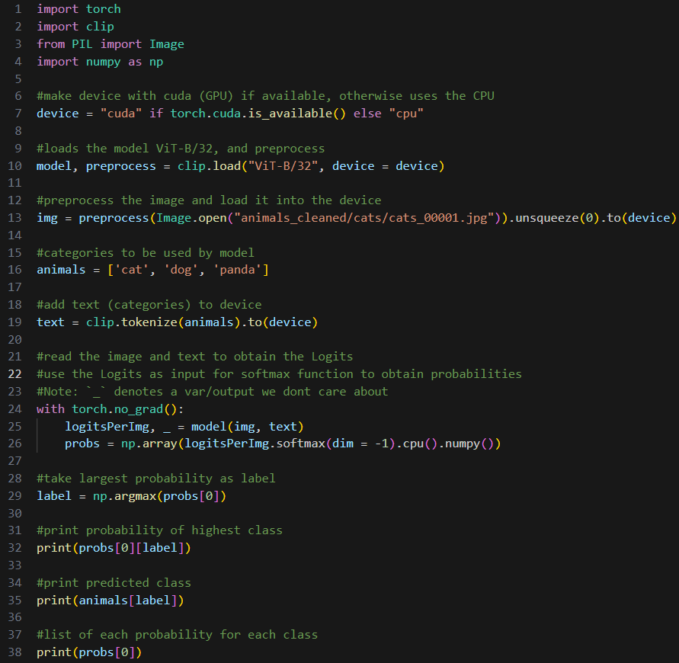

Code Sample on Cat image 1 using ViT-B/32 Model:
Cat Image 1
Print statement results
Entirety of code for predicting 1st cat image

Slide 22


Model evaluation: CLIP
CLIP doesn’t yield Evaluation Metrics
These Confusion Matrices were computed using a function on the dataset
Columns refer to the predicted class: 1 = Cat, 2 = Dog, 3 = Panda
Rows refer to the actual class: 1 = Cat, 2 = Dog, 3 = Panda
Using ViT-B/32 Model
Using RN50x16 Model
CM ViT-B/32
CM RN50x16

Slide 23
Machine Learning Model - CNN
CNN models apply convolution operations to input data to learn features and identify patterns
Filters and kernels in the convoluted layers capture these features and patterns
MaxPooling layers retain important features and patterns
Connected layers combine these features for the model to learn relationships between them
CNN models are good for image classification because of these methods of capturing and learning features and patterns

Slide 24
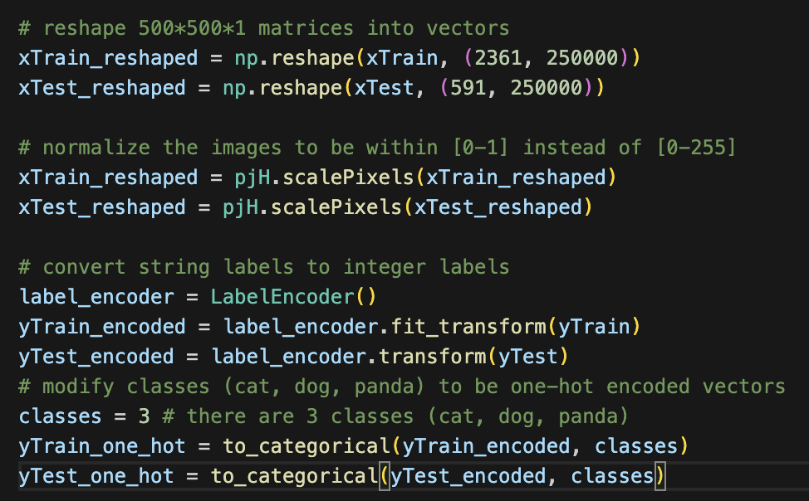
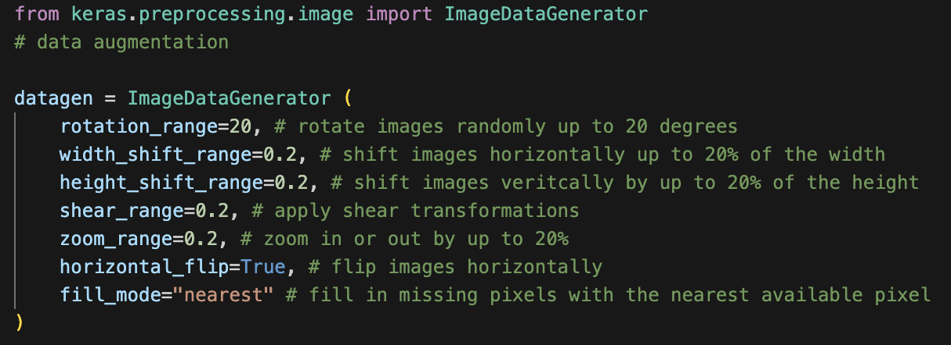
Model: CNN
Before applying the CNN model, we must pre-process the images and classes
Additionally, apply data augmentation to the dataset to increase variance within the data
Augmented Image Generator
Pre-processing steps

Slide 25
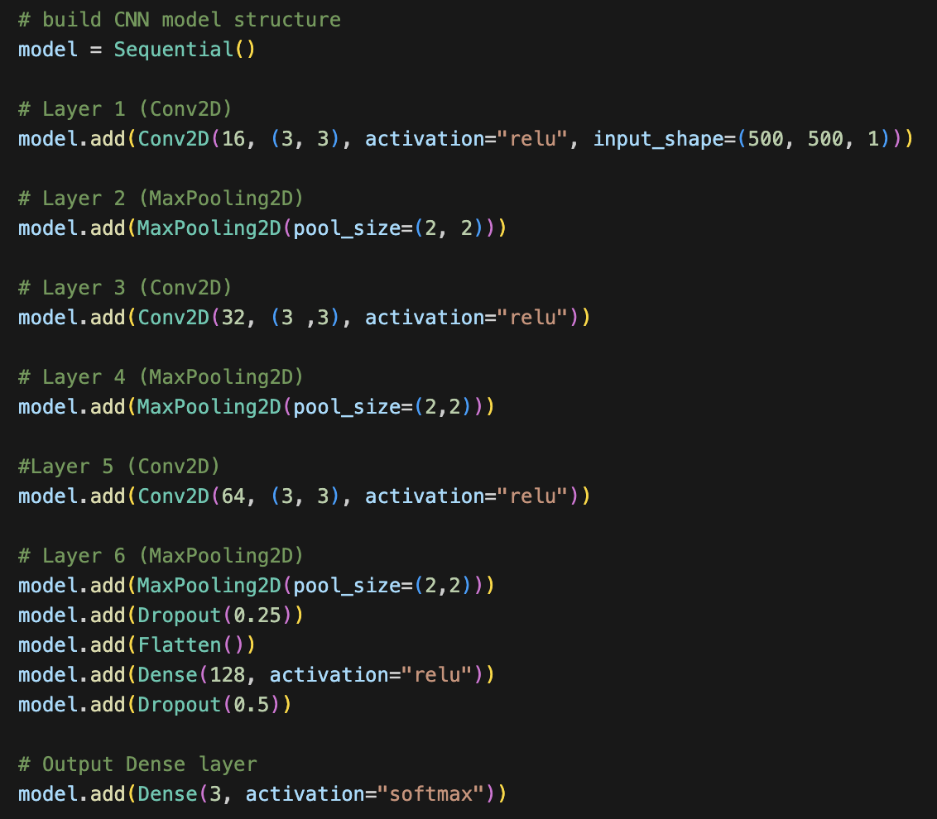
Model: CNN
Input layer is a Conv2D layer with 16 filters of size 3x3
Next layer is a MaxPooling layer with window size 2x2
MaxPooling retains the max value within the 2x2 window, and discards the rest
Retaining important features and discarding the rest makes the model more computationally efficient
Dropout layers are used to help prevent overfitting by randomly dropping neurons during training
We flatten the output from the previous convoluted layer into a 1-Dimensional vector before moving onto the fully connected layer
Dense adds a fully connected layer
Output layer is a fully connected layer with 3 neurons:
one for each class: cat, dog, panda

Slide 26
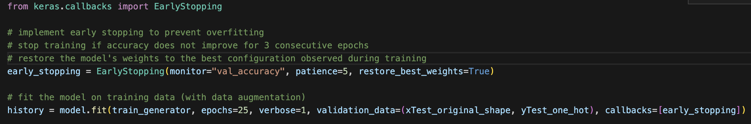
Model: CNN
Train generator is used to generate augmented batches of data
Fit the model and implement early stopping with a significant epoch size to prevent overfitting

Slide 27
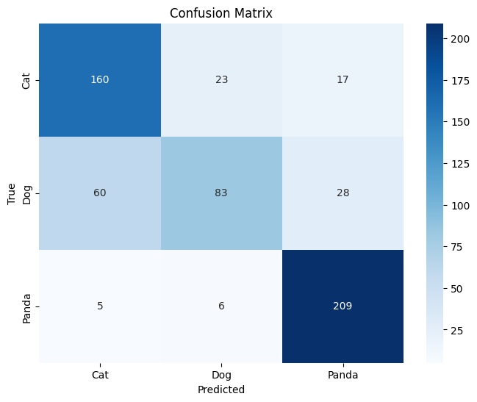
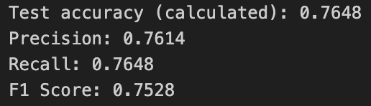
Model Evaluation: CNN
Evaluation Metrics CNN
Most runs would reach between 60-70% accuracy
Applying data augmentation seemed to be what increased performance the most
Model consistently had the most difficulty classifying dogs and the most success classifying pandas
CM CNN

Slide 28
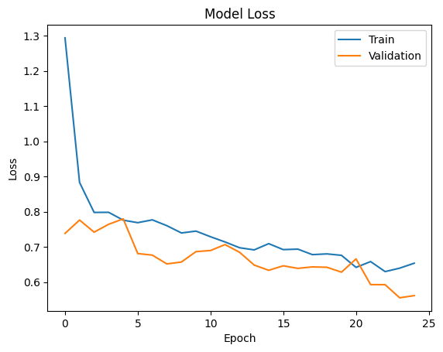
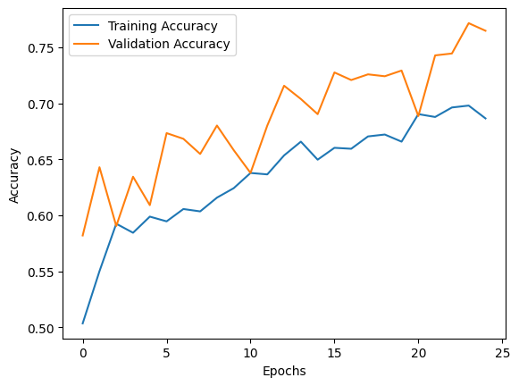
Model Evaluation: CNN
Loss vs Epoch
Accuracy vs Epoch
Generally positive trend
Oscillations in validation accuracy may indicate unstable learning
No clear sign of stabilization in general
However, when they converge, it stabilizes

Slide 29
Model: VGG16
VGG16 is a pretrained image classification CNN model that can be accessed through TensorFlow
Pretrained on large datasets such as ImageNet
16 layers (13 convoluted layers, 3 fully connected layers)
Input layer designed to take in images of size (224, 224, 3)
224x224 pixels with 3 color channels (RGB)

Slide 30
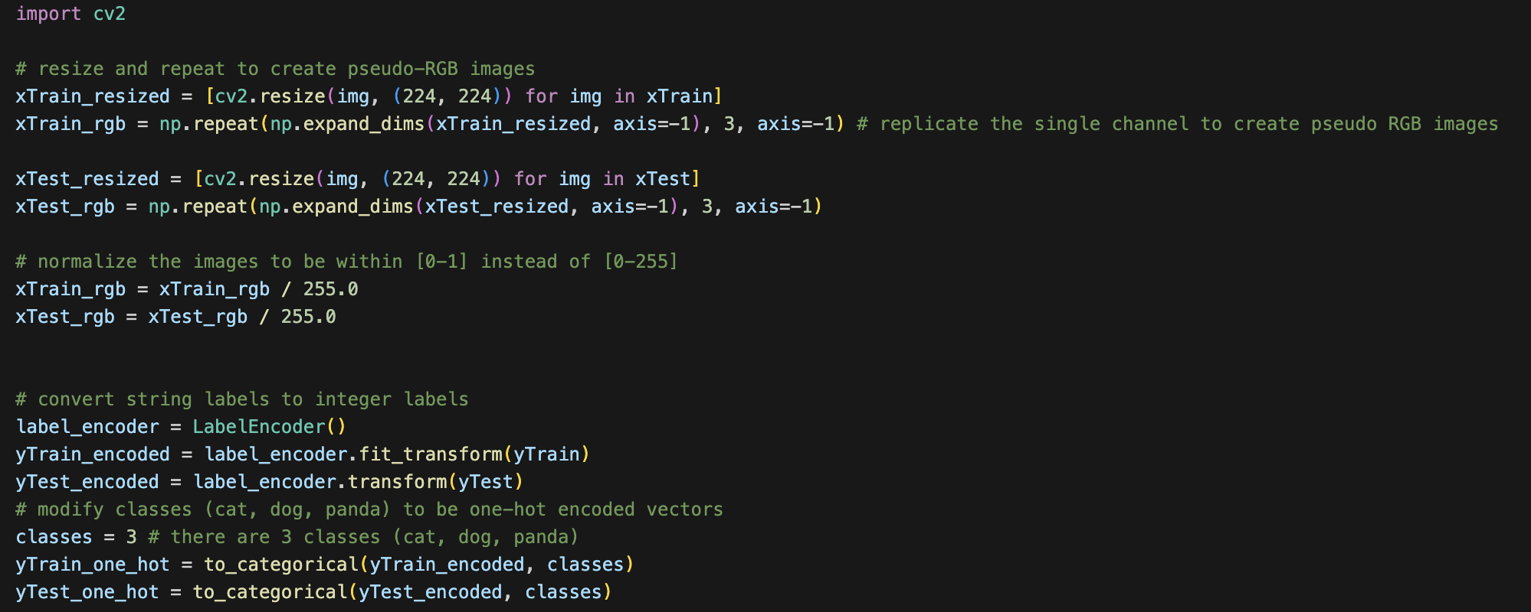
Model: VGG16
We must resize the images in preprocessing to be 224 x 224 pixels and in RGB
VGG16 is computationally expansive
If we don’t resize then training time takes longer
Pre-processing for VGG16

Slide 31
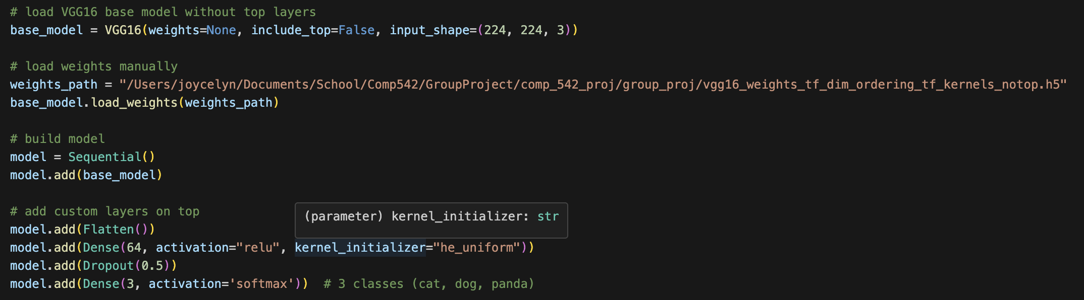
Model: VGG16
Creation of VGG16 Model
Load base model from TensorFlow without the top layers
Load the pretrained weights manually
Try to keep the top layers simple as we have a smaller dataset
Notes:
Isaiah: I blocked out the path for safety reasons

Slide 32
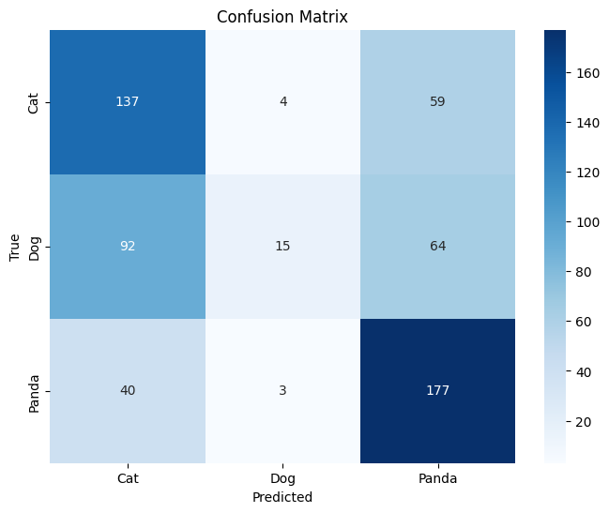
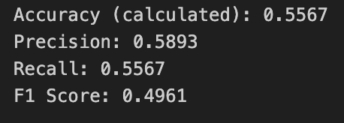
Model Evaluation: VGG16
Evaluation Metrics VGG16
Most runs stayed between 50-60% accuracy
Overall performance not great
This may be because our dataset is small which makes the model prone to overfitting
VGG16 was pretrained on images with 3 color channels
CM VGG16

Slide 33
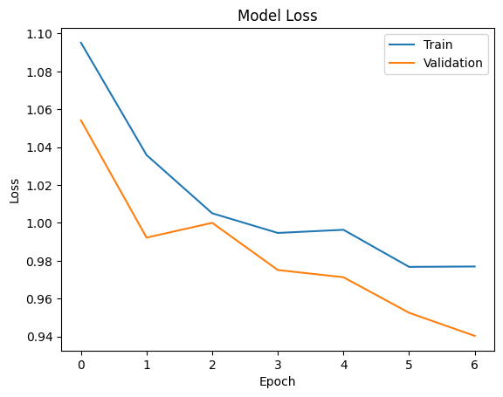
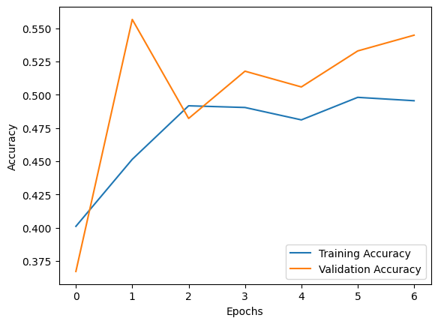
Model Evaluation: VGG16
Loss vs Epoch
Accuracy vs Epoch
Looks like the training process may be unstable
Possibly due to our dataset being too small for a complex model like VGG16
The dramatic increase in validation accuracy before dropping back down and plateauing may indicate instability

Slide 34
ML Performance comparison
List of ML algorithms used:
Isaiah:
SVM Classifier
Res Net 50
Zero-Shot Prediction with CLIP **
Joycelyn:
CNN
VGG16
Notes:
** Not for grade thus not included in performance comparison

Slide 35
ML Performance comparison
INSERT PERFORMANCE FOR EACH OF THE 4 ALGS HERE:
SVM
RESNET50
CNN
VGG16

Slide 36
Future works
Notes:
** Not for grade

Slide 37
Future Works
Increase dataset size and diversity
A larger dataset may allow CNN models to achieve learning stability, increasing overall performance
This would particularly be useful while applying the VGG16 model, as it is more computationally expansive and was pretrained on larger datasets
For CNN models built from scratch, more layers, filters, and neurons may need to be added to increase complexity, ensuring that the intricate features and patterns of the images were captured
Stricter set of criteria for clean images
Additional augmentations of images

Slide 38
conclusion
Notes:
** Not for grade

Slide 39
Conclusion
Learned a lot about how image classification works
Image classification is both difficult and time consuming
Pre-trained models exist and are available for public usage
Neural Networks are fantastic at Image Classification

Slide 40
Related works
First
Second
Third
…

Slide 41
Questions?

Slide 42
Thank You

