Slide 1
Cat Image Classification
Group 4:
Isaiah Martinez, Joycelyn Tuazon

Slide 2
Presentation Guidelines
Jupyter notebook ready
5-7 mins and don’t read from slides

Slide 3
Dataset
Project name: Animal Image Dataset(DOG, CAT and PANDA)
Link to project: https://www.kaggle.com/datasets/ashishsaxena2209/animal-image-datasetdog-cat-and-panda
3 folder structure:
Cat
Dog
Panda

Slide 4
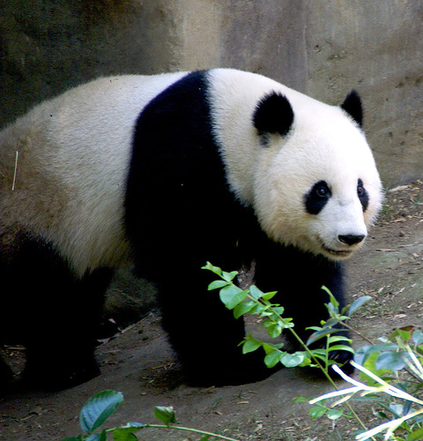
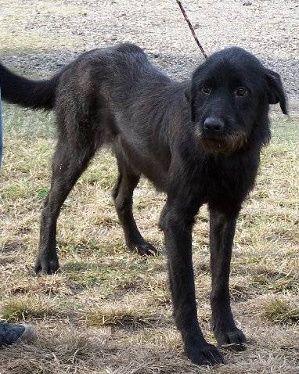
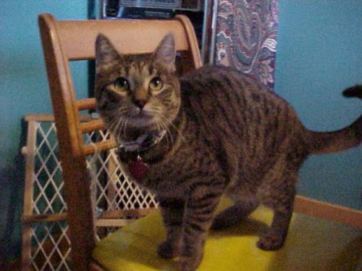
Dataset Sample

Slide 5
Dataset
3000 non-standardized images:
Image sizes range from (1600, 1200) to (60,32)
Some images:
have low resolution/are out of focus
contain multiple animals (2 cats, 1 cat 1 dog, etc.)
contain drawings of the animal (not a photo)
The subjects of some images are:
not centered
hidden partially behind objects
No corrupt images
Animals are in various positions and different colored fur
Animals come from all age ranges
Already separated by animal species in folder structure

Slide 6
Dataset
We are considering:
Standardizing image size and resolution
Removing images that are too small/too low resolution for use
Removing non-photo images of animals

Slide 7
Algorithms
Binary Classifier – SVM, Linear Classifiers

Slide 8
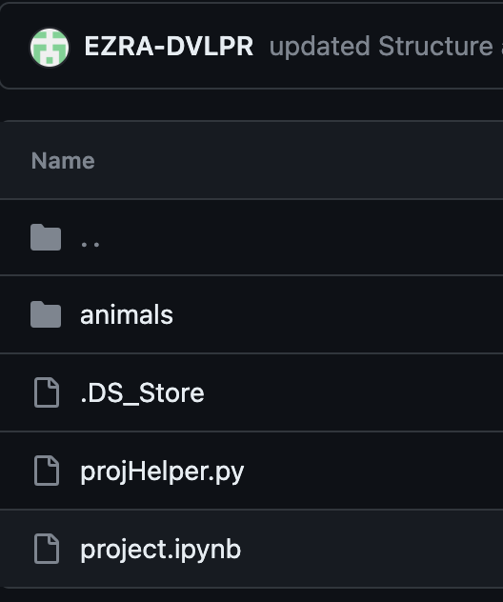
Github Repo
https://github.com/EZRA-DVLPR/comp_542_proj/tree/main/group_proj

Slide 9
Thank You

