Slide 1
Animal Image Classification
Group 4:
Isaiah Martinez, Joycelyn Tuazon

Slide 2
Table of contents
Dataset Overview
Data Visualization
Data Cleaning
Data Preparation
ML Models
Model Evaluation
Model Performance Comparison
Future Work
Conclusion
1

Slide 3
Dataset Overview
Guiding Questions:
Where did the given data come from?
What did the given data look like?
What is the structure of the given data?
2

Slide 4
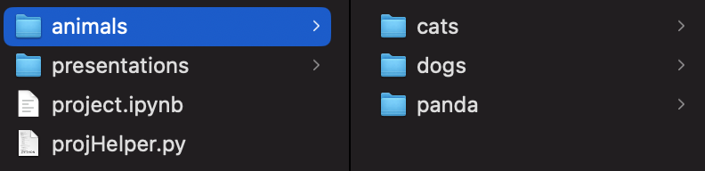
Dataset overview
Dataset name: Animal Image Dataset (DOG, CAT and PANDA)*
Link to Dataset:
https://www.kaggle.com/datasets/ashishsaxena2209/animal-image-datasetdog-cat-and-panda
3 folder structure:
cats
dogs
panda
Folder Structure
3
Notes:
* Verbatim

Slide 5
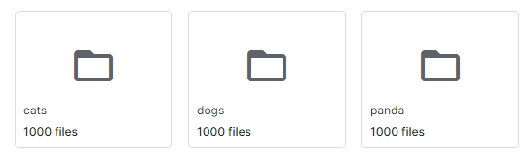
Dataset Overview
Each animal/directory had 1000 images
Image size was highly varied:
Smallest images were 55 x 75 pixels and 94 x 69 pixels
Largest image was 1600 x 1200 pixels
Avg image dimensions were
431 x 372 pixels
Files per Directory
4

Slide 6
Data visualization
5

Slide 7
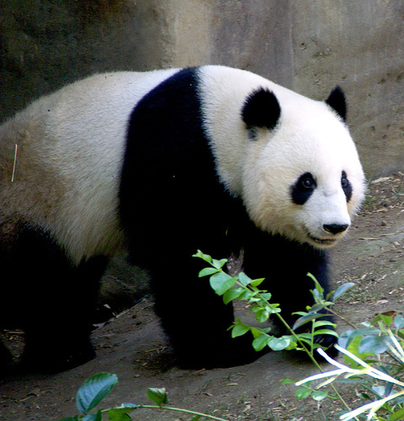
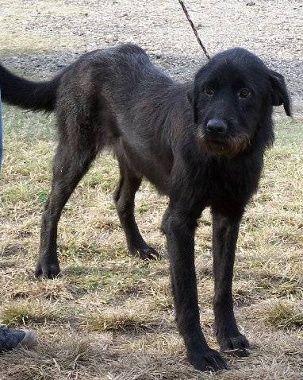
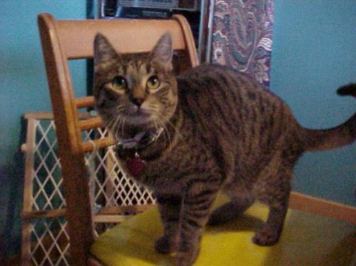
Data Visualization
Cat Image 1
Dog Image 1
Panda Image 1
6

Slide 8
Data cleaning
Guiding Questions:
Were there “bad” images?
What was the criteria used?
What are some examples of “bad” images?
7

Slide 9

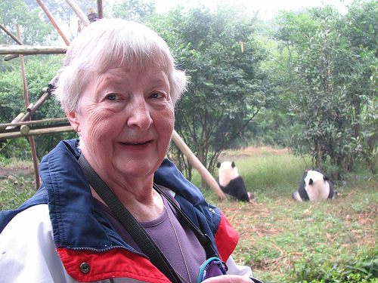

Data Cleaning
Cleaned manually
Got rid of “bad” images meeting any of the following criteria:
Multiple interested animal species within the same image
Too small of image size (< 100 x 100)
Difficult to view subject
Image does not contain subject
Cat image 374
Cat image 556
Panda Image 475
8

Slide 10
Data preparation
Guiding Questions:
Could the cleaned images be used as is?
What are some examples of the images used to train the models?
9

Slide 11
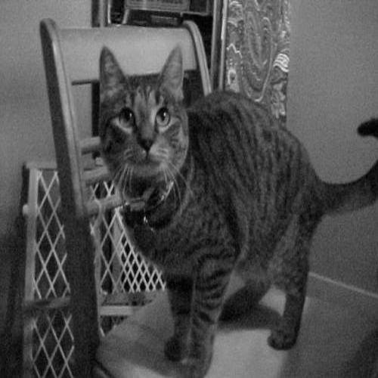
Data preparation
Several ideas employed:
Resize to 500 x 500 pixels
Convert to Grayscale
Convert images to flattened arrays
Resize to 224 x 224 pixels
Generate new images using image augmentation
GS Cat Image 1
Cat Image 1
10

Slide 12
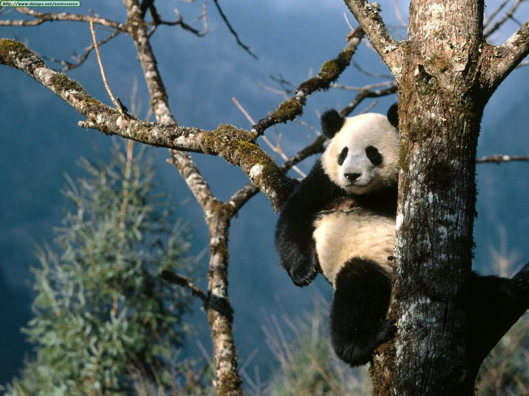
Data Preparation
Sample conversion to array:
[[[159 155 128] [162 161 131] [165 169 134] ... [120 141 162] [118 138 162] [119 139 163]] [[136 136 112] [154 157 128] [158 165 131] ... [124 144 168] [123 143 167] [125 145 169]] [[124 133 112] [127 137 112] [148 163 132] ... [132 154 178] [133 155 179] [135 157 181]] ... [[ 31 51 58] [ 26 46 53] [ 22 42 51] ... [ 53 55 42] [ 49 52 41] [ 48 51 40]] [[ 33 52 59] [ 29 48 55] [ 24 44 53] ... [ 50 52 41] [ 47 50 41] [ 47 50 41]] [[ 34 53 60] [ 29 48 55] [ 25 45 54] ... [ 45 47 36] [ 42 45 36] [ 43 46 37]]]
Panda Image 880
Panda Image 880 as an array
11

Slide 13
Data preparation
Each image holds (Length x Width x Color Mode) features:
500 x 500 Images x 1 brightness (Grayscale) => 250,000 Features
500 x 500 Images x 3 color intensity (RGB) => 750,000 Features
224 x 224 Images x 3 color intensity (RGB) => 150,528 Features
2952 images were used
250,001 Features x 2952 tuples
750,001 Features x 2952 tuples
150,529 Features x 2952 tuples
Recall: 1 Feature is the animal class within the given image
12

Slide 14
ML algorithms
List of ML algorithms used:
Isaiah:
SVM Classifier
Res Net 50
Zero-Shot Prediction with CLIP **
Joycelyn:
CNN
VGG16
13
Notes:
** Not for grade

Slide 15
Model: SVM Classifier
Lots of usage with image classification
Easy to implement and update with better performing parameters
Took a long time to run
> 1-2 days in many cases
Highly sensitive to the data size:
Ω(D)*** ~ Ω(N²) ~ O(N² x D) ~ ∏(N³)
For N = Number of tuples, D = Number of Features
N = 2952
D = [750,000, 250,000]
Kfold = O(KN) = O(N) for K = Number of Folds
Grid Search = (Kfold x SVM x Combinations of Parameter List)
O(N² x N x P) for P = Number of Parameter Combinations
O(N³)
14
Notes:
References:
2.
3.
*** Only for Linear SVM

Slide 16
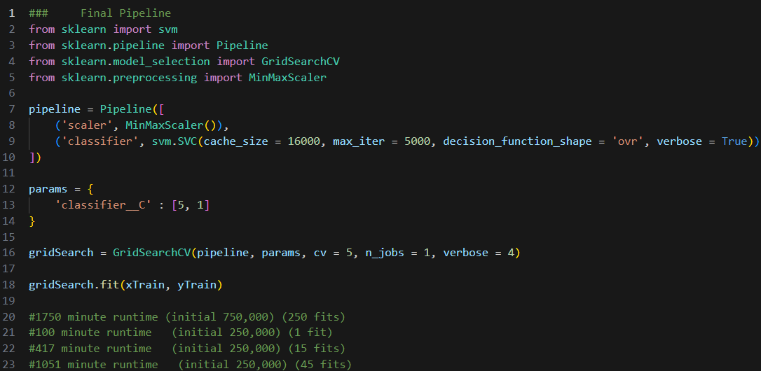
Model: svm classifier
1750 minutes = 29.17 hours =
1.22 days
Pipeline + GridSearch
15

Slide 17
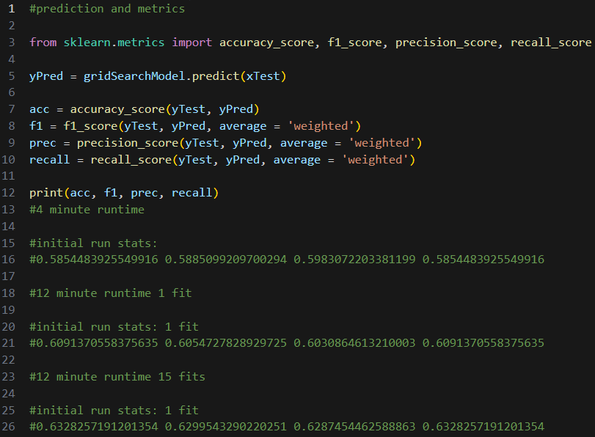
Model evaluation: SVM
~63% consistent metrics
No Loss Plot
No Confusion Matrix
16
Evaluation Metrics SVM

Slide 18
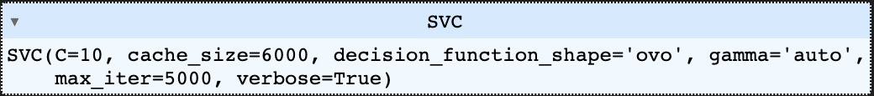
Model: SVM
Model Parameters
Evaluation Metrics
Accuracy F1 Score Precision Recall
17

Slide 19
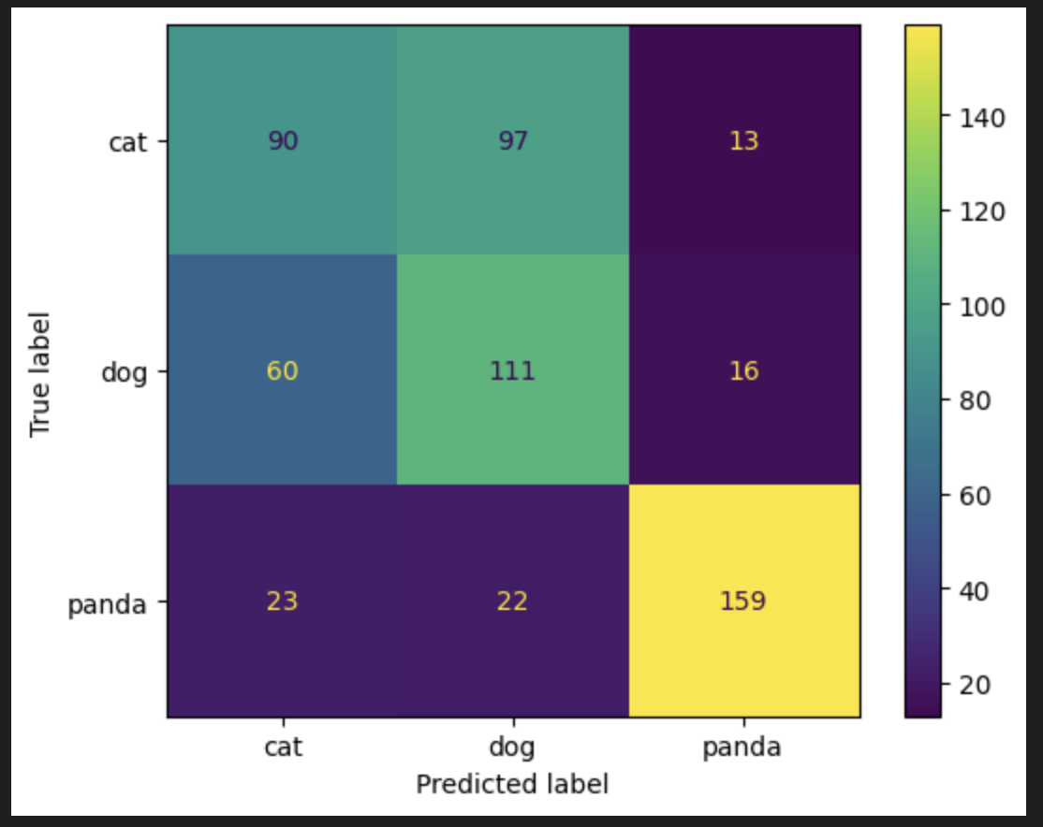
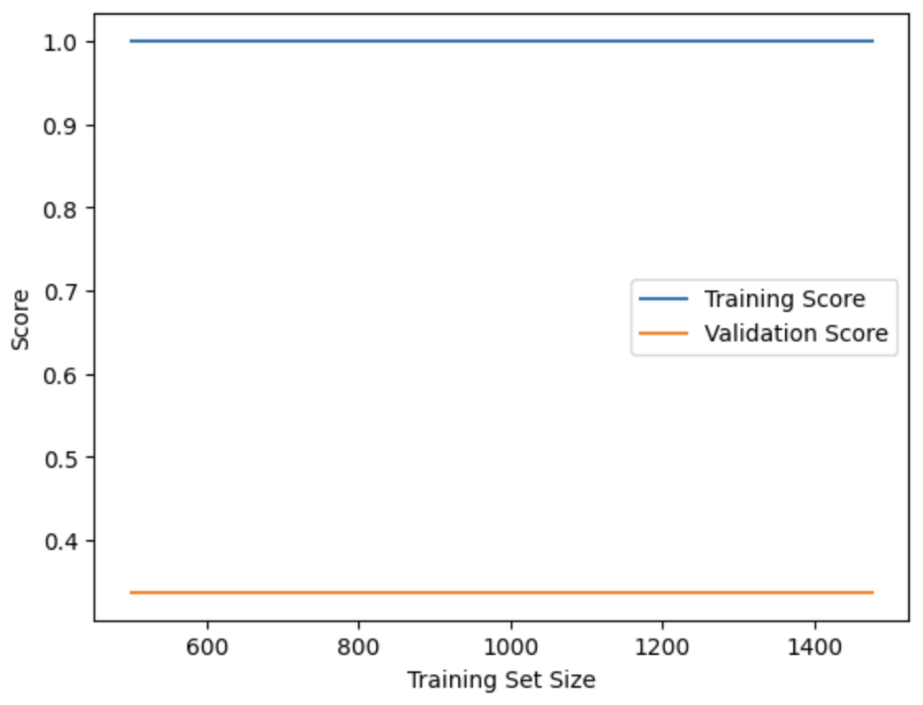
Model Eevaluation: SVM
EXTREME overfitting
Long time to process
CM SVM
Score vs Training Size
18

Slide 20
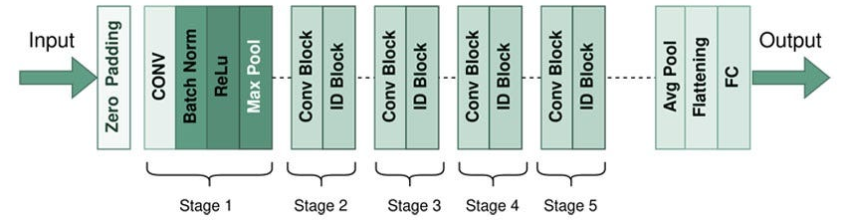
Model: Res Net 50
A type of CNN that is 50 layers deep
Has shortcuts allowing the gradient to flow easily during training
Very powerful for DL and ML tasks regarding images
Can perform 2D Convolutions and Max Pooling to obtain images and extract features to improve performance
Res Net 50 example
19
Notes:
Reference: 4

Slide 21
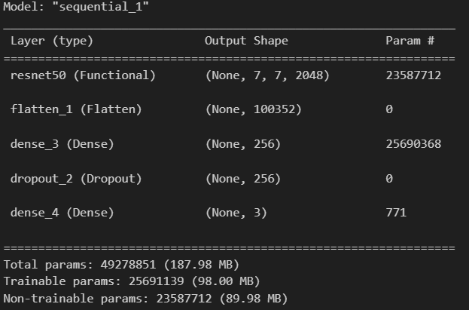
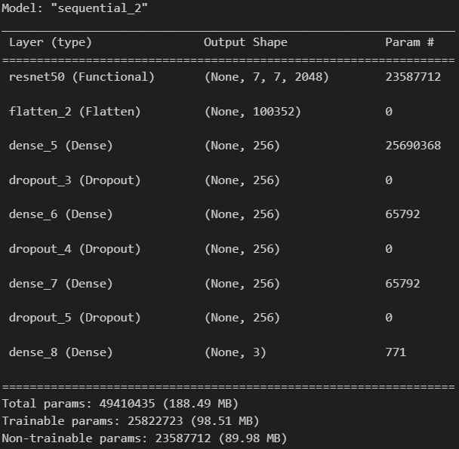
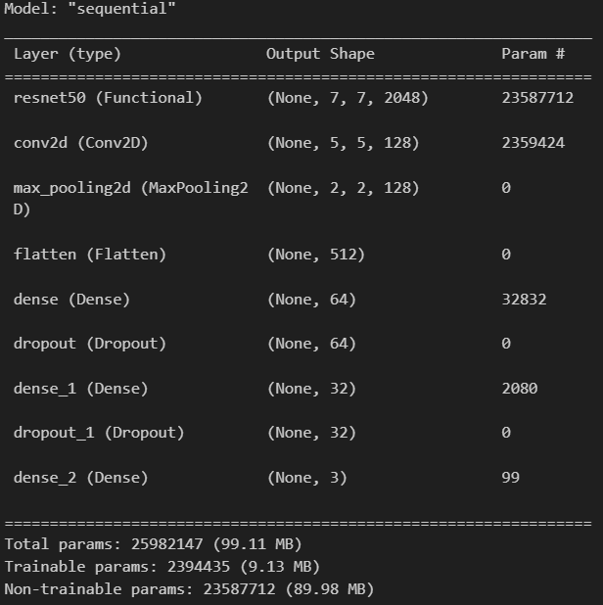
Model: res net 50
Ran 3 separate models
V1
V2
V3
Model 1
Model 2
Model 3
20
Notes:
Model 1 was untouched after creation and was used as a baseline comparison

Slide 22
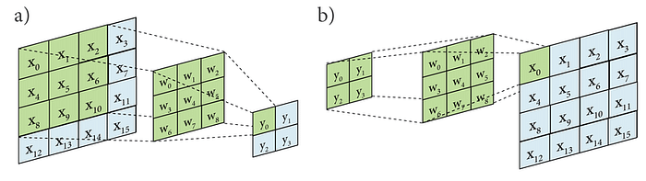
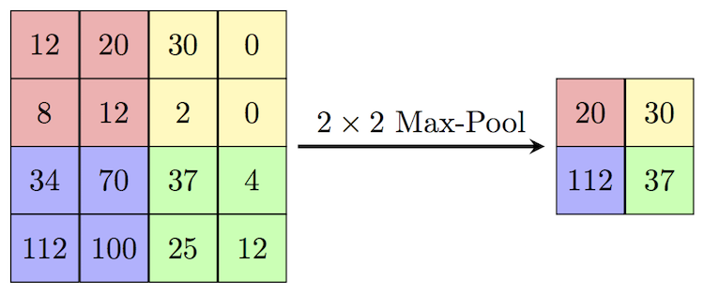
Model: Res net 50
V1 was the simplest
1 hidden layer
V2 was simplistic and designed based off of V1
3 hidden layers
All had the same number of neurons and dropout value
V3 was designed to be complex and different from V1 and V2
Used Conv2D layers and MaxPooling2D layers
Different dropouts per layer
Strictly decreasing neuron count per layer
All models:
used ReLu activation function
Had a single output layer with 3 neurons – 1 per animal
Convolution 2D
Max Pool 2D
21
Notes:
References:
5.
6.

Slide 23
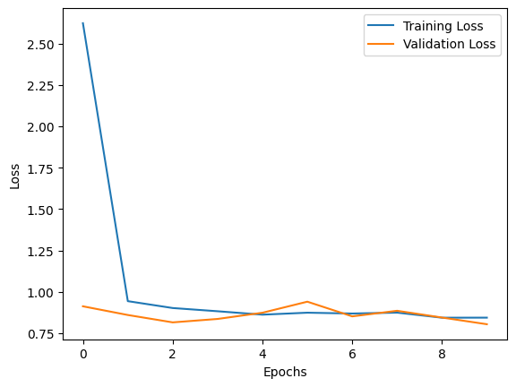
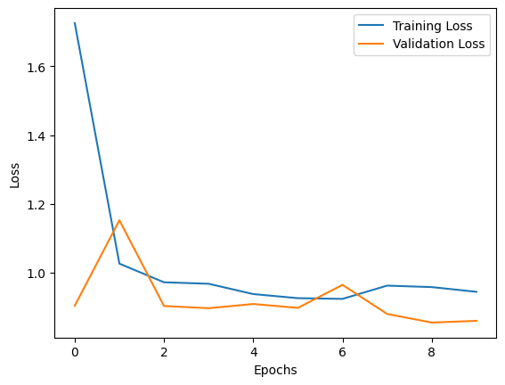
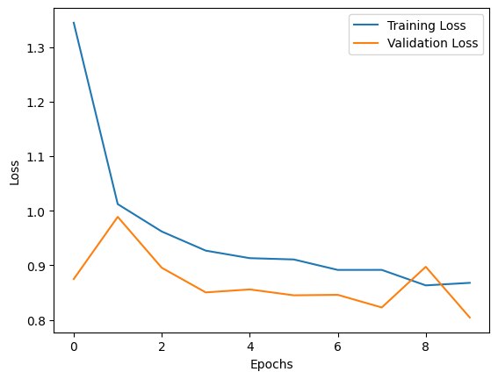
Model Evaluation: Res net 50
V1
V2
V3
Loss V1
Loss V2
Loss V3
22

Slide 24
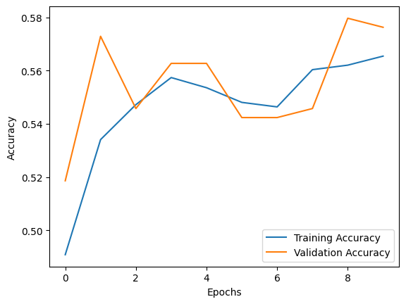
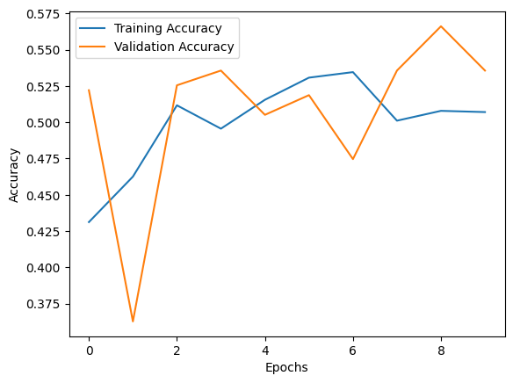
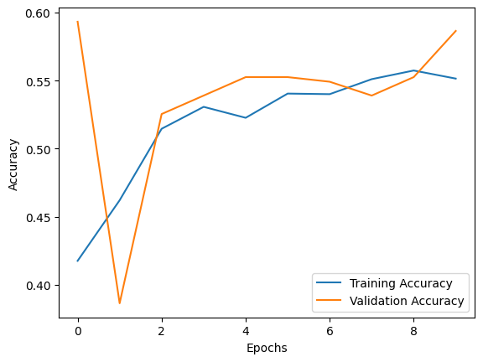
Model evaluation: Res net 50
V1
V2
V3
Accuracy V1
Accuracy V2
Accuracy V3
23

Slide 25
Model evaluation: res net 50
Resulting Accuracies:
V1: ~ 61%
V2: ~ 29%
V3: ~ 55%
Thus, V1 yielded the best performance despite model modification
24

Slide 26
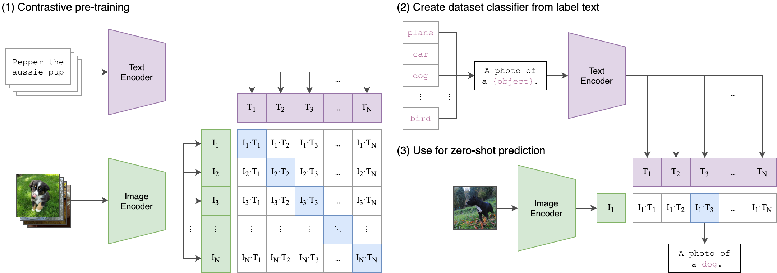
Model: CLIP
How CLIP works with ZSP
25
Notes:
Reference:
7.

Slide 27
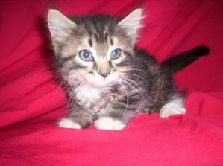

Model: CLIp
Zero-Shot Prediction:
Can a model make accurate predictions about instances without being trained on any part of the desired dataset?
Operates like the following example:
Step 1: Show an image of an animal to a person
Step 2: Ask them to determine what animal is being shown
An extreme alternative to not using labeled data
(Cat Image 461)
Step 1
Step 2
I guess that this image contains a cat!
Visual Example
26
Notes:
References:
8.
9.
10.

Slide 28
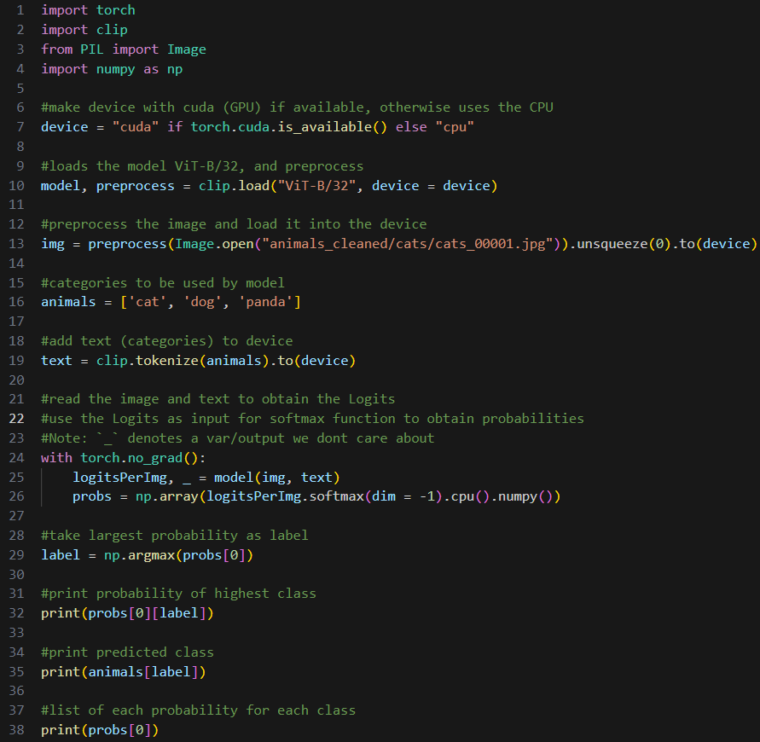

Code Sample on Cat image 1 using ViT-B/32 Model:
Cat Image 1
Print statement results
27
Entirety of code for predicting 1st cat image

Slide 29


Model evaluation: CLIP
CLIP doesn’t yield Evaluation Metrics
These Confusion Matrices were computed manually
Columns refer to the predicted class: 1 = Cat, 2 = Dog, 3 = Panda
Rows refer to the actual class: 1 = Cat, 2 = Dog, 3 = Panda
Using ViT-B/32 Model
Using RN50x16 Model
CM ViT-B/32
CM RN50x16
28

Slide 30
Model: CNN
CNN models apply convolution operations to input data to learn features and identify patterns
Filters and kernels in the convoluted layers capture these features and patterns
MaxPooling layers retain important features and patterns
Connected layers combine these features for the model to learn relationships between them
CNN models are good for image classification because of these methods of capturing and learning features and patterns
29
Notes:
Reference:
11.
5.
6.

Slide 31
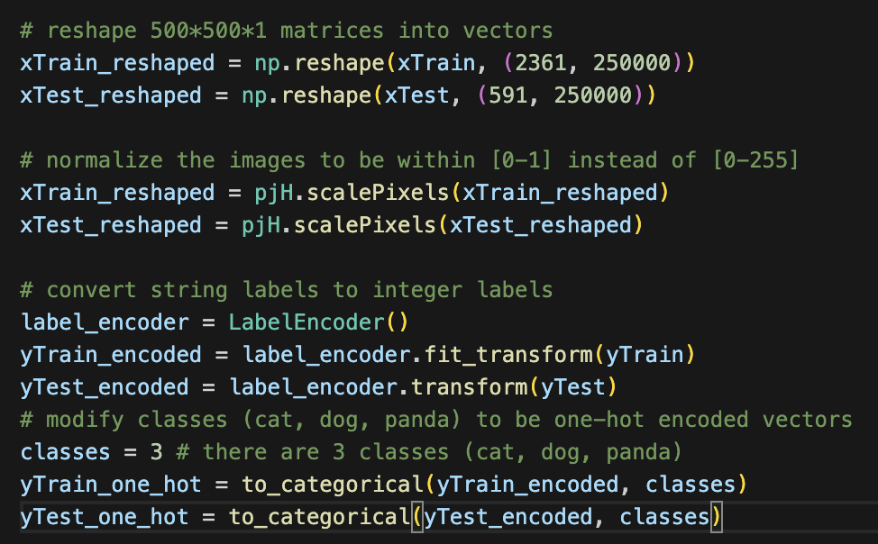
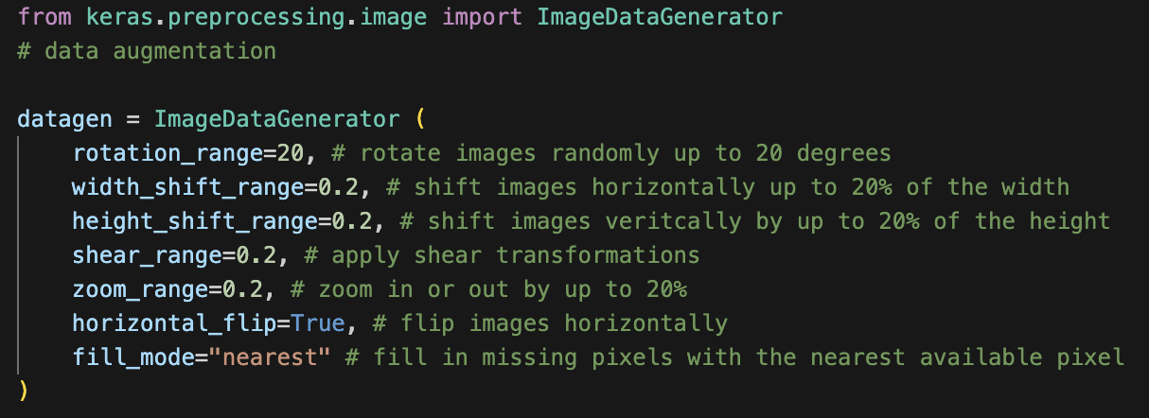
Model: CNN
Before applying the CNN model, we must pre-process the images and classes
Additionally, apply data augmentation to the dataset to increase variance within the data
Augmented Image Generator
Pre-processing steps
30

Slide 32
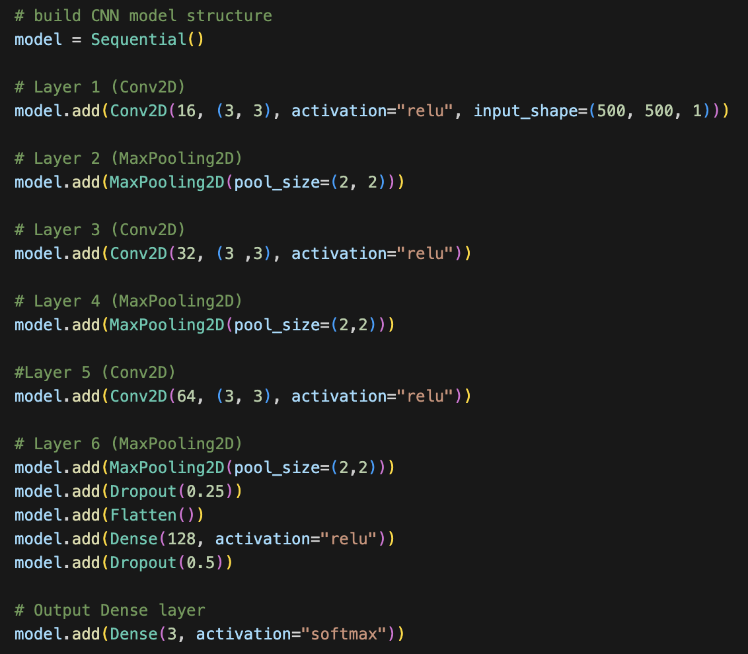
Model: CNN
Input layer is a Conv2D layer with 16 filters of size 3x3
Next layer is a MaxPooling layer with window size 2x2
MaxPooling retains the max value within the 2x2 window, and discards the rest
Retaining important features and discarding the rest makes the model more computationally efficient
Dropout layers are used to help prevent overfitting by randomly dropping neurons during training
We flatten the output from the previous convoluted layer into a 1-Dimensional vector before moving onto the fully connected layer
Dense adds a fully connected layer
Output layer is a fully connected layer with 3 neurons:
one for each class: cat, dog, panda
31

Slide 33
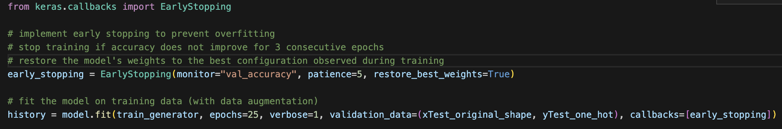
Model: CNN
Train generator is used to generate augmented batches of data
Fit the model and implement early stopping with a significant epoch size to prevent overfitting
32

Slide 34
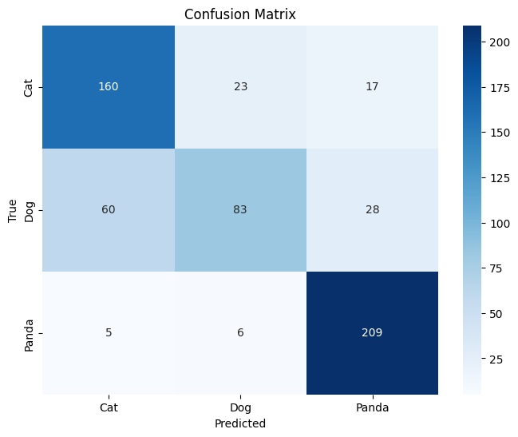
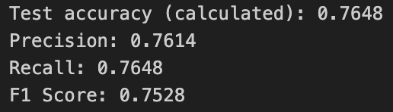
Model Evaluation: CNN
Evaluation Metrics CNN
Most runs would reach between 60-70% accuracy
Applying data augmentation seemed to be what increased performance the most
Model consistently had the most difficulty classifying dogs and the most success classifying pandas
CM CNN
33

Slide 35
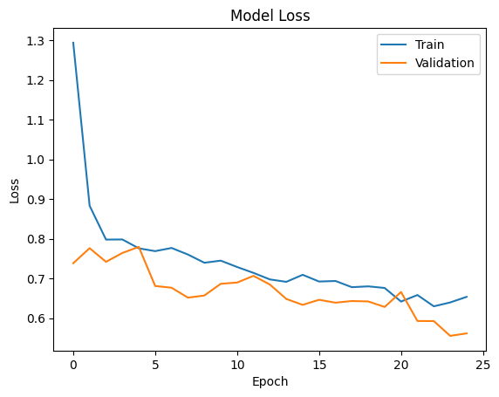
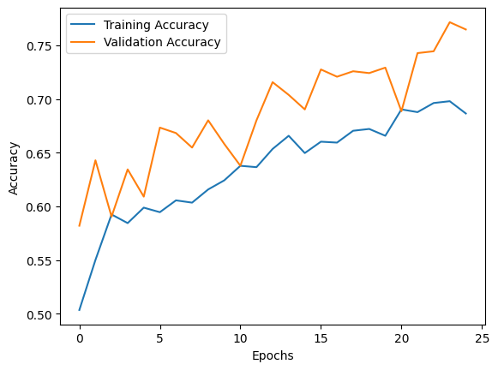
Model Evaluation: CNN
Loss vs Epoch
Accuracy vs Epoch
Generally positive trend
Oscillations in validation accuracy may indicate unstable learning
No clear sign of stabilization in general
However, when they converge, it stabilizes
34

Slide 36
Model: VGG16
VGG16 is a pretrained image classification CNN model that can be accessed through TensorFlow
Pretrained on large datasets such as ImageNet
16 layers (13 convoluted layers, 3 fully connected layers)
Input layer designed to take in images of size (224, 224, 3)
224x224 pixels with 3 color channels (RGB)
35
Notes:
Reference:
12.

Slide 37
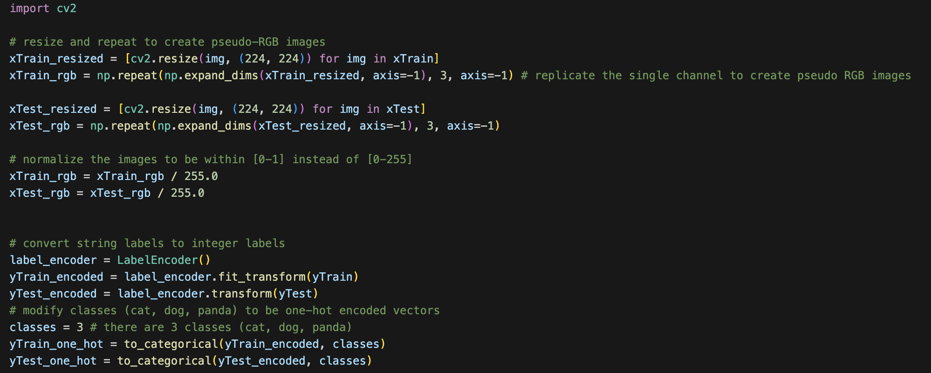
Model: VGG16
We must resize the images in preprocessing to be 224 x 224 pixels and in RGB
VGG16 is computationally expansive
If we don’t resize then training time takes longer
36
Pre-processing for VGG16

Slide 38
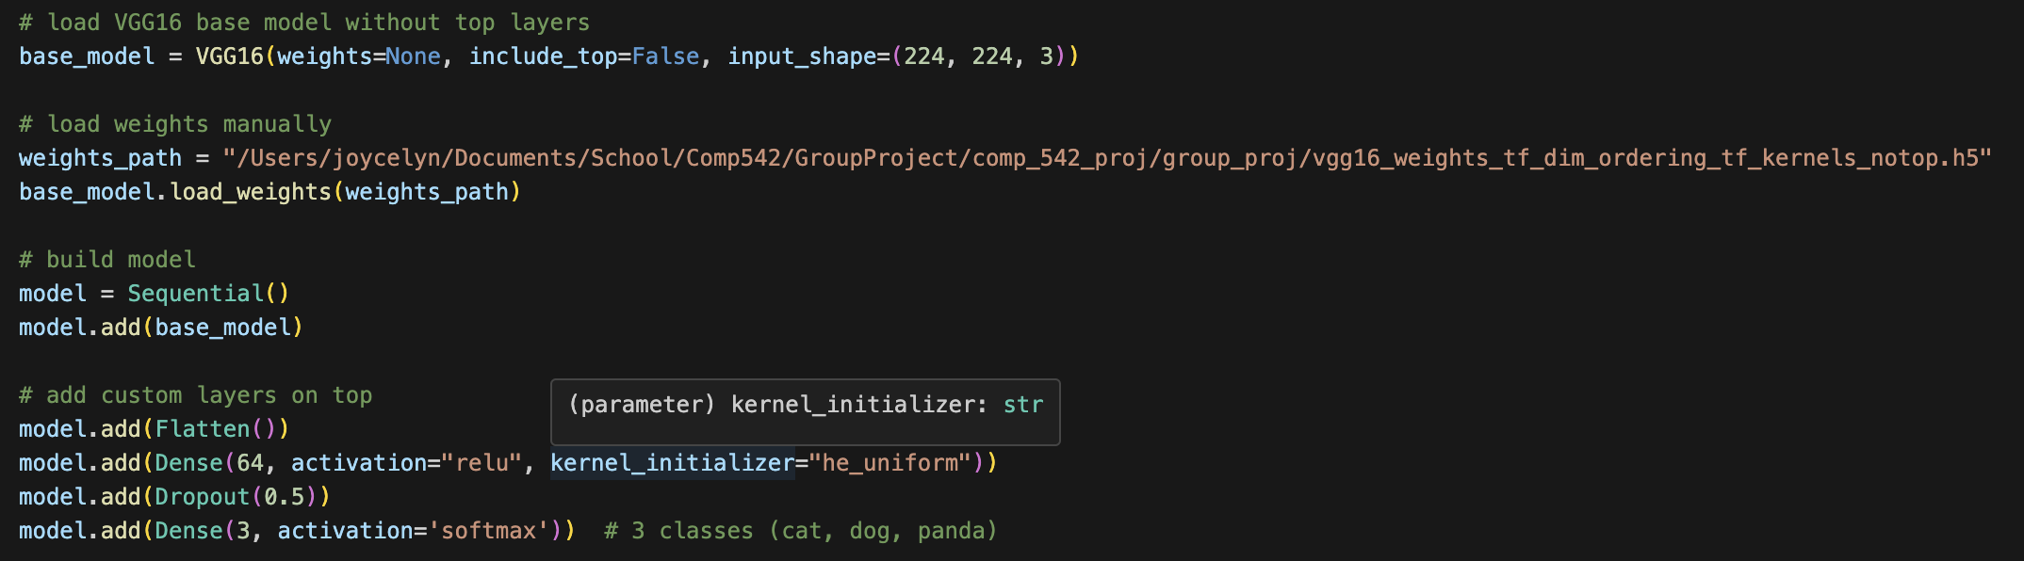
Model: VGG16
Creation of VGG16 Model
Load base model from TensorFlow without the top layers
Load the pretrained weights manually
Try to keep the top layers simple as we have a smaller dataset
37
Notes:
Isaiah: I blocked out the path for safety reasons

Slide 39
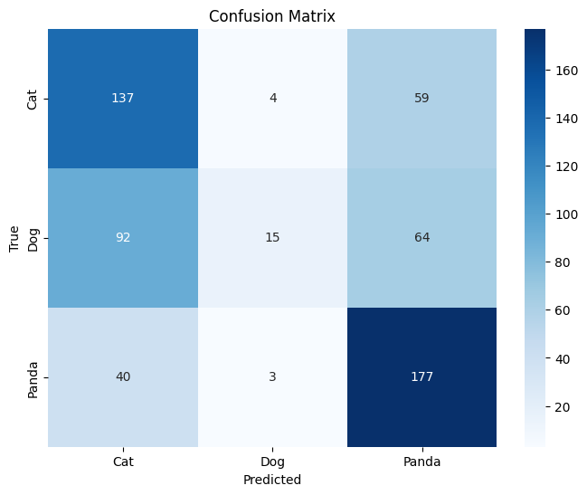
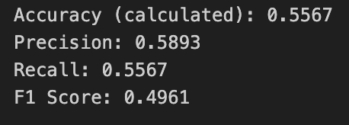
Model Evaluation: VGG16
Evaluation Metrics VGG16
Most runs stayed between 50-60% accuracy
Overall performance not great
This may be because our dataset is small which makes the model prone to overfitting
VGG16 was pretrained on images with 3 color channels
38
CM VGG16

Slide 40
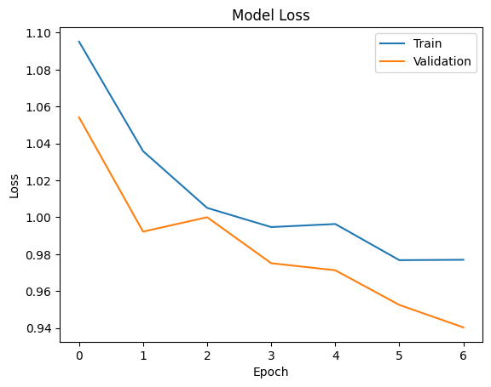
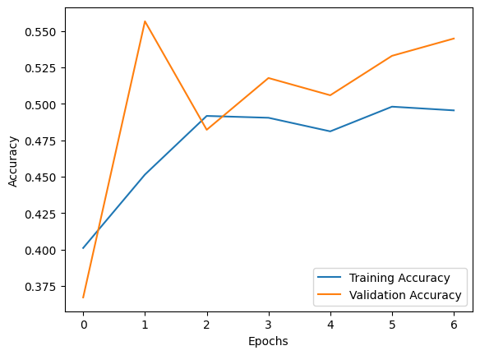
Model Evaluation: VGG16
Loss vs Epoch
Accuracy vs Epoch
Looks like the training process may be unstable
Possibly due to our dataset being too small for a complex model like VGG16
The dramatic increase in validation accuracy before dropping back down and plateauing may indicate instability
39

Slide 41
ML Performance comparison
List of ML algorithms used:
Isaiah:
SVM Classifier
Res Net 50
Zero-Shot Prediction with CLIP **
Joycelyn:
CNN
VGG16
40
Notes:
** Not for grade thus not included in performance comparison

Slide 42
ML Performance comparison
SVM:
Overfitting
Accuracy: ~60%
Res Net 50:
(V1) Accuracy: ~61%
CNN:
Accuracy: ~76%
VGG16:
Accuracy: ~55%
41

Slide 43
Future works
42
Notes:
** Not for grade

Slide 44
Future Works
Increase dataset size and diversity
A larger dataset may allow CNN models to achieve learning stability, increasing overall performance
This would particularly be useful while applying the VGG16 model, as it is more computationally expansive and was pretrained on larger datasets
For CNN models built from scratch, more layers, filters, and neurons may need to be added to increase complexity, ensuring that the intricate features and patterns of the images were captured
Stricter set of criteria for clean images
Additional augmentations of images
For SVM, use a smaller subset of the data to perform training
43

Slide 45
conclusion
44
Notes:
** Not for grade

Slide 46
Conclusion
Learned a lot about how image classification works
Image classification is both difficult and time consuming
Pre-trained models exist and are available for public usage
Neural Networks are fantastic at Image Classification
45

Slide 47
Related works
https://www.kaggle.com/datasets/ashishsaxena2209/animal-image-datasetdog-cat-and-panda
https://marcovirgolin.github.io/extras/details_time_complexity_machine_learning_algorithms/
https://stats.stackexchange.com/questions/94596/computational-complexity-of-prediction-using-svm-and-nn
https://medium.com/@arashserej/resnet-50-83b3ff33be7d
https://medium.com/analytics-vidhya/2d-convolution-using-python-numpy-43442ff5f381
https://paperswithcode.com/method/max-pooling
https://github.com/openai/CLIP/tree/main
https://deepchecks.com/glossary/zero-shot-learning/
https://blog.roboflow.com/zero-shot-learning-computer-vision/
https://www.freeiconspng.com/img/1682
https://www.ibm.com/topics/convolutional-neural-networks
https://www.geeksforgeeks.org/vgg-16-cnn-model/
46

Slide 48
Questions?

Slide 49
Thank You

