Slide 1
Cat Image Classification
Group 4:
Isaiah Martinez, Joycelyn Tuazon

Slide 2
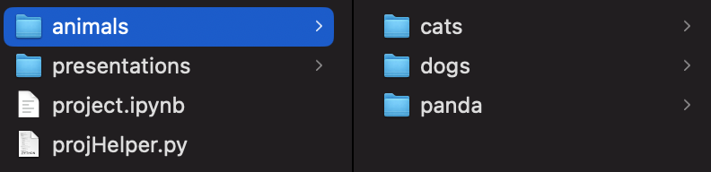
Dataset
Dataset name: Animal Image Dataset (DOG, CAT and PANDA)
Link to Dataset: https://www.kaggle.com/datasets/ashishsaxena2209/animal-image-datasetdog-cat-and-panda
3 folder structure:
Cat
Dog
Panda

Slide 3
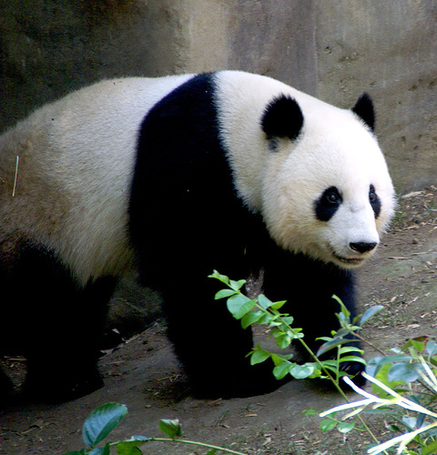
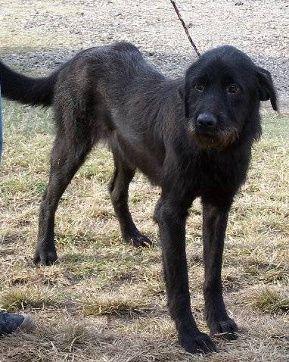
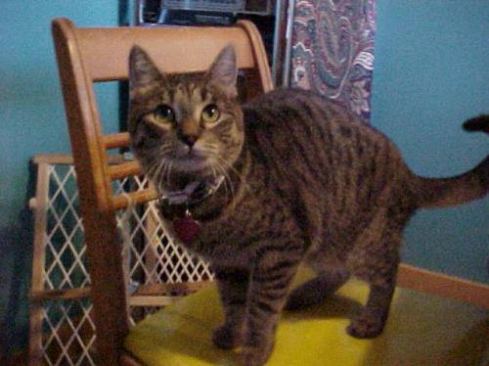
Dataset Sample
Cat Image 1
Dog Image 1
Panda Image 1

Slide 4

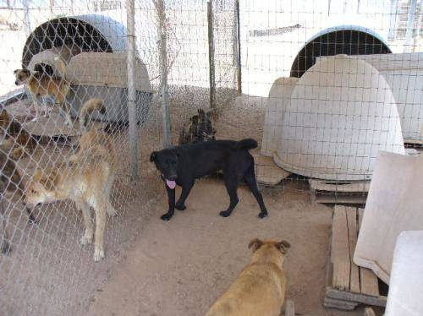
Dataset Overview
3000 non-standardized images:
Image sizes range from (1600, 1200) to (60,32)
Image Qualities:
Multiple animals in frame
No animal photographed
No corrupt images
Animals are in various positions
Animals have varying colors of fur
Animals are of varying ages
Dog Image 65
Dog Image 983
Notes:
Some are partially hidden or not centered

Slide 5

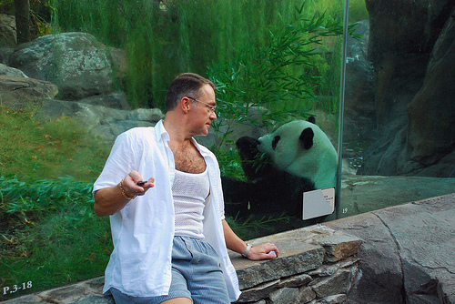

Dataset Cleaning
We are considering:
Standardizing image size and resolution ~(500,500)
Removing non-photograph images of animals
Cat image 556
Cat image 374
Panda Image 56

Slide 6
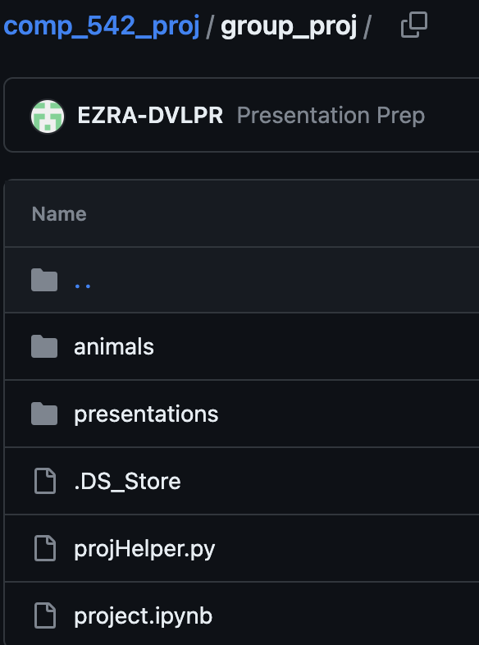
Github Repo
https://github.com/EZRA-DVLPR/comp_542_proj/tree/main/group_proj

Slide 7
Thank You

