Slide 1
Cat Image Classification
Group 4:
Isaiah Martinez, Joycelyn Tuazon

Slide 2
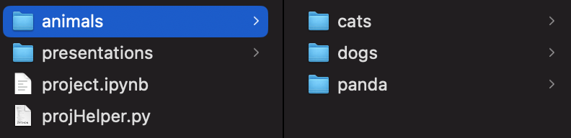
Dataset
Dataset name: Animal Image Dataset (DOG, CAT and PANDA)
Link to Dataset: https://www.kaggle.com/datasets/ashishsaxena2209/animal-image-datasetdog-cat-and-panda
3 folder structure:
Cat
Dog
Panda
Folder Structure
1

Slide 3
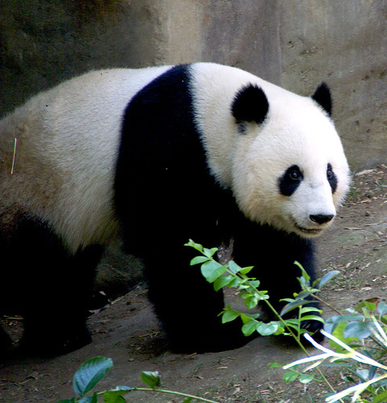
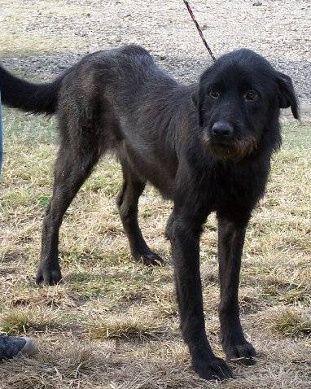
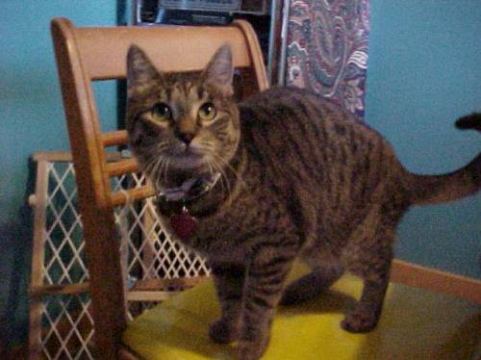
Dataset Sample
Cat Image 1
Dog Image 1
Panda Image 1
2

Slide 4
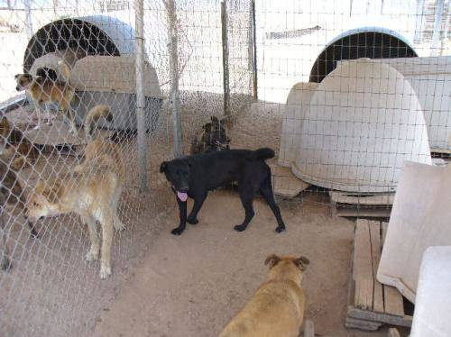

Dataset Overview
3000 non-standardized images:
Image sizes range from (1600, 1200) to (60,32)
Image Qualities:
Multiple animals in frame
No animal photographed
Animals are in various positions
Animals have varying colors of fur
Animals are of varying ages
Dog Image 65
Dog Image 983
3
Notes:
Some are partially hidden or not centered
No corrupt images

Slide 5

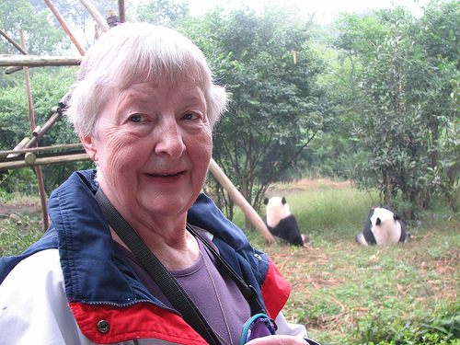

Dataset Cleaning
We are considering:
Standardizing image size ~(500,500)
Removing non-photograph images of animals
Removing photographs with difficult to spot subjects
Cat image 374
Cat image 556
Panda Image 475
4

Slide 6
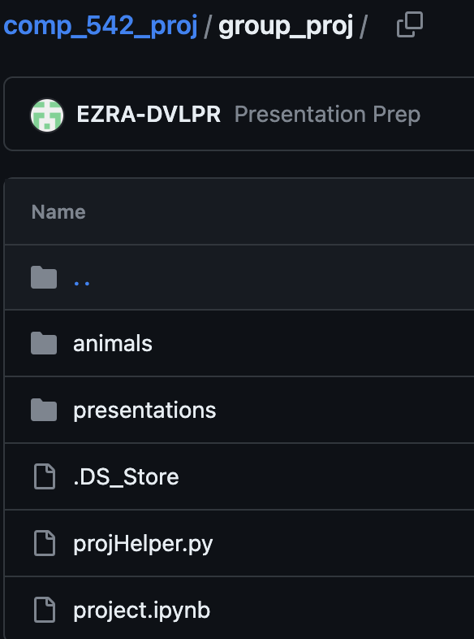
Github Repo
https://github.com/EZRA-DVLPR/comp_542_proj/tree/main/group_proj
Separated by file type:
Images
PPTX
Project Files
Github Structure
5

Slide 7
Thank You

