Slide 1
Animal Image Classification
Group 4:
Isaiah Martinez, Joycelyn Tuazon

Slide 2
NOTES
Add slide # to each slide
Edit thank you slide
Add questions slide
15 min max w/ 5 min questions
We are the first to present on 11/29
Don’t add too much text
Big pictures that are legible
Add images of eval metrics
Add final resulting accuracy

Slide 3
Table of contents
Dataset Overview
Data Visualization
Data Cleaning
Data Preparation
ML Models:
Model Evaluation/Comparison
Future Work
Conclusion

Slide 4
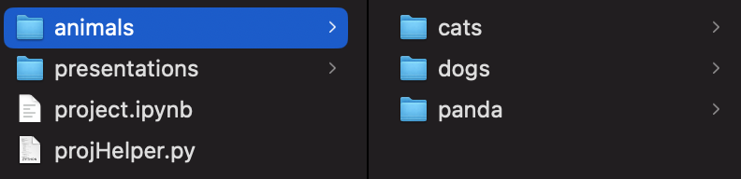
Dataset Overview
Dataset name: Animal Image Dataset (DOG, CAT and PANDA)*
Link to Dataset:
https://www.kaggle.com/datasets/ashishsaxena2209/animal-image-datasetdog-cat-and-panda
3 folder structure:
Cat
Dog
Panda
Folder Structure
1
Notes:
*Verbatim

Slide 5
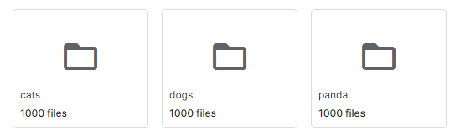
Dataset Overview
Each animal/directory had 1000 images
Image size was highly varied:
Smallest images were 55 x 75 pixels
Largest image was 1600 x 1200 pixels
Avg image was 431 x 372 pixels

Slide 6
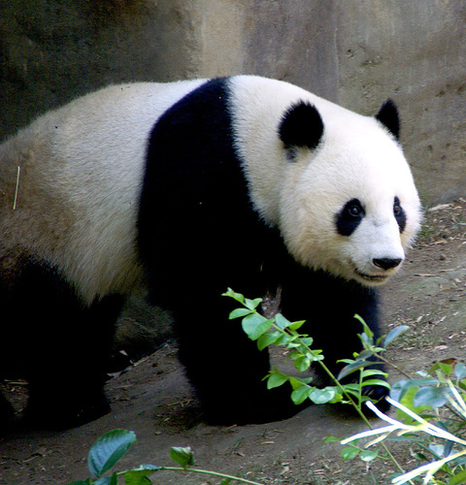
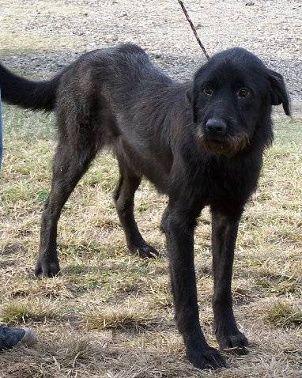
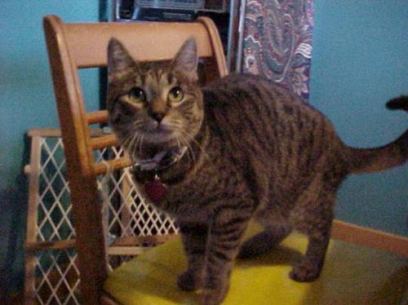
Data Visualization
Cat Image 1
Dog Image 1
Panda Image 1
2

Slide 7
Data visualization
Show conversion of img to array

Slide 8
Data Cleaning
Got rid of bad images meeting any of the following criteria:
Criteria…
Criteria…
Show a single img that was cut out

Slide 9

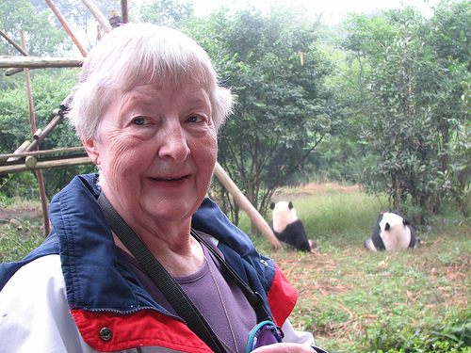

Dataset Cleaning
We are considering:
Standardizing image size ~(500,500)
Removing non-photograph images of animals
Removing photographs with difficult to spot subjects
Cat image 374
Cat image 556
Panda Image 475
4

Slide 10
Data preparation
Any algorithm used in data prep:
GLCM (RGB → Grayscale)
Class Balancing for Model
???

Slide 11
Machine Learning Models - SVM

Slide 12
Model Evaluation - SVM

Slide 13
Machine Learning Model - CNN

Slide 14
Model Evaluation - CNN

Slide 15
Conclusion

Slide 16
Thank You

