Slide 1

Proteus is Turing Complete
Isaiah

Slide 2
Requirements for TC
To be TC you require:
  Basic Arithmetic/Binary Operators (+,-,*,/) → Functions
  Conditional Statements (if)
  Looping (while)
  Readable and Writable Memory (store)
We lack the ability to overwrite a value of a complex structure like an array
Instead we can utilize the value of a variable

Slide 3
Variable = ???
However, the variable is what I’m most unsure of. Firstly,
  We are able to read its value dynamically
  We are able to write its value dynamically
The issue is how to understand what the variable means to us
  Does it store the infinite tape of 0’s and 1’s in a classical TM?
  Does it represent the output of some problem we give the machine to solve?
  How do we utilize it to show TC explicitly?

Slide 4
Variable = 42 => Profit $$$
The variable is just a representative of what we will be storing based on the computation of the given program/machine
  I.e. it is variable and relies on the objective/goal
Thus, we have the building blocks of showing TC.
The problem is how…

Slide 5
Different Approaches

Slide 6
Math/Engineering Approach

Slide 7
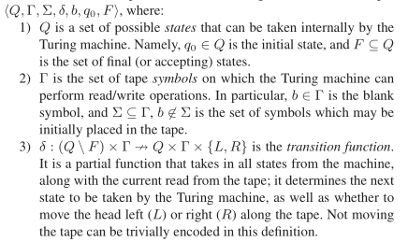
Approach 1
We utilize Math and Engineering notation for State Machines to show the classical understanding of TC for this language.
This is explicit and highly
technical, but concise.
This approach also utilizes
the usage of State Machines
and the notation for them.
Src: “Turing Completeness and
Sid Meier’s Civilization”

Slide 8
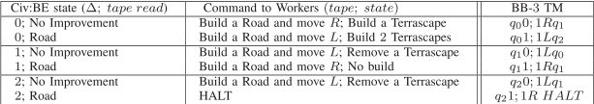
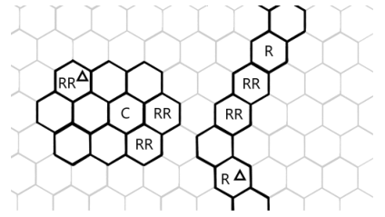
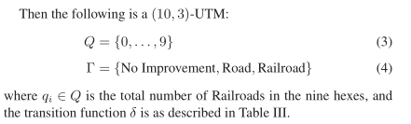
Approach 1
State/Tape Reading
Description of States, Transition functions, Symbols
Map Layout of Tape

Slide 9
Wordy/Game-ified Approach

Slide 10
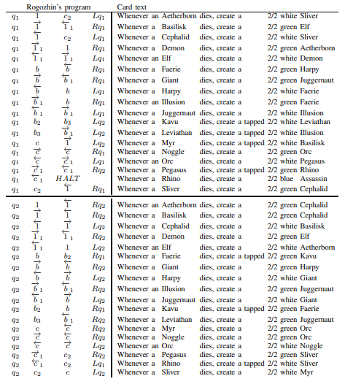
Approach 2
We utilize words and describe what each of the transitions/reading/writing looks like in a TM.
This would result in a much longer paper/thesis, but more easily readable to the layman.
This approach is more “game-ified” and thus easier to digest. Think of a 1 or 2 player game.
Src: “Magic: The Gathering is Turing Complete”

Slide 11
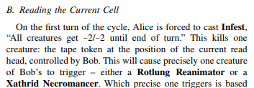
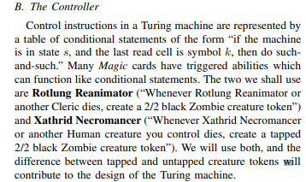
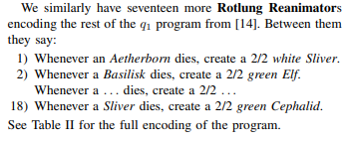
Approach 2
How each component is represented
in the game (with each card)
Explicit description of what each
component of TC requires and
how to achieve it
Show the different outcomes and states

Slide 12
Coding

Slide 13

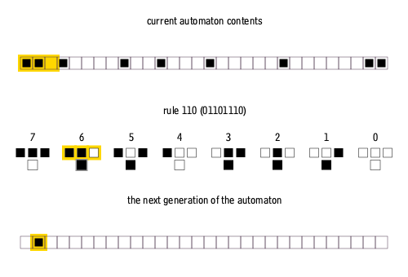
Approach 3
We will rely on utilizing the language itself (abstracting from the grammar) by creating program(s) to demonstrate TC
These programs would demonstrate TC problems like Rule 110 or Conway’s Game of Life
This is probably the most difficult and time consuming, but simplest to explain
  “B/C this is TC and Proteus can do it, then Proteus is TC”

Slide 14
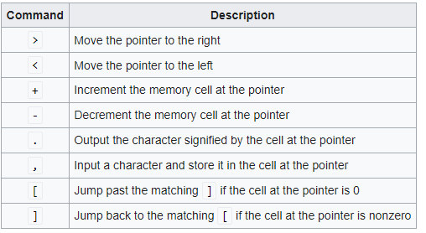
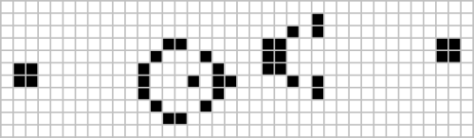
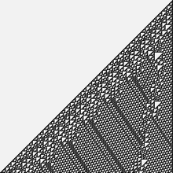
Approach 3
Conway’s Game of Life
Brainfuck Interpreter
Rule 110

Slide 15
What next?

Slide 16

Proof
I think the simplest would be to do Approach 3. It provides the most straightforward understanding to showing how Proteus is TC.
I however would prefer to do a mixture of the 3:
  I would like to show Rule 110 using a combination of State Machines and functions (Approach 3)
  Describe how it works using the more mathematical and engineering notation for the state machines used (Approach 1)
  Talk through the process of how it works step by step; i.e. simulating/running the program with words (Approach 2)
{Start, Stop}
{0, 1} => {Off, On}

Slide 17
Proof
Specifically, I would like to avoid using the mathematical notation heavily. One of the things that stumped me for a long time was trying to understand how to apply the math notation (delta, tau, lambda, etc.) to our grammar.
It would be easier to describe “physical” state machines (each state machine could have an LED which represents on/off) which would be coded using Proteus.
  This can be used for Conway’s Game of Life or Rule 110 (I think the latter is cooler, but CGoL would probably be easier in design I think)
  I would like to retain the notation for the state machines however, as it makes it more “science-y”

Slide 18
Proof
The last part (Approach 2) is really just optional and considered padding/extra stuff at the end to fill pages or something. It would basically be just for further explanation/discussion I think.
I’m not entirely sure how to structure the Thesis and whatnot so I’m eager to hear your feedback.

Slide 19
Mock Diagram

Slide 20
My Questions
Does this sound reasonable to aim for in a semester?
  Is the scope too large? Am I too ambitious? Is it not enough for a paper/thesis?
How many citations needed? What number of pages to aim for in the thesis/paper?
How do I run Proteus code on Windows or MacOS?
  Does the compiler v1 or v2 work as of right now? Are there any compilation things I should know of in particular?
Any final thoughts?

