Slide 1
Parking Spots Allocation
Presentation and Detailed Report
Francisco Teixeira Lopes up201106912
Maria Eduarda Santos Cunha up201506524

Slide 2
Problem Description and Data Analysis
Our first project consisted of the allocation of parking lots to several cars. The cars had certain requirements regarding the kind of spot they preferred and negotiated with the various parking lots to assess which was the best one for them.
The problem now is to analyse the satisfaction of each car agent with their chosen parking lot.
This is a regression problem which will be analysed in RapidMiner by using a dataset with 1000 cars and varying parking lot configurations. These will be explained in detail later in the report.

Slide 3
Performed Experiments
The software developed for the first project was used with varying parameters to generate 10 sets of 100 cars with accompanying parking lots (handcrafted). This final set of 1000 data rows was used for regression in RapidMiner.

Slide 4
Gathered Data Statistics
The CSV file generated from the software contains many columns, a summary description of each follows:
Zone<num>Parks – parks were divided in 9 districts of 5x5 boxes
CheapZone<num> - ModerateZone<num> - PremiumZone<num> – each district was divided in 3 pricing ranges
CarZone – the car agent’s starting district
CarCost – the max hourly cost tolerated by the car agent
CarDistance – the max distance tolerated by the car agent
CarType – the behavior of the car type
Satisfaction – the percentage rating of the satisfaction of the car client

Slide 5
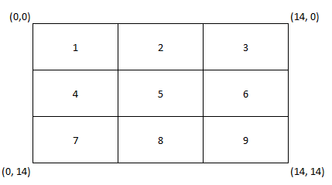
Gathered Data Statistics
Districts are divided in 5x5 boxes as follows:
Pricing ranges are divided as follows:
cheap (1 – 5)
moderate (6 – 10)
premium (11 – 15)
Car behaviors used are:
STRICT – must have both distance and cost conditions met
LOWERCOST – always goes for the lower cost up to a maximum
LOWERDIST – always goes for the lowest distance up to a maximum
FLEXIBLE – like STRICT but allows parking lots to demand more than its maximum tolerated up to a margin

Slide 6
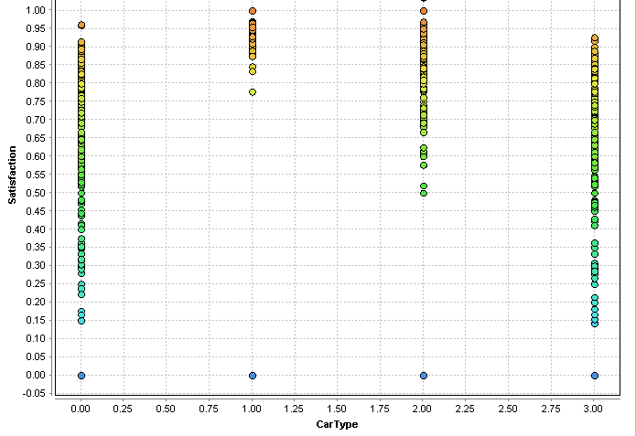
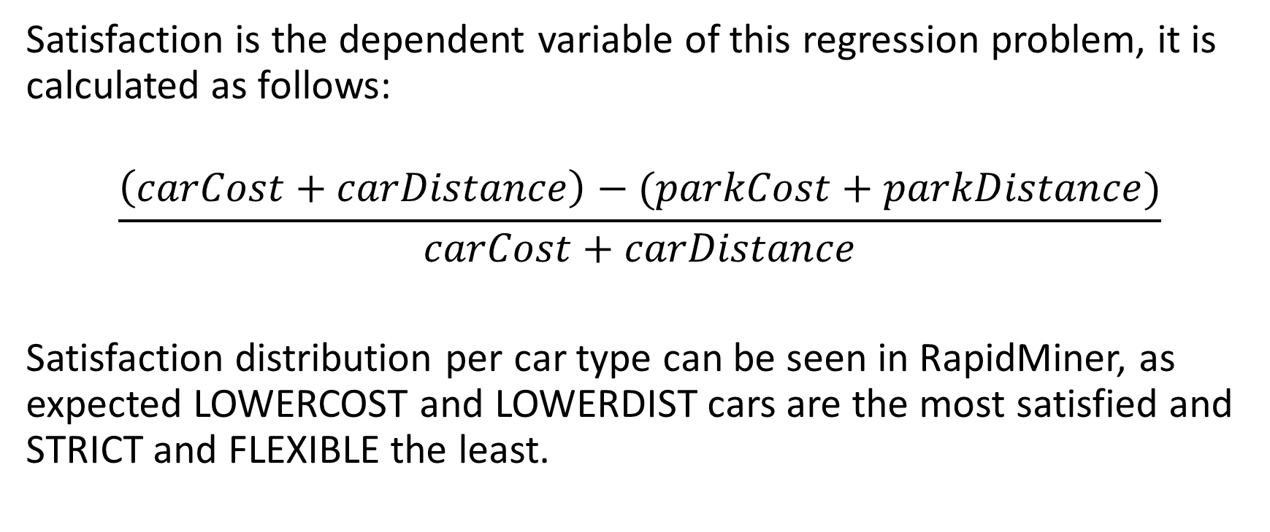
Gathered Data Statistics
Satisfaction is the dependent variable of this regression problem, it is calculated as follows:
$$\frac{\left(carCost+carDistance\right)−(parkCost+parkDistance)}{carCost+carDistance}$$
Satisfaction distribution per car type can be seen in RapidMiner, as expected LOWERCOST and LOWERDIST cars are the most satisfied and STRICT and FLEXIBLE the least.

Slide 7

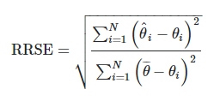
Data Analysis with RapidMiner
We used 4 kinds of regression models in RapidMiner, the following table shows the results obtained from those regressions.
Regression Type: | Linear Regression | Polynomial Regression | Neural Net | Deep Learning | Formula
Root Mean Squared Error | 0.274 | 55.294 | 0.236 | 0.266
Root Relative Squared Error | 0.866 | 174.742 | 0.744 | 0.841

Slide 8
Data Analysis with RapidMiner
RMSE – measures the difference between the actual values and the predicted values
RRSE – compares the predictor used to a simple predictor (one that only uses the average of the actual values for prediction). Values of 0 to 1 represent a useful model.
Given this information, all of the models except the Polynomial Regression model are useful being that the Neural Net performs the best out of the 4.

Slide 9
Conclusion
The dataset generated by our software contains data that can be analysed properly using regression models. We conclude that given a sufficiently large set of data, RapidMiner or other machine learning software could reasonably estimate the output of our software without having to run the actual software.
For future work, one could analyse other quality indicators of regression models: different error measurements and correlation coefficients. One could also expand the dataset with new columns relating to desired spot types of the car agents, parking lots’ available spot types and seeing how parking lot vacancy altered the results. For this analysis, parking lots had “infinite” capacity.

Slide 10
Additional Info

Slide 11
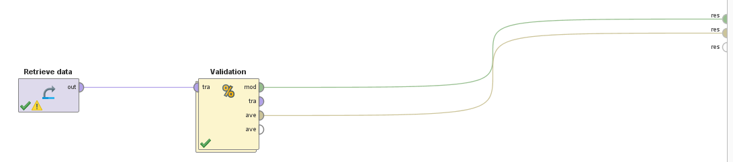
RapidMiner Processes
The data was imported to RapidMiner as a CSV file with first line representing the header of the columns. Satisfaction’s role was changed to “label” since it is our dependent variable. This data was then plugged into a SplitValidator to divide the dataset in Training and Testing sets for evaluating the performance of a chosen model.

Slide 12
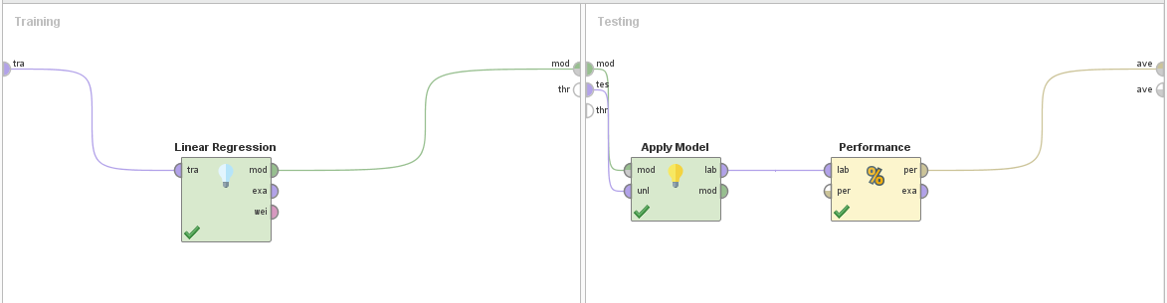
RapidMiner Processes
The dataset split was set to 0.7/0.3 (train / test) and a model was applied to the data (Linear Regression, Neural Net, etc). After applying the model, a Performance operator was used to get the RMSE and RRSE of the applied model.

Slide 13
Other Experiments Results
Parking lot config (in “configInfo.txt) nice tables? Boxes?

Slide 14
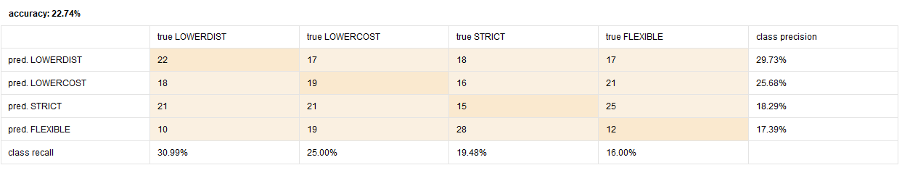
Other Observations
Classification using kNN was also performed, switching the dependent variable from Satisfaction to CarType, that is, for a given configuration we wanted the model to predict the CarType. The confusion matrix evaluated an accuracy of 22.74% which means this model is not useful, a random selection would roughly equal ~50% meaning this model is even worse than a random predictor.

