Slide 1

Seminar Hasil 2023 / 2024
SUBJECT-LEVEL STUDENT ACADEMIC PERFORMANCE
SEGMENTATION USING STABILITY-AWARE K-MEANS++
Program Studi Teknik Informatika
Tegar Rahmadani Firdaus
P36.2026.00005
Universitas Dian Nuswantoro Semarang

Slide 2
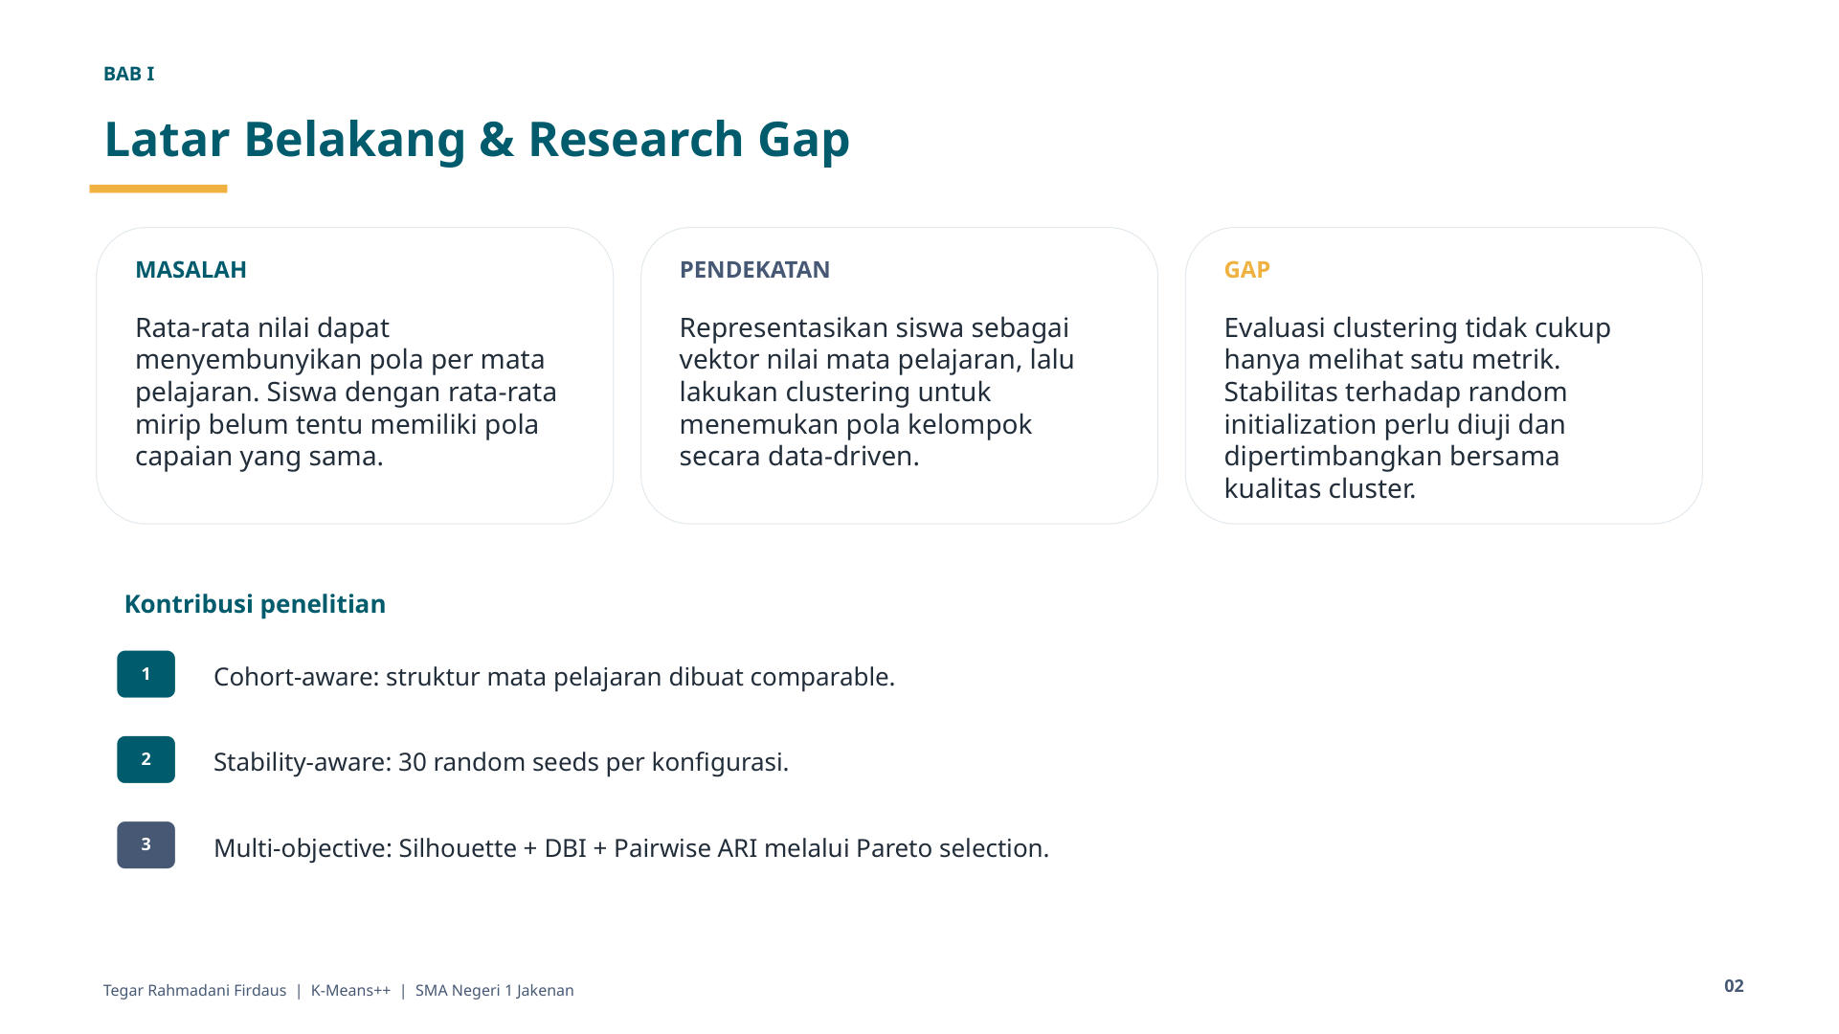

Slide 3
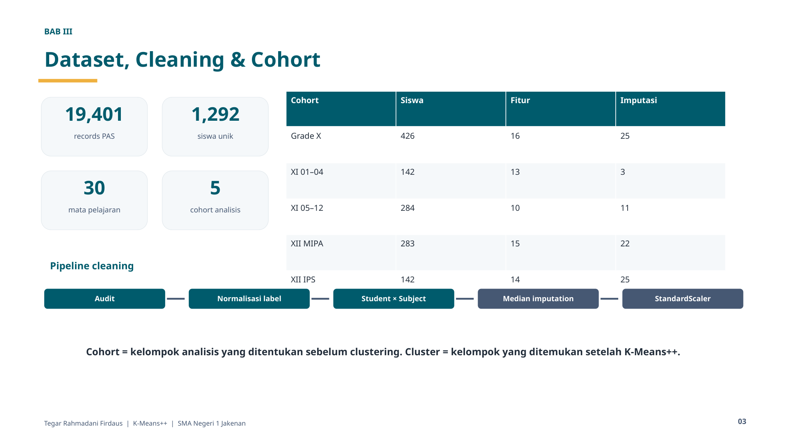

Slide 4
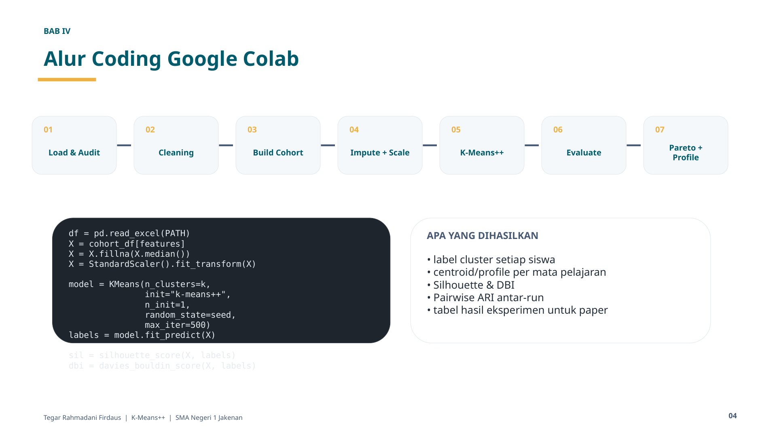

Slide 5
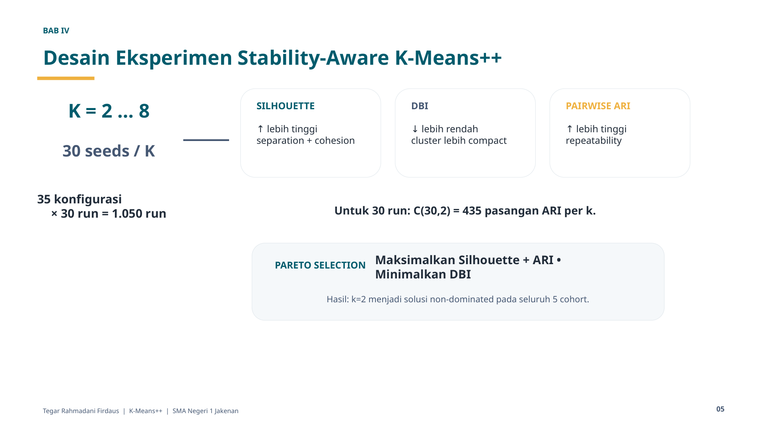

Slide 6
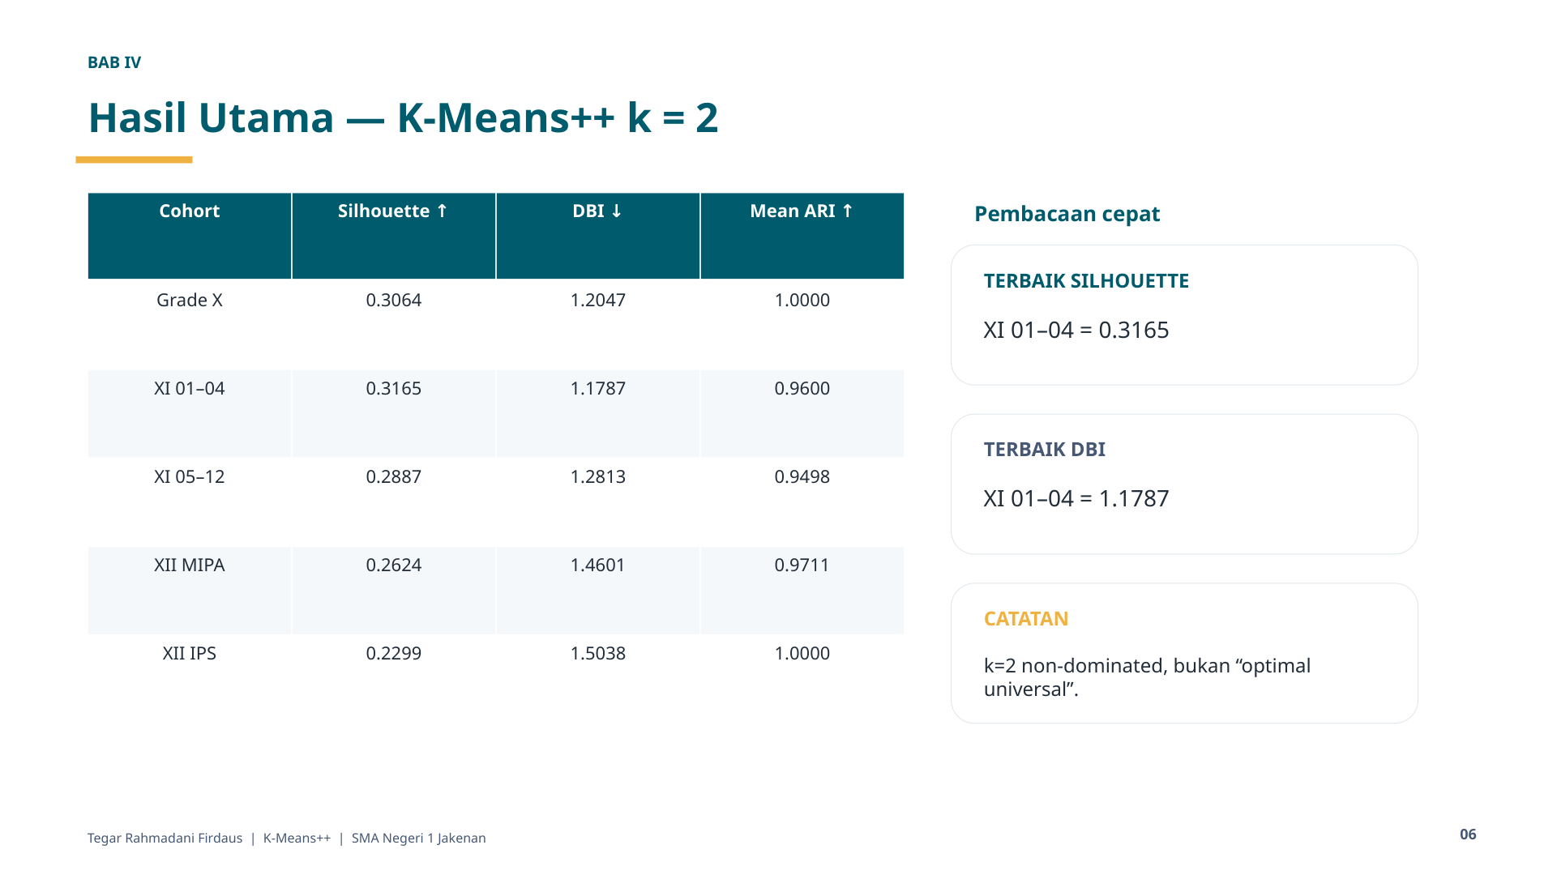

Slide 7
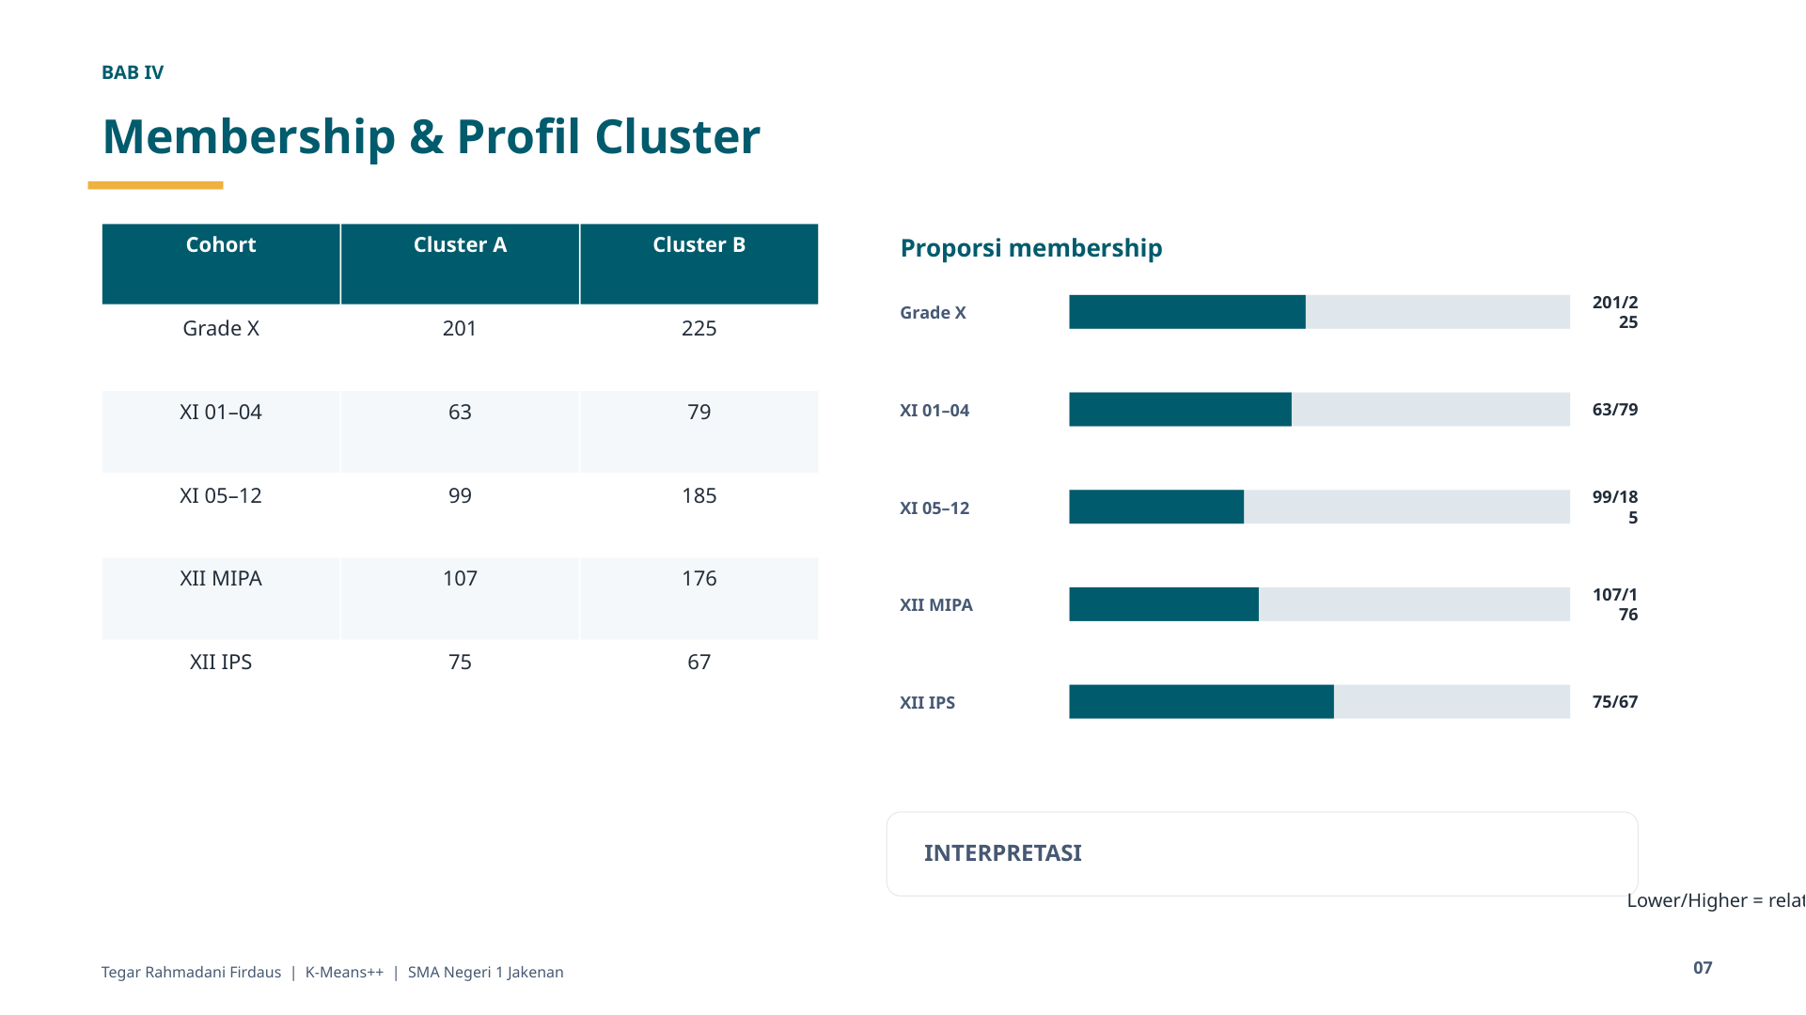

Slide 8
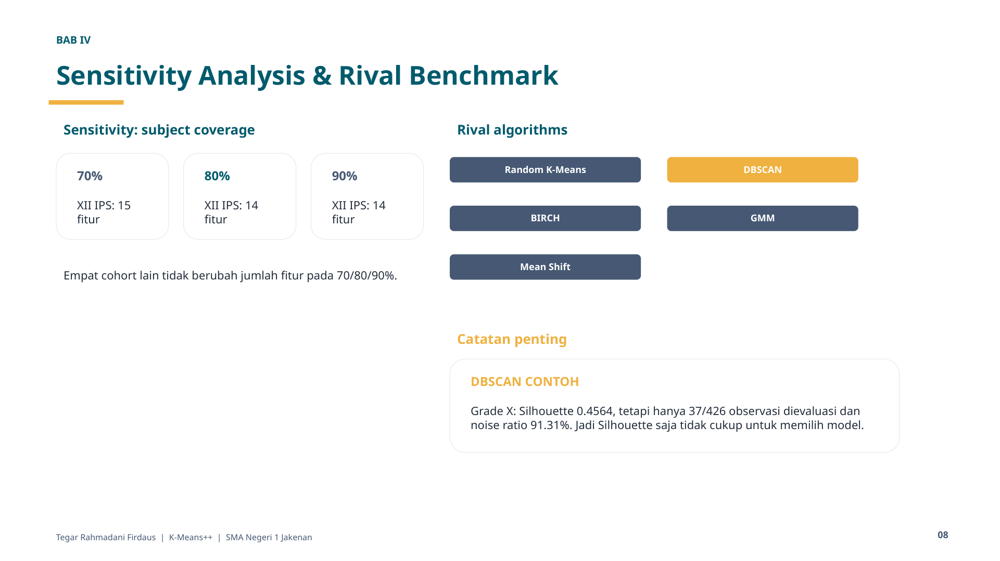

Slide 9
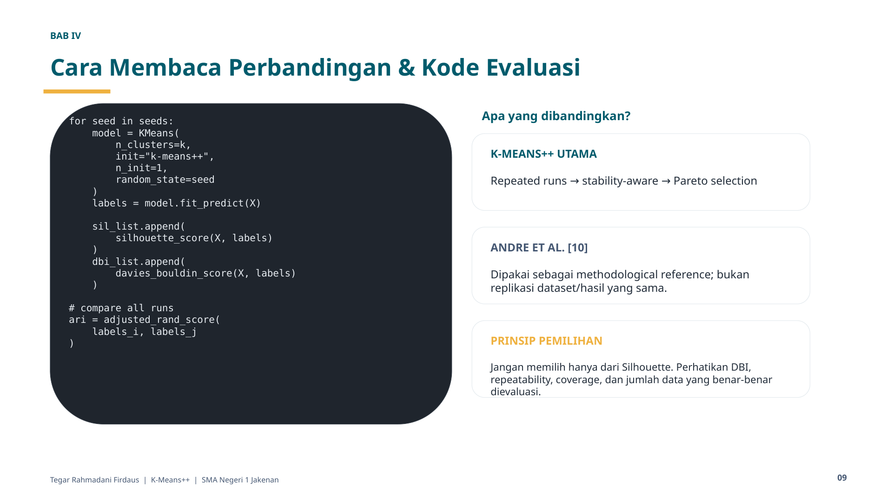

Slide 10


