Slide 1

www.it-academy.by
application testing
Created by the Team1:
Angelina Bolgar, Ekaterina Zakomornaya, Olga Pavlovich

Slide 2







About www.it-academy.by application testing
The testing durated 4 weeks, during which the team performed the following tasks:
divide app into modules,
creation of checklists,
peer-review implementation,
creation of bug reports,
creation of bugs statistics,
creation of recommendations
Each team member was in the role of Team Lead.
We used the next Test Management Tools:
The application was tested in Web browsers and Mobile OS.

Slide 3

Test Result Report It-Academy.by
Next, we will consider all the following items:
Test Team
Testing process description
Timetable
Summary
Blocker bugs
Risks
Overall bugs statistics
Conclusion
Recommendations

Slide 4
Test Team
Name | Position | Module
Angelina Bolgar | Team Lead 2 week, QA specialist | "Education", "Distance learning", "Reviews"
Ekaterina Zakomornaya | Team Lead 1 and 4 weeks, QA specialist | "Footer", "Upcoming starts","Employment", "Success stories", "General"
Olga Pavlovich | Team Lead 3 week, QA specialist | "Start page", "Menu", "EPAM trainings", " IT Practicum", "News", "About the center","Chat with consultant"
Position | Responsibilities
Team lead | Coordinating the work of the team, basic check of builds, revision of test scenarios; Planning, monitoring and controlling the testing activities and tasks; Effectively leading a team of testers to achieve product goals; Creating TRR;
QA specialist | Collecting the test data; Creating and implementing the test plan, bug report, Preparing, documentation and performing the test cases and test suites; Performing of functional testing.

Slide 5




Testing process description
Web application:
https://www.it-academy.by/
Test Method:
Manual
Test environment:
Test Level:
System testing
Mojave 10.14.6
OC Windows 11
Web Browsers:
Cross-browser testing
Usability testing
System testing
Functional testing
Localization testing
GUI testing
Positive/negative testing
Black box
Testing
types:
Google Chrome
107.0.5304.107
Mozilla Firefox
107.0
Safari 14.1.2
(14611.3.10.1.7)
Mobile OS:
Android v.12
IOS 14.8.1
Testing Tools:
Microsoft Word
Microsoft Excel

Slide 6
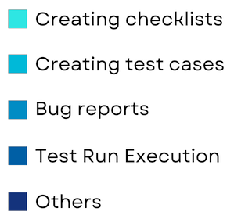
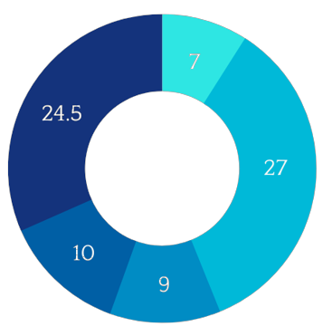
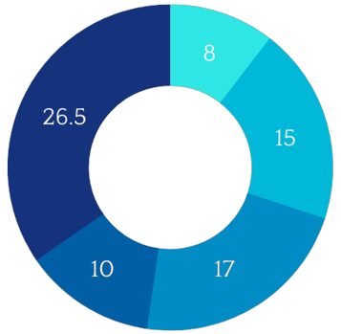
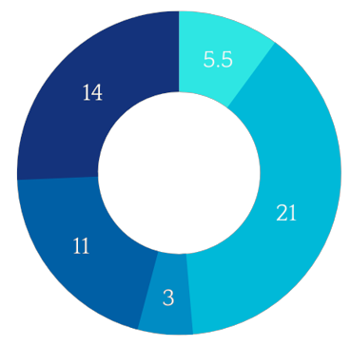
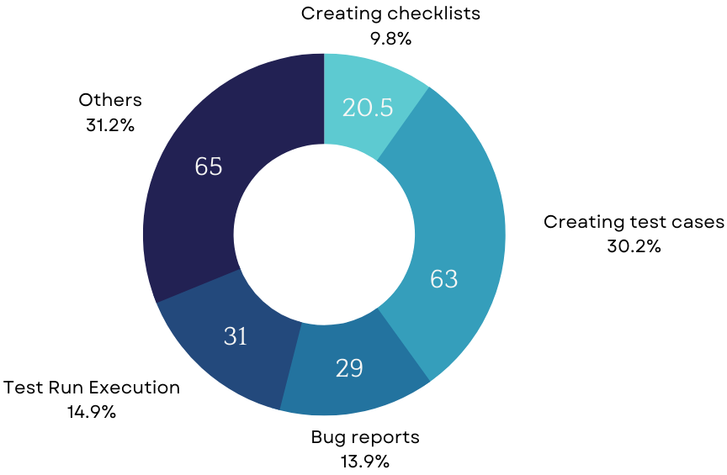
Time statistics
Angelina Bolgar
Ekaterina Zakomornaya
Olga Pavlovich
7
Total amount of time spent on tasks
The total amount of time
spent on the project
by all team members
208.5h

Slide 7
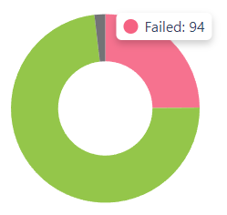

Summary
During the work, the team created 378 test cases in 15 modules.
Test Cases were created in the test management tool “Qase”.
Test run Mobile OS
5 test runs were completed.
When testing:
94 test cases were failed on a mobile device that is 25 % of all Test Cases.
14 test cases were failed in desktop browser testing that is 4 % of all Test Cases.
7 test cases were skipped on mobile due to irrelevance or can't be passed.
1 test case were skipped in browser safari due to irrelevance.
64 bugs were founded in total and reported in Jira Software.
All bugs statistics:
Status | Quantity | Severity
 |  | Critical | Major | Medium | Minor
Submitted | 64 | 7 | 7 | 11 | 39
Test Status: Red

Slide 8

Blocker bugs
No blocker bugs were found during testing process.

Slide 9

Risks
The incurred the project risk
"Lack of human resources when testing is to begin (tester’s illness, absence etc.)"
was mitigated with the help redistribute
the high priority work of the absent tester to other team members.

Slide 10
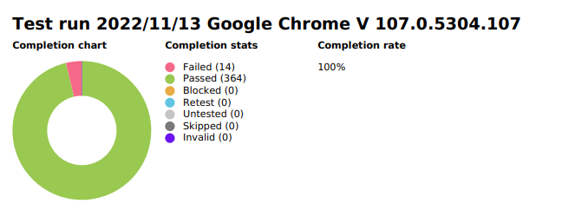
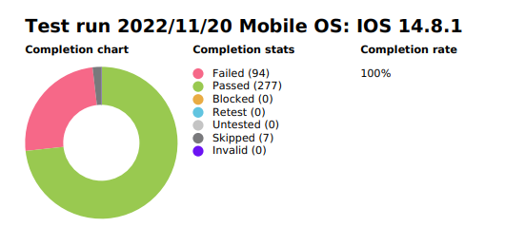
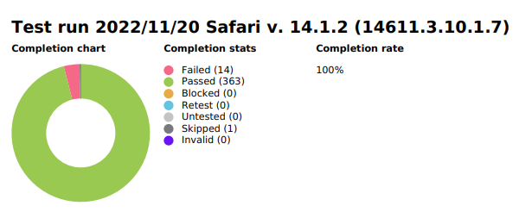
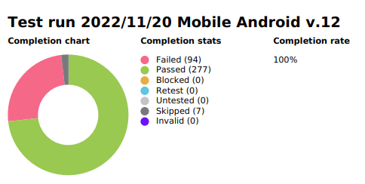
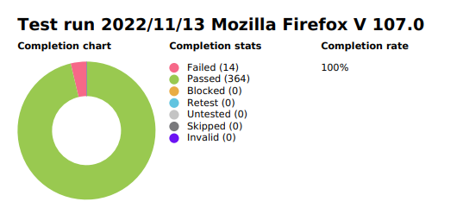
Overall Bugs Statistics by Environment
4% of failed test cases in Google Chrome, Safari and Firefox.
25% of failed test cases in Mobile OS: iOS and Android.

Slide 11
Some of bugs found:
№ | ID | Bugs | Severity | Who found the bug
1 | ST336221-125 | The number of preparatory courses is not displayed | Medium | Olga
2 | ST336221-122 | The city is automatically put Minsk, if you do not choose | Minor | Olga
3 | ST336221-121 | The menu is not displayed in full after selecting minsk, scrolled down hovering the mouse over the empty space of the menu, scrolled up | Major | Olga
4 | ST336221-120 | The background is absent in tab "Site's map" in mobile OS iOS | Minor | Ekaterina
5 | ST336221-58 | Impossible Send your data in the form Consultation and appointment with valid number | Major | Ekaterina
6 | ST336221-112 | In menu Hyperlinks "Upcoming start's", "Distance learning", "EPAM trainings", "IT Practicum", "Reviews", "Success stories" don't work in mobile OS iOS | Critical | Ekaterina
7 | ST336221-81 | Name link does not match its logic 'работодателей-партнеров' page 'manual testing'. | Minor | Angelina
8 | ST336221-85 | Link to a wrong name company | Minor | Angelina
9 | ST336221-105 | The text "Системное и сетевое администрирование" in the card is cut off when the window size is reduced. | Minor | Angelina

Slide 12

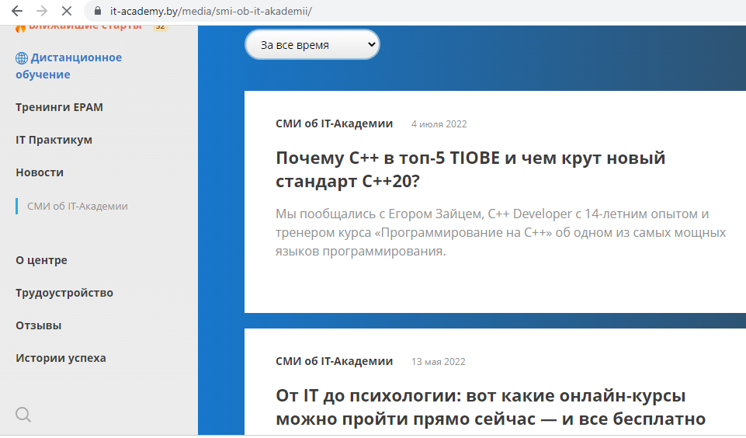
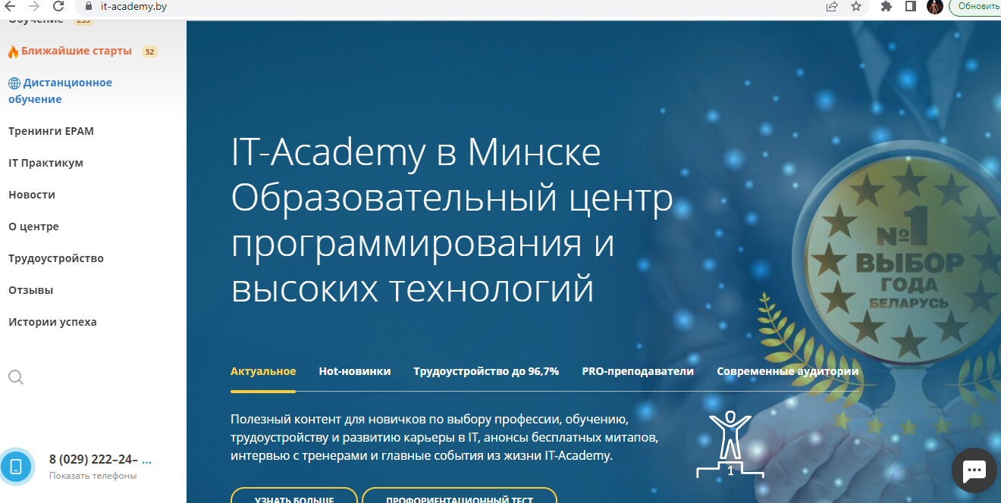
Olga Pavlovich
№ | ID | Some of the bugs found | Severity | Attachments
1 | ST336221-125 | The number of preparatory courses is not displayed. | Medium
2 | ST336221-74 | Sub-menu of the news module disappear from the nav-menu after click [СМИ об IT-Академии]. | Minor
3 | ST336221-75 | The menu is not displayed in full after selecting minsk, scrolled down hovering the mouse over the empty space of the menu, scrolled up. | Major

Slide 13
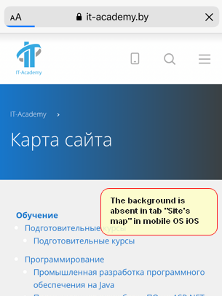
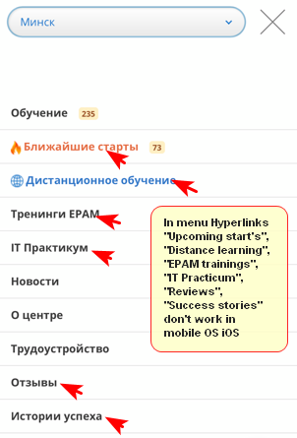
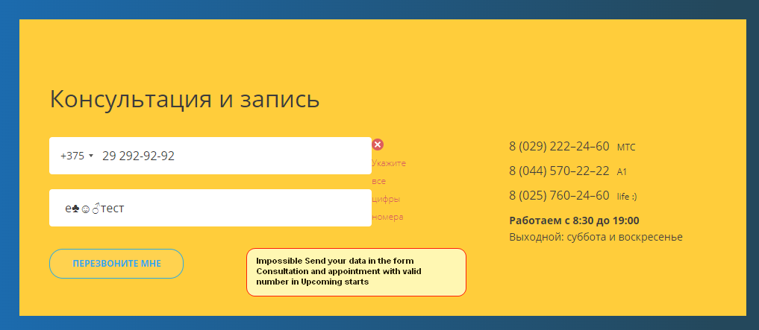
Ekaterina Zakomornaya
№ | ID | Some of the bugs found | Severity | Attachments
4 | ST336221-120 | The background is absent in tab "Site's map" in mobile OS iOS. | Minor
5 | ST336221-112 | In menu Hyperlinks "Upcoming start's", "Distance learning", "EPAM trainings", "IT Practicum", "Reviews", "Success stories" don't work in mobile OS iOS. | Critical
6 | ST336221-58 | Impossible Send your data in the form Consultation and appointment with valid number. | Major

Slide 14
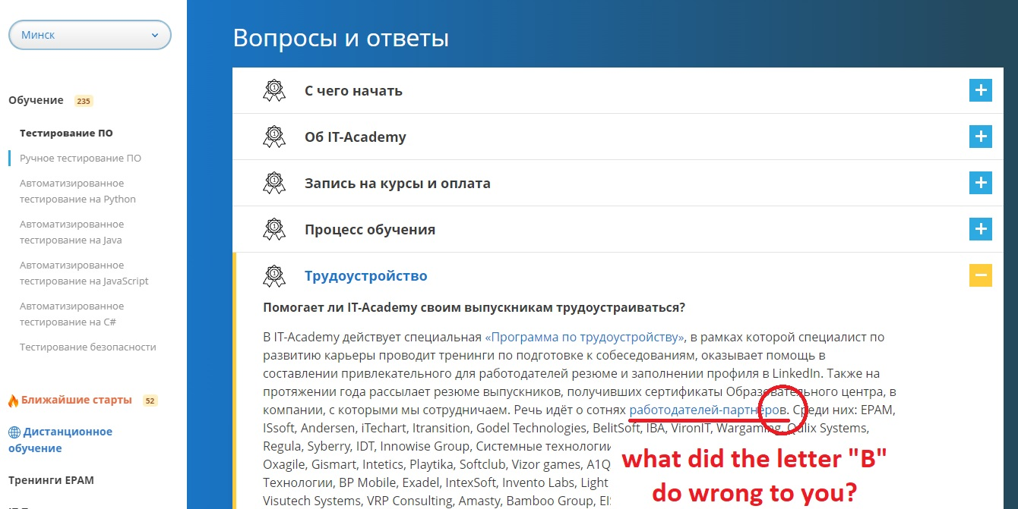
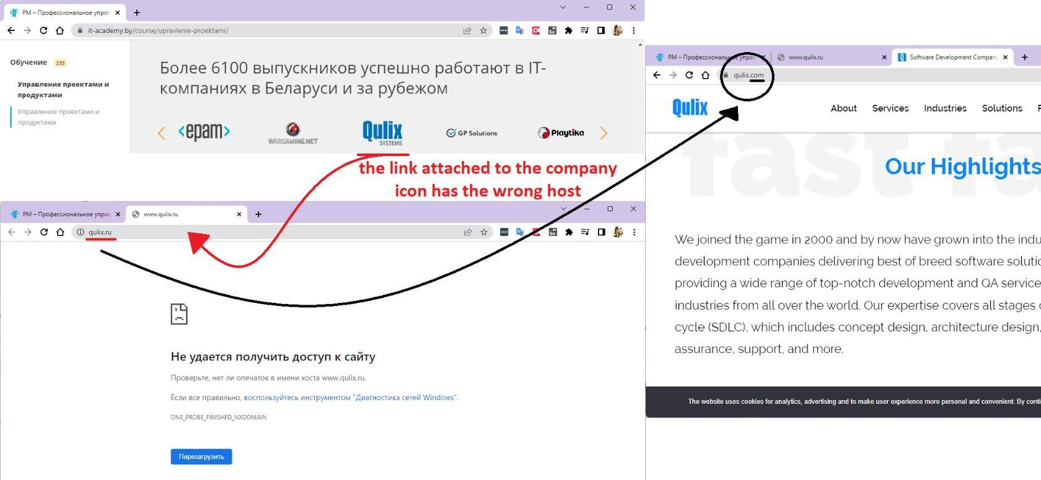
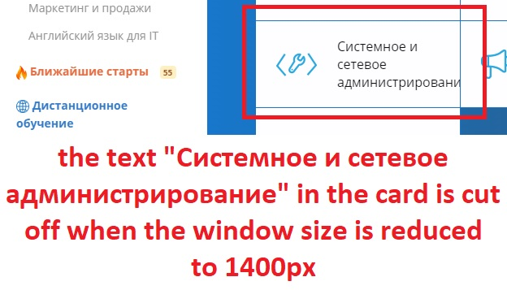
Angelina Bolgar
№ | ID | Some of the bugs found | Severity | Attachments
7 | ST336221-81 | Name link does not match its logic 'работодателей-партнеров' page 'manual testing'. In the inscription "работодателей-партнеров" the letter "в" is not included in the hyperlink. | Minor
8 | ST336221-85 | Link to a wrong name company. The link attached to the “Qulix” company icon has the wrong host. | Minor
9 | ST336221-105 | The text "Системное и сетевое администрирование" in the card is cut off when the window size is reduced to 1400px. | Minor

Slide 15
Conclusion
Test Status: Red in connection with 7 critical bugs
Planned | Actual result
Test Run must be completed 100% | Test Run was completed 100%
Determine how many test cases are passed in % | % of test cases passed is 75% in Mobile OS and 96% in Web browsers
Determine how many blocker and critical bugs | Blocker bugs were not found Critical bugs are 7
Blocker bugs were not found. Bugs with “Critical” severity are 7, that is unacceptable. Most of bugs are “Minor” 39, “Major” 7, "Medium" 11 and this is quite high for the application released into production.
Most bugs are the same for desktop environments under test (Google Chrome, Mozilla Firefox, Safari browsers) and the same for Mobile OS (Android v.12, iOS v.14.8.1 ). More bugs in the mobile than desktop version of the application.

Slide 16
Recommendations
Despite the large number of site modules and the large amount of test verification, the site https://www.it-academy.by/ has been tested to improve its quality.
We recommend paying attention to the functionality and usability mobile version www.it-academy.by associated with:
broken links on the main pop-up menu
problem with slow loading on some pages
problem with chat in some cities
a filtering problem
a lot of GUI bugs
because it is directly affects course sales.

Slide 17

Do you have any question for us?
Let's discuss them!

