Slide 1
Information Retrieval CW3
Search Engine Implementation

Slide 2
BACKGROUND
Aim
A large amount of clinical trials do not meet their requirement criteria for patient uptakes due to the lengthy unstructured documents and large amount of time it takes for researchers to review trials physically. Therefore, this project establishes a search engine that utilises a patient-to-trial paradigm to retrieve relevant trials given a patient profile.
Dataset
The project utilised the Clinical Trials 2021 TREC:
Database: ClinicalTrials 2021 part 1 - NCT0075 to NCT0099 (16k clinical trials)
Query: Patient profiles given in the ClinicalTrials 2021 (75 patient profiles)
Relevance: The Qrels2021 document (35k ground truths for various files)

Slide 3
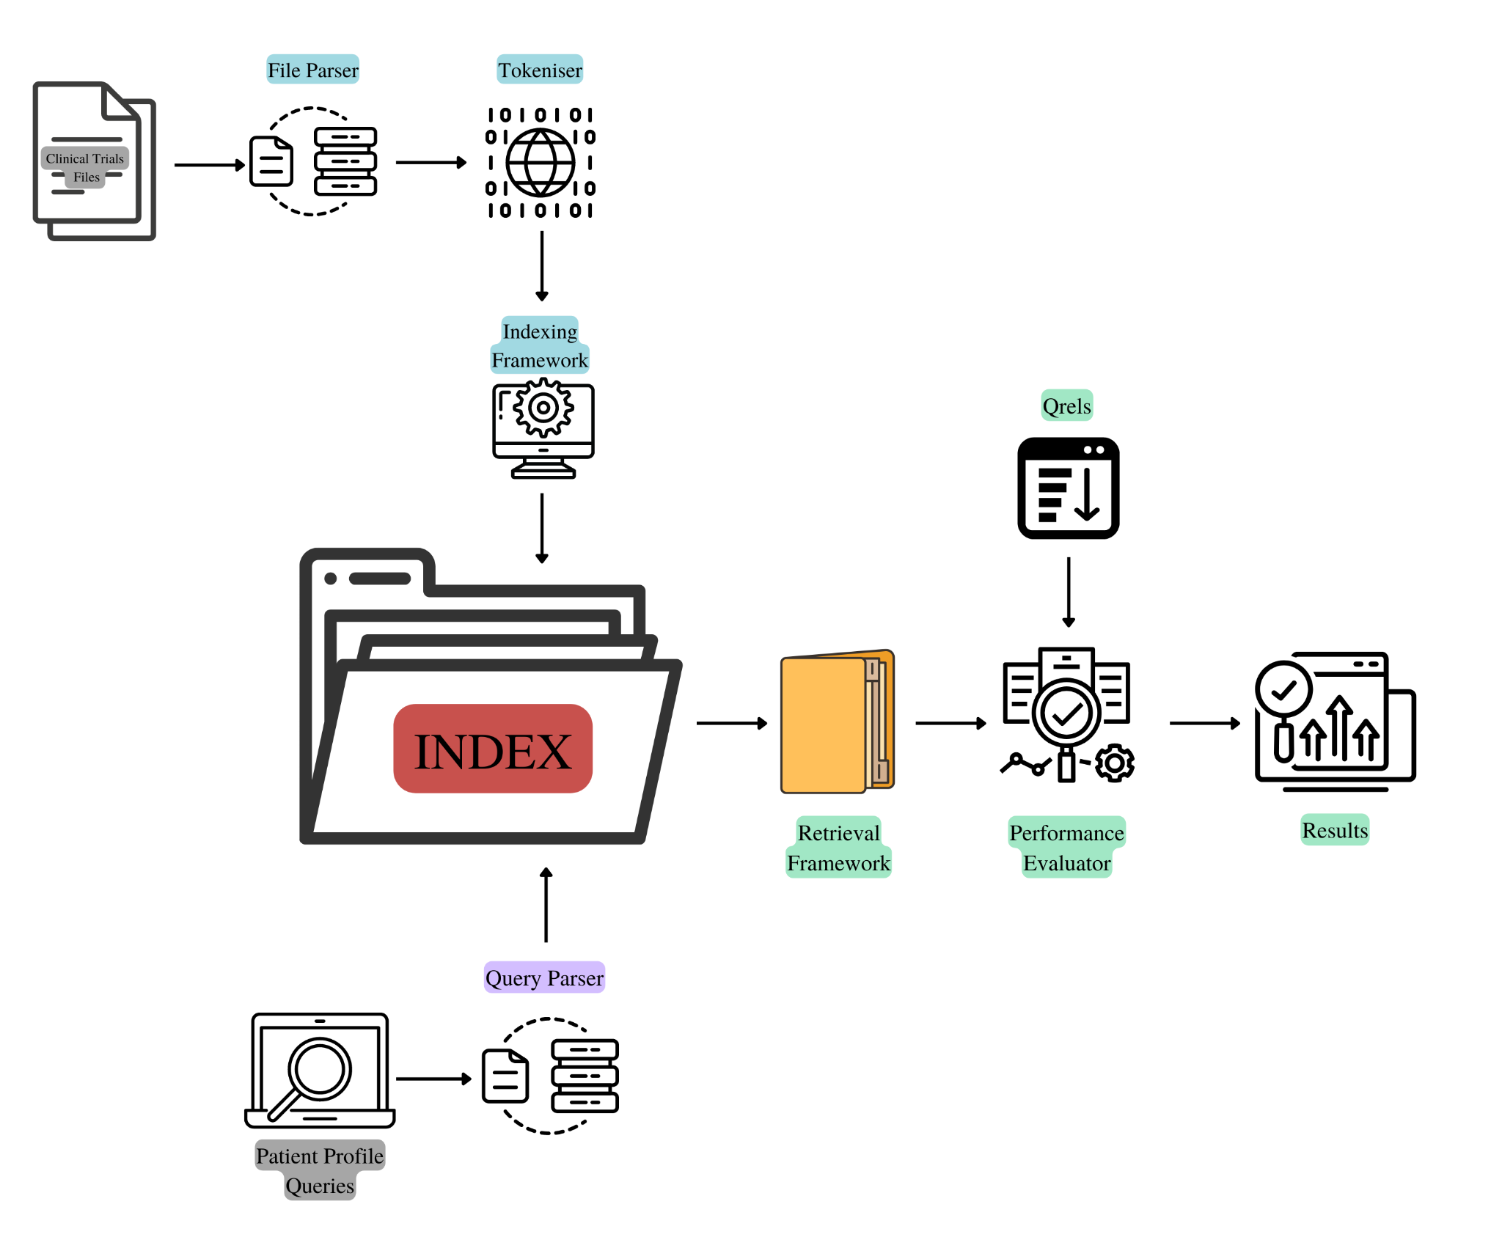
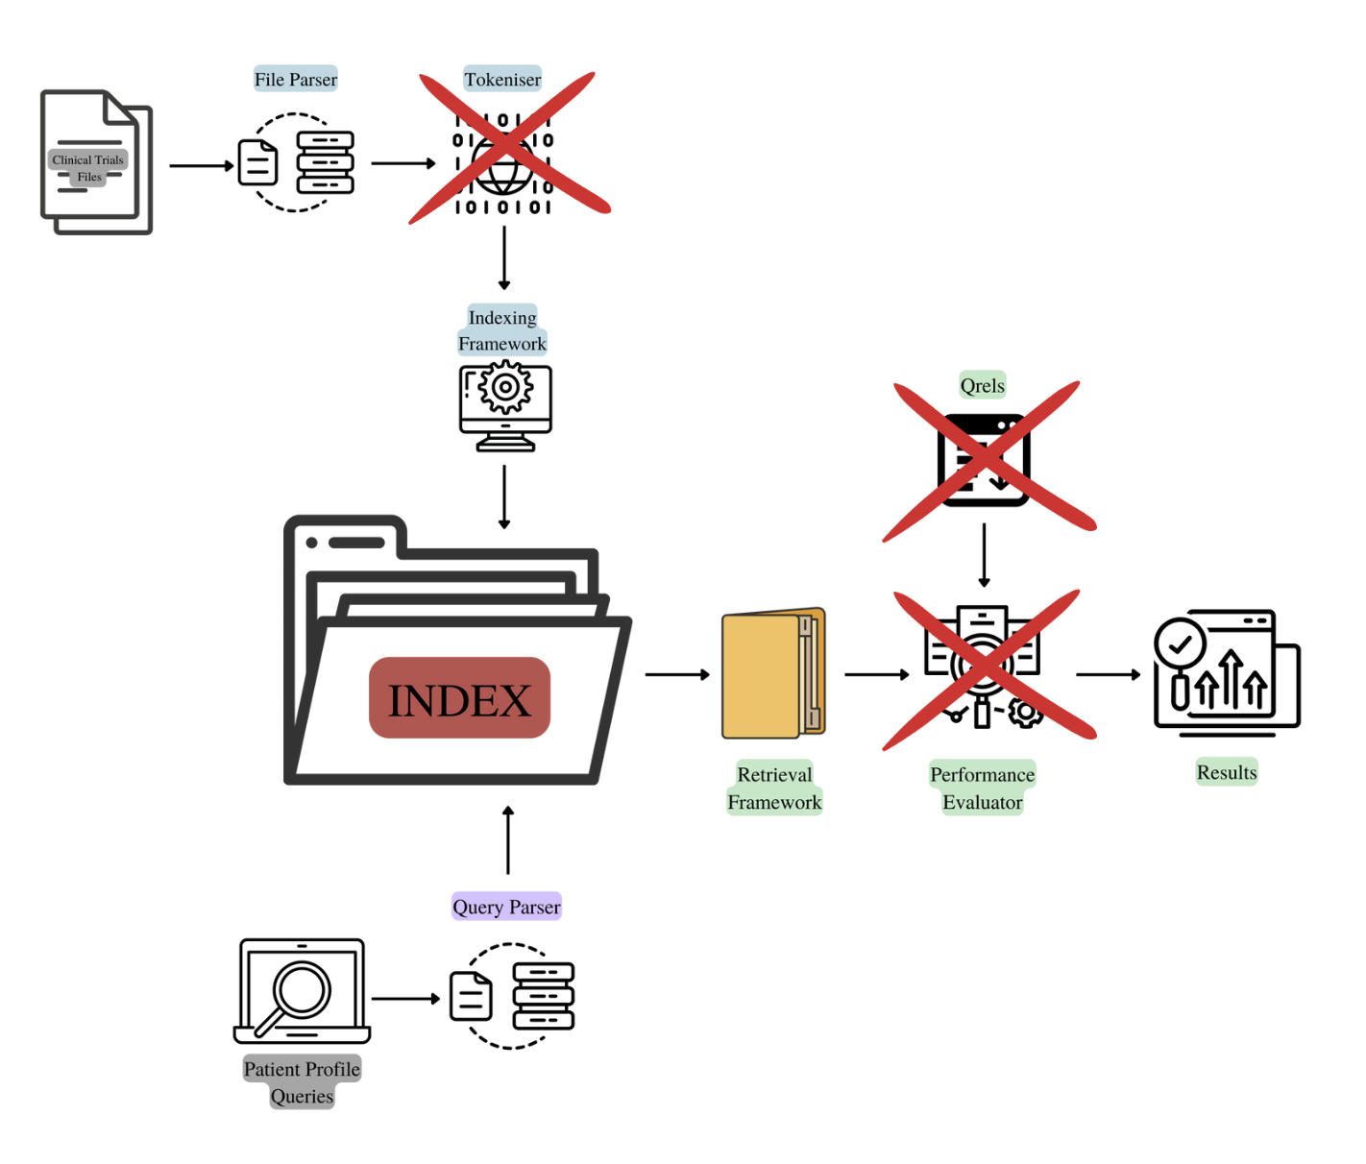
MODIFICATIONS OF PROPOSED PLAN
No tokenization of files - ElasticSearch automatically tokenizes the database
Relevance and Performance Evaluation was conducted after results were gathered

Slide 4
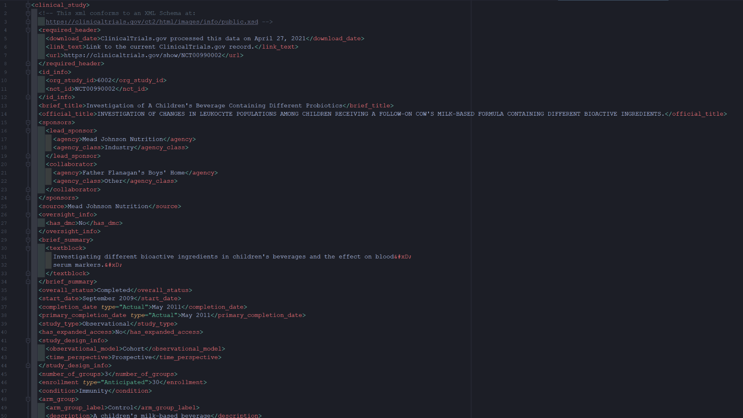
HTML FILES
Relevant Fields
Title
ID
Brief
Description
Gender
Healthy
Minage
Maxage
Condition
Intervention
Criteria

Slide 5
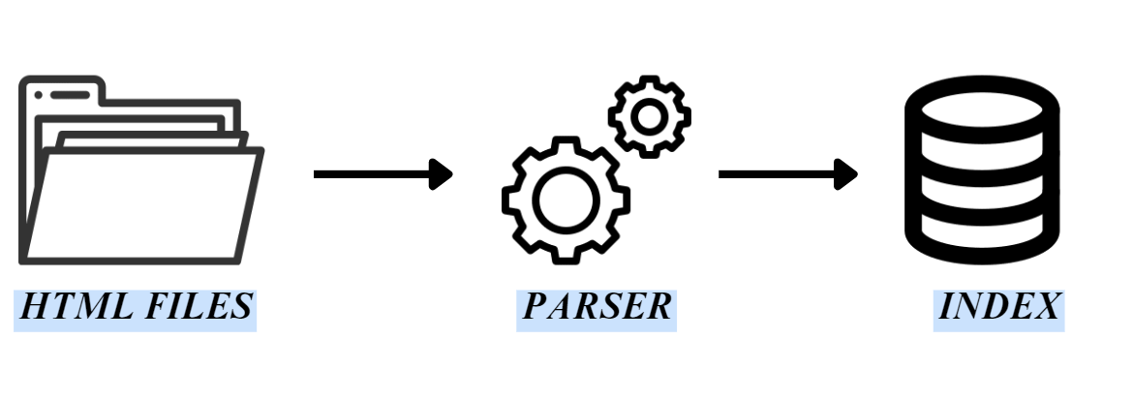
DATABASE
Database Preprocessing
Beautiful Soup and Regex were used to create a function that was able to parse through all the folders and extract these features: title, id, brief, description, gender, healthy, minage, maxage, condition, intervention, and criteria.
The features were combined as tuples and stored in a list resulting in > 16k items
The list was stored in a CSV file which is the basis for the final search engine index - it is uploaded as a dataframe and parsed as a list of tuples for ElasticSearch

Slide 6
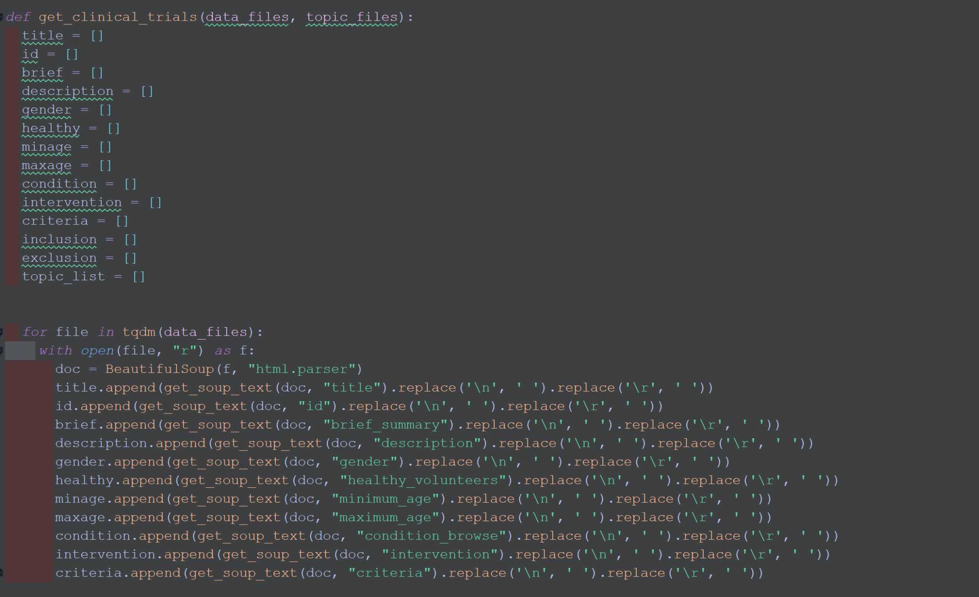
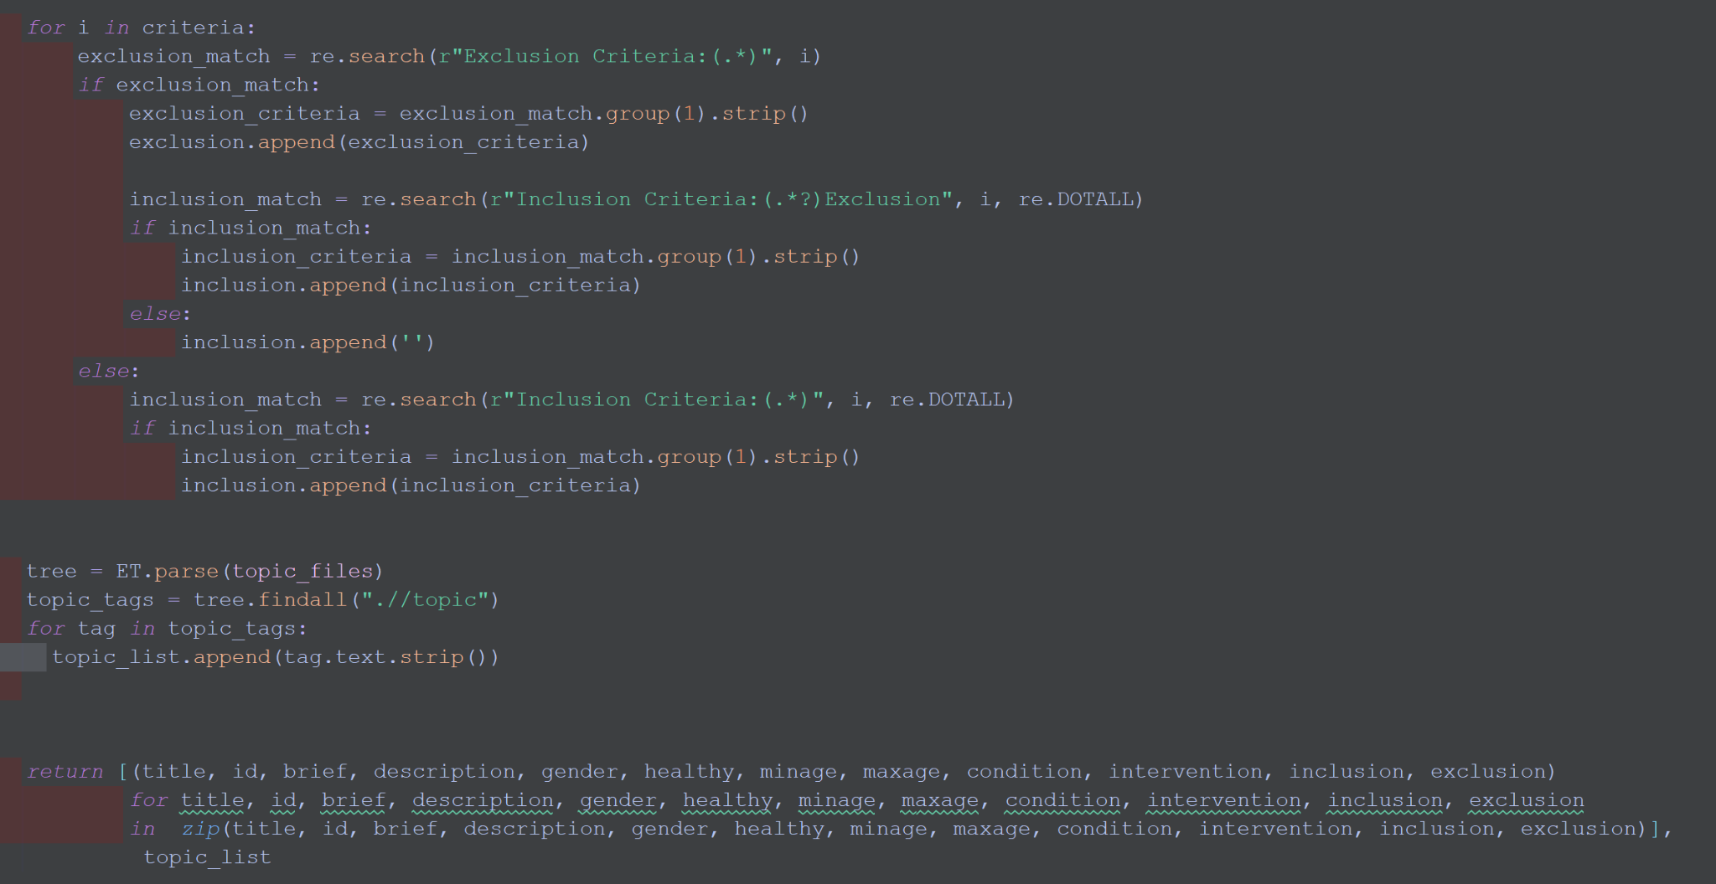
DATABASE PARSER
This original parser will not be included in the final submission

Slide 7
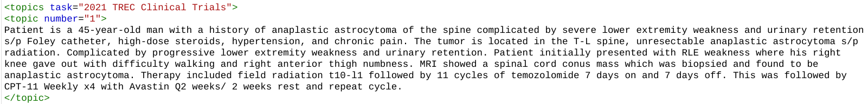
QUERIES
Features:
Verbose
Intended to emulate doctor notes
Complex terminology
Include treatment outline

Slide 8
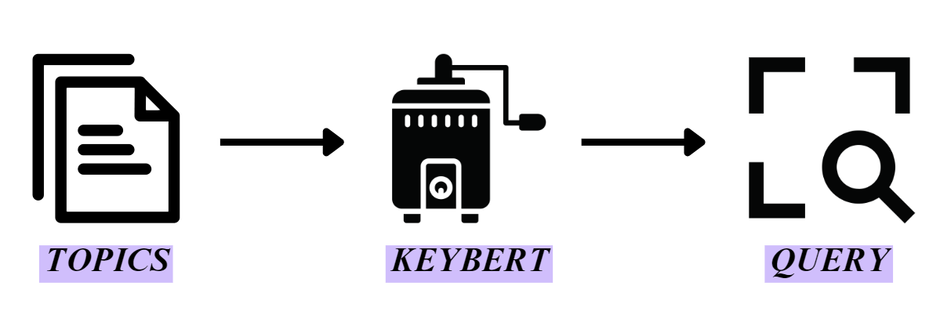
QUERIES
Query Preprocessing
The topic file is parsed with a function that transforms it into a list of topics
A random topic can be chosen using random.choice or a custom topic can be chosen to go through KeyBERT which will extract the most important keywords as specified
These keywords will act as the query for ElasticSearch

Slide 9
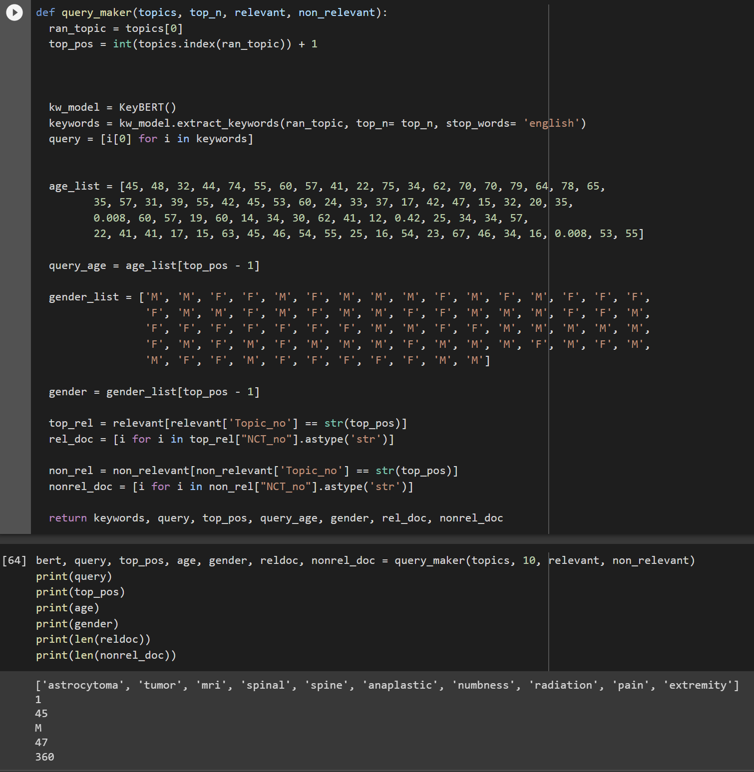
QUERY EXAMPLE
Input Parameters
Topics
Number of keywords retrieved
Relevance/Non-Relevance Dataframe
Output
Keywords
Topic number
Age of patient query (mapped)
Gender of patient query (mapped)
Reldoc/Nonrel_doc

Slide 10
QUERY EXAMPLE: CONTROL
“Control” condition uses the entire query rather than keywords
Offers comparison for performance of keyword search vs verbose query
Topics undergo following processes:
Tokenization: sentences are split into words
Stopword removal: removing words which appear commonly across the corpus. Standard english stopword dictionary is used from the nltk toolkit
Lemmatization: each word is broken into its root meaning to identify similarities
E.g. “changing”, “changes”, “changed” are all lemmatized to “change”

Slide 11
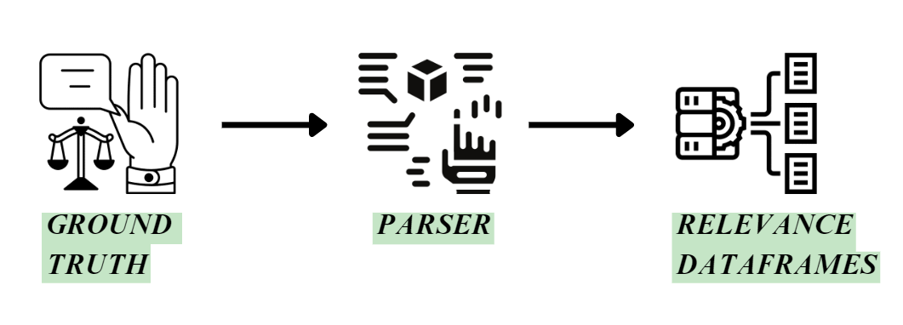
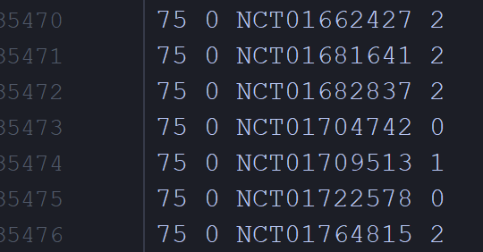
RELEVANCE
Ground Truth Processing
The qrels2021 file was saved as a CSV and read into a function that extracts the 35k truths into a dataframe with columns for the various parameters
The parser function accepts a number as a parameter which retrieves a “relevant” dataframe based on the given relevance number, and also an additional “non-relevance” dataframe which is everything that is not the given relevance number

Slide 12
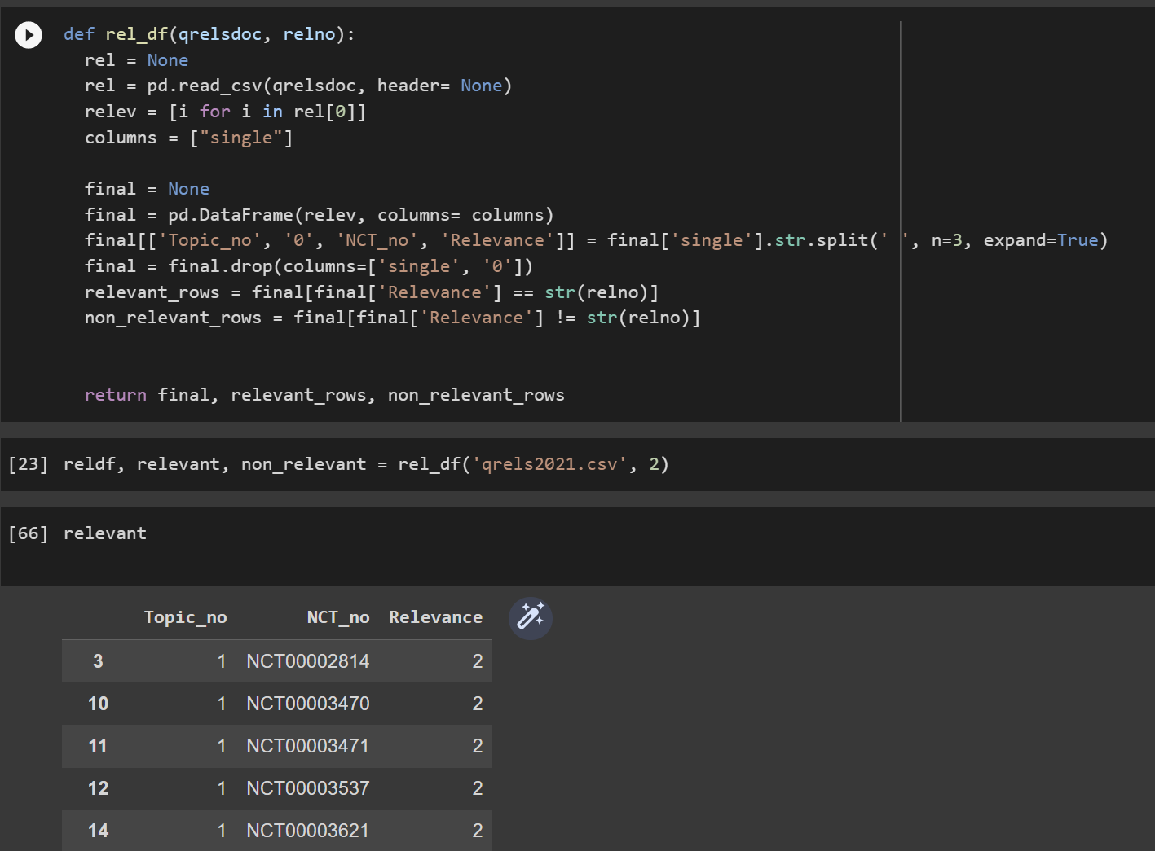
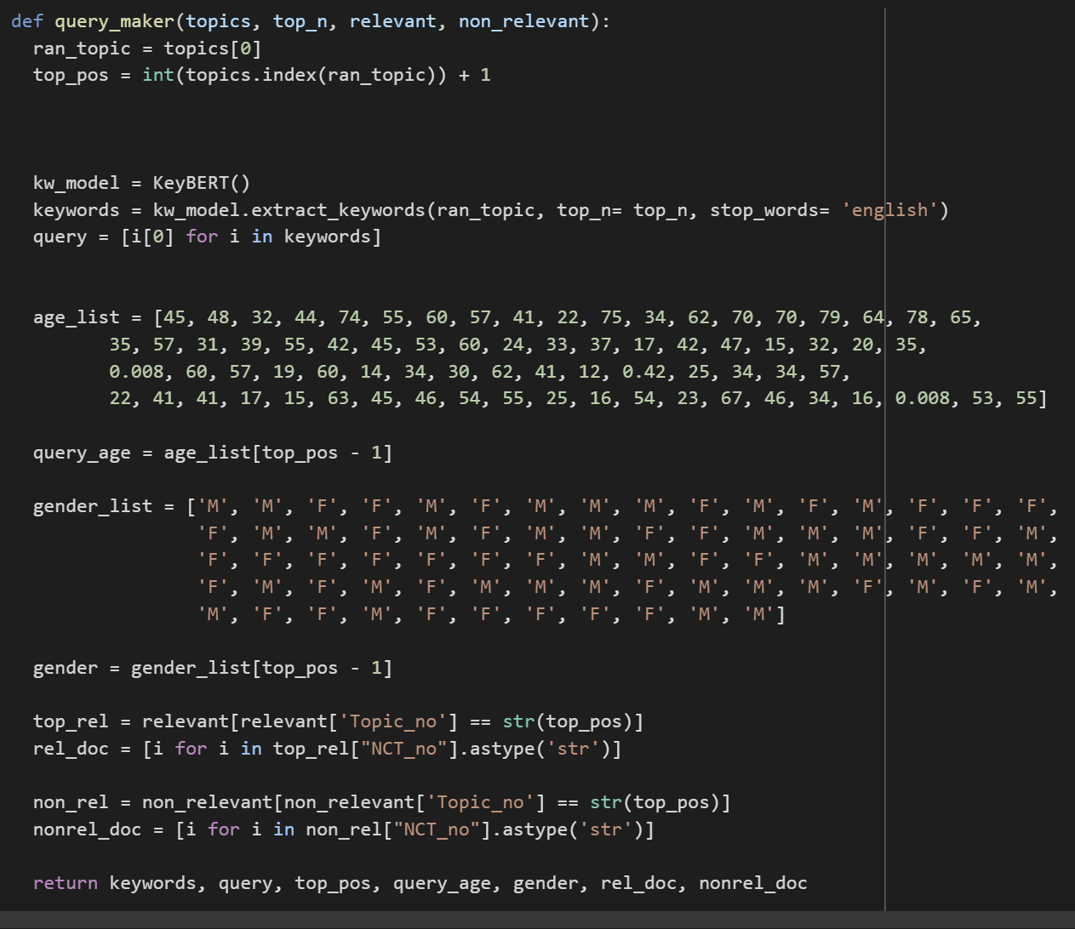
UTILISATION OF RELEVANCE
The relevant/non-relevant dataframes are used to retrieve a list of topic IDs given the specific topic query chosen

Slide 13

BACKGROUND: ELASTICSEARCH
Based on Apache Lucene search engine library
Indexing, searching and querying capabilities
Stores data in JSON object format with chosen field mappings
Indexing a document involves:
Breaking down into individual terms
Adding each term to an inverted index (maps each term to documents that contain this term)
Queries are presented in a JSON query structure which specifies which fields to be searched
Relevance scores are calculated using BM25 algorithm:
Uses term-frequency and inverse document-frequency
k: nonlinear term frequency saturation
b: normalisation of document length
Notes:
ElasticSearch is based on the apache lucene search engine library. It is able to handle indexing document collections, query parsing and searching. It does so by storing data in JSON object format where the user can specify the fields to be mapped. Indexing a document involves breaking it down into individual terms, and adding these terms to an inverted index which maps each term to documents that contain that term. Queries are also defined in a JSON structure where the specified fields map those presented in the index mapping. Elasticsearch will then compare the query to the indexed document collection. To calculate, relevance, Elasticsearch uses the BM25 ranking algorithm.
The BM25 algorithm assigns a weight to each query term based on its importance in the query. This weight is determined by how often the the term appears in the query (the term frequency) as well as how common it is across all documents in the corpus (the inverse document frequency). This gives higher scores to documents that contain more occurrences of important query terms. The BM25 also has two parameters that can be tuned: k and b. The K parameter impacts how much the term frequency component affects the scores, and the b parameters affects how much the document length affects the score.

Slide 14
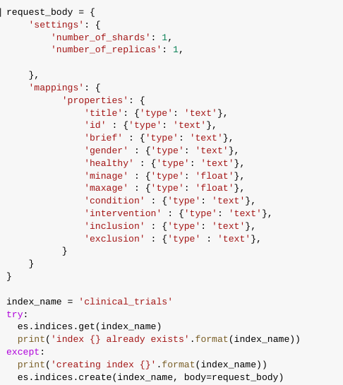
INDEXING DOCUMENT COLLECTION
Index mapping created based on fields defined by document parsing function
Indexed using ElasticSearch
Notes:
The index mapping is created based on fields defined by the document parsing function. The documents are then indexed using ElasticSearch.

Slide 15
EXPERIMENT TOPICS
Topic 1
Demographics: 45 year-old male
History: anaplastic astrocytoma of the spine complicated by severe lower extremity weakness and urinary retention. Complicated by progressive lower extremity weakness and urinary retention.
Presentation: initially presented with RLE weakness where his right knee gave out with difficulty walking and right anterior thigh numbness.
Diagnosis: anaplastic astrocytoma
Topic 49
Demographics: 12 year-old female
Presentation: short stature, delayed in puberty and developmental delay
Diagnosis: Turner syndrome
Additional factors: obese, mentally retarded
Topic 73
Demographics: 3-day-old female
History: born at 34w of gestation
Presentation: yellow sclera and icteric body
Diagnosis: neonatal jaundice
Notes:
The following three topics have been chosen in order to perform a series of experiments to attempt to optimise the evaluation metrics for the search engine. These three topics are patients with a variety of demographics, characteristics and presentations. Especially important are factors like gender and age which form the basis of inclusion and exclusion criteria. The medical history and presentation of each patient may also impact their eligibility for trials.
Topic 1 is a 45 year old male diagnosed with anaplastic astrocytoma
Topic 49 is a 12 year old female diagnosed with turner syndrome with additional factors of obesity and mental retardation
Topic 73 is a 3 day old female with neonatal jaundice.

Slide 16
EXPERIMENT 1
KEYBERT TERM NUMBERS + NUMBER OF HITS

Slide 17
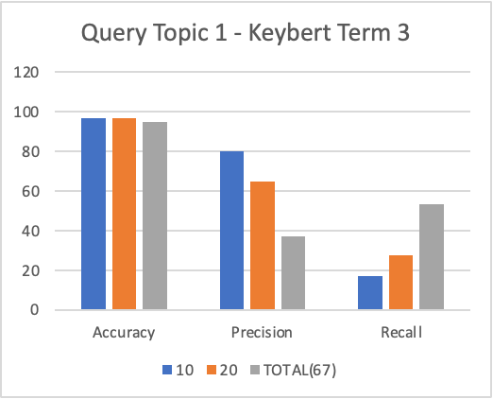
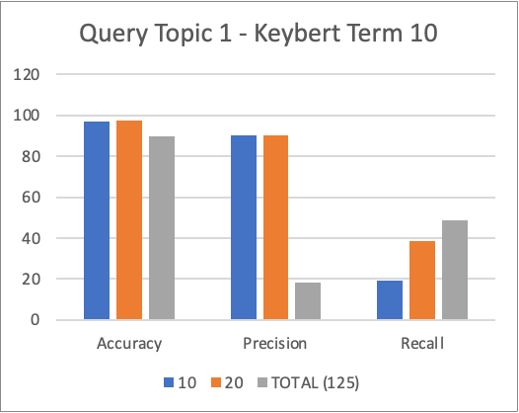
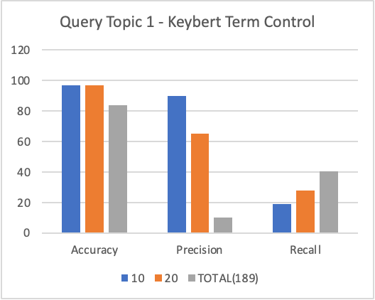
EXPERIMENT 1 RESULTS: TOPIC 1
Notes:
These graphs display the accuracy, precision and recall values for different combinations of KeyBERT terms and top values.
From the data, we can see that generally, increasing the number of keyBERT terms and top values tends to improve the accuracy and precision however the recall may not always increase.
For example, when using 10 keyBERT terms and Top2 results, the accuracy is 97.5% and the precision is 90%, which is higher than when using 3 KeyBERT terms and Top 20 (which gives an accuracy of 96.7%, precision 65%). However when using 10 KeyBERT terms and Top 20, the recall is only 38.3%, which is lower than the recall of 27.7%, when using 3 KeyBERT terms and Top20.
Similarly, when looking at the Top 10 searches, we can see that regardless of the number of KeyBERT terms, the accuracy and precision is generally higher. For example, when using the Control KeyBERT terms we can see that the accuracy and precisions are 96.8% and 90% whereas for top 20 searches it is 96.7% and 65% and for total searches it is 83.9% and 10.1%. However once again the recall does not follow the same pattern.
The reason for this is when we are only looking at the top values, the search algorithm becomes more specific and only retrieves a smaller subset of relevant documents instead of a broader range of potentially relevant documents.
For the purpose of our medical trials, we would prefer a higher precision than recall as we would like a high proportion or relevant documents retrieved by the search engine from all the relevant documents that were retrieved rather than the out of the relevant documents that exist in the collection. Therefore the low recall is not as relevant?

Slide 18
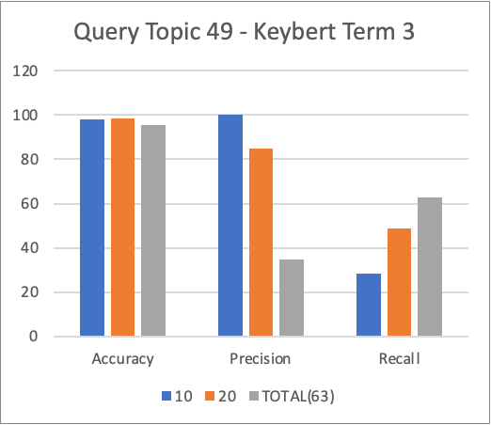
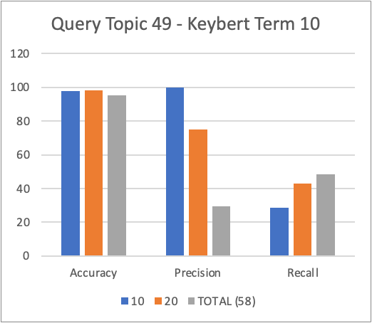
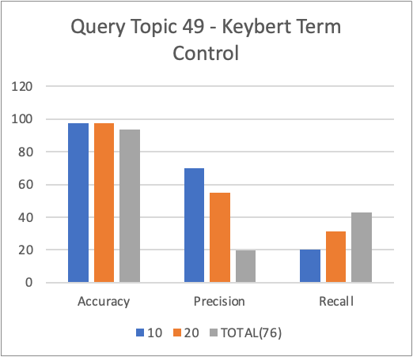
EXPERIMENT 1 RESULTS: TOPIC 49
Notes:
Same as previous slide.

Slide 19
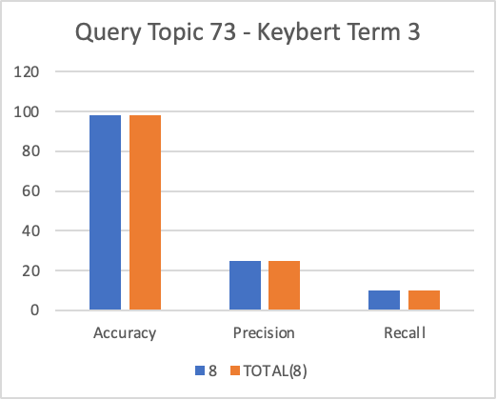
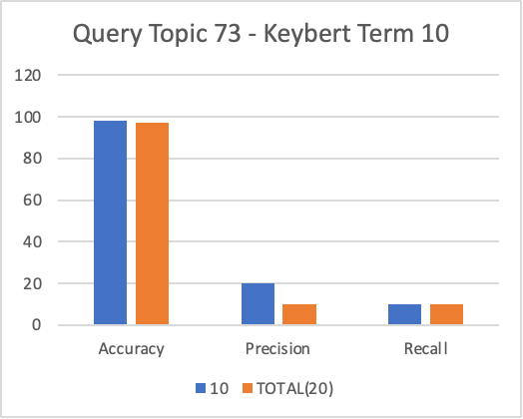
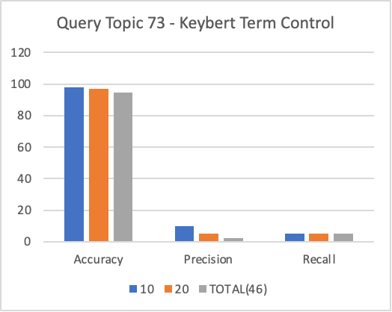
EXPERIMENT 1 RESULTS: TOPIC 73
Notes:
Same as previous slides.

Slide 20
EXPERIMENT 2
QUERY STRUCTURE

Slide 21
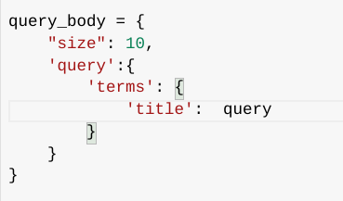
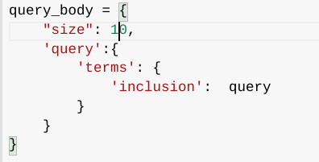
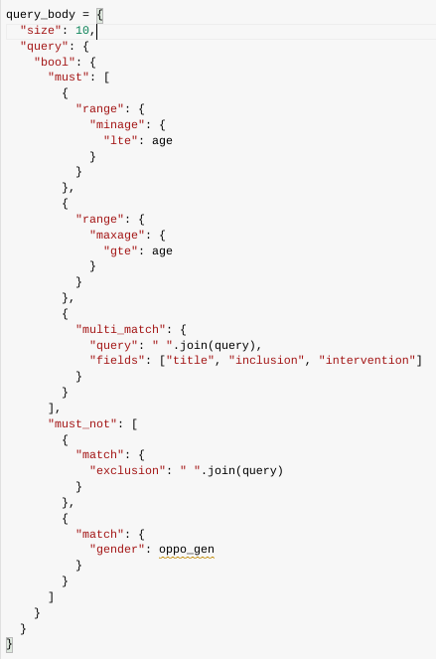
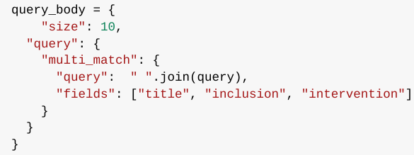
EXPERIMENT 2 - DIFFERENT QUERY STRUCTURES
Structure 1
One field only
Title
Inclusion
Structure 3
Multi-match for multiple fields
Title
Inclusion
Intervention
Must match (boolean):
Range:
Minimum age ⋜ patient age
Maximum age ⋝ patient age
Must not match( boolean)
Exclusion criteria
Opposite gender of patient
Structure 2
Multi-match for multiple fields
Title
Inclusion
Intervention

Slide 22
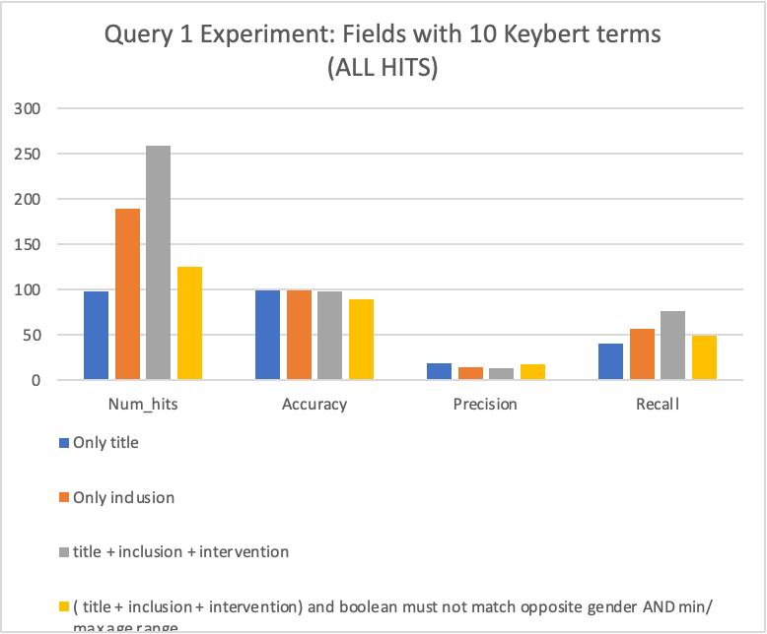
EXPERIMENT 2 RESULTS: ALL HITS
Notes:
This graph presents the results from experimenting with different field types using 10 KeyBERT terms and all number of hits.
We can see that although the title had the highest accuracy of 99.4%, the precision and recall were relatively low compared to the other results. This suggest that while searching for the query topic by the title field may increase the likelihood of retrieving the documents that were correctly classified, it may not be the most efficient approach to retrieving all relevant documents. Therefore, it may be more effective to use a combination of different search fields to retrieve more relevant documents, rather than relying solely on the title field.

Slide 23
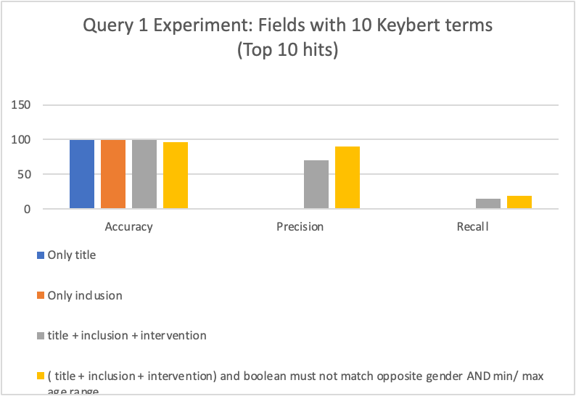
EXPERIMENT 2 RESULTS: TOP 10 HITS
**Precision and Recall are 0 for “only title” and “only inclusion”
Notes:
This next graph presents the results from experimenting with different field types using 10 KeyBERT terms for the top 10 hits
From the results we can see that using only the title or inclusion fields alone result in results which are not very relevant. So similar to the previous experiment we can see that using a single field may not be sufficient in retrieving relevant results. Combining the search criteria from different field is shown here to increase the precision and recall.

Slide 24
EXPERIMENT 3
MINIMUM SCORE THRESHOLD

Slide 25
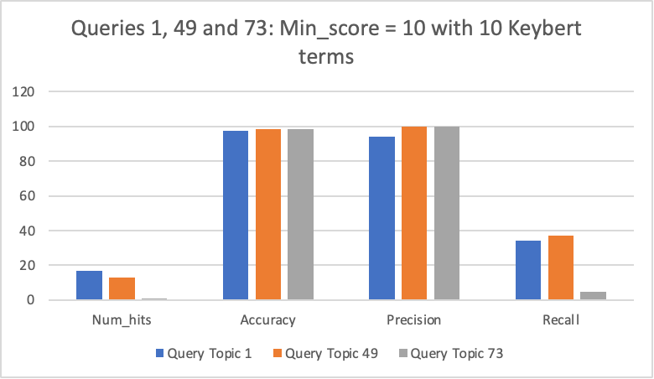
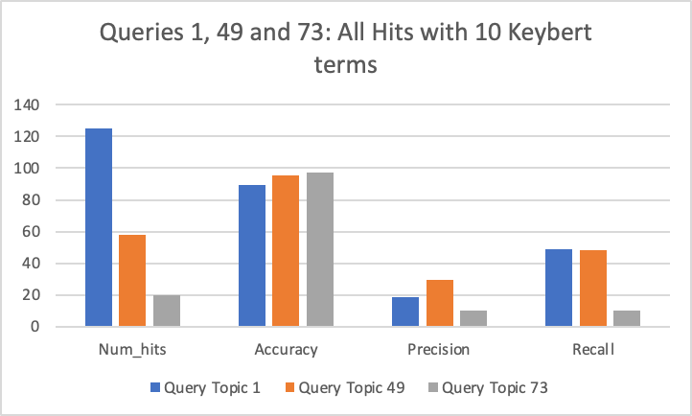
EXPERIMENT 3 - RESULTS
Notes:
ElasticSearch also offers a parameter called min_score which controls the relevance score threshold needed to produce hits. In order to improve precision for the results, a minimum score of 10 was used. We can see that the number of hits produced is significantly reduced, and precision improves drastically for all queries. However, for Query 73, only one relevant document is found, resulting in low recall. Overall, high precision should be paramount to avoid false positives where patients are put forward for trials they are not eligible for, making this an important parameter to include.

Slide 26
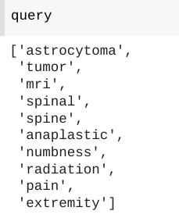
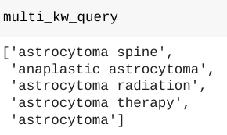
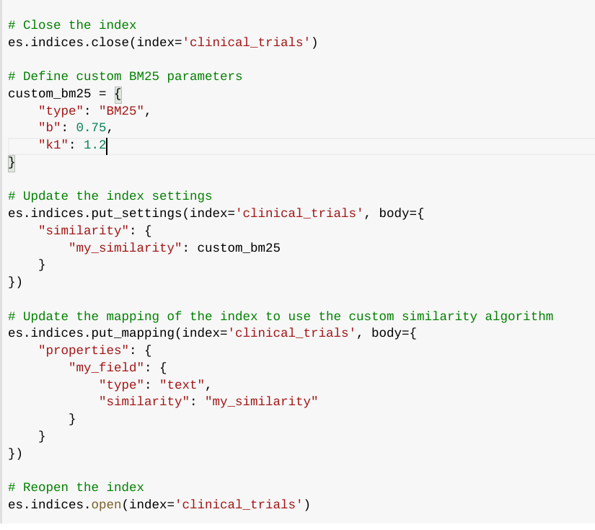
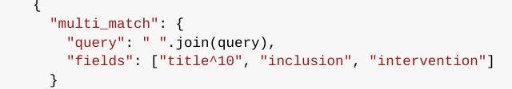

ADDITIONAL EXPERIMENTS
Adjusting k and b parameters
Negligible differences
Kept at default (b = 0.75, k = 1.2)
N-gram keyword extraction [1, 2-gram, 3-gram]
Negligible differences
Boosting fields
Title
Inclusion
Exclusion
Harmed recall
Notes:
Additional experiments were carried including adjusting the k and b parameters, extracting multiple word keywords and boosting field weights. These had negligible impact on evaluation metrics, and boosting fields such as the title or inclusion criteria harmed recall.

Slide 27
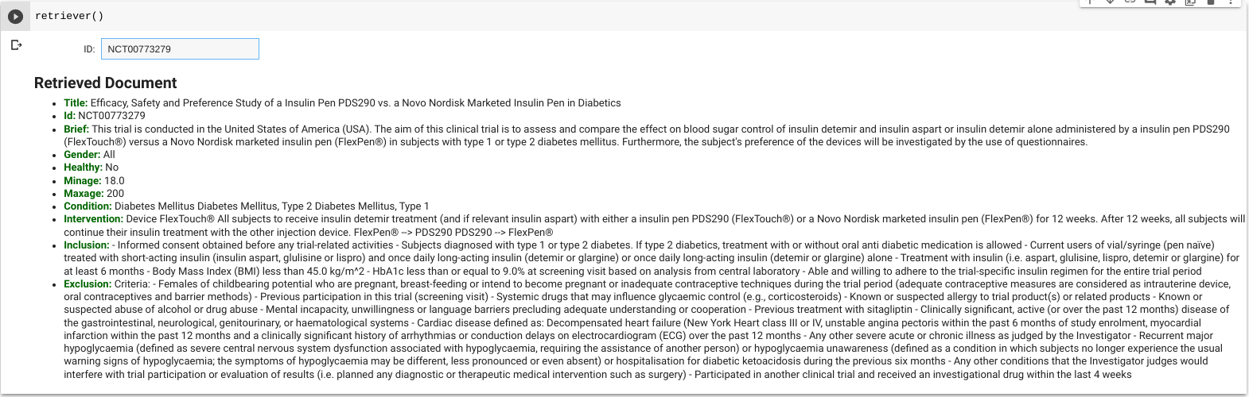
USER INTERFACE
Users can enter ID number from a retrieved document to access more information about the topic
Useful for medical professionals who want to validate patient’s suitability for trial

Slide 28
LIMITATIONS
Missing ground truth for many documents and resulting limited sample size
Limited computational power for parsing entire document collection
Potential loss of semantic meaning in search queries e.g. negatives “pregnant” vs “not pregnant”
Inconsistency of document fields e.g. lack of inclusion/ exclusion criteria for some trials
Need for “minimum threshold” of relevance to produce hits with high precision
Need for domain experts to validate search results

