Slide 1
Exponentiable Virtual Double Categories
1
By: Ea E T (they/she)¹
(joint work with Kevin Carlson²)
¹Department of Mathematics
University of Illinois Urbana-Champaign
²Topos Institute
2025 Category Theory Octoberfest

Slide 2
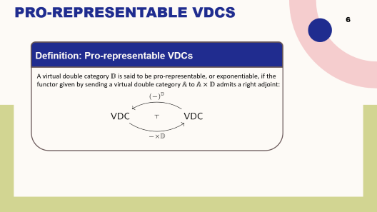
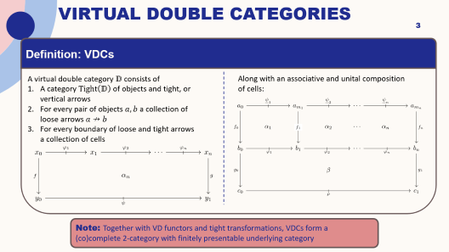
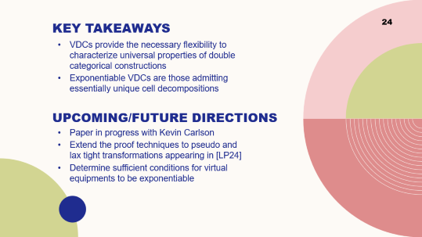
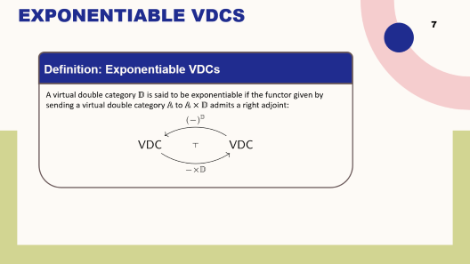
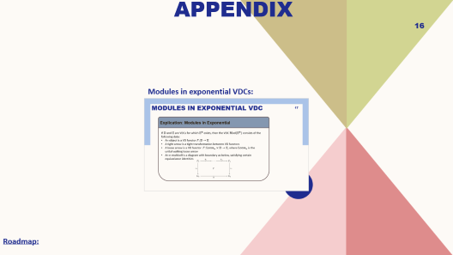

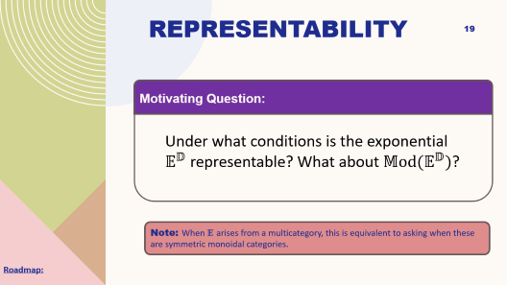
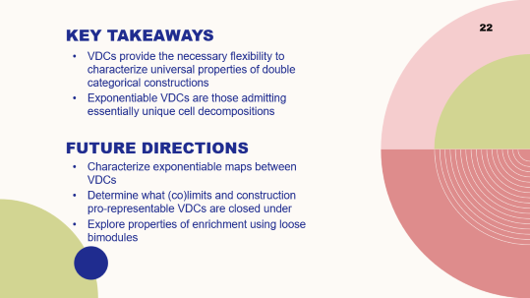
Roadmap
Intro to VDCs:
Representability:
Exponentiability:
Conclusions and Future Work:

Slide 3
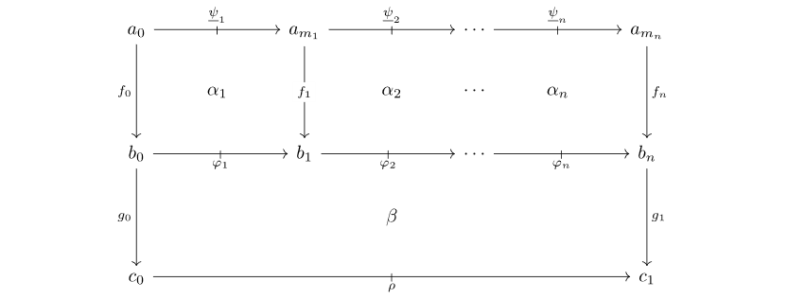
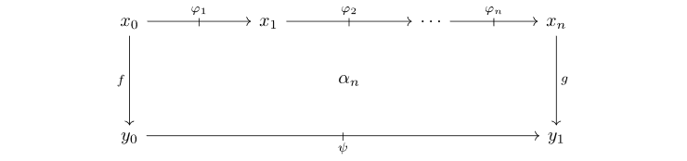
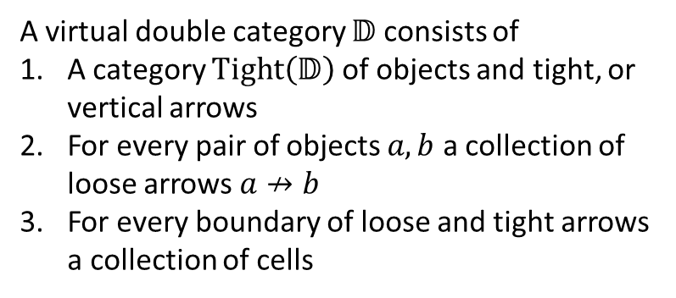
Virtual Double Categories
Definition: VDCs
A virtual double category $𝔻$ consists of
A category $Tight\left(𝔻\right)$ of objects and tight, or vertical arrows
For every pair of objects $a,b$ a collection of loose arrows $a↛b$
For every boundary of loose and tight arrows a collection of cells
Along with an associative and unital composition of cells:
Note: Together with VD functors and tight transformations, VDCs form a (co)complete 2-category with finitely presentable underlying category

Slide 4


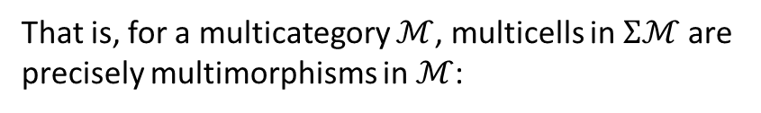
Multicategories as VDCs
Example: Multicategories as VDCs
Multicategories embed fully-faithfully into VDCs:
That is, for a multicategory $ℳ$, multicells in $Σℳ$ are precisely multimorphisms in $ℳ$:
as the VDCs with trivial underlying tight category.

Slide 5


Pseudo vs. Virtual Constructions
5
(Pseudo-)Double Categories:
Virtual Double Categories:
If $ℰ$ is a category with pushouts, we have a double category $ℂ$ospan$(ℰ)$
If $(𝒱,⊗,I)$ is a monoidal category with finite coproducts that are preserved by $⊗$, then we have a double category $𝒱𝕄$at
If $𝔻$ is a double category with local reflexive co-equalizers, we have a double category $𝕄$od$(𝔻)$ of modules in $𝔻$
For any category $ℰ$, we have a virtual double category $ℂ$ospan$(ℰ)$
For any virtual double category $𝔻$ we have a virtual double category $𝔻𝕄$at
For any virtual double category $𝔻$, we have a unital virtual double category $𝕄$od$(𝔻)$ of modules in $𝔻$

Slide 6

Universality of Virtual Constructions
6
Universality of Constructions on Virtual Double Categories:
For any category $ℰ$, the virtual double category $ℂ$ospan$\left(ℰ\right)$ is the free virtual equipment on $ℰ$ [DPP10]
For any virtual double category $𝔻$ the virtual double category$𝔻𝕄$at is the free coproduct completion of $𝔻$ [Ark25]
For any virtual double category $𝔻$, $𝕄$od$(𝔻)$ is the cofree normal completion of $𝔻$ [CS10]
For any virtual double category $𝔻$, $𝔻ℙrof=𝕄$od$(𝔻𝕄$at$)$ is the free collage cocompletion of $𝔻$ [Ark25]

Slide 7

Exponentiable VDCs
7
Definition: Exponentiable VDCs
A virtual double category $𝔻$ is said to be exponentiable if the functor given by sending a virtual double category $𝔸$ to $𝔸×𝔻$ admits a right adjoint:

Slide 8
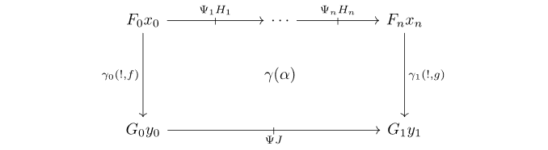
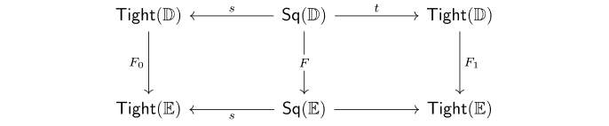
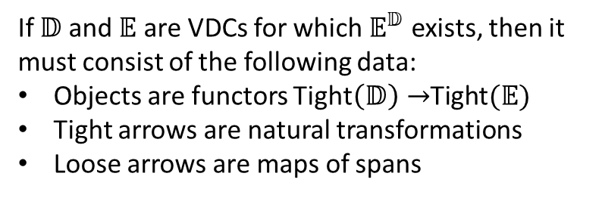
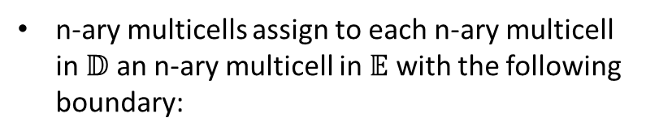
Exponentials
Explication: Exponential
If $𝔻$ and $𝔼$ are VDCs for which $𝔼^{𝔻}$ exists, then it must consist of the following data:
Objects are functors Tight$\left(𝔻\right)→$Tight$(𝔼)$
Tight arrows are natural transformations
Loose arrows are maps of spans
n-ary multicells assign to each n-ary multicell in $𝔻$ an n-ary multicell in $𝔼$ with the following boundary:
… (cont. on next slide)

Slide 9
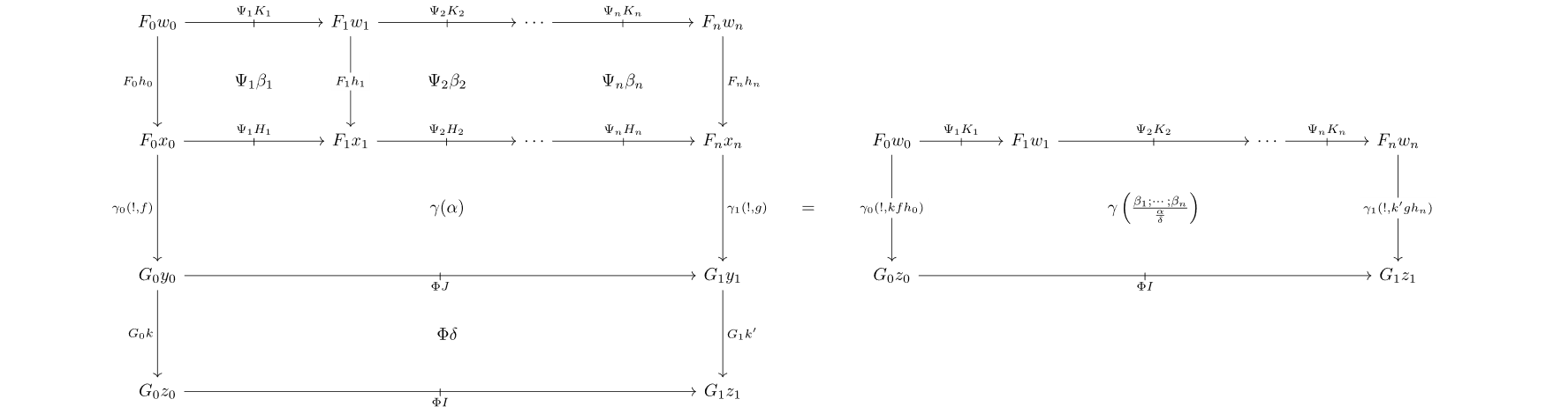
Exponentials
Explication: Exponential (cont.)
The assignment on multicells is subject to functoriality with respect to vertical pasting:

Slide 10
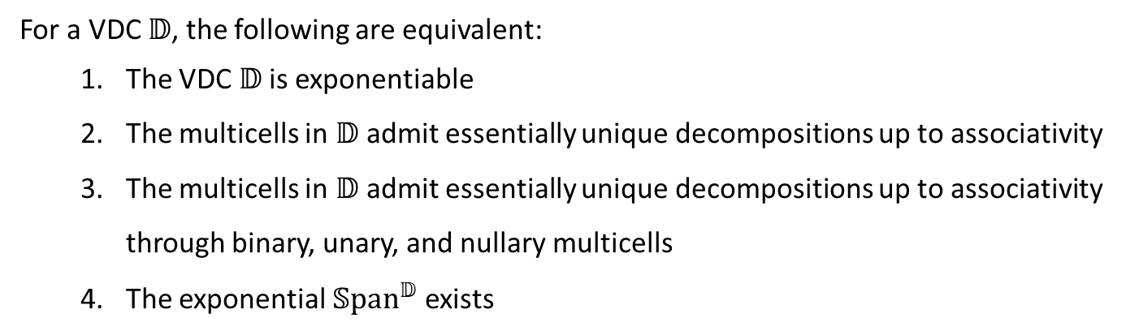
Exponentiable VDCs
Theorem: Characterization of Exponentiable VDCs
For a VDC $𝔻$, the following are equivalent:
The VDC $𝔻$ is exponentiable
The multicells in $𝔻$ admit essentially unique decompositions up to associativity
The multicells in $𝔻$ admit essentially unique decompositions up to associativity through binary, unary, and nullary multicells
The exponential $𝕊\text{pa}{\text{n}}^{𝔻}$ exists

Slide 11
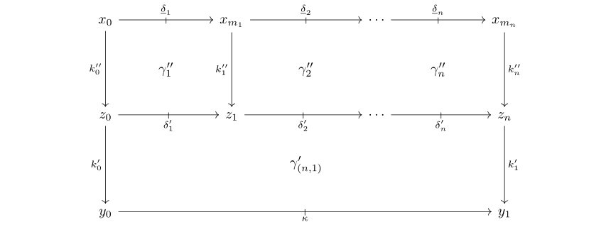
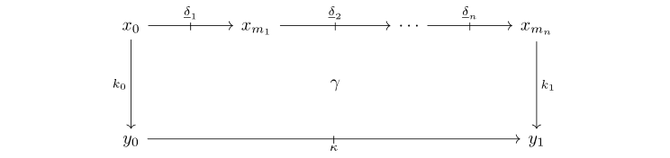

Exponentiable VDCs
Explication: Characterization of Pro-representable VDCs
In terms of pasting diagrams, condition (2) says that a VDC $𝔻$ is exponentiable precisely when for any $N≥0$ and any partition $0≤m_{1}≤⋯≤m_{n}=N$, $N$-ary multicells decompose as vertical pastings:
$$=$$
and any two decompositions are equivalent up to associativity of pasting with cells in the center of the decomposition.

Slide 12
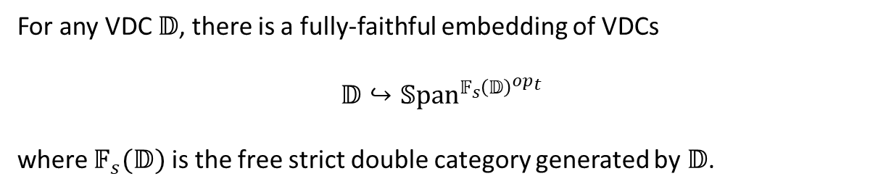
Exponentiable VDCs
Explication: Yoneda Characterization of Exponentiable VDCs
Condition (5) hints at, and follows from, the Yoneda theory of VDCs:
Yoneda Lemma for VDCs
For any VDC $𝔻$, there is a fully-faithful embedding of VDCs
$$𝔻↪𝕊\text{pa}{\text{n}}^{𝔽_{s}{\left(𝔻\right)}^{op_{t}}}$$
where $𝔽_{s}(𝔻)$ is the free strict double category generated by $𝔻$.

Slide 13
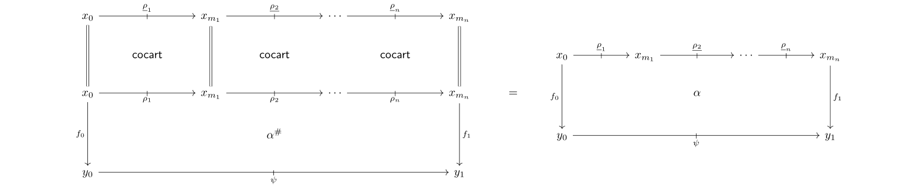

Representable VDCs
Corollary: Representable $⟹$ Exponentiable
Representable VDCs (i.e. pseudo-double categories) are exponentiable.
Proof Idea:
Let $𝔻$ be a representable VDC. Then any cell admits a canonical decomposition

Slide 14
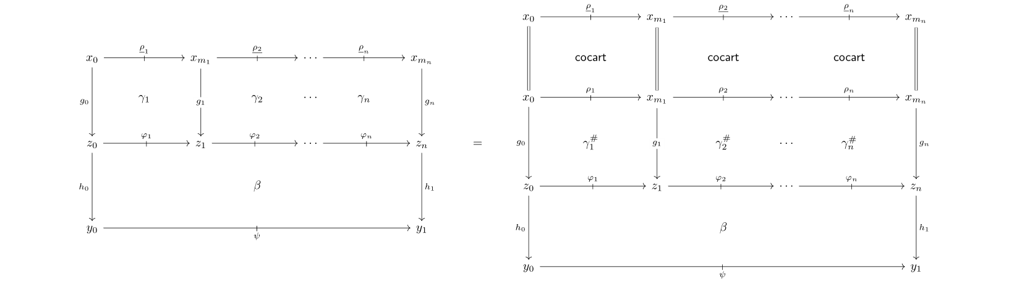
Representable VDCs
Corollary: Representable $⟹$ Exponentiable
Representable VDCs (i.e. pseudo-double categories) are exponentiable.
Proof Idea: (cont.)
Any other decomposition below left can be canonically factored through the composition cells:

Slide 15
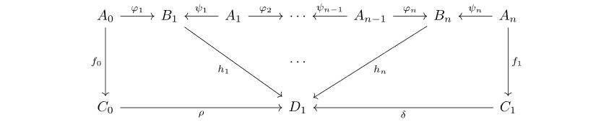
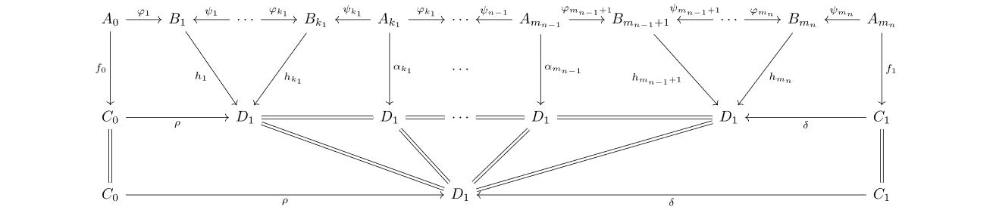

Cospans are Exponentiable
Proposition: Cospan VDCs are Exponentiable
For any category $ℰ$ the VDC $ℂ$ospan$(ℰ)$ is exponentiable, and it is representable if and only if $ℰ$ has finite pushouts.
Proof Idea:
An arbitrary multicell:
admits a canonical decomposition:
for any partition of $n$ (the case where $k_{1},k_{n}≥1$ is shown for simplicity).

Slide 16
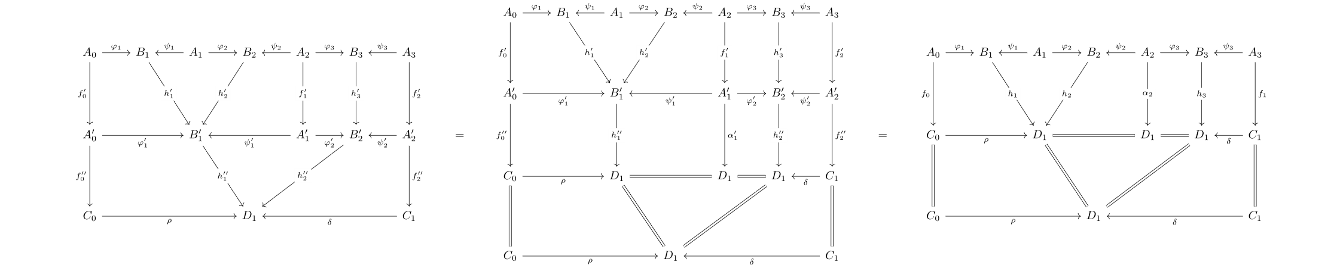
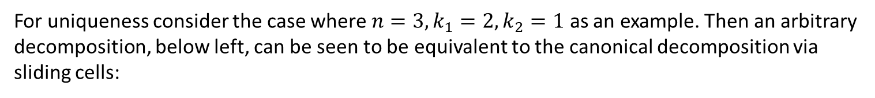
Cospans are exponentiable
For uniqueness consider the case where $n=3,k_{1}=2,k_{2}=1$ as an example. Then an arbitrary decomposition, below left, can be seen to be equivalent to the canonical decomposition via sliding cells:
Proof Idea (cont):

Slide 17
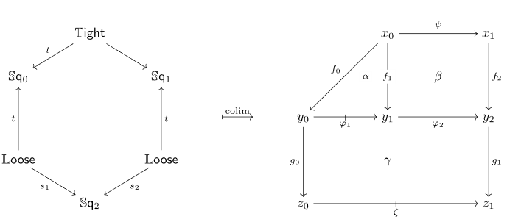
Non-exponentiable VDC
17
Non-example: Non-unital Walking Loose Arrow
The VDC $𝕃$oose consisting of two objects 0 and 1 and a single loose arrow $0↛1$ is not exponentiable. Consider the diagram and colimit $ℂ$ in VDC depicted below:
Then$ℂ×𝕃$oose has two non-identity cells, while the VDC obtained by applying $−×𝕃$oose to the diagram before taking the colimit only has one.

Slide 18

Modules in Exponential VDC
Explication: Modules in Exponential
If $𝔻$ and $𝔼$ are VDCs for which $𝔼^{𝔻}$ exists, then the VDC $𝕄$od$(𝔼^{𝔻})$ consists of the following data:
An object is a virtual double functor $F:𝔻→𝔼$
A tight arrow is a tight transformation between virtual double functors
A loose arrow is a virtual double functor $F:𝕃{oose}_{u}×𝔻→𝔼$, where $𝕃{oose}_{u}$ is the unital walking loose arrow
An n-multicell is a virtual double functor $Γ:𝕊{\text{q}}_{n,u}×𝔻→𝔼$, where $𝕊{\text{q}}_{n,u}$ is the unital walking n-multicell

Slide 19
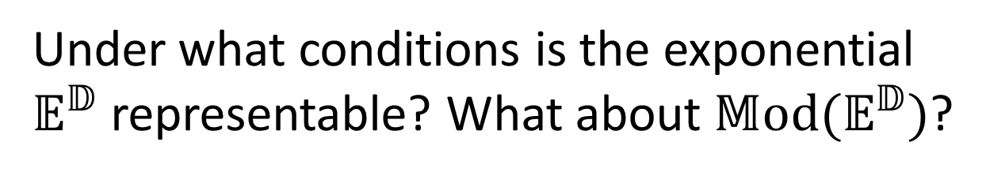
Representability
Motivating Question:
Under what conditions is the exponential $𝔼^{𝔻}$ representable? What about ${𝕄\text{od}(𝔼}^{𝔻})$?
Note: When $𝔼$ arises from a multicategory, this is equivalent to asking when these are symmetric monoidal categories.
Roadmap:

Slide 20
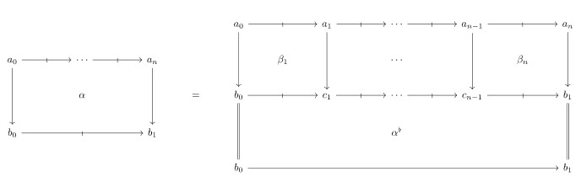

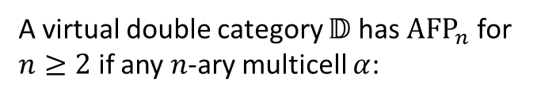
Representability
Definition: AFP Conditions (c.f. [Par13] for pseudo case)
A virtual double category $𝔻$ has ${\text{AFP}}_{n}$ for $n≥2$ if any $n$-ary multicell $α$:
admits a unique up to associativity decomposition through a special $n$-ary multicell
Roadmap:

Slide 21

Representability
21
Example: VDCs Satisfying AFP Conditions
The following VDCs always satisfy the AFP conditions:
The cospan VDC, $ℂ$ospan$(ℰ)$, for any category $ℰ$
The VDC $Σℳ$ associated to an arbitrary multicategory $ℳ$
The VDC $𝕃{\text{oose}}_{u}(ℬ)$ for any bicategory $ℬ$

Slide 22
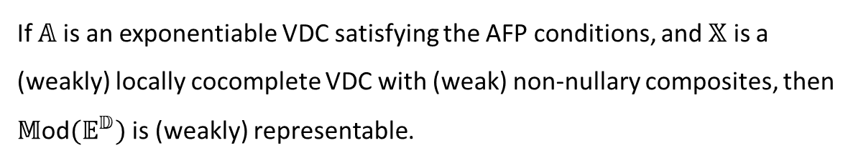
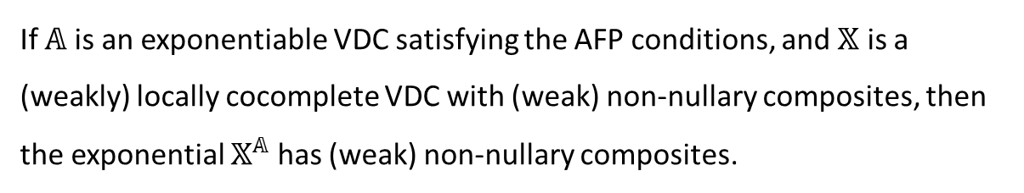

Representability
22
Theorem: Non-nullary composites for Exponentials
If $𝔸$ is an exponentiable VDC satisfying the AFP conditions, and $𝕏$ is a (weakly) locally cocomplete VDC with (weak) non-nullary composites, then the exponential $𝕏^{𝔸}$ has (weak) non-nullary composites.
Corollary: Representability of $𝕄$od$(𝔼^{𝔻})$
If $𝔸$ is an exponentiable VDC satisfying the AFP conditions, and $𝕏$ is a (weakly) locally cocomplete VDC with (weak) non-nullary composites, then $𝕄$od$(𝔼^{𝔻})$ is (weakly) representable.

Slide 23
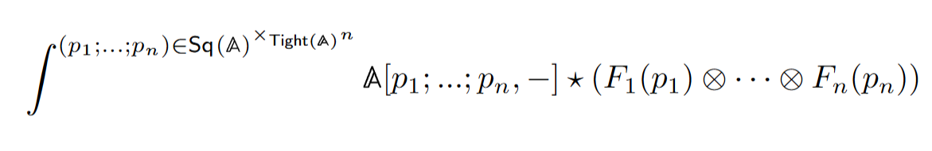
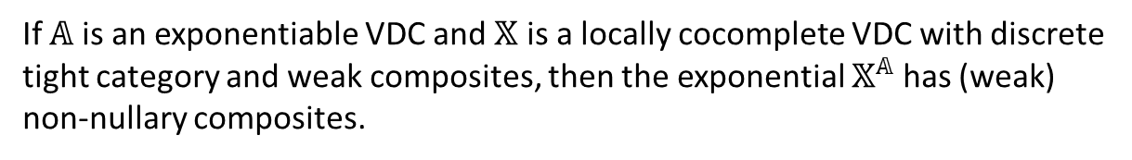
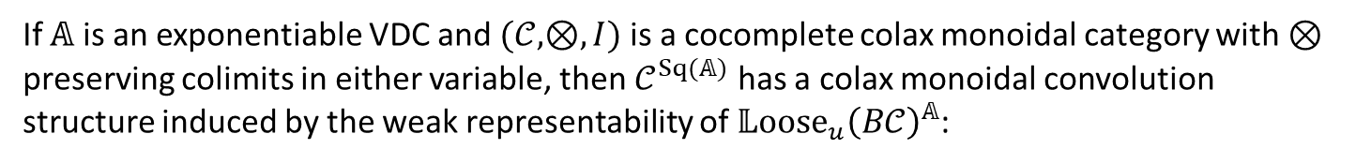
Representability
23
Theorem: (Weak) composites for Exponentials into Tightly Discrete VDCs
If $𝔸$ is an exponentiable VDC and $𝕏$ is a locally cocomplete VDC with discrete tight category and weak composites, then the exponential $𝕏^{𝔸}$ has (weak) non-nullary composites.
Example: Colax Monoidal Convolution Structure
If $𝔸$ is an exponentiable VDC and $(𝒞,⊗,I)$ is a cocomplete colax monoidal category with $⊗$ preserving colimits in either variable, then $𝒞^{Sq(𝔸)}$ has a colax monoidal convolution structure induced by the weak representability of $𝕃{\text{oose}}_{u}{\left(B𝒞\right)}^{𝔸}$:

Slide 24
Key Takeaways
24
VDCs provide the necessary flexibility to characterize universal properties of double categorical constructions
Exponentiable VDCs are those admitting essentially unique cell decompositions
Upcoming/Future Directions
Paper in progress with Kevin Carlson
Extend the proof techniques to pseudo and lax tight transformations appearing in [LP24]
Determine sufficient conditions for virtual equipments to be exponentiable

Slide 25
References
25
[P14] Pisani, C. (2014, February 2). Sequential multicategories. arXiv. https://doi.org/10.48550/arXiv.1402.0253
[CS10] Cruttwell, G. S. H., & Shulman, M. A. (2010, December 8). A unified framework for generalized multicategories. arXiv. https://doi.org/10.48550/arXiv.0907.2460
[LP24] Lambert, M., & Patterson, E. (2024). Cartesian double theories: A double-categorical framework for categorical doctrines. Advances in Mathematics, 444, 109630. https://doi.org/10.1016/j.aim.2024.109630
[FL25] Fujii, S., & Lack, S. (2025, July 7). The familial nature of enrichment over virtual double categories. arXiv. https://doi.org/10.48550/arXiv.2507.05529
[Ark25] Arkor, N. (2025, June 6). Virtual Double Categories: Past, Present, and Future. Séminaire Itinérant de Catégories. Virtual double categories (SIC 2025).pdf
[Par13] Pare, R.: Composition of modules for lax functors. Theory and Applications ofCategories 27(16), 393–444 (2013) 1, 2, 58, 60, 61
[Kaw25] Kawase, Y. (2025, April 26). Double categories of profunctors. arXiv. https://doi.org/10.48550/arXiv.2504.11099
[Kou25] Koudenburg, S. R. (2025, March 3). Augmented virtual double categories. arXiv. https://doi.org/10.48550/arXiv.1910.11189
[Kou24] Koudenburg, S. R. (2024, April 2). Formal category theory in augmented virtual double categories. arXiv. https://doi.org/10.48550/arXiv.2205.04890
[LM25] Libkind, S., & Myers, D. J. (2025, May 28). Towards a double operadic theory of systems. arXiv. https://doi.org/10.48550/arXiv.2505.18329
[DPP10] Dawson, R., Paré, R., & Pronk, D. (2010). The span construction. In: Theory and Applications of Categories 24.13, p. 302-377.

