Slide 1
Pro-representable Virtual Double Categories
1
By: Ea E T (they/them)¹
(work with Kevin Carlson and Sophie Libkind)
¹Department of Mathematics
University of Illinois Urbana-Champaign

Slide 2
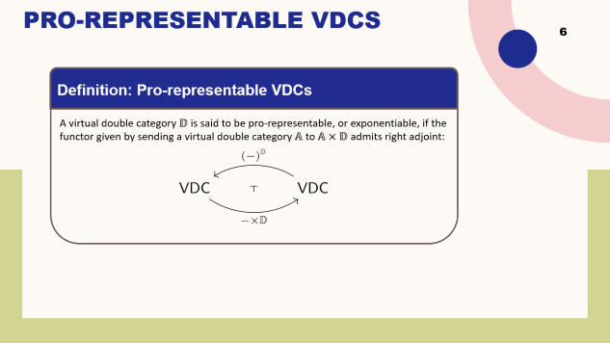
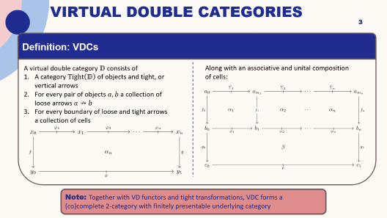
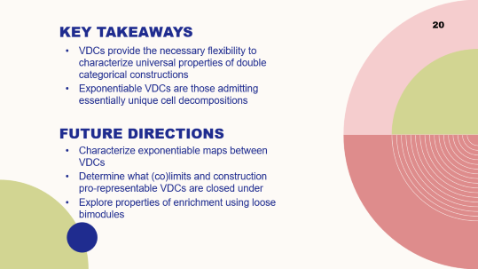

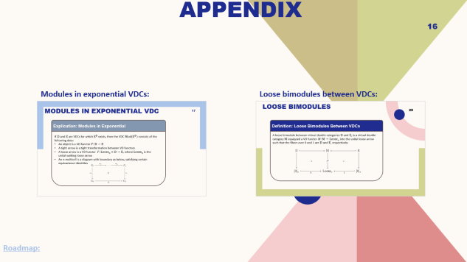

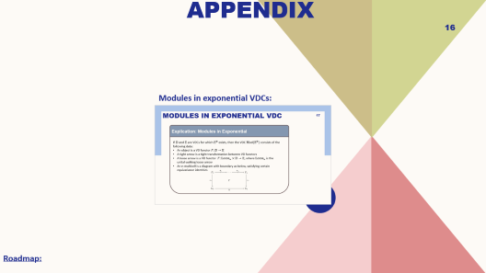

Roadmap
Intro to VDCs:
Appendices:
Pro-representability:
Conclusions and Future Work:

Slide 3
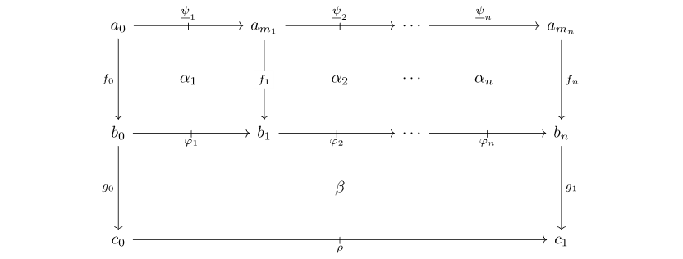
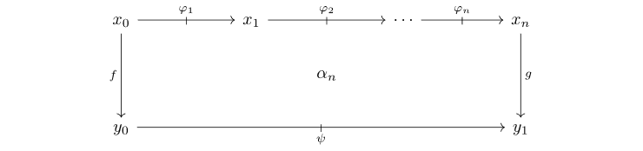
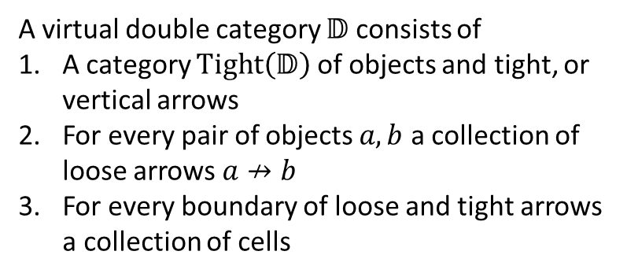
Virtual Double Categories
Definition: VDCs
A virtual double category $𝔻$ consists of
A category $Tight\left(𝔻\right)$ of objects and tight, or vertical arrows
For every pair of objects $a,b$ a collection of loose arrows $a↛b$
For every boundary of loose and tight arrows a collection of cells
Along with an associative and unital composition of cells:
Note: Together with VD functors and tight transformations, VDC forms a (co)complete 2-category with finitely presentable underlying category

Slide 4


Pseudo vs. Virtual Constructions
4
(Pseudo-)Double Categories:
Virtual Double Categories:
If $ℰ$ is a category with pushouts, we have a double category $ℂ$ospan$(ℰ)$
If $(𝒱,⊗,I)$ is a monoidal category with finite coproducts that are preserved by $⊗$, then we have a double category $𝒱𝕄$at
If $𝔻$ is a double category with certain reflexive co-equalizers, we have a double category $𝕄$od$(𝔻)$ of monoids in $𝔻$
For any category $ℰ$, we have a virtual double category $ℂ$ospan$(ℰ)$
For any virtual double category $𝔻$ we have a virtual double category $𝔻𝕄$at
For any virtual double category $𝔻$, we have a unital virtual double category $𝕄$od$(𝔻)$ of modules in $𝔻$

Slide 5

Universality of Virtual Constructions
5
Universality of Constructions on Virtual Double Categories:
For any category $ℰ$, the virtual double category $ℂ$ospan$\left(ℰ\right)$ is the free virtual equipment on $ℰ$ [DPP10]
For any virtual double category $𝔻$ the virtual double category$𝔻𝕄$at is the free coproduct completion of $𝔻$ [Kaw25]
For any virtual double category $𝔻$, $𝕄$od$(𝔻)$ is the cofree normal completion of $𝔻$ [CS10]
For any virtual double category $𝔻$, $𝔻ℙrof=𝕄$od$(𝔻𝕄$at$)$ is the free collage cocompletion of $𝔻$ [Kaw25]

Slide 6

Pro-representable VDCs
6
Definition: Pro-representable VDCs
A virtual double category $𝔻$ is said to be pro-representable, or exponentiable, if the functor given by sending a virtual double category $𝔸$ to $𝔸×𝔻$ admits a right adjoint:

Slide 7
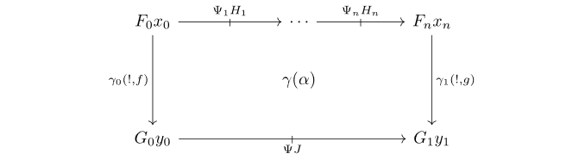
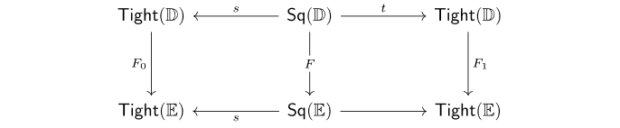
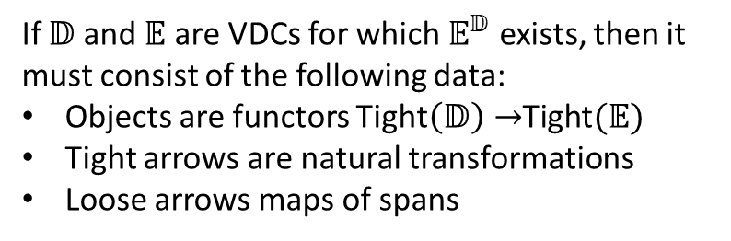
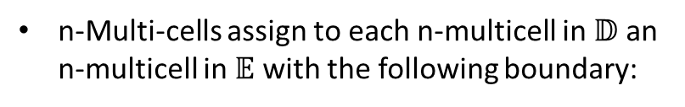
Exponentials
Explication: Exponential
If $𝔻$ and $𝔼$ are VDCs for which $𝔼^{𝔻}$ exists, then it must consist of the following data:
Objects are functors Tight$\left(𝔻\right)→$Tight$(𝔼)$
Tight arrows are natural transformations
Loose arrows maps of spans
n-Multi-cells assign to each n-multicell in $𝔻$ an n-multicell in $𝔼$ with the following boundary:
… (cont. on next slide)

Slide 8
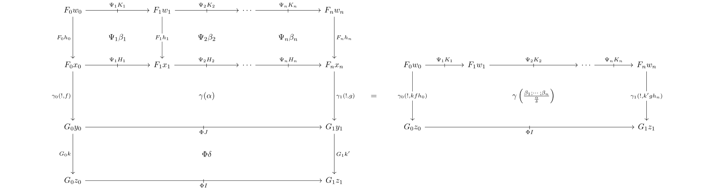
Exponentials
Explication: Exponential (cont.)
Where multicells are subject to functoriality with respect to vertical pasting:

Slide 9
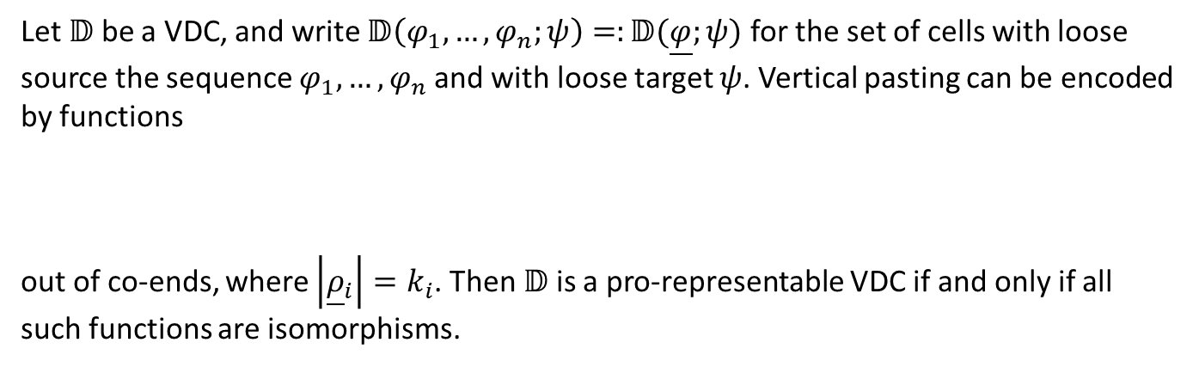
Pro-representable VDCs
Theorem: Characterization of Pro-representable VDCs
Let $𝔻$ be a VDC, and write $𝔻\left(φ_{1},…,φ_{n};ψ\right)=:𝔻(\underline{φ};ψ)$ for the set of cells with loose source the sequence $φ_{1},…,φ_{n}$and with loose target $ψ$. Vertical pasting can be encoded by functions
out of co-ends, where $\left|{\underline{ρ}}_{i}\right|=k_{i}$. Then $𝔻$ is a pro-representable VDC if and only if all such functions are isomorphisms.

Slide 10
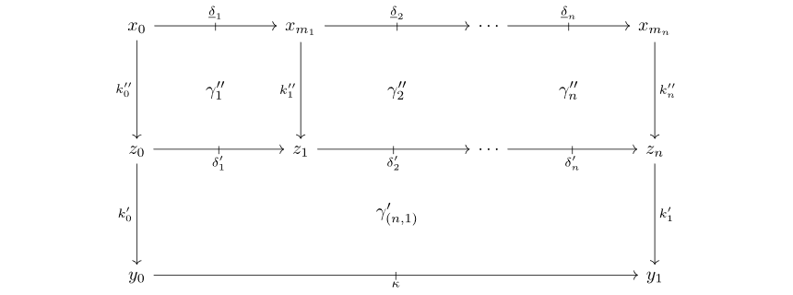
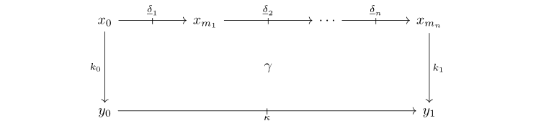

Pro-representable VDCs
Explication: Characterization of Pro-representable VDCs
In terms of pasting diagrams, a VDC $𝔻$ is pro-representable precisely when for any $N≥0$ and any partition $N=k_{1}+⋯+k_{n}$, $N$-multicells decompose as vertical pastings:
$$=$$
and any two decompositions are equivalent up to associativity of pasting with cells in the center of the decomposition

Slide 11
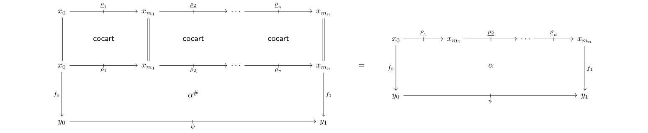

Representable VDCs
Corollary: Representable $⟹$ Pro-representable
Representable VDCs (i.e. pseudo-double categories) are pro-representable.
Proof Idea:
Let $𝔻$ be a representable VDC. Then any cell admits a canonical decomposition

Slide 12
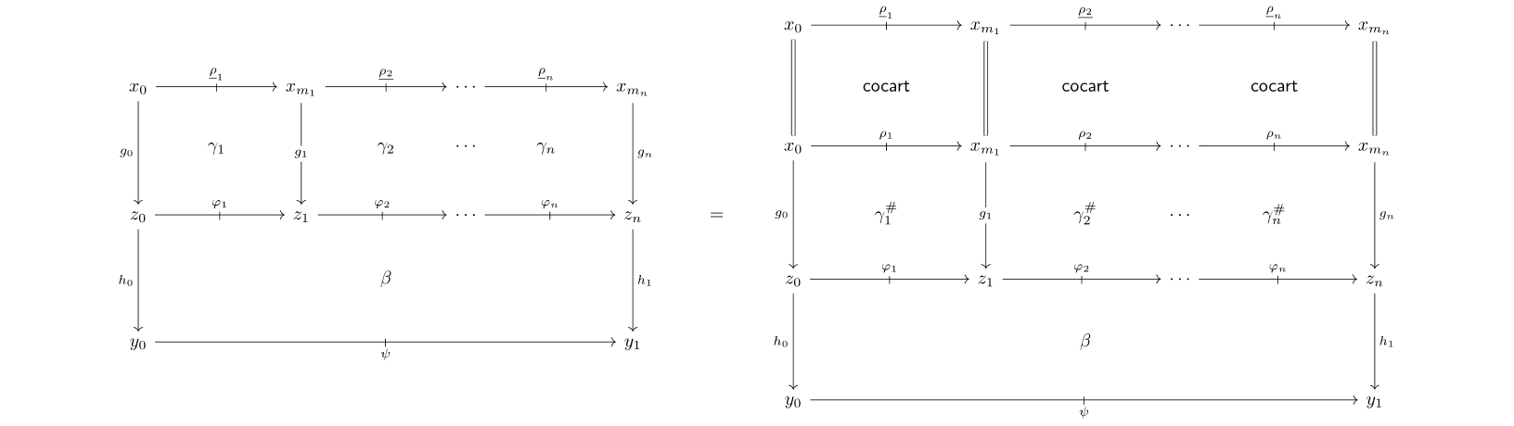
Representable VDCs
Corollary: Representable $⟹$ Pro-representable
Representable VDCs (i.e. pseudo-double categories) are pro-representable.
Proof Idea: (cont.)
Any other decomposition below left can be canonically factored through the composition cells:

Slide 13
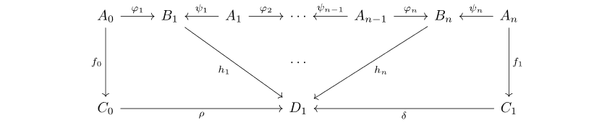
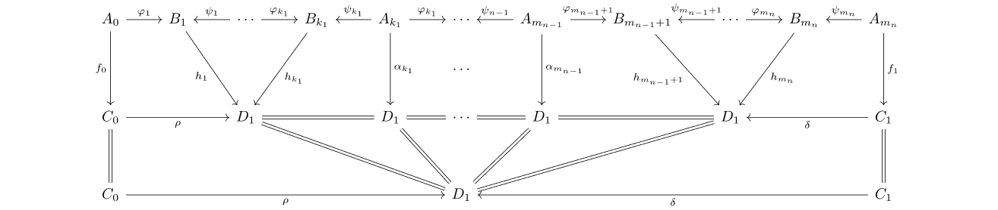

Cospans are Pro-representable
Proposition: Cospan VDCs are Pro-representable
For any category $ℰ$ the VDC $ℂ$ospan$(ℰ)$ is pro-representable, and it is representable if and only if $ℰ$ has finite pushouts.
Proof Idea:
An arbitrary multicell:
admits a canonical decomposition:
for any partition of $n$ (the case where $k_{1},k_{n}≥1$ is shown for simplicity).

Slide 14
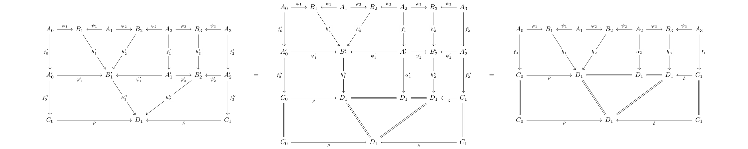
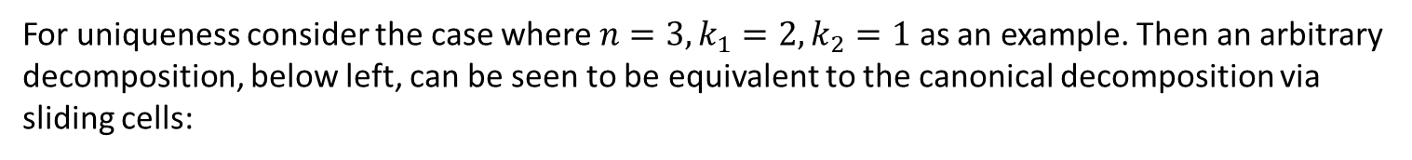
Cospans are Pro-representable
Proposition: Cospan VDCs are Pro-representable
For any category $ℰ$ the VDC $ℂ$ospan$(ℰ)$ is pro-representable, and it is representable if and only if $ℰ$ has finite pushouts.
Proof Idea:
For uniqueness consider the case where $n=3,k_{1}=2,k_{2}=1$ as an example. Then an arbitrary decomposition, below left, can be seen to be equivalent to the canonical decomposition via sliding cells:

Slide 15
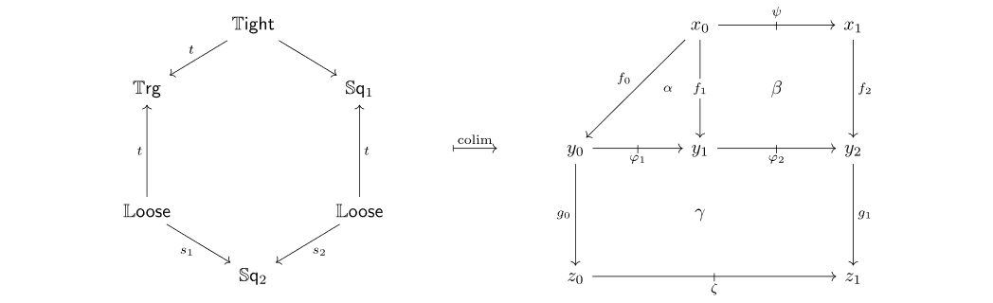
Non-pro-representable VDC
15
Non-example: Non-unital Walking Loose Arrow
The VDC $𝕃$oose consisting of two objects 0 and 1 and a single loose arrow $0↛1$ is not pro-representable. Consider the diagram and colimit $ℂ$ in VDC depicted below:
Then$ℂ×𝕃$oose has two non-identity cells, while the VDC obtained by applying $−×𝕃$oose to the diagram before taking the colimit only has one.

Slide 16
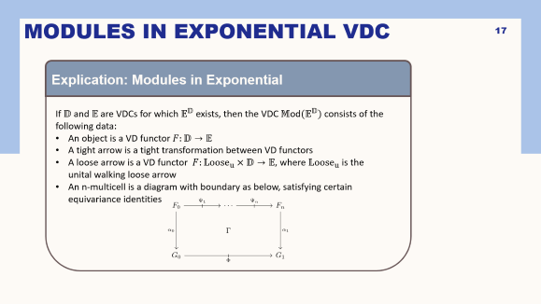

Appendix
Modules in exponential VDCs:
Roadmap:

Slide 17
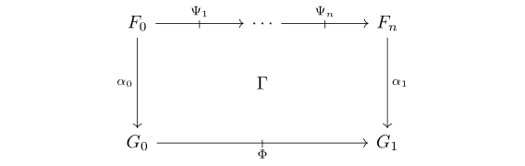
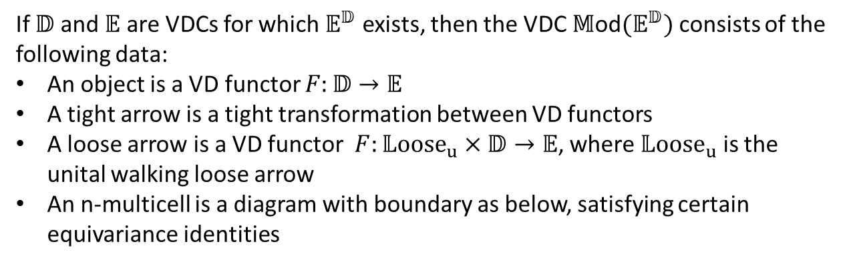
Modules in Exponential VDC
Explication: Modules in Exponential
If $𝔻$ and $𝔼$ are VDCs for which $𝔼^{𝔻}$ exists, then the VDC $𝕄$od$(𝔼^{𝔻})$ consists of the following data:
An object is a VD functor $F:𝔻→𝔼$
A tight arrow is a tight transformation between VD functors
A loose arrow is a VD functor $F:𝕃{oose}_{u}×𝔻→𝔼$, where $𝕃{oose}_{u}$ is the unital walking loose arrow
An n-multicell is a diagram with boundary as below, satisfying certain equivariance identities

Slide 18
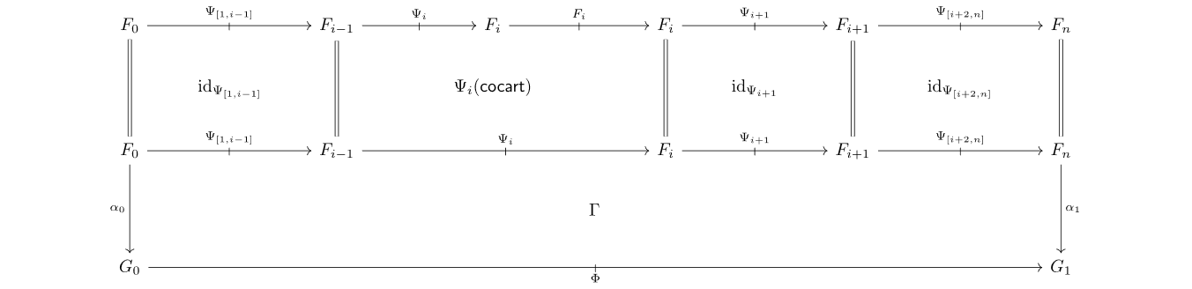
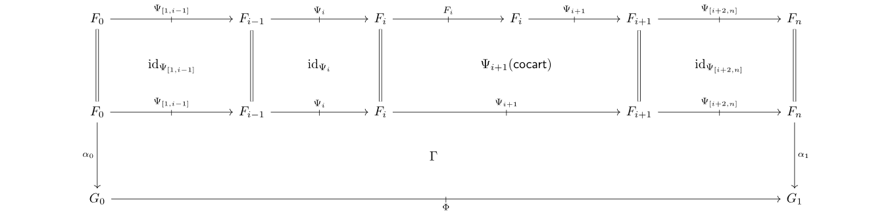

Modules in Exponential VDC
Explication: Modules in Exponential (Inner Equivariance)
Inner equivariance requires that the pasting diagrams below are equal for any $1<i<n$:
$$=$$

Slide 19
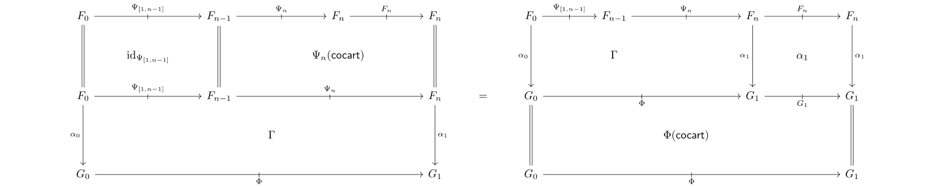
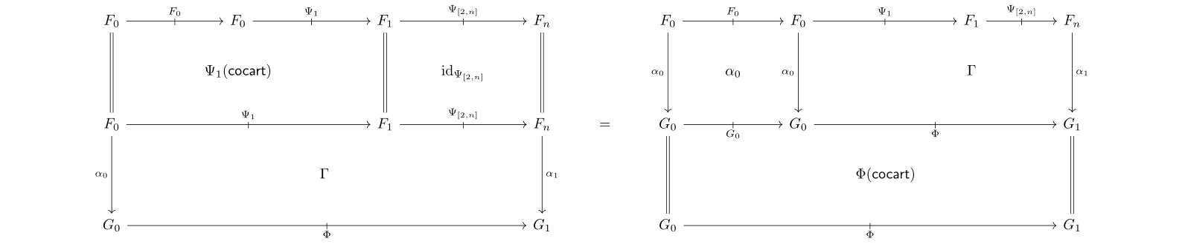
Modules in Exponential VDC
Explication: Modules in Exponential (Outer Equivariance)
Outer equivariance requires we have the two pasting equalities below:

Slide 20
Key Takeaways
20
VDCs provide the necessary flexibility to characterize universal properties of double categorical constructions
Exponentiable VDCs are those admitting essentially unique cell decompositions
Future Directions
Characterize exponentiable maps between VDCs
Determine what (co)limits and construction pro-representable VDCs are closed under
Explore properties of enrichment using loose bimodules

Slide 21
References
21
[P14] Pisani, C. (2014, February 2). Sequential multicategories. arXiv. https://doi.org/10.48550/arXiv.1402.0253
[CS10] Cruttwell, G. S. H., & Shulman, M. A. (2010, December 8). A unified framework for generalized multicategories. arXiv. https://doi.org/10.48550/arXiv.0907.2460
[LP24] Lambert, M., & Patterson, E. (2024). Cartesian double theories: A double-categorical framework for categorical doctrines. Advances in Mathematics, 444, 109630. https://doi.org/10.1016/j.aim.2024.109630
[FL25] Fujii, S., & Lack, S. (2025, July 7). The familial nature of enrichment over virtual double categories. arXiv. https://doi.org/10.48550/arXiv.2507.05529
[Kaw25] Kawase, Y. (2025, April 26). Double categories of profunctors. arXiv. https://doi.org/10.48550/arXiv.2504.11099
[Kou25] Koudenburg, S. R. (2025, March 3). Augmented virtual double categories. arXiv. https://doi.org/10.48550/arXiv.1910.11189
[Kou24] Koudenburg, S. R. (2024, April 2). Formal category theory in augmented virtual double categories. arXiv. https://doi.org/10.48550/arXiv.2205.04890
[LM25] Libkind, S., & Myers, D. J. (2025, May 28). Towards a double operadic theory of systems. arXiv. https://doi.org/10.48550/arXiv.2505.18329
[LMCB25] Libkind, S., Myers, D. J., Carlson, K., & Brown, J. (2025, in preparation). Loose bimodules and their construction. Topos Forest.
[DPP10] Dawson, R., Paré, R., & Pronk, D. (2010). The span construction. In: Theory and Applications of Categories 24.13, p. 302-377.

